Slide 1
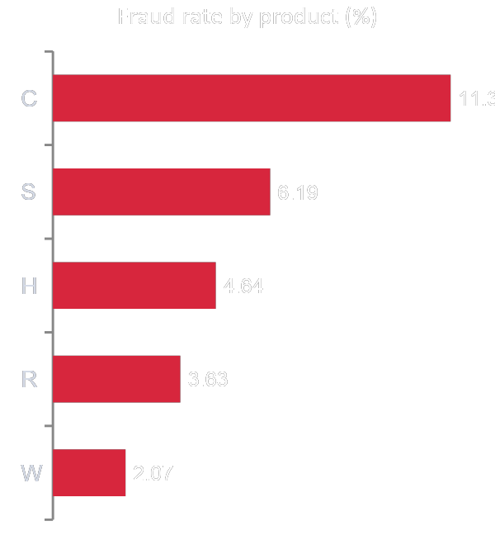
BANKING B · BREAK THROUGH TECH × MASTERCARD
Exploratory Data Analysis
What drives fraud in 590,540 online card transactions
Open our Colab notebook
Notes:
Introduce the team and the project: an exploratory analysis of the IEEE-CIS fraud data for Mastercard. The chart previews one headline finding: product C has by far the highest fraud rate.

Slide 2




Where we are: EDA complete and combined
01
02
03
04
Independent EDAs
Combined analyses
Joined and split
Analyzed patterns
Each team member explored the data on their own.
Merged Salamot's and Eric's work into one fuller EDA.
Joined transactions to identity on TransactionID; split train and validation by time.
Imbalance, missing data, amounts, products, devices and accounts.
Result: a shortlist of features and patterns that can help predict fraud.
Banking B · Mastercard fraud EDA
2
Notes:
Each of us did an independent EDA, then we combined Salamot's and Eric's analyses. Key setup steps: joining the two tables and a time-based train/validation split, set aside before any exploring so validation stays honest.

Slide 3
Key findings
3.51%
of training transactions are fraud, so accuracy alone is misleading
11.33%
fraud rate in product C, the riskiest; product W holds the most fraud cases
89%
of repeat-account fraud sits in accounts that are mostly fraud
42 of 67
missing-data patterns shift the fraud rate: missingness is a signal
Also different for fraud: transaction amount, time of day, card type, email provider and device type.
Banking B · Mastercard fraud EDA
3
Notes:
Four headline numbers. Fraud is rare at 3.51 percent. Product C is riskiest per transaction, but product W holds the most fraud cases because it is 73 percent of transactions. Fraud clusters by account: among accounts with more than one transaction, 89 percent of fraud is in accounts that are at least half fraud; those repeat accounts hold about half of all fraud. And missing values are structured, so missingness itself carries signal.

Slide 4
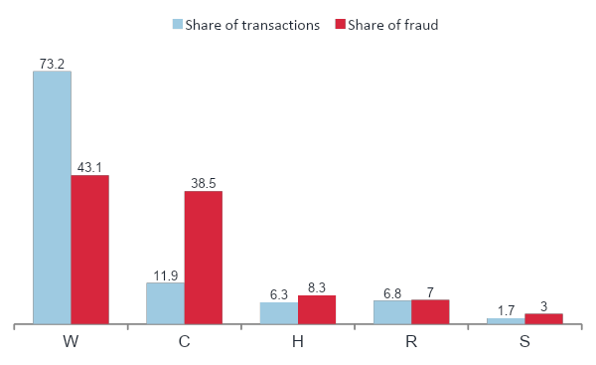
Product: C has the highest fraud rate, W has most fraud cases
11.9% → 38.5%
Product C: has 11.9% share of transactions vs share of fraud (11.33% fraud rate)
73.2% → 43.1%
Product W: share of transactions vs share of fraud (2.07% fraud rate)
Red taller than blue: the product produces more than its share of fraud.
Banking B · Mastercard fraud EDA
4
Notes:
Blue is each product's share of transactions, red its share of fraud. When red is taller than blue, the product produces more than its share of fraud. Product C is the clearest case. A model must work on both C and W.

Slide 5
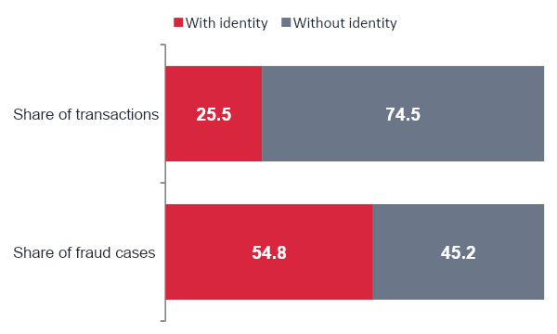
Transactions with identity make up over half the fraud
25.5% → 54.8%
Transactions with identity are a quarter of the data but over half of all fraud cases.
1.92 of 3.51 pts
of the overall fraud rate come from identity transactions, more than the 1.59 points from the other three quarters.
Their fraud rate is 7.55%, over 3× the 2.13% without identity.
Banking B · Mastercard fraud EDA
5
Notes:
Red is transactions with identity data. They are 25.5 percent of the data but 54.8 percent of all fraud cases. A group's contribution is its share of transactions times its fraud rate, and contributions add up to the overall 3.51 percent. Identity transactions contribute 1.92 of those 3.51 points, more than the 1.59 points from transactions without identity, even though those are three quarters of the data. The reason is their fraud rate: 7.55 percent, versus 2.13 percent without identity. Caveat if asked: within product C, where both kinds exist, identity transactions are about 2 times as risky, not 3.5 times, because product W never has identity data.

Slide 6
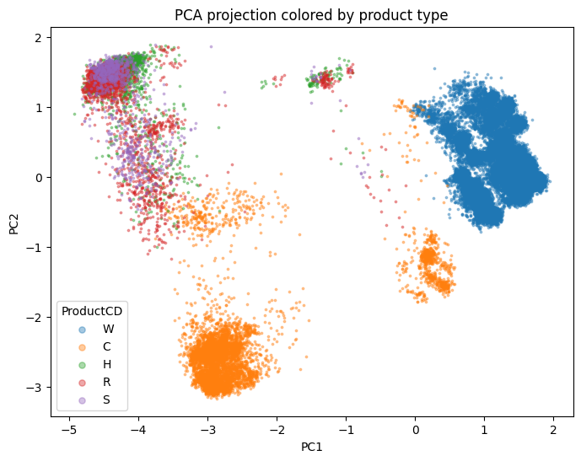
Transactions without identity are largely explained by Product W
Cluster | What it is | Share | Fraud rate | Points
1 | No identity, almost all W | 75.0% | 2.1% | 1.60
2 | Identity, H, R, S | 14.5% | 4.4% | 0.64
3 | Identity, product C | 10.5% | 12.0% | 1.27
Total |  | 100% |  | 3.51
Never told identity or product, the clustering still separated them. Its two identity clusters hold about 25% of transactions and 1.91 of 3.51 points, matching the identity split on the previous slide.
PCA of the 67 missing-data indicators, colored by product
Banking B · Mastercard fraud EDA
6
Notes:
We grouped transactions by which columns they were missing, using k-means on 67 missing-data indicators, and never gave the algorithm product type or identity. It still found three groups that line up with them: a no-identity group that is almost all product W, an identity group for products H, R and S, and an identity group for product C, the riskiest at 12 percent fraud. The PCA map on the left shows the same separation: each product forms its own region. The two identity clusters together match the identity numbers on the previous slide, which tells us product type and identity collection are the backbone of the data's structure.

Slide 7
Small payments look risky due to product mix
Amount | Share of transactions | Share of fraud | Fraud rate | Share that's C | Share that's W
Up to $10 | 1.3% | 2.6% | 7.16% | 78% | 5%
$10 to 30 | 13.1% | 17.8% | 4.77% | 35% | 47%
$30 to 100 | 48.3% | 40.4% | 2.94% | 11% | 73%
$100 to 500 | 33.5% | 34.5% | 3.63% | 3% | 84%
Over $500 | 3.8% | 4.7% | 4.29% | 0% | 95%
Total | 100% | 100%
Within every product, fraud rises with amount (product C: 8.0% up to $10, 14.6% at $100 to 500). The overall pattern reverses because of product mix, a case of Simpson's paradox.
Banking B · Mastercard fraud EDA
7
Notes:
This settles a team debate. Overall, payments up to 10 dollars look twice as risky as 30 to 100 dollar payments, which suggested card testing. But 78 percent of small payments are product C, the riskiest product, while mid-range payments are mostly product W, the safest. Within every product, small payments are actually less risky. And small payments are only 2.6 percent of all fraud.

Slide 8
Credit cards are riskier where most fraud happens
Product | Credit fraud | Debit fraud | Credit / debit
W | 4.44% | 1.61% | 2.76×
C | 16.51% | 7.76% | 2.13×
R | 3.82% | 3.18% | 1.20×
H | 4.95% | 4.27% | 1.16×
S | 6.00% | 6.39% | 0.94×
2.1–2.8×
Credit vs debit fraud in products W and C, which together hold 82% of all fraud.
In H, R and S the gap nearly disappears.
Banking B · Mastercard fraud EDA
8
Notes:
We checked card type within each product so product mix wouldn't fool us. Credit is clearly riskier in W and C, where most fraud is. In the smaller products the difference is small.

Slide 9
Missing addresses: 11% of data, 37% of fraud
Account type | Share of transactions | Fraud rate | Fraud cases | Share of all fraud
Repeat account | 67.7% | 2.71% | 8,677 | 52.3%
Address missing | 11.4% | 11.40% | 6,128 | 36.9%
One-transaction account | 20.9% | 1.81% | 1,794 | 10.8%
Total | 100% |  | 16,599 | 100%
89% of 52%
The 89% account-clustering result covers repeat accounts only, about 47% of all fraud.
Our account key can't link missing-address transactions: the biggest blind spot to investigate.
Banking B · Mastercard fraud EDA
9
Notes:
Accounts are our approximate key: card identifier, address and estimated card start day. Repeat accounts, with two or more transactions, hold about half of all fraud, and within them 89 percent of fraud sits in mostly-fraud accounts. Transactions with a missing address are only 11 percent of the data but 37 percent of fraud, at over four times the average rate, and we can't link them into accounts yet.

Slide 10
Fraud within products rose after day 25
Product | Share, early | Share, later | Fraud, early | Fraud, later
W | 53.7% | 79.6% | 1.84% | 2.12%
C | 11.2% | 12.2% | 8.32% | 12.23%
H | 16.8% | 2.9% | 1.67% | 10.32%
R | 16.0% | 3.8% | 0.89% | 7.38%
S | 2.4% | 1.5% | 2.27% | 8.23%
6–8×
Rise in fraud rate for products H and R. Early = days 1–25; later = after day 25.
Product rates drift over time, so we validate on later data and watch for further drift.
Banking B · Mastercard fraud EDA
10
Notes:
The early low-fraud period is mostly a change within products, not just product mix. Early on, H and R were a third of transactions with almost no fraud; later they shrank but their fraud rates jumped six- to eightfold. We don't know why yet. It's another reason for time-based validation.

Slide 11




Challenges we identified
30-day gap
Class imbalance
Test data starts about 30 days after our labeled data ends, so fraud patterns may drift.
96.5% of transactions are legitimate, so accuracy alone would mislead.
Heavy missing data
Entity overlap
414 of 434 features have missing values; 229 are more than half empty.
About 42% of validation transactions come from accounts seen in training, which can inflate scores.
Banking B · Mastercard fraud EDA
11
Notes:
Four challenges shape how we model. The test period starts a month after our data, fraud is rare, most columns have gaps, and many validation transactions come from accounts already seen in training.

Slide 12





What we'll do next
Time-aware validation
Train on the past, test on the future
Seen vs new accounts
Report performance for each separately
Keep meaningful missingness
Don't drop columns just for being empty
Avoid data leakage
Learn everything from training data only
ROC-AUC and PR-AUC
Judge models on these, not accuracy
Banking B · Mastercard fraud EDA
12
Notes:
Our plan for modeling follows directly from the challenges: time-aware validation, separate results for new accounts, keeping missingness, strict leakage rules, and the right metrics.

