Slide 1
Merging the Sarasota chlorophyll-a datasets
Two satellite datasets, one consistent daily record from 2010 to 2026: the approach, the evidence behind each step, and the result.
Notes:
Goal: walk the team through how the two chlorophyll files were compared and merged, and why each choice was made. Everything shown comes from two notebooks: compare_chlorophyll_datasets.ipynb (the evidence) and merge_chlorophyll.ipynb (the merge). Issue #14.

Slide 2
Two satellite datasets measuring the same thing
 | DS1 | DS2
File | ChlorophyllaConcentrationSarasota.csv | ChlorophyllaConcentrationSarasota_Dataset2.csv
Dates | Jun 2020 → Sep 2026 | Jan 2010 → May 2022
Grid spacing | 0.0375° (about 4.2 km) | 0.0417° (about 4.6 km)
Grid cells | 1,886 | 1,554
Rows with no value | 75% | 81%
Columns | time, altitude, latitude, longitude, chlor_a | time, latitude, longitude, chlor_a
Both cover the same box off Sarasota (latitude 26.5–28, longitude −83.5 to −81.8). Goal: one daily chlorophyll table for the bloom-risk model.
Source: compare_chlorophyll_datasets.ipynb, sections 1 and 2.1
Notes:
Same measurement (chlorophyll-a in mg per cubic metre), same area, different satellite products. The extra altitude column in DS1 is always 0, so it is dropped. The missing share is high because clouds, glint and land remove most pixels on a given day.

Slide 3
They span 2010–2026 and overlap for two years
Overlap: Jun 2020 → May 2022
DS2 · Jan 2010 → May 2022
DS1 · Jun 2020 → Sep 2026
2010
2014
2018
2022
2026
The overlap is the only window where the two can be compared directly, and where DS2 is calibrated to read like DS1.
Notes:
DS2 alone covers 2010 to mid-2020, DS1 alone covers mid-2022 to 2026. The two years in the middle are the only time both exist, so every comparison and the calibration of DS2 uses that window.

Slide 4
Four differences to resolve before merging
1. The grids don't line up
Different spacing; zero shared grid points.
Fix: match by nearest distance
2. The readings differ
DS1 reads ~8% lower, more at bloom levels.
Fix: adjust DS2 level by level
3. Most rows are empty
Land, clouds, sun glint and quality masks.
Fix: drop land, flag coast, never fill with a mean
4. Extreme, skewed values
Values at the product's limits; long tail.
Fix: keep highs with a flag, use log10
Notes:
The rest of the deck takes these one at a time: the problem, the evidence, and the fix. Problems 1 and 2 are about combining the two datasets; 3 and 4 are about cleaning each one.

Slide 5
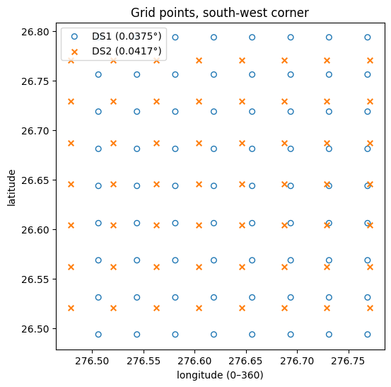
Problem 1: the two grids never line up
0
grid points appear in both datasets
Both grids are evenly spaced, but DS1 uses 0.0375° squares and DS2 uses 0.0417°. The squares drift in and out of line.
A plain merge on latitude + longitude would return nothing.
Source: compare_chlorophyll_datasets.ipynb, section 2.1
Notes:
Every gap between neighbouring grid points was checked: DS1 is exactly 0.0375 degrees everywhere; DS2 is 1/24 degree, with a few metres of rounding wobble from how the file was saved. So these are two regular grids with different spacing.

Slide 6
Fix: match each cell to its nearest neighbour
DS1 cells · about 4.2 km
Why not just round coordinates?
A
B
C
D
E
DS1's points sit exactly halfway between multiples of 0.0375, so rounding gives two neighbours the same label:
DS1 latitude | ÷ 0.0375 | rounded
26.49375 | 706.5 | 706
26.53125 | 707.5 | 708
26.56875 | 708.5 | 708 (same label)
P
Q
R
S
DS2 pixels · about 4.6 km
Each DS1 cell copies the value of the closest DS2 pixel (within 3.5 km). Values are relabelled, not changed.
Nearest-distance matching: 0 duplicates, median 1.6 km apart.
Source: compare_chlorophyll_datasets.ipynb, section 2.3 · merge_chlorophyll.ipynb, stage 2
Notes:
DS2 pixels are about 11% bigger, so some DS2 pixels feed two neighbouring DS1 cells (A and B both take P). No new information is created; the coarser picture is laid onto the finer grid. The matching uses scipy's cKDTree on coordinates converted to kilometres. An early version rounded coordinates and produced 57,498 duplicate matches; that bug was found and fixed.

Slide 7
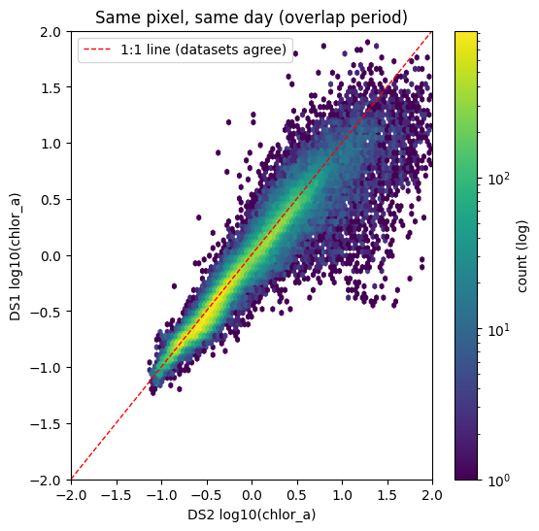
Problem 2: same place, same day, different reading
0.96
correlation (log10): they rise and fall together
~8%
DS1 reads lower than DS2 on average (median ratio 0.92)
110,262 matched pixel-days, Jun 2020 – May 2022
Source: compare_chlorophyll_datasets.ipynb, section 2.3
Notes:
The comparison has to be pixel by pixel. Comparing daily area-wide medians gives a correlation of only 0.12 and even points the wrong way (DS1 looks higher), because clouds hide different pixels in each dataset on a given day. The two are likely different satellite products (DS1's grid matches NOAA's VIIRS 4 km products, DS2's matches the standard NASA 4 km grid); this is not confirmed.

Slide 8
…and the gap is not the same everywhere
Small in clear water, about 40% at bloom levels, and it shifts with the season. One correction factor is not enough.
0 = the datasets agree · Source: compare_chlorophyll_datasets.ipynb, section 2.3
Notes:
Chlorophyll level is grouped by the average of both datasets, so neither one decides which group a pair falls into (grouping by DS2 alone exaggerates the bloom-level gap, grouping by DS1 alone hides it). Multiplying all of DS2 by 0.92 would fix typical water but leave pre-2020 blooms about 1.6 times too high. The bloom-level point rests on fewer pairs, about 1,800.

Slide 9
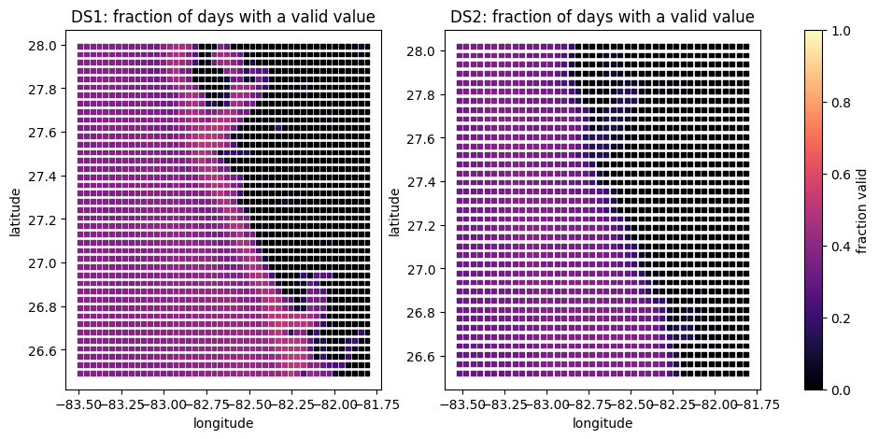
Problem 3: where the missing values come from
39–45%
of empty rows are land: cells never valid on any day
11–19%
of days with data near the coast, vs 35–40% offshore
Jun–Sep
most gaps in water: Florida's rainy season
A missing value is a pixel removed by quality masks: land, cloud, stray light, sun glint or failed atmospheric correction.
Sources: notebook section 2.4 · Hu et al. (NOAA/USF) · NWS Tampa Bay · global-land-mask (GLOBE 1 km)
Notes:
Hu et al. (NOAA/USF), Table 1 and section 2: if a pixel is associated with any L3 mask flag, the pixel is not used in the Level-3 composite. Never-valid cells were checked against a 1 km land mask: DS1 100 percent and DS2 97 percent are centred on land, none are pure water. On the map, DS1 sees inside Tampa Bay, Sarasota Bay and Charlotte Harbor on 16 to 28 percent of days, DS2 on only 3 to 6 percent. Rainy season: NWS Tampa Bay, May 15 to Oct 15 for Southwest Florida.

Slide 10
Fix: how we handle missing values
Situation | Evidence | What we do
Never-valid cells | 100% (DS1) / 97% (DS2) centred on land; none pure water | Drop
Coastal cells (< 10 km from land) | Data on 11–19% of days; light from land contaminates water pixels | Keep, flag as coastal
Gaps in water cells | Clouds, stray light, sun glint; peak in the rainy season | Leave as "no observation"
Fill with mean or median | Would erase blooms; masks may hide dense blooms more often | Never
For the model (next step) | 3×3 cells over the past 8 days gives a value ~90% of the time | Backward-looking window + missing flag
Sources: notebook section 2.4 · Bulgarelli & Zibordi 2018 · Houskeeper & Kudela
Notes:
Windows only look backwards in time: interpolating from days after the sample date would leak future information into a forecasting model. Bulgarelli and Zibordi (2018, Remote Sensing of Environment) show land adjacency effects remain detectable tens of kilometres offshore. Houskeeper and Kudela found quality flags hit high-fluorescence (bloom-like) pixels about twice as often; their study was in Monterey Bay, not Florida, so this is a caution rather than a proven effect here.

Slide 11
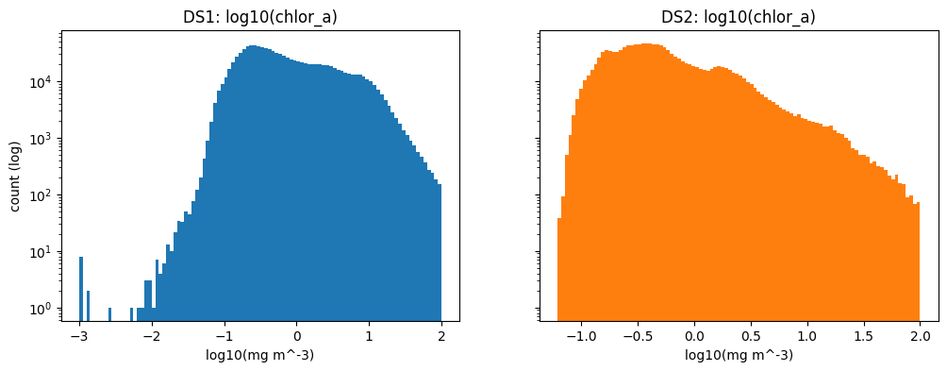
Problem 4: extreme values and a long tail
Values | How many | Action
≥ 99 mg m⁻³ (top limit) | 10 each | Keep + flag
< 0.01 (DS1 only) | 20 | Set to missing
Everything else | ~2.4 million | Keep, use log10
Why not the IQR rule or winsorizing?
1 in 8
pixels the IQR rule would delete, including every value ≥ 10 mg m⁻³: the blooms we want to predict
Log10 instead: the satellite algorithm itself works in log space, and chlorophyll is roughly log-normal.
Sources: notebook section 2.5 · NASA OBPG chlor_a ATBD (2023) · Campbell 1995
Notes:
The NASA algorithm (OCx) is designed for 0.01 to 100 mg per cubic metre, so values below 0.01 are outside its range; DS1 has 7 values at exactly 0.001, the product minimum. Values near 100 likely mean very high chlorophyll with an uncertain exact value, so they are kept with a chl_at_limit flag. On the raw scale the median is about 0.5 but the mean is 1 to 2; after log10 mean and median nearly agree. Winsorizing at the 99th percentile would flatten everything above about 15 to 22 into one value.

Slide 12
The merge pipeline
STAGE 1
Clean
Longitude − 360, drop land, flag coast and limits, add log10
STAGE 2
Match
Each DS1 cell takes its nearest DS2 pixel (within 3.5 km)
STAGE 3
Adjust
Quantile mapping fitted on the 2020–22 overlap
STAGE 4
Combine
DS1 first, adjusted DS2 fills the rest; save as Parquet
STAGE 5 · NEXT
Features
Per habsos sample: 3×3 cells over the past 8 days
Stages 1–4 are done in merge_chlorophyll.ipynb. Stage 5 waits on the team's choice of target and forecast horizon.
Notes:
Which value wins: 2010 to mid-2020 adjusted DS2 only; in the overlap, DS1 wherever it has a value and adjusted DS2 only where DS1 is empty; mid-2022 onwards DS1 only. Quantile mapping: for each percentile 1 to 99, note DS2's value and DS1's value in the overlap, then translate every DS2 value through that table; beyond the 1st and 99th percentile the end offset is carried on rather than extrapolated.

Slide 13
The adjustment, tested on a year it never saw
Overall gap
7.3% → 0.1% (closed)
Typical water (up to 3 mg m⁻³)
About 0 (closed)
Bloom level (above 10 mg m⁻³)
~44% → ~22% (halved)
Fitted on Jun 2020 – May 2021, tested on Jun 2021 – May 2022 · Source: merge_chlorophyll.ipynb, stage 3
Notes:
Grey is the raw gap, blue is after adjustment, on data the adjustment was not fitted on. It closes the gap overall and for typical water, roughly halves it at bloom level, and over-corrects spring (DS2 now reads about 10 percent lower) while under-correcting winter. Quantile mapping matches the overall distributions; it does not force each matched pair to agree. Next options: one table per season, or a paired calibration using the median DS1 value for each DS2 level.

Slide 14
The merged dataset: no jump at the switch-overs
2.52 million
daily observations
1,328
water cells on DS1's grid
0
duplicate cell-days
35 MB
Parquet file, 9 columns
Notes:
Columns: date, latitude, longitude, chlor_a, log_chl, chlor_a_raw, source, chl_at_limit, coastal. Rows by source: 1.38 million adjusted DS2 before mid-2020; in the overlap 313 thousand from DS1 plus 100 thousand adjusted DS2 filling DS1's gaps; 726 thousand from DS1 after mid-2022. The monthly median mixes whichever cells have data that month, so it wobbles with clouds; the check is that there is no sudden jump in June 2020 or June 2022. Output file: data/processed/chlorophyll_merged.parquet.

Slide 15
Known limitations
Limitation | What it means | What to do
Pre-2020 bloom values still somewhat high | The bloom-level gap was halved, not closed | Keep source as a model feature; try a per-season or paired calibration
Bays before 2020 mostly empty | DS2 sees inside the bays on only 3–6% of days | Expect chl_missing = 1 at bay sites before 2020
One year-round adjustment | Spring over-corrected, winter under-corrected | Fit one table per season
Gaps may hide blooms | Masks can remove dense-bloom pixels more often | Use the missing flag as a feature, never fill with a mean
Product identity unconfirmed | Exact satellite products for DS1 and DS2 not confirmed | Ask the data provider
Notes:
None of these block using the merged data, but each should be noted wherever the data is used. The first three can be improved with a per-season or paired calibration and with a gap-filled product; the fourth is why the missing flag will be a feature rather than something to hide.

Slide 16
Next steps and open questions
For our advisor
For the team
For us
Which exact products are DS1 and DS2?
Can we get NOAA's 2 km gap-filled (DINEOF) chlorophyll for 2018–2026, as named in the project overview?
Confirm habsos CATEGORY as the target.
Agree the forecast horizon: same day or N days ahead.
Issue #8 is closed, but no datasets are merged yet.
Per-season or paired calibration for bloom levels.
Stage 5: chlorophyll features per habsos sample.
Clean SarasotaWindData (also 0–360 longitude).
Notes:
The gap-filled DINEOF product would remove most of the cloud gaps from 2018 onward; check whether it flags filled versus observed values and whether its gap-filling uses future days, which matters for forecasting. No branch in the repo contains any merge, concat or join yet, so the habsos-centred join is a whole-team decision. Running the notebooks needs scipy, pyarrow and global-land-mask; requirements.txt is still empty.

