Slide 1
Sentiment Analysis of Microblog Data Streams
Student: Yaroslav Balashov
Group: M4138c

Slide 2
Preprocessing tweets
Let’s transform this text objects to <TextObjectName>
URL
Punctuation
Hashtag
Mention
Numeric
Cashtag
Data time
Email
Contraction
EMPHASIS
ElONGATED
EMOJI&EMOTICON
NON-ASCII

Slide 3
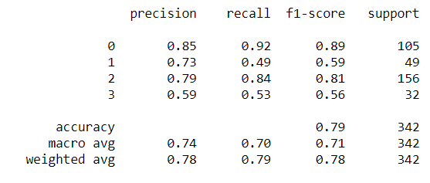
Tweet sentiment Classifier
Clean tweets (previous slide)
Tokenizing
Language detecting and removing stopwords
Converting words given lexicon dictionary
Vectorizing data
Fit the model according to the given training data
Predict class labels for samples in test data

Slide 4
Classify organization given tweet
Hypothesis: No need to convert hashtags and mentions in the preprocessing tweets, when we want to predict organization
Let’s build all subsets of <URL, EMOJI, HASHTAG, EMAIL, MENTION, CASHTAG, DATE, TIME, EMPHASIS, ELONG> and find the subset, which has a best score

Slide 5
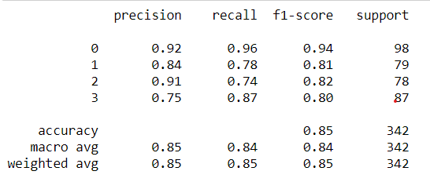
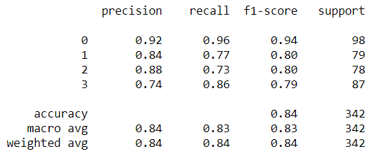
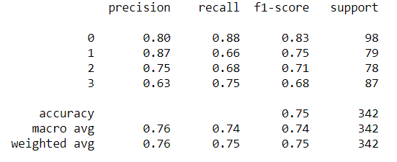
Classify organization given tweet
Best ignore pattern subset:
<URL, HASHTAG, MENTION, TIME, ELONG>
Let’s try only <HASHTAG, MENTION>
Ignore nothing
Summary: Profit +0.11 score. Significant influence comes from ignoring hashtags and mentions.

Slide 6
Thanks for attention!

