Slide 1

The seL4® Core Platform
The presentation will start shortly…
To submit questions, we are asking that you place them into the discussion board on the virtual hub page.
You can also use this area to continue the discussion after the presentation as speakers will be checking for new comments throughout the summit.
Simplifying The Use Of seL4
Gernot Heiser, Trustworthy Systems Group
Ben Leslie, Breakaway Consulting
https://sel4.systems/Foundation

Slide 2
The seL4® Core Platform
Simplifying The Use Of seL4
Gernot Heiser, Trustworthy Systems Group
Ben Leslie, Breakaway Consulting
https://sel4.systems/Foundation

Slide 3
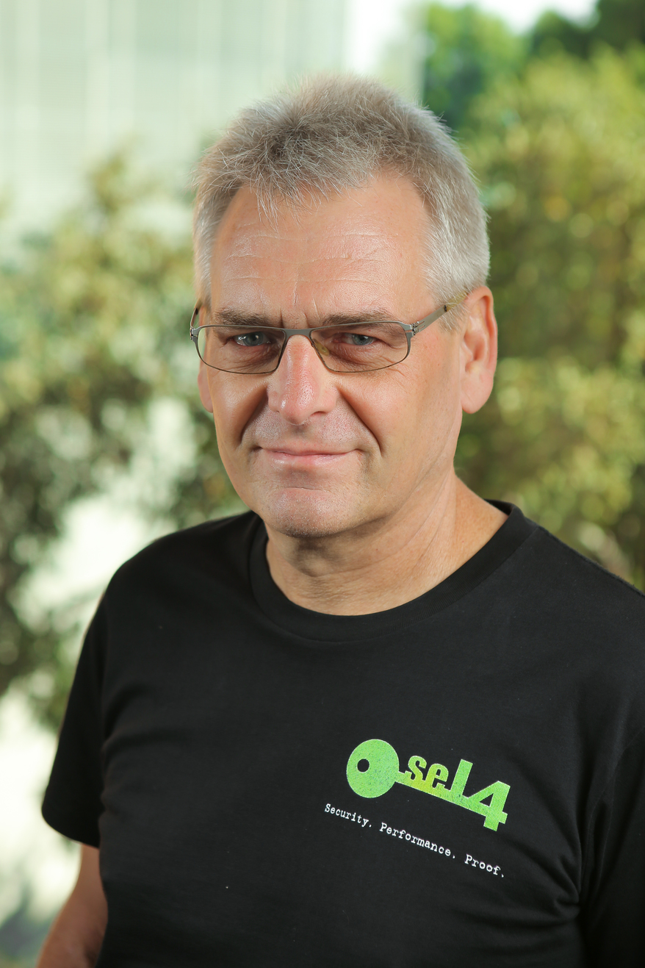
Why seL4 Core Platform?
With seL4 we achieved unprecedented levels of security and user-unfriendliness [2015]
The seL4 API is (for good reason):
very general
very low-level
architecture-dependent
very spartan
… and requires a lot of expertise to use correctly
See https://microkerneldude.wordpress.com/2020/ 03/11/sel4-design-principles/
Almost all present deployments are:
embedded/cyber-physical systems
simple, static architectures

Slide 4
Aims of the seL4 Core Platform
Small OS for IoT, cyber-physical and other embedded use cases
Ease development and deployment
Provide reasonable degree of application portability, defined HW interfaces
Support implementation diversity through well-defined interfaces
Support code re-use between related deployments
Support ”correct” use of seL4 mechanisms by default
Retain near-minimal trusted computing base (TCB)
Leverage seL4-enforced isolation for strong security/safety
Retain seL4’s superior performance
Be amenable to formal verification of the TCB

Slide 5
The seL4 Core Platform is POSIX-Compliant
Intentionally Not
Posix is past its use-by date,
and too inefficient for seL4.
See Curtis Millar’s talk for details
For legacy software use virtual machines!
Core Platform properties:
Simple execution model
Simple communication model
Real-time capable
Efficient
Deadlock-free
Some integrity properties enforced by build tools
Suitable for formal reasoning

Slide 6

Target Hardware: Embedded SoCs
Homogenous multicore
Shared L2 cache
Single system image
Uniform memory access
Accelerators (GPUs etc) are “devices”
Software
Application
seL4 Core Platform
N/W
Drivers
Core
Core
Devices
L1-I
L1-D
L1-I
L1-D
L2

Slide 7
Core Platform Abstractions
f(){
…
}
_{f(..);}
Protected Procedure Call (PPC)
Communication
Channel (CC)
Notification
Protection Domain (PD)
Protection Domain (PD)
Memory Region (MR)

Slide 8
Abstractions: Protection Domain
R
Superficially similar to Unix process
… but much more lightweight
Consists of several seL4 objects:
Vspace
Cspace
Scheduling context
Priority (fixed)
Notification
All three execute atomically with respect to each other!
They may
signal another PD’s notification
call another PD’s PP
f(){
…
}
_{f(..);}
Protected Procedure Call (PPC)
Runs once, on
PD’s prio and SC
Invoked when PD’s notification is signalled
Runs on PD’s prio and SC
Contains:
Init procedure
Notification procedure
Optional: Protected procedure (PP)
Communication
Channel (CC)
Notification
Protection Domain (PD)
Protection Domain (PD)
Invoked from other PD
Runs on PD’s prio but caller PD’s SC
Memory Region (MR)

Slide 9
Abstractions: Memory Region
R
Represents physical memory
contiguous
power-of-two multiple of page size
size-aligned
f(){
…
}
_{f(..);}
May be mapped into one or more PDs
at a virtual address
with defined caching attributes
with specific permissions
Protected Procedure Call (PPC)
May be attached to a CC
shared buffer
zero-copy communication
Communication
Channel (CC)
Notification
Protection Domain (PD)
Protection Domain (PD)
MR
Memory Region (MR)

Slide 10
Abstractions: Communication Channels
R
Supports communication between PDs
connects exactly two PDs
any pair of PDs has at most one common CC
data flow can be uni- or bidirectional
information flow is bi-directional (no data diode!)
Supported channel operations:
reading/writing the channel’s MR – mapped into the accessing PD
referencing channel buffer locations
signalling the other PD’s Notification
calling the other PD’s PP (if available)
f(){
…
}
_{f(..);}
Protected Procedure Call (PPC)
Using reference wrappers, not plain pointers!
Communication
Channel (CC)
Notification
Protection Domain (PD)
Protection Domain (PD)
In general:
no trust relationship implied
CCs form non-directed, cyclic graph
MR
Memory Region (MR)

Slide 11
Abstractions: Notifications
R
Notifications are binary semaphores
Multiple signals from same PD may not invoke notification procedure multiple times
Processing of signals from multiple PDs should happen in priority order
Ideally enforced by Core Platform tooling
For now limit of 64 CCs per PD (seL4 limitation)
Support triggering of events:
can signal PD’s Notification through CC
this invokes target PD’s notification procedure
Platform provides source PD’s identity
uses seL4’s badged capabilities
Signalling is asynchronous
f(){
…
}
_{f(..);}
Protected Procedure Call (PPC)
Notification
MR
Protection Domain (PD)
Protection Domain (PD)
Communication
Channel (CC)
Memory Region (MR)

Slide 12
Abstractions: Protected Procedure Calls
R
Supports execution of code in a different PD
Callee must have a PP
Caller and callee must share a CC
PPC arguments may reference locations in the CC’s MR (using reference wrappers)
PPCs may nest
Client–server model
f(){
…
}
_{f(..);}
Protected Procedure Call (PPC)
Enforceable by build tools!
Asymmetric relationship:
Caller trusts callee
PPC must not block
Callee must be at higher prio than caller
Remember: PPC runs on caller’s SC!
PPCs form acyclic, directed graph
Communication
Channel (CC)
Notification
Protection Domain (PD)
Protection Domain (PD)
Memory Region (MR)

Slide 13
Abstractions: Virtual Machine (VM)
R
A VM is a PD with extra attributes
supports extra execution mode (guest mode)
else behaves like any PD
may share MRs
may signal/be signalled
may be PPC caller or callee
f(){
…
}
_{f(..);}
Protected Procedure Call (PPC)
VM
Communication
Channel (CC)
Notification
Apps
Protection Domain (PD)
Guest OS
Memory Region (MR)

Slide 14
Core Platform Considerations
Initially all PDs will be single-core
Single scheduling context means single core
This restriction be removed in the future for pure client PDs
PDs without a PPC
For now targeting static architectures:
All PDs known at build time
Will (eventually) support late loading/re-loading of (known) PDs

Slide 15
Summary: seL4 Core Platform
Designed to ease construction of well-designed seL4-based embedded systems
Design mostly complete
Will integrate with the seL4 Driver Framework
We’ll provide best-practice training material
Stay tuned for an RFC
f(){
…
}
_{f(..);}
Protected Procedure Call (PPC)
Communication
Channel (CC)
Notification
Protection Domain (PD)
Protection Domain (PD)
Memory Region (MR)

Slide 16
Questions?

