Slide 1

Computationally Detecting and Quantifying the Degree of Bias in Sentence-Level Text of News Stories C.J. Hutto Dennis Folds Scott Appling

Slide 2


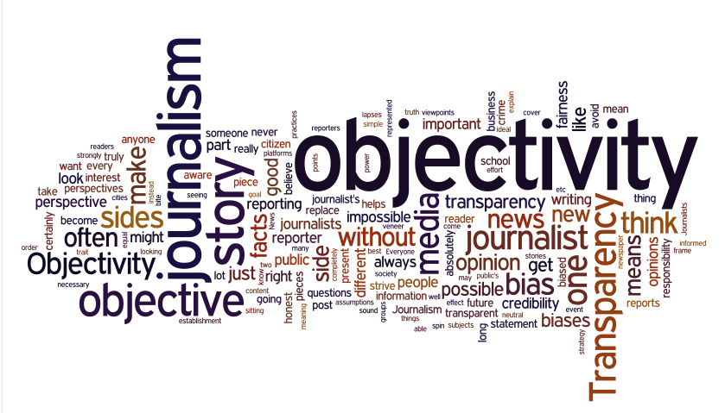
People use the news to learn about and understand what’s going on in the world.
Notes:
Fair and impartial reporting is a prerequisite for objective journalism.
People use the news to learn about and understand what’s going on in the world.
Most news organizations strictly separate journalism (news that is oriented towards presenting facts and evidence) and editorial staffs.
In the work we are talking about today, we focus on text that represents journalistic news – that is, news intending to objectively present evidence and facts.
--- REMOVED FOR TIME ---
The public holds faith in the idea that the journalists we look to for insights about the world are presenting us with neutral, unprejudiced facts.
Bias is, unfortunately, ubiquitous nevertheless.

Slide 3
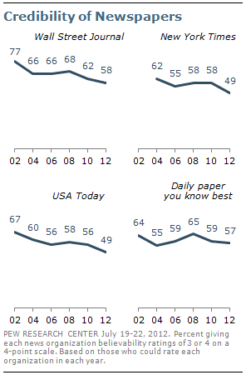
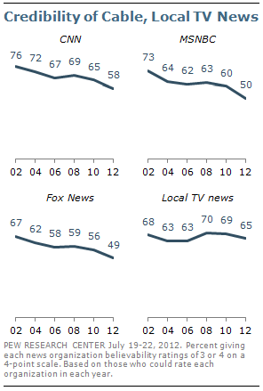
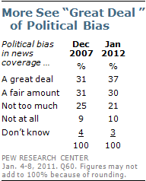
Perceived bias in journalism is on the rise while
perceived credibility continues to decline.
Notes:
One area in which bias is particularly prevalent is with political journalism.
67% of Americans polled in 2012 thought that there was either a “fair amount” or a “great deal” of political bias in news coverage.
Perceived credibility of both print and television journalism has been steadily declining for more than a decade.
This has led to what some have called the “Hostile Media Phenomenon”…

Slide 4
Hostile Media Phenomenon
Definition: Perception that the media is biased against one’s views
Pew Research (2011) – Record high proportion of the public believe the media to be biased
N = 1,501 adults 18 years or older
Regarding press performance as a whole:
66% of stories are inaccurate
77% favor one side
80% influenced by powerful outside source
Notes:
… the perception that the supposed “objective” journalistic news media is actually biased against one’s views.
In fact, in 2011 the Pew Research Group reported a record high proportion of the American public believed the news media to be biased.
[CLICK] in particular, 77% of the America public believe that many news stories unfairly favored one side over another.

Slide 5
Manifestations of Bias in Journalism
Gatekeeping bias
Tendency to feature stories that support the journalist’s point of view
Coverage bias
Tendency to spend more time/space discussing the side of an issue that the journalist supports
Statement bias
Tendency to comment on an issue in a way that reveals the underlying opinion of the journalist
(D’Alessio & Allen, 2000)
Notes:
Bias in journalism can be manifested in 3 ways…
[CLICK… CLICK… CLICK…]
It is the third type that intrigue us here – in particular, we are exploring the (mis)matches between the viewpoint expressed in the news article, and the views of the reader.
--- REMOVED FOR TIME ---
Humans are social creatures by nature, and much of human knowledge is socially constructed…
…this is interesting to us because we have a larger research program at GA Tech related to investigating the underpinnings of how humans go about processing socially conveyed information and either adopting, ignoring, or rejecting new thoughts/ideas, and new opinions/attitudes.

Slide 6
Data Set of Biased and Unbiased Text
D. J. Folds, “Perception of bias in unattributed news stories,” in Procedures of the Annual Meeting of the Association for Psychological Science, New York, NY, 2015.
Attribution bias: individuals typically assign greater attribution to internal/personal factors for positive outcomes of a story when the actor in the story is someone they agree with or like (an in-group member), and to external/situational factors if the outcome is negative.
The opposite pattern occurs for the out-group.
Surveyed 91 people for attitudes about George W. Bush and Barack Obama
Responses determined in-group or out-group placement; P’s assigned five news stories about either Bush or Obama
Three of the stories described positive outcomes, and two described negative outcomes.
In every story, one sentence was randomly manipulated to attribute the outcome to either an internal trait of the president or to external factors in an effort to observe the effects of attribution bias
Notes:
This talk is about *computationally* detecting and quantifying the degree of bias in sentences from journalistic new stories.
In order to do that with any kind of expectation of success, we first need to have samples of biased and unbiased text.
Dr. Dennis Folds, my colleague at GA Tech and my co-author on this WIP paper, published a study earlier this year in which he was particularly interested in this idea of attribution bias…
[CLICK … CLICK] (attribution bias and opposite pattern)
In American politics, Bush and Obama occupy opposite ends of the political spectrum, each representing one of the two major political parties in America – Bush was a conservative republican president; Obama is a liberal democrat president.
They are each quite strongly associated with their respective groups, and are polarizing for that reason (it is easy for most people to identify with one of these groups, and often make subconscious in-group/out-group associations).
[CLICK] So after answering questions about their attitudes towards Bush and Obama, P’s were divided into to main groups – those who were presented news stories with the ACTOR they favored most (in-group), or the ACTOR they favored least (out-group).
[CLICK] P’s read a total of 5 news stories, 2 had negative outcomes, 3 had positive outcomes
[CLICK] … (in every story…)

Slide 7
Example: Text of News Story #1
According to Forrester Research, an estimated 200,000 American jobs are lost annually due to offshore outsourcing. While in the past it was predominantly blue-collar jobs and low-level white-collar jobs that were relocated, the data show even mid- to high-level white-collar jobs are now being outsourced. During {Bush/Obama}’s presidential campaign, he maintained outsourcing is a part of globalization, which will be good for the American people in the long run. High unemployment rates led to growing public condemnation of outsourcing and demand for new regulations to stop or limit outsourcing. In response, corporations increased lobbying efforts to defend their ability to outsource jobs overseas, which they argued is necessary in order to remain competitive with international firms. Ultimately, President {Bush/Obama} rejected the proposal to implement trade protection policies that would discourage outsourcing. The President dismissed the proposal mainly because of…
“… his unwillingness to stand up to corporate special interests.”(internal attribution)
OR
“… intense pressure from corporations.” (external attribution)
Notes:
Things to notice:
Each story has an in-group/out-group ACTOR… (president Bush or Obama, depending on P’s randomly assigned group)
…performing some ACTION (that the P may or may not agree with)… (here, “rejecting the proposal… ”)
…and an experimentally manipulated sentence that either attributed the ACTION to an internal attribute of the ACTOR… or to some external attribute…
A total of 91 human subjects rated the degree of bias for each sentence in all five news stories (scale was from -3 to +3).

Slide 8
Biased and Unbiased Text
Mean (Standard Deviation) for 91 ratings of perceived bias [scale: 0=Unbiased to 3=Extremely biased]
Sentence Level Bias (for text from the first news story) |  | Mean (SD)
1 | According to Forrester Research, an estimated 200,000 American jobs are lost annually due to offshore outsourcing. | 0.10 (0.42)
2 | While in the past it was predominantly blue-collar jobs and low-level white-collar jobs that were relocated, the data show even mid- to high-level white-collar jobs are now being outsourced. | 0.11 (0.46)
3 | During Bush/Obama’s presidential campaign, he maintained outsourcing is a part of globalization, which will be good for the American people in the long run. | 0.71 (1.00)
4 | High unemployment rates led to growing public condemnation of outsourcing and demand for new regulations to stop or limit outsourcing. | 0.20 (0.64)
5 | In response, corporations increased lobbying efforts to defend their ability to outsource jobs overseas, which they argued is necessary in order to remain competitive with international firms. | 0.12 (0.51)
6 | Ultimately, President Bush/Obama rejected the proposal to implement trade protection policies that would discourage outsourcing. | 0.70 (1.04)
7e | The President dismissed the proposal mainly because of intense pressure from corporations. | 1.35 (1.22)
7i | The President dismissed the proposal mainly because of his unwillingness to stand up to corporate special interests. | 1.90 (1.21)
Notes:
We leave the question of the direction of bias to future work, and focus in the current study on DETECTING and QUANTIFYING the magnitude of bias in sentences.
For that reason, we convert the rating scale to absolute values (0 = unbiased, 1 = slightly, 2 = moderately, 3 = extremely)
P’s are able to identify biased sentences (so this is good).
So now the RQ at hand is whether we can approximate these ratings using automated/computational processes?
For example, can we use NLP and computational linguistics to automatically parse the text and identify biased versus unbiased text (in *journalistic* news)?
If so, how well can we estimate the degree of bias?

Slide 9
Detecting and Quantifying Bias
Features of Computational Model
Structural (New)
+ VADER sentiment
+ Modality (certainty)
– Subjectivity score
– Mood
– Readability
Linguistic (Prior)
+ Factive verbs
+ Strong subj. intensifiers
+ Weak subj. intensifiers
+ Hedges
+ Assertive verbs
+ Biased labels/terms
– Implicative verbs
M. Recasens, C. Danescu-Niculescu-Mizil, and D. Jurafsky, “Linguistic Models for Analyzing and Detecting Biased Language,” Assoc. for Computational Linguistics, 2013, pp. 1650–1659
Linguistic (New)
+ 3rd Person Pronouns
+ Achievement words
+ Work words
+ Discrepancy words
+ Tentative words
+ Opinion words
– Degree modifiers
– Coherence markers
– Causation words
– Certainty words
(Stepwise Akaike information criterion (step-AIC) used to reduce feature space)
– Controls: Adverbs, Auxiliary verbs, Conjunctions, Prepositions
Notes:
We develop a computational model using the Python programming language to parse the text from each story and extract sentence level features which we hypothesize might indicate bias.
[CLICK] Some features are analyzed based sentence level structure.
For example, the freely available/open source Python package VADER is a highly accurate and well-validated sentiment analysis processing engine. We use VADER to compute both the direction and intensity of the sentiment of each sentence (values range continuously from –1.0 [Extremely Negative] to +1.0 [Extremely Positive]).
We use a computational linguistics Python package called Pattern to assess the Modality (degree of certainty, scored -1 [COMPLETELY UNCERTAIN] to +1 [COMPLETEY CERTAIN])
Subjectivity/objectivity scored from 0 (completely subjective/not at all objective) to 1 (completely objective).
We implement a Python version of the Flesch-Kincaid Grade Level (FKGL) algorithm to compute the readability of the sentence and associate it with a typical required grade level of reading comprehension needed to understand the text.
[CLICK] we implement several linguistic features ID’s by PRIOR research aimed at detecting bias.
Factive verbs: presuppose some underlying “truth” (research indicates vs research reveals)
Hedges are used to reduce the commitment to the truth of a proposition (might, perhaps, maybe)
Biased labels are one-sided terms, reflecting a pos/neg oriented “sidedness” within the context (e.g., pro-life vs anti-abortion, liberated vs captured, freedom fighters/paramilitary/rebels/terrorists)
[CLICK] (LIWC)
3rd Person Pronoun: e.g., he, him, she, hers, they (thought to be useful for detecting attribution bias)
Achievement words: e.g., accomplished, master, prized (signal internal attributes)
Work words: e.g., ambitious, resourceful, hard-work
Discrepancy words: e.g., inadequate, mistake, liability
[CLICK] Control lists…
Adverbs: e.g., mostly, nearly, primarily
Auxiliary verbs: e.g., may, oughta, should, will
Conjunctions: e.g., while, although, cuz, whereas
Prepositions: e.g., within, over, through
All linguistic features are normalized for sentence level analysis.
We next processed these 26-item feature vectors for each sentence through an initial statistical linear regression model using both forward and backwards stepwise Akaike information criterion (AIC) to measure the relative quality of each feature for characterizing the degree of bias in text.
Using step-AIC for feature selection in this way helped us restrict the feature space to the 14 most useful and valuable features (indicated using the + sign on this slide).
--- REMOVED FOR TIME ---
Mood of the sentence, which can be INDICATIVE (used to express facts, beliefs, e.g., “It’s raining”.), IMPERATIVE (used for commands or warnings, e.g., “Make it rain!”), CONDITIONAL (used for conjectures, e.g., “It might rain today”) or SUBJUNCTIVE (used to express wishes or opinions, e.g., “I hope it rains today.”).
Subjective intensifiers are adj & adv that add (subjective) force to a proposition
Assertive verbs ASSERT a proposition (the witness says they saw… the witness claims to have seen… the witness clearly stated they saw…)
Implicative verbs IMPLY the truth or untruth of their complement by entailing a stronger connotation of their meaning (murder vs kill)
Tentative words: e.g., bets, dubious, hazy, guess
Opinion words signal the expression of positive or negative attitudes or opinions
Degree modifiers are words that modify the intensity or degree of an action/adj/adv (extremely/slightly)
Coherence markers are either words or phrases that may be used to bias a reader towards a specific conclusion (as a result of, for that reason, because of this, therefore…)
Causation words are words that suggest causal links: e.g., create, founded, generate
Certainty words: e.g., absolutely, frankly, must

Slide 10
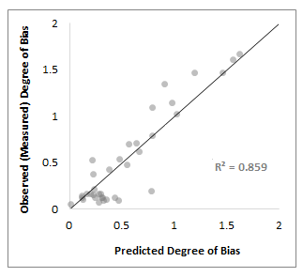
Preliminary Results are Remarkably Promising!
New Feature
Prior Feature
Notes:
The initial results look quite promising!
Our improved 14-feature model accounts for nearly 86% of the variance in human judgments of bias in news stories
On the right you can see the predicted values for degree of bias matched quite well with the degree of bias measured as the average of our 91 human P’s
The graph to the left shows the ranking of each feature according to the proportion of variance accounted for by the feature in the improved model
To obtain this ranking, we use the average feature variance calculations resulting from three regression techniques (feature added to model first, feature added to model last, and feature beta squared).

Slide 11
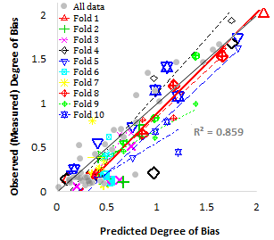
Model is Accurate and Robust: 10-Fold Cross Validation
Precision | Recall | Accuracy | F1-Score
0.91 | 1.00 | 0.98 | 0.95
Notes:
The model is accurate for distinguishing BIASED from UNBIASED sentences… using an arbitrary threshold of 0.75 (on scale of 0 to 3), model has 98% accuracy.
Over-fitting is often a concern in computational modeling, but 10-fold cross validation suggests the model is fairly robust…

Slide 12
Next Steps: Get more data. Explore Details, e.g., …
Notes:
Get more data! We are currently working to expand the data set to include a larger sampling of ground-truth ratings for bias in news stories.
Explore nuanced relationships in particular features and variables…
Then work on determining DIRECTION of bias (in favor or against the actor in the story).

Slide 13
Question, Comment, Feedback?
This is a Work In Progress; your (constructive) input is appreciated!
Contact the Authors:
C.J. Hutto cjhutto@gatech.edu
Dennis Folds Dennis.Folds@gtri.gatech.edu
Scott Appling Scott.Appling@gtri.gatech.edu

Slide 14
BACKUP SLIDES

Slide 15
Five News Stories
New Story #1: {Bush/Obama}’s decision about an economic/financial situation with negative outcome.
New Story #2: {Bush/Obama}’s decision to eliminate a federal grant program for teachers who would no longer receive incentive grants to work in inner-city school districts due to budget concerns (a negative outcome).
New Story #3: {Bush/Obama}’s promise to seek funding to support better emergency planning efforts, particularly those aimed at assisting with disaster preparedness for individuals with disabilities (a positive outcome).
New Story #4: {Bush/Obama}’s pledge to improve healthcare services to military service veterans (a positive outcome).
New Story #5: {Bush/Obama}’s new airport security regulation successfully foiled a bioterrorism attempt to smuggle Ebola virus aboard an airplane in New York City (also a positive outcome).

