Slide 1


Analysis of Submissions to the House of Commons Standing Committee on Health (HESA) An LLM-Powered Policy Gap Analysis
Term project
Large Language Models WatSPEED – University of Waterloo
Presented by Siarhei Yermakou

Slide 2
HESA & The Policy Lifecycle
Tracking stakeholder advocacy from parliamentary submission to executive commitment.
Stakeholder Briefs Submissions filed by healthcare associations, industry, and advocates.
Committee Study. House of Commons Standing Committee on Health (HESA) reviews evidence.
Reports and Recommendation HESA publishes final report containing explicit, numbered policy asks.
Government Response The government bound to respond/commit within a strict 120-day window.
THE PROBLEM
Hundreds of scattered, unsearchable parliamentary PDFs. Critical policy insights are trapped without thematic or organizational cross-referencing.
THE PROMISE (CORE CAPABILITIES)
• RAG Engine: "What did nursing organizations ask for regarding healthcare workforce retention?”
• Gap Analysis: "Which specific stakeholder asks made it into official recommendations, and which secured final funding commitments?"

Slide 3
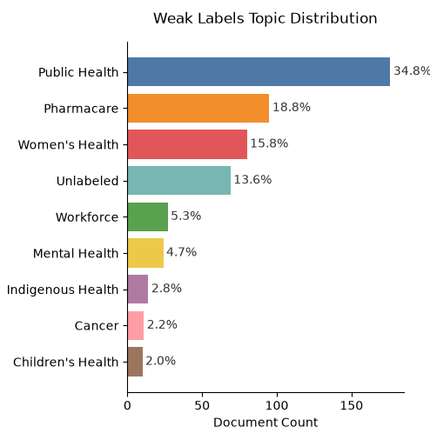
Data Engineering
1
Harvest
2
Extract
3
Clean
4
Dedupe
5
Label
(weak)
6
Cards
7
Gold set
Scrapers + whitelist,
1 req/s, manifest.jsonl
PDF + HTML router,
[[page N]] markers, OCR layer
Headers/footers, boilerplate,
contact scrubbing
Hash + embedding near-dups,
clusters kept whole in splits
Content-first keyword rules,
strong keywords
Title + first 250 words,
[ORG]-masked — leak-proof inputs
217 hand-labelled cards using codebook
Dataset / Corpus Split | Count
Raw documents harvested | 562
Extracted successfully | 538
Classifier corpus (briefs, corpus.csv) | 506
Train set (train.csv) | 258
Gold-labeled docs / Test set (gold_test.csv) | 217
Dev set (dev.csv) | 28
562
public documents harvested
19
HESA studies, 2 parliaments
9
health-policy topics
217
hand-labelled gold cards

Slide 4
One corpus, two questions
CORPUS
562 documents · briefs + reports + responses
“What is each
document about?”
“What does the
record contain?”
506 cards
title + 250 words, org-masked
~2,000 chunks + metadata
unmasked full text · layer, org, study, page
Keyword rules | embeddings+LR | LLM zero-shot
three methods, identical inputs
ChromaDB → filtered retrieval
by layer: briefs → recommendations → responses
gemma4 grounded generation
cited answer · gap status per ask
Topic label (9 classes)
graded on 217 frozen gold cards

Slide 5
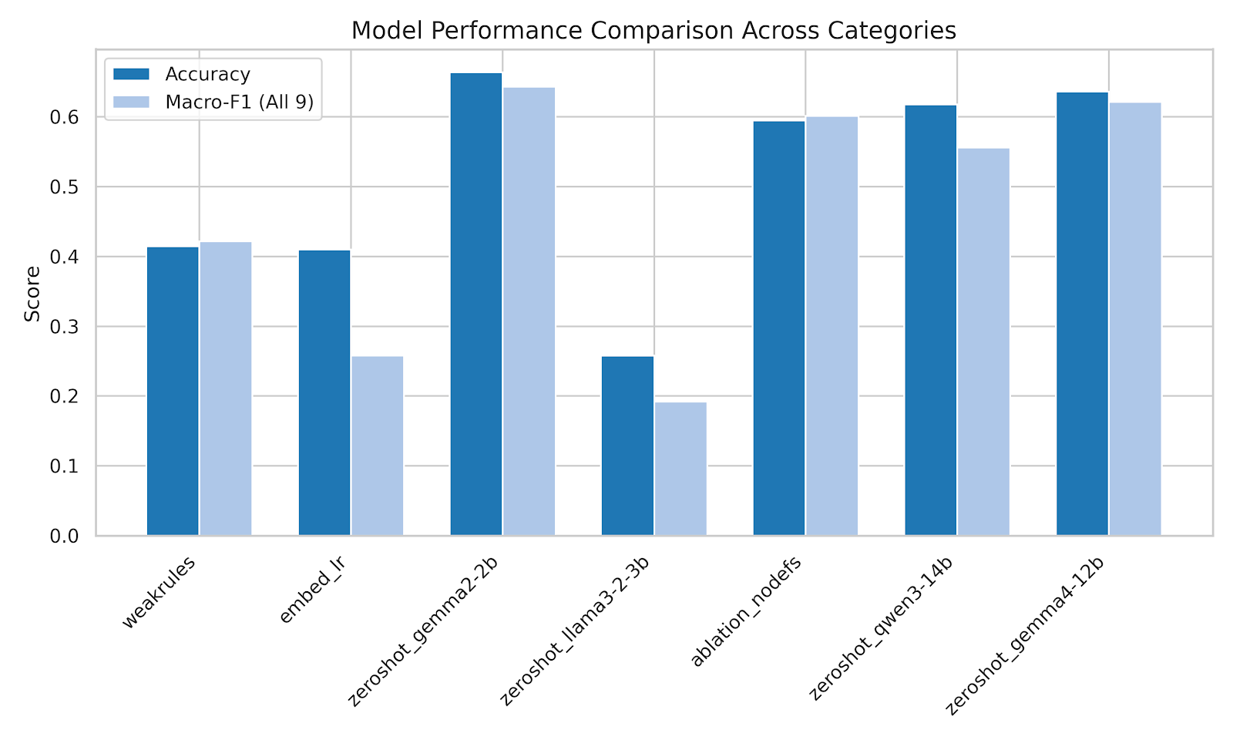
Model evaluation

Slide 6
Model evaluation (continued)

Slide 7
Prompt engineering

Slide 8
Prompt engineering

Slide 9
Conclusions
Smaller model can outperform larger model on specific tasks
Personal time management needs to improve

