Slide 1
Database Deployment

Slide 2
Outline
Why automate DB deployment?
Solution(s)
Full automation
Datical, DB Maestro
Partial
Dbup, SQL Package

Slide 3
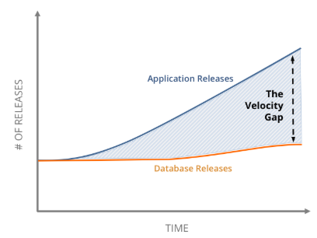
Challenges
Database Release slowing down application release frequency
Replica of a new database (new environment) is more expensive than application
As application ages, production database is constantly optimised to serve efficient while informal environments may or may not take advantage of applied improvements
Database deployment (and rollback) is much more difficult than application if system outage is not an option
According to a survey (2017): DB release processes are the biggest bottleneck for IT organisations (Reference)

Slide 4
Solution
Automate Database Deployment
Distribute Database Contribution to the team
Align and sync your databases in different environments

Slide 5
Database deployment scenarios
Database changes are not included in the deployment pipeline
Human intervention (scripting upgrade, rollback)
Promotes fear of changes
Database deployment is part of release pipeline
Increases agility to changes
Traceability
Sharing SQL code and knowledge
CI / CD
Increases visibility

Slide 6
Datical
Datical automates and transforms database deployments into a simple, repeatable process that can be completed in a few minutes, instead of days or weeks. As a result, application teams get weeks back to deliver new innovation and digital transformation efforts are no longer bottlenecked by the database.

Slide 7
Simple Approach (Moving forward)
Dbup
Comprehensive (Backward compatible)
Manual (Extensive SQL script to include upgrade/roll-back)
SQL Package (Excludes any data manipulation)

Slide 8


Database Deployment Tools
Datical
DB Maestro
Claive Software
Redgate Source Control

Slide 9
DB Maestro
https://www.youtube.com/watch?v=5gL5k1JqOz4

Slide 10

DbUp
+ Great for SQL
+ Great community support
+ Simplicity
- Immature support for Oracle
- No support for downgrade
- Easily can tweak dbup engine
Rule of (from DbUp creator – Paul Stovell)
Idempotent scripts
No script should be deleted/changed as soon as push to Source Control
Sequential name convention for script files
Use DbUp in all environments

Slide 11
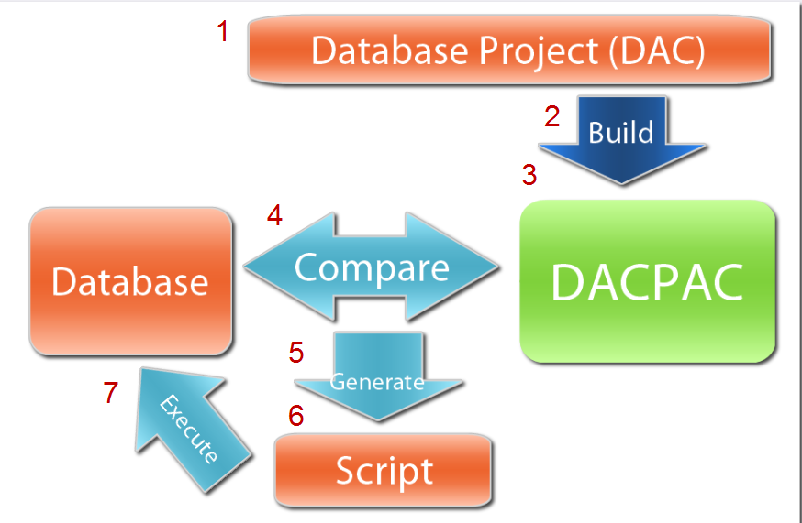
SQL Package
Sync destination database by comparing with Source database and generate snapshot script

Slide 12
Demo
1. How DACPAC looks like?

Slide 13
Summary
DbUp
+ Does work
+ Simple (No learning is required)
- Requires manual downgrade script for each production app release
DACPAC
+ Comprehensive Solution
+ Support downgrade
- Complex for most developers
My Personal Experience
Use DACPAC if DBAs are part of DevOps or App team / project
Allow Developers to contribute in DACPAC
DBAs should be DACPAC owner
Use DbUp if App Devs are DB owners

Slide 14
Q & A

Slide 15
References

