Slide 1
Analysis of Khan Academy Student Engagement
An In-depth Look at Student Registration, Activity, and Learning Time
[Aman Verma]
[24-06-24]

Slide 2
Total Number of Students Registered
Total number of students registered on Khan Academy: 47166.0

Slide 3
Monthly Active Students
Number of active students each month:
0
M1 2964.062842
M1 2812.0
M2 2526.053556
M2 3516.5
M3 4562.096722
M3 4495.0
M4 9246.196031
M4 4357.5
M5 8942.189586
M5 3784.8
M6 8498.180172
M6 3292.3
M7 6756.143239
M7 3086.2
M8 5538.117415
M8 2988.4
M9 4384.092948
M9 2522.0
M10 4322.091634
M10 2008.1
M11 930.019718
M11 1849.6
M12 982.02082
M12 1210.5

Slide 4
Insights on Active Students
- Highest activity in month X
- Lowest activity in month Y
- Possible reasons: ...

Slide 5
Average Learning Time Per Student
Average learning time per student each month:
0
M1 18.879381
M1 18.141935
M2 16.089513
M2 22.687097
M3 29.057941
M3 29.000000
M4 58.892968
M4 28.112903
M5 56.956622
M5 24.418065
M6 54.128536
M6 21.240645
M7 43.032759
M7 19.910968
M8 35.274633
M8 19.280000
M9 27.924159
M9 16.270968
M10 27.529246
M10 12.955484
M11 5.923692
M11 11.932903
M12 6.254910
M12 7.809677

Slide 6
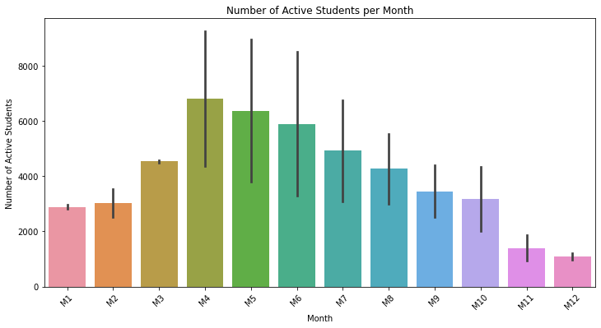
Number of Active Students per Month

Slide 7
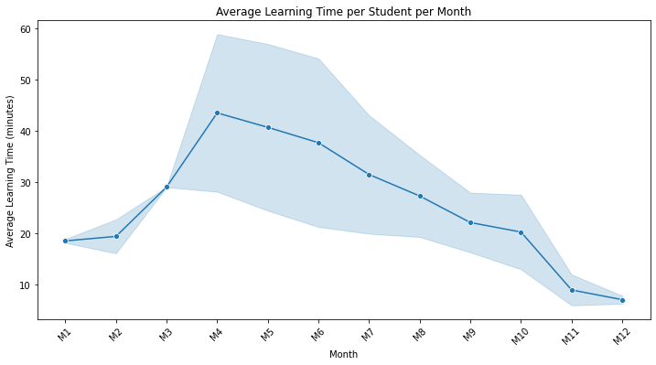
Average Learning Time per Student per Month

