Slide 1
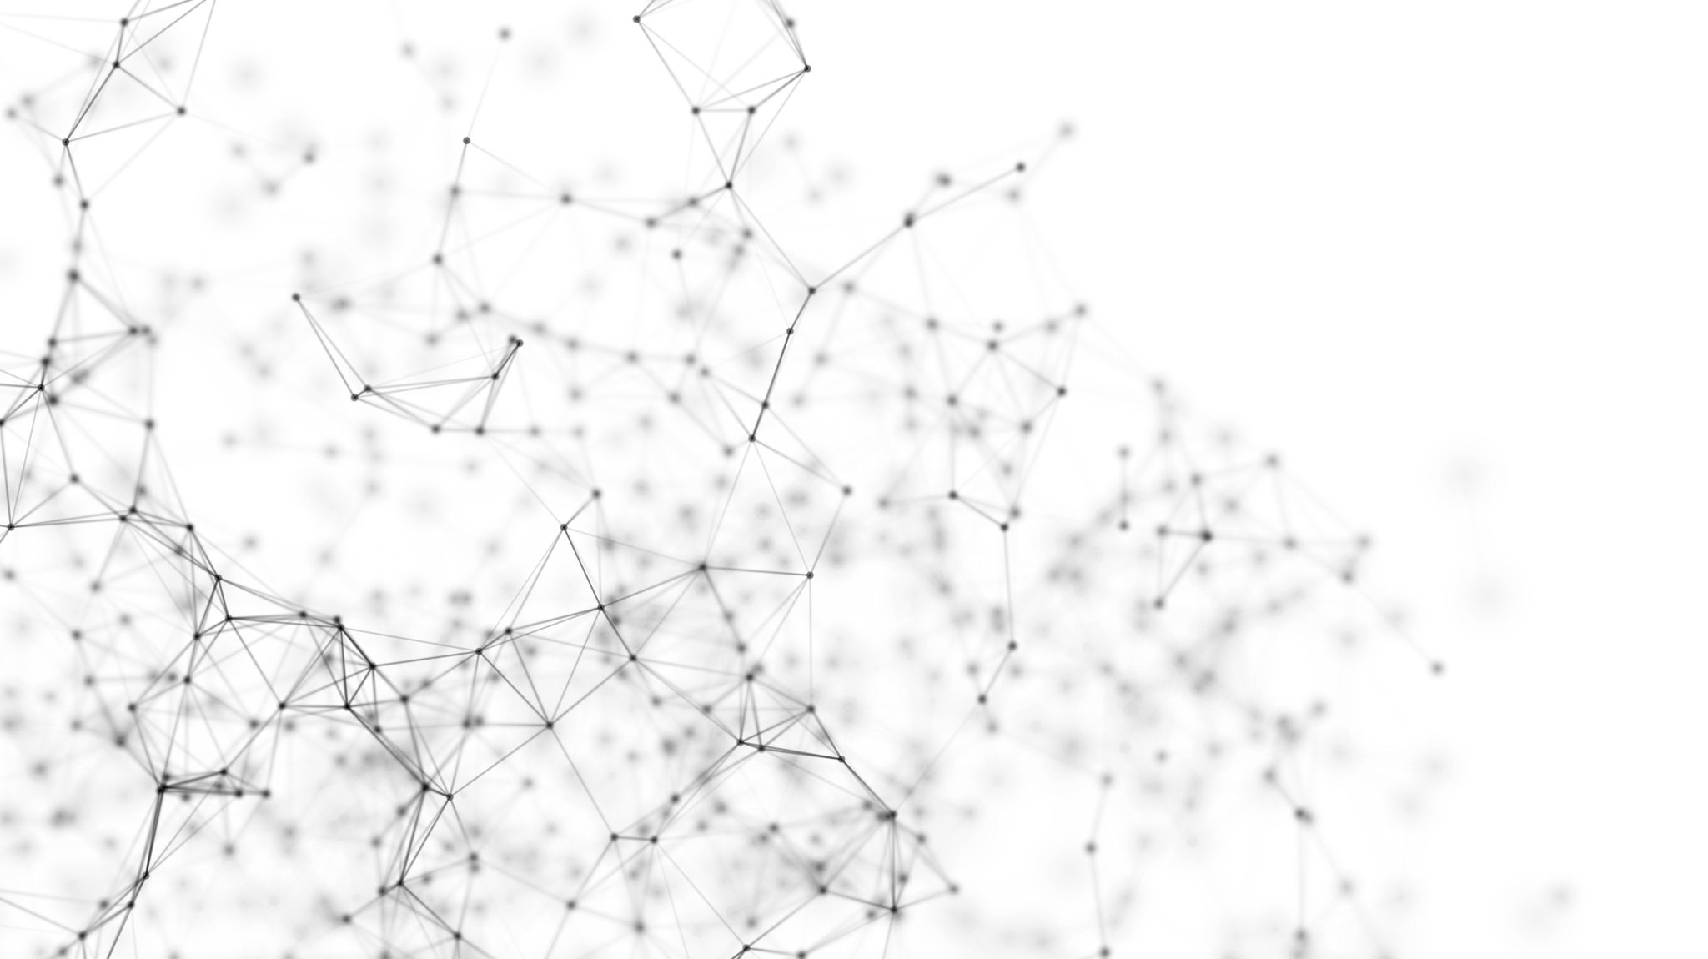

AI Workshop

Slide 2
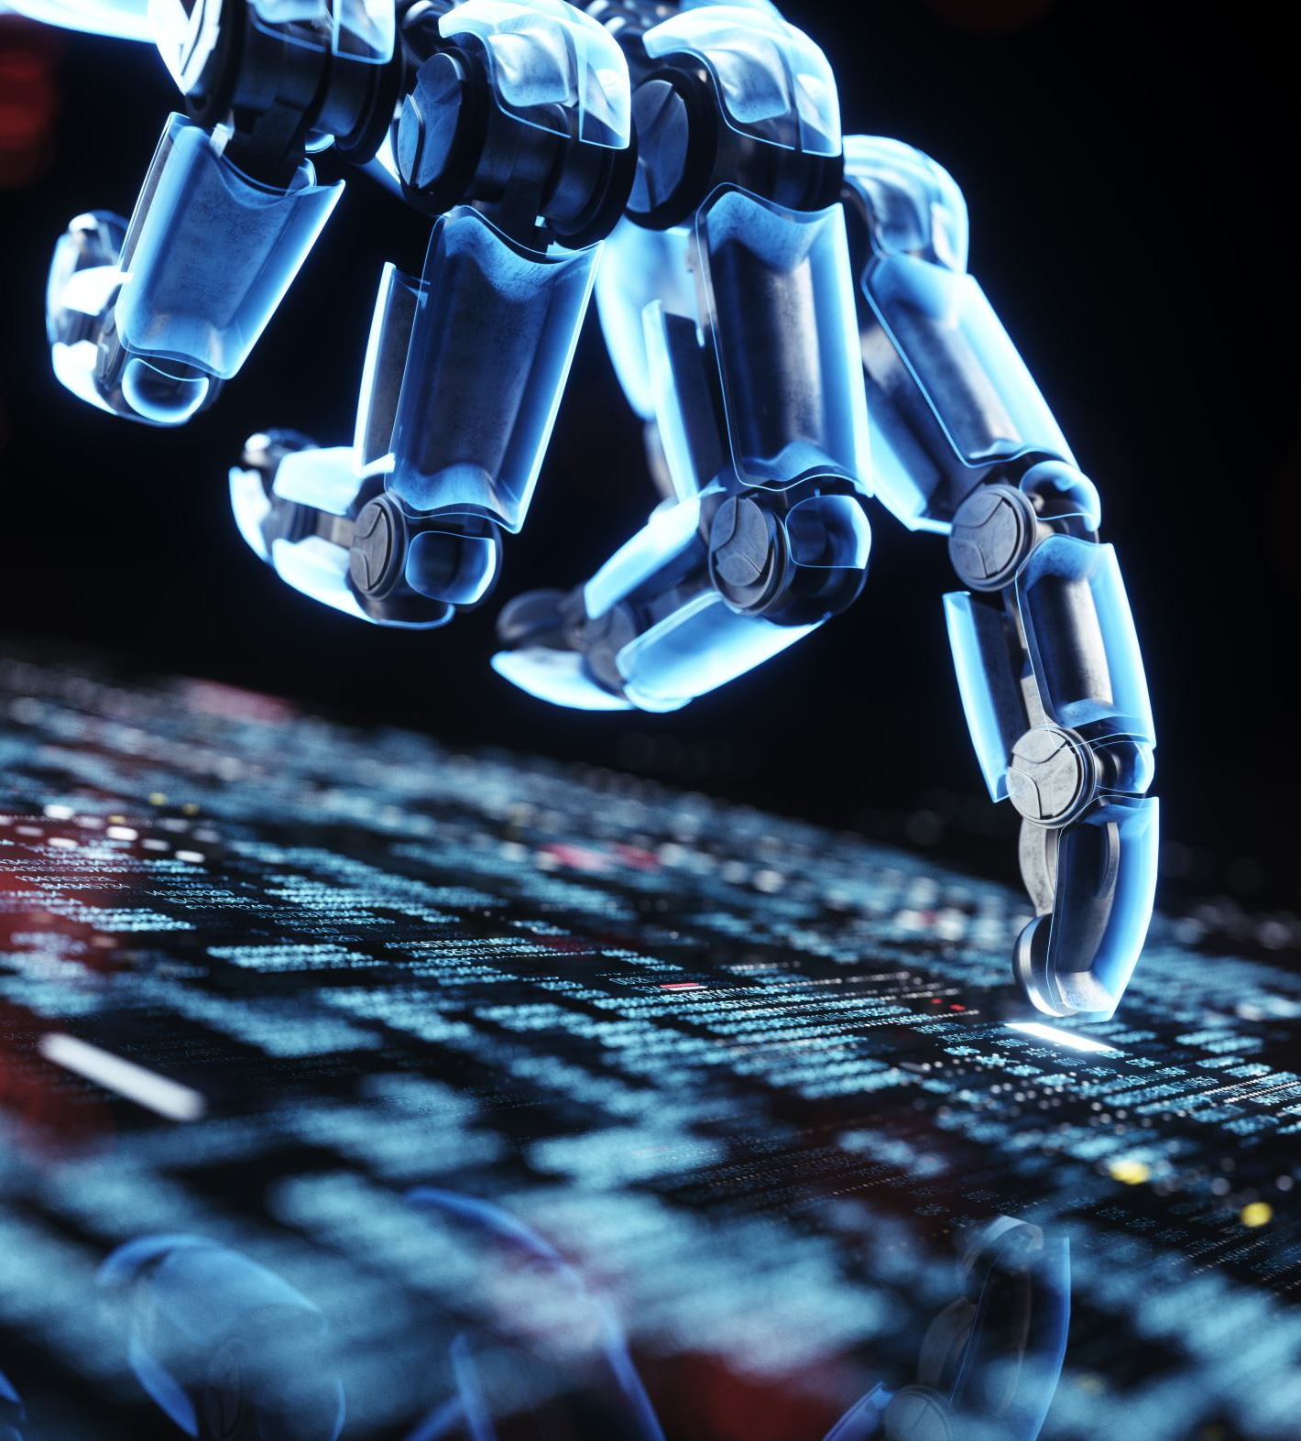
Lesson 0: Introductions
Who is your Mentor?
Ice Breaker Game: “Two Truths and a Lie”
Say your name
Tell us two honest facts and one fake fact about yourself for everyone to guess.
Notes:
I once built a fully functional robot using only paper clips and rubber bands.
I have 3 dogs and 1 cat.
I enjoy hiking and staying updated with AI news.

Slide 3
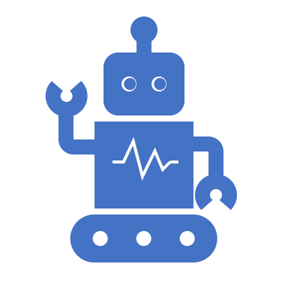
Discussion
Artificial intelligence is a hot phrase nowadays and for good reason! It’s changing the world as we know it.
Discussion Question: What does AI mean to you?
Notes:
Continue around 15 minutes in
All of these are great definitions of AI!

Slide 4
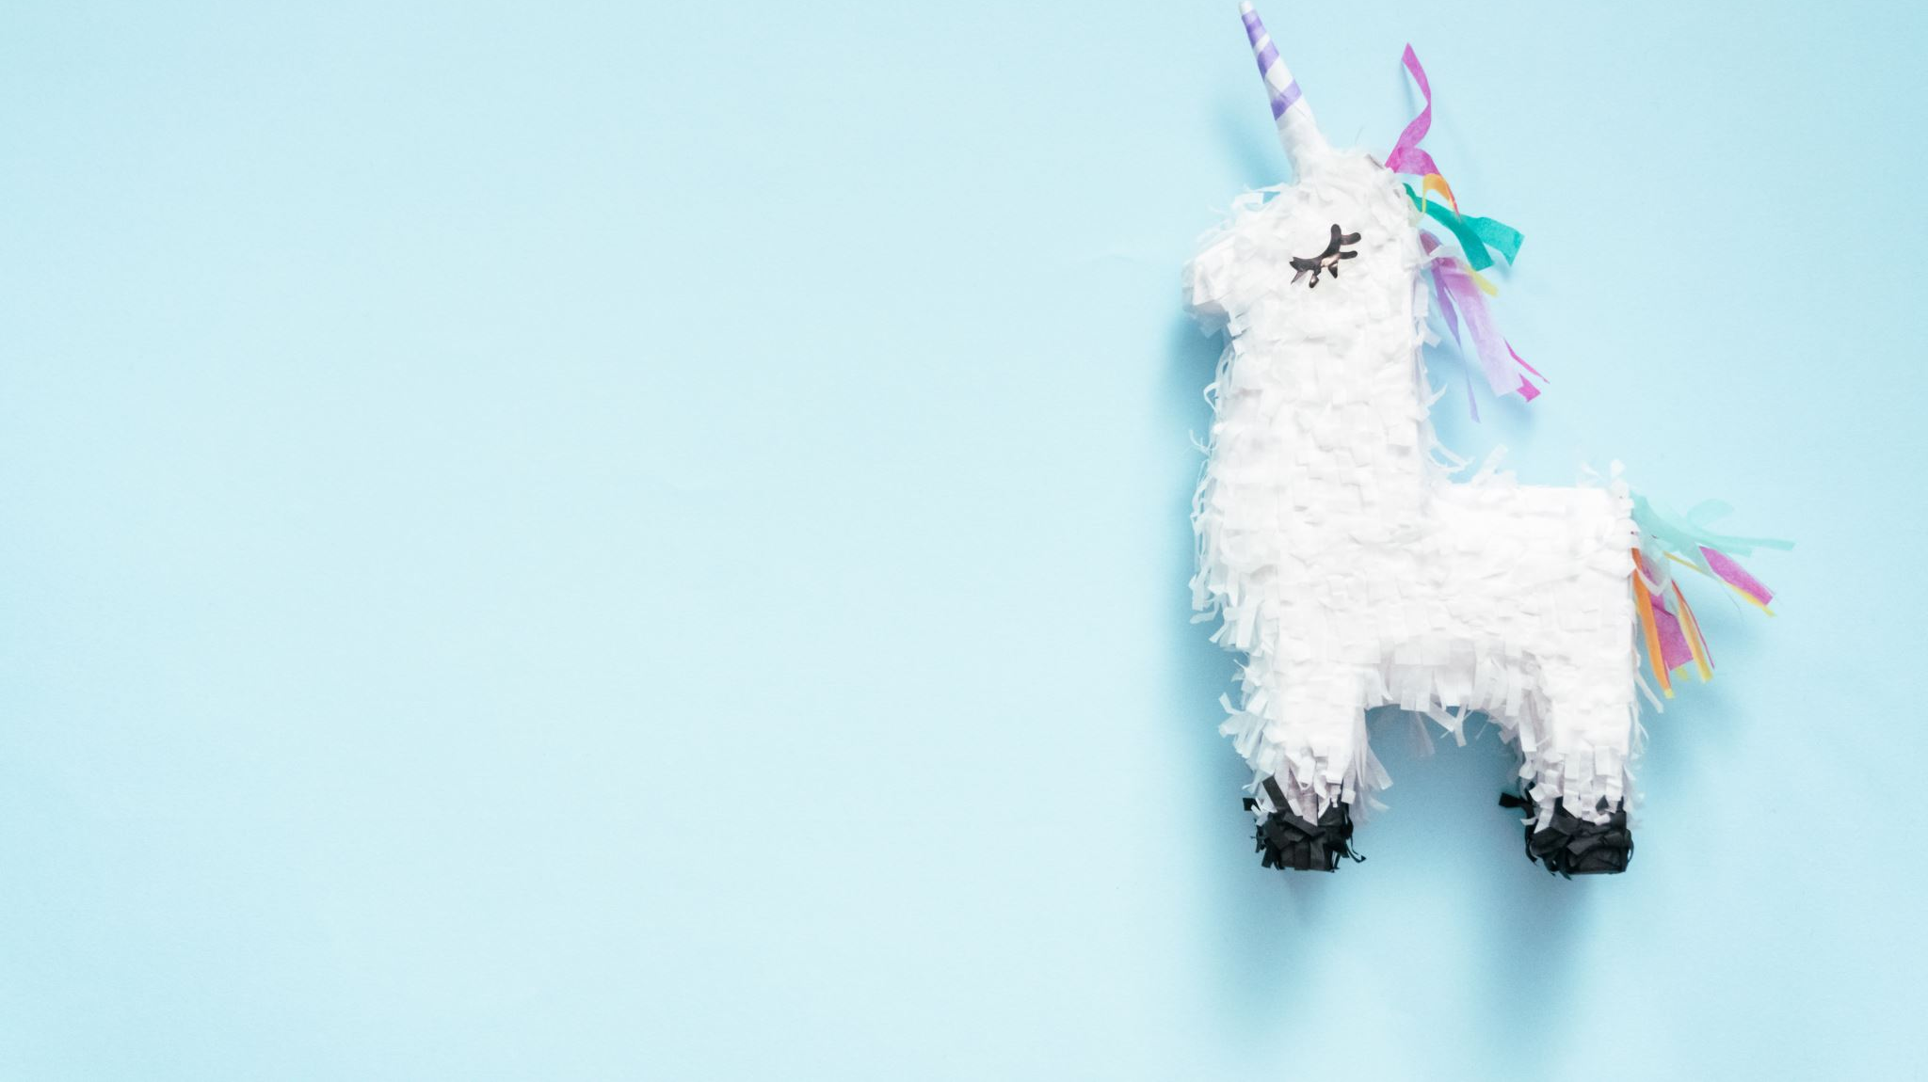
Lesson 1: Hugging Face Demo
Llama 2 is an advanced AI language model developed by Meta that can understand human text and is similar to ChatGPT.
Navigate to this link: https://huggingface.co/spaces/huggingface-projects/llama-2-7b-chat

Slide 5
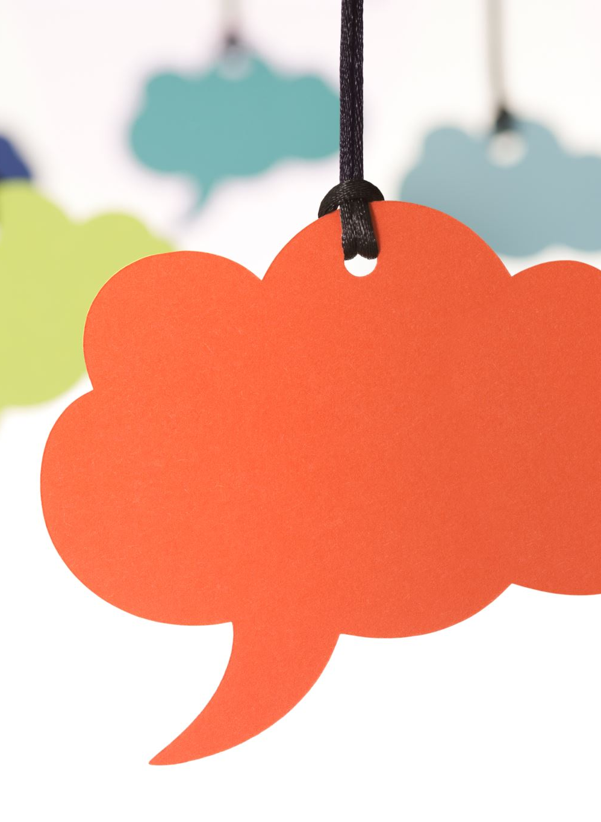
Prompting
You can ask the model anything. But here are a few fun and interesting prompts to get you started:
"Tell me a joke."
"Write a short story about a time-traveling cat."
"Can you explain what a black hole is?"
"How does a rainbow form?"
"Compose a poem about summer.”
As you interact with the model, think about:
How realistic do the responses seem?
Where does the model excel, and where does it fall short?
Notes:
Hammer down relation to ChatGPT, or other models they might have seen.

Slide 6

Discussion
AI is more than chatbots and games; it subtly impacts our daily lives in our pockets, homes, and schools, revolutionizing how we interact with the world. Let's take a moment to think about the impact of AI in our lives.
Discussion questions:
Where else have you seen AI?
How have you been affected by AI on a daily basis?
Notes:
Continue around 25 minutes in.

Slide 7
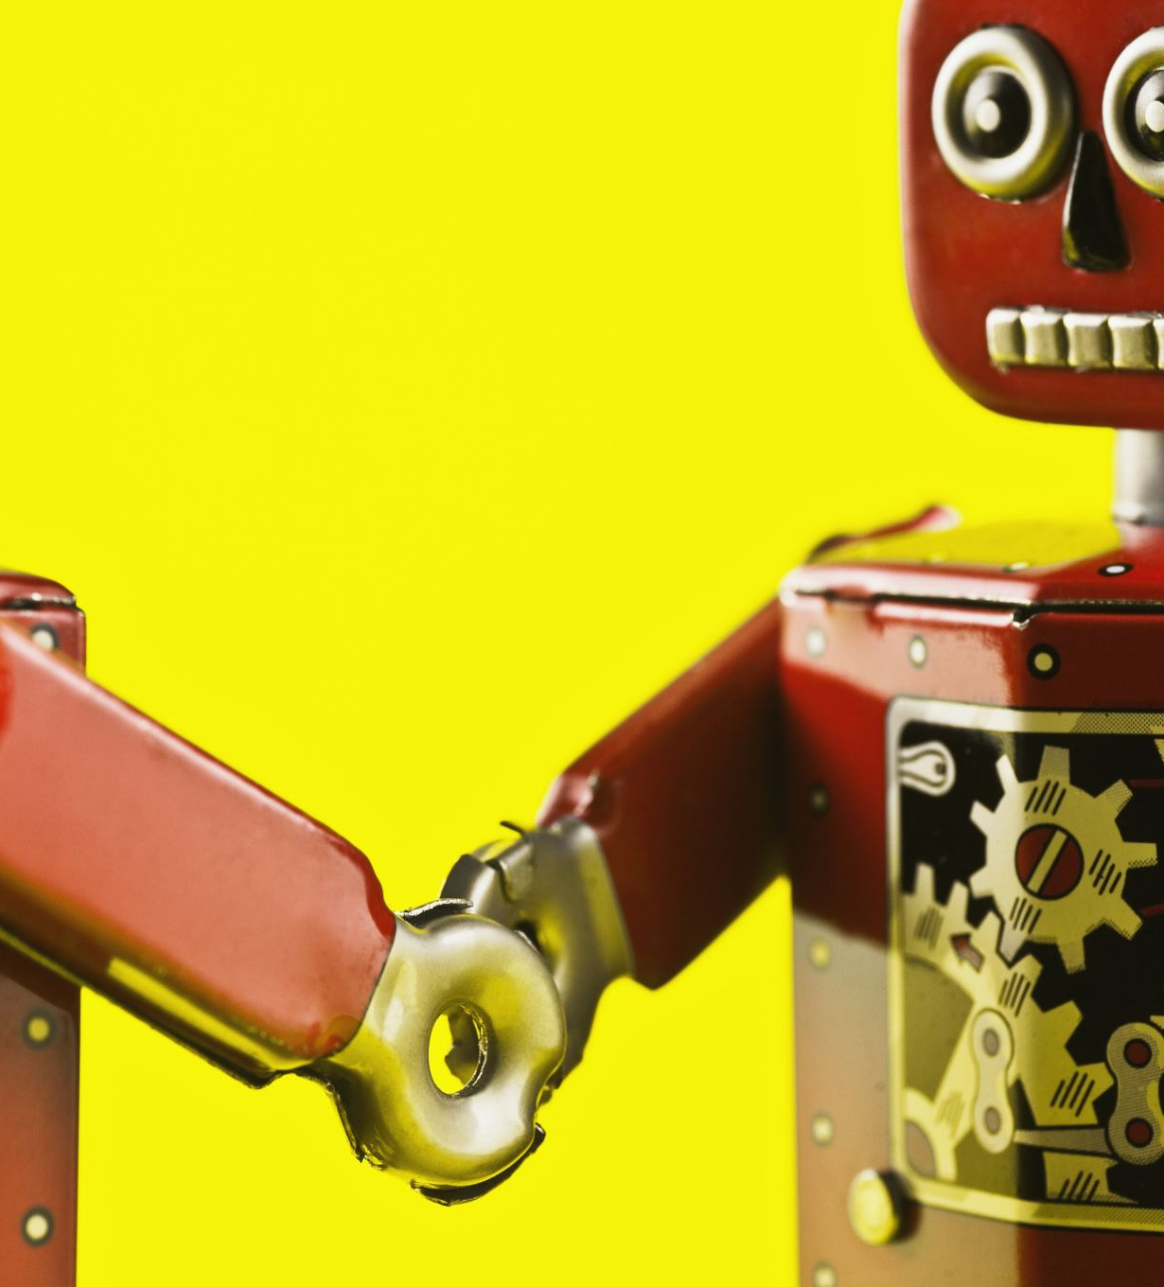
Lesson 2: Machine Learning Tools
There are many tools that are integral for your data science toolbelt. These are some, but not all, of the tools you’ll use.
Google Colab
Hugging Face
Gradio
Notes:
The tools!

Slide 8
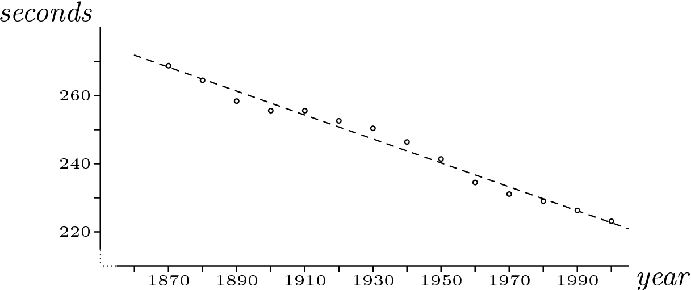
Line of Best Fit
Line Equation:
f(x) = mx + b

Slide 9
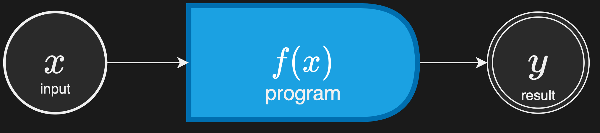
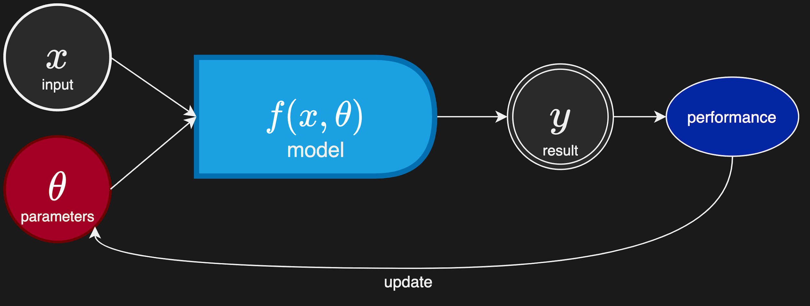
What is Machine Learning?
Machine learning is a branch of artificial intelligence that enables computers to learn and make predictions based on patterns and data without being explicitly programmed.
Regular Programming
Machine Learning
The coder explicitly defines the relationship between inputs (x) and outputs (y) (e.g., data)
The coder uses machine learning to discover the relationship between the inputs (x) and outputs (y) and make predictions.

Slide 10

Google Colab
Google Colab is like a playground for coding and AI experimentation! It's a website that allows you to write, run, and share python code without any setup. We call this a cloud-based environment.
Best of all, you can use free GPUs, which are specialized processors for supercharging your machine learning projects!
Notes:
Google Colab is the platform we will use to write our code and create our machine learning app. Potentially ask students if they’ve built a computer before.

Slide 11
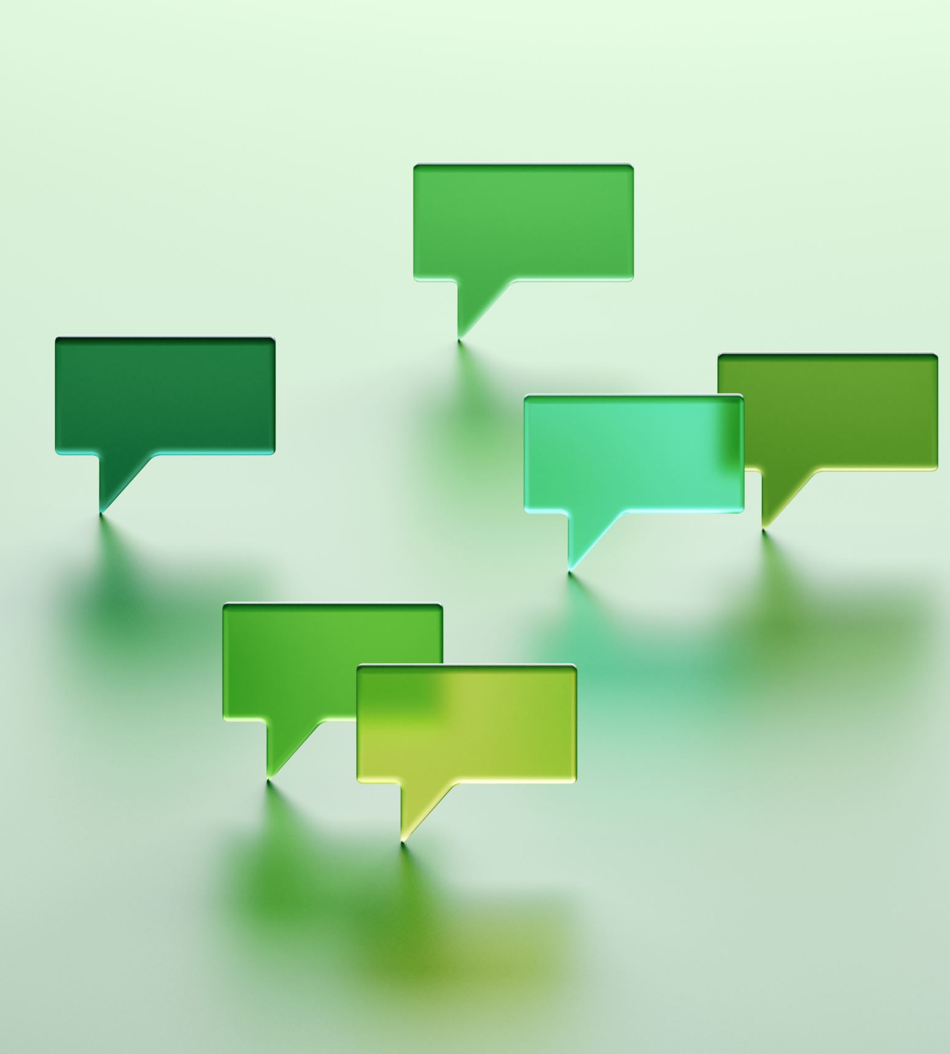
APIs - The Internet Messengers
APIs act like messengers. You ask them something or give them a command (that's your input), and they return the information (that's the output). Kind of like functions in Python!
They're crucial when we want to use complex code someone else wrote, even if we don’t understand the code ourselves! For example, we will be using machine learning models later.
Notes:
APIs are what we’ll use inside of our code to make our lives easier. They help us write less code and integrate powerful software into our app with ease.
Now we are going to introduce some useful APIs for machine learning

Slide 12

Hugging Face
Hugging face is an open-source library for machine learning that offers pre-trained models and tools.
You can use Hugging Face to build chatbots, analyze text sentiment, and so much more!
Notes:
Ask if they’re interested in learning more about open-source (if possible)
Consider other examples, such as image generation.

Slide 13

Gradio
Gradio is a library for building user interfaces that bring your machine learning models to life.
You can create interactive apps in just a few lines of code.
Notes:
A library also allows you use code other people wrote

Slide 14

Coding Lab
https://colab.research.google.com/drive/1Be0f7gJD1kJYAg7K-nqmfSVy-aYe3dVV?authuser=1
First, everyone needs to sign into their Google account if they aren’t already.
Click “copy to drive”.
Now, let’s run through the notebook together!

Slide 15
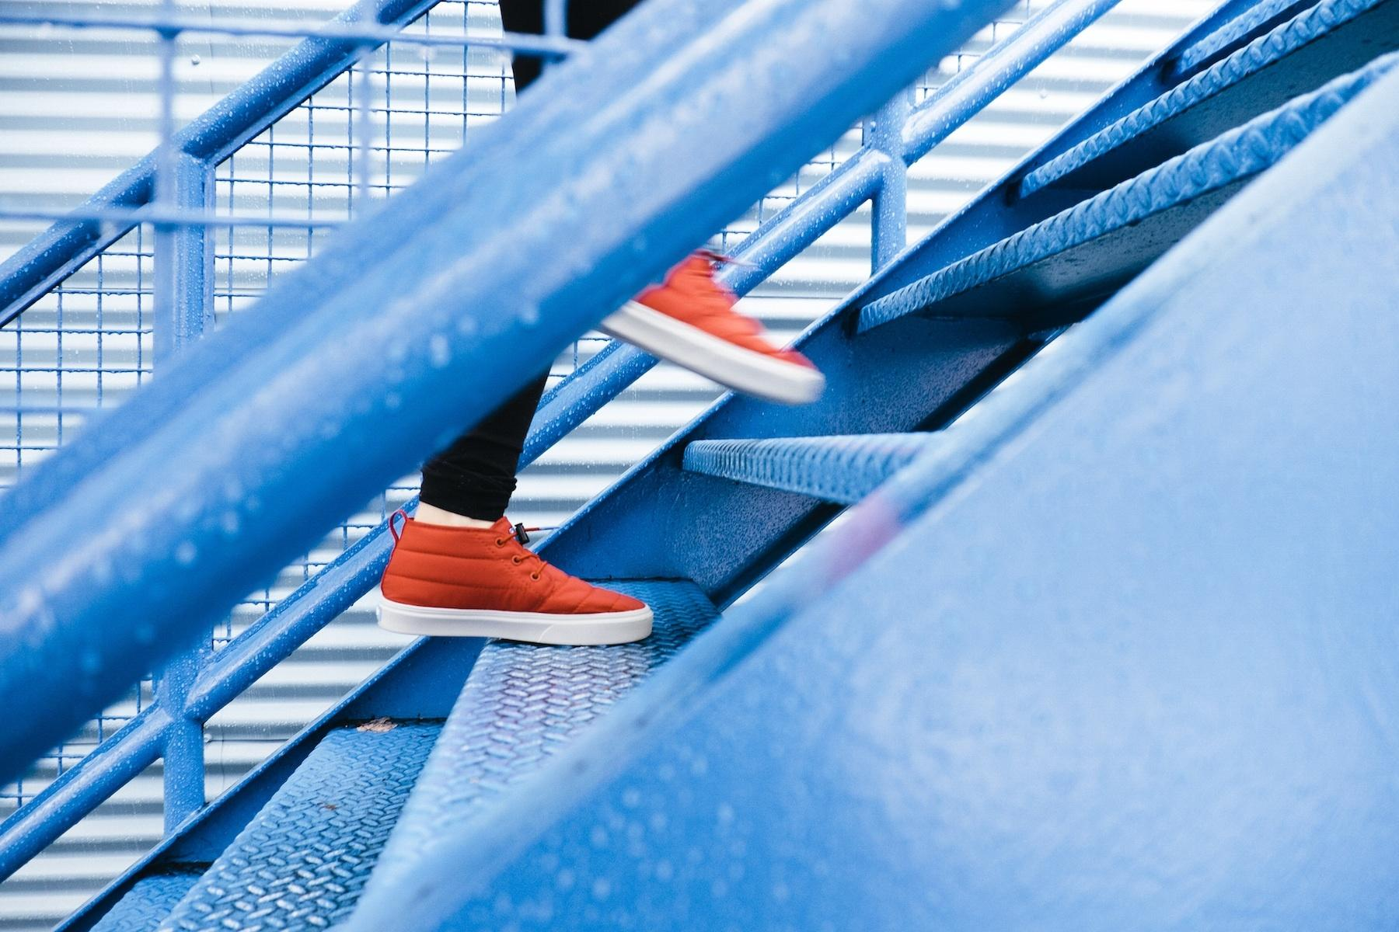
Next Steps
Congratulations on finishing your first lab!
Next we’re going to learn about how to integrate a machine learning model into our Gradio Interfaces.
Notes:
Should be around 1 hour in
Take a 10-15 minute break.

Slide 16

Lesson 3: Project - AI Assistant
AI chatbot assistants are software programs designed to mimic human conversation. Can you think of any examples?
We will use APIs (eg. Gradio + HuggingFace!) to create our own AI chatbot.
Notes:
Examples include Siri, Alexa, and Google Assistant.
We won’t cover how these machine learning models learn to produce the best response in this workshop
The AI chatbot we will use is pre-trained to produce good results. In our ML academy we show how you can train these chatbots from scratch!

Slide 17
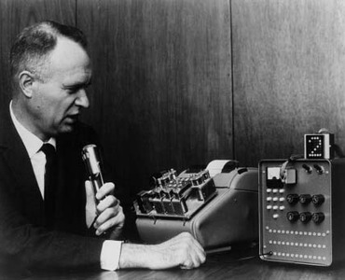
The First AI Assistant
The first AI assistant was IBM's Shoebox, unveiled at the 1962 Seattle World's Fair.
Could recognize 16 spoken words and digits 0 to 9.
Notes:
Shoebox marked the beginning of a journey towards creating more complex and capable AI systems.
Now, just 61 years later, the best AI assistants are capable of mimicking human-level responses and actions!

Slide 18
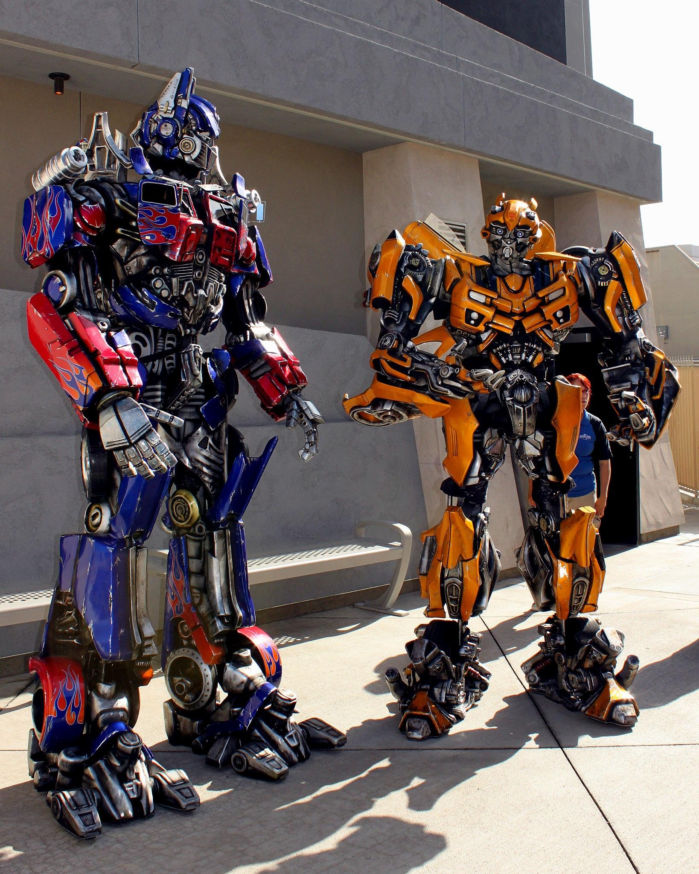
Transformers - Not Just a Movie!
Transformers are a type of machine learning model that are really good at understanding text.
They consider every word in a sentence and how each word relates to the others, kind of like humans.
Notes:
We are going to build an AI chatbot assistant
Since a chatbot interacts with the user through text, we want to use an ML model that excels at understanding human text. The best ML models for this problem are called Transformers.
We will use a pre-trained Transformer to power our AI chatbot assistant. We call it a pre-trained Transformer because someone else already did the hard work of designing it to achieve a specific task.

Slide 19


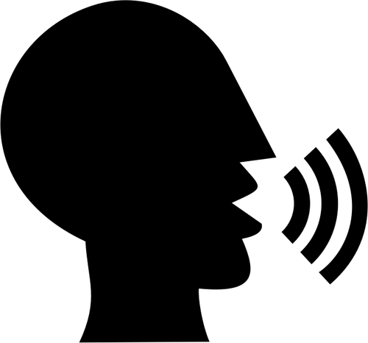
Lab Time
We will be creating our own AI assistant using the Hugging Face API and a Gradio interface.
https://colab.research.google.com/drive/1uyuv034ioMxgiS1IFVYgANg9SZ5fkSSh?authuser=1
Let your creative juices flow!
Afterwards we will have a show and tell where you show off your assistant! Keep track of any interesting convos.

Slide 20



Show and Tell
Now that we all have a personalized assistant, it’s time to show them off!
Give us a short description of your assistant.
Show us how your assistant responds when prompted with:
For example: “My assistant Peter Parker is super friendly and intelligent. He enjoys reading and programming, and he has a secret: he was bit by a radioactive computer bug! His goal in life is to become the greatest friendly, neighborhood AI assistant.”
“What is the meaning of the universe?”

Slide 21
Discussion
Reflection time! What stood out and what surprised you?
What are some use cases for your personal assistant?

Slide 22
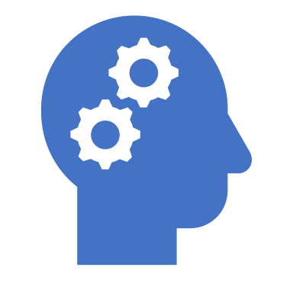
The Impact and Future of AI Assistants
AI Assistants have made technology more accessible and improved multitasking.
They have found their place in businesses and homes, aiding with tasks like scheduling meetings, answering questions, and controlling smart devices.

Slide 23
Want to Learn More?
Sign up for a phone call with Kai, our machine learning director:
https://calendly.com/kai-bm-ml/ml-consultation
Or send me an email:
sj@breakoutmentors.com

