Slide 1
Project Meeting
29/10/2025

Slide 2
Summary of Past Week
Literature Review:
  Reading on methods for measuring reflection coefficient/extracting resonant frequency from wireless LC sensors.
  Reading on existing sensors.
  Taking notes on papers.
Getting current circuit up and running:
  Tested DDS output and filtered output on oscilloscope.
  Looking over the Arduino code.
Finalising project plan.

Slide 3
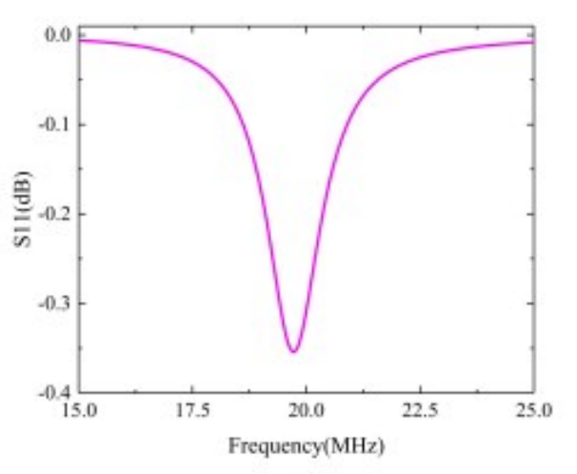
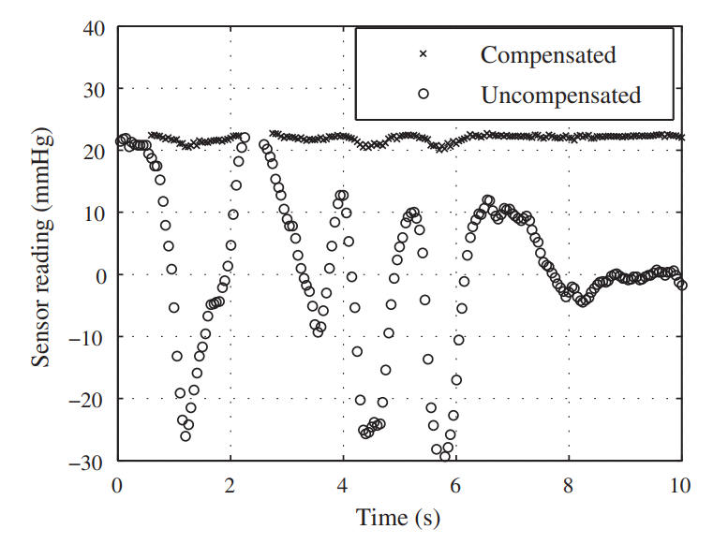
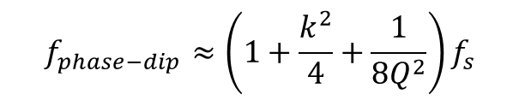
Phase-Dip Method (current method)
Measure phase difference between DDS output and transmitted signal.
Resonant frequency of sensor is ‘near’ the minimum in the phase curve.
Dependent on coupling coefficient.
Can be measured with phase detector.
Requires compensation.
$$f_{phase−dip}≈\left(1+\frac{k^{2}}{4}+\frac{1}{8Q^{2}}\right)f_{s}$$

Slide 4
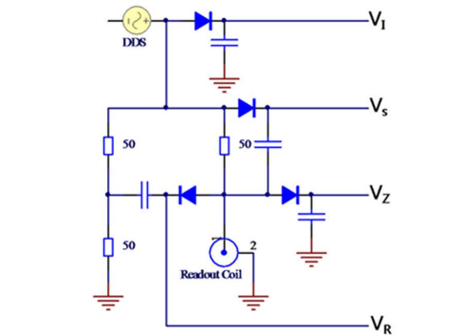
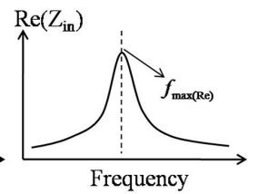

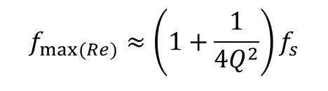
$Re\{Z_{in}\}$ Measurement
Measures real component of readout coil impedance.
The maximum occurs very close to the sensors resonance frequency.
Minimally affected by coupling variations (independent of k).
Can be measured with SWR bridge.
$$f_{max⁡(Re)}≈\left(1+\frac{1}{4Q^{2}}\right)f_{s}$$

Slide 5
Plan for Next Week
Look into the phase shifter circuitry.
Get full circuit running:
  Need transmitter coil.
Continue reviewing literature.
  Look into operation of SWR bridge.

