Slide 1
Project Meeting
05/11/2025

Slide 2
Summary of Past Week
Literature Review:
  Reading patents of existing readout systems.
Getting current circuit up and running:
  Looking into how the phase shifter works.
  Simulating the phase shifter.
Simulating different methods for extracting the resonance frequency.
  Phase dip method
  SWR Bridge (measuring real component of coil impedance)
  Current Source Method (measuring real component of coil impedance)

Slide 3
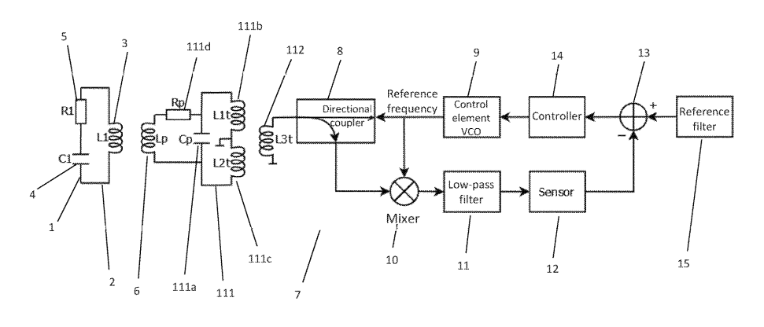
Vesselsens readout system

Slide 4
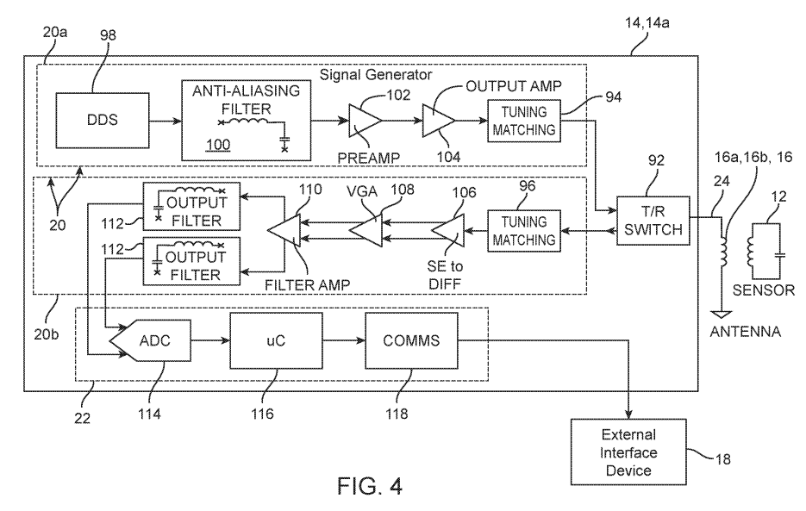
Fire1 Readout System

Slide 5
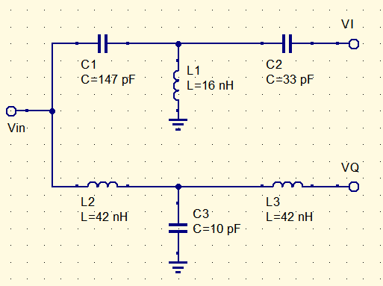
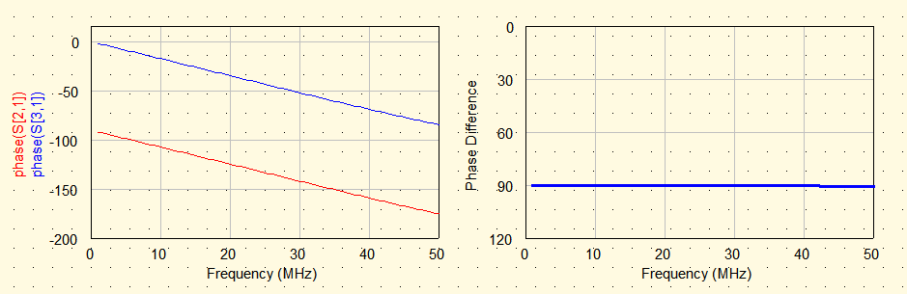
Phase Shifter

Slide 6
Plan for Next Week
Work on getting readings from current circuit.
Continue Literature Review:
  Review general methods for reading transmission/reflection coefficients.

