Slide 1

Dimensionality Reduction Algorithms

Slide 2

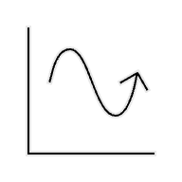
Aim 2: Identify features of interest through bioinformatic clustering
c) UMAP
a) PCA
b) t-SNE
c) UMAP
Background
Hypothesis & Aims
Methods
Feasibility
Conclusions
References
Questions
18

Slide 3
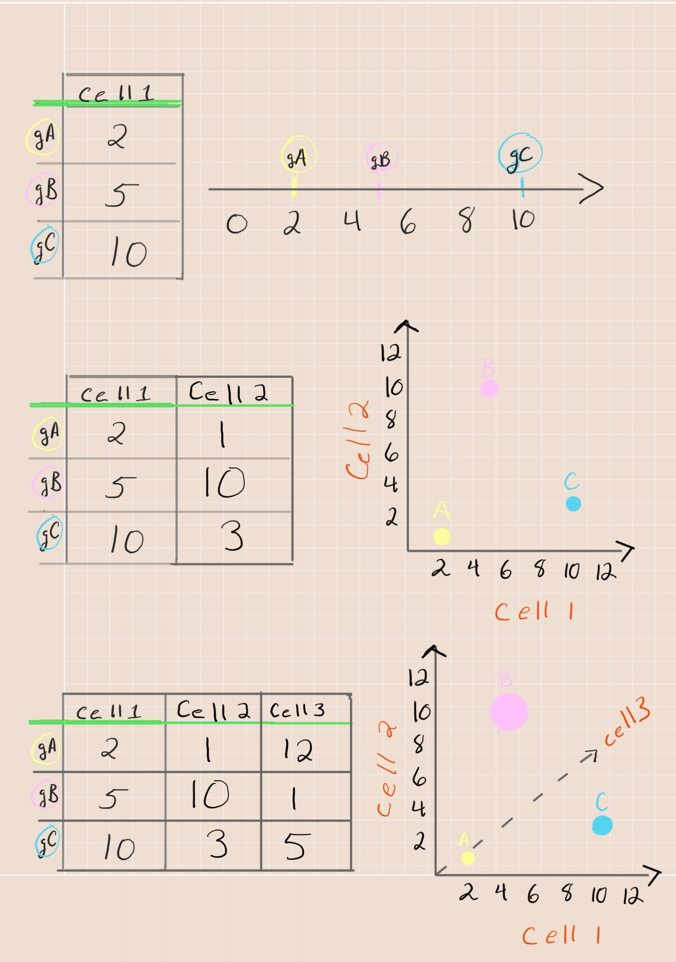
Why cluster?
The curse of dimensionality
1-D
One factor
x-axis
Background
Hypothesis & Aims
Methods
Feasibility
Conclusions
References
Questions
19

Slide 4
Why cluster?
The curse of dimensionality
2-D
Two factors
X and y axes
Background
Hypothesis & Aims
Methods
Feasibility
Conclusions
References
Questions
20

Slide 5
Why cluster?
The curse of dimensionality
3-D
Three factors
x, y and z axes
Background
Hypothesis & Aims
Methods
Feasibility
Conclusions
References
Questions
21

Slide 6

Why cluster?
The curse of dimensionality
4-D?
Background
Hypothesis & Aims
Methods
Feasibility
Conclusions
References
Questions
22

Slide 7
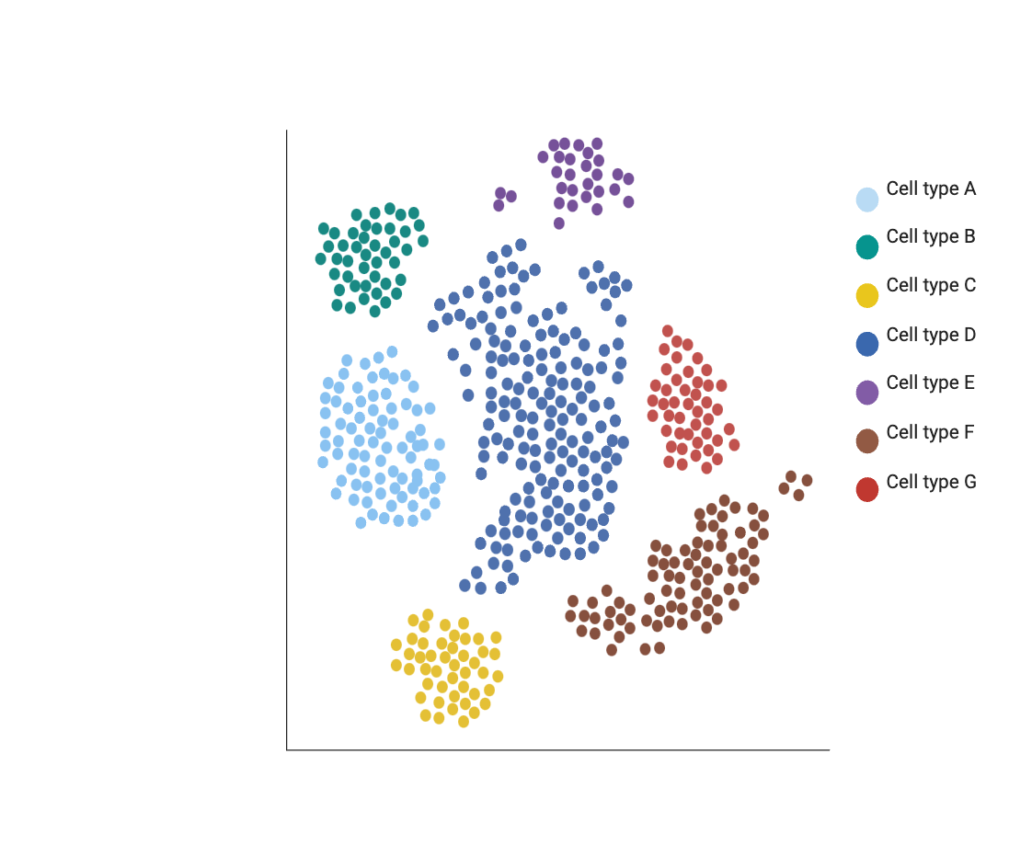
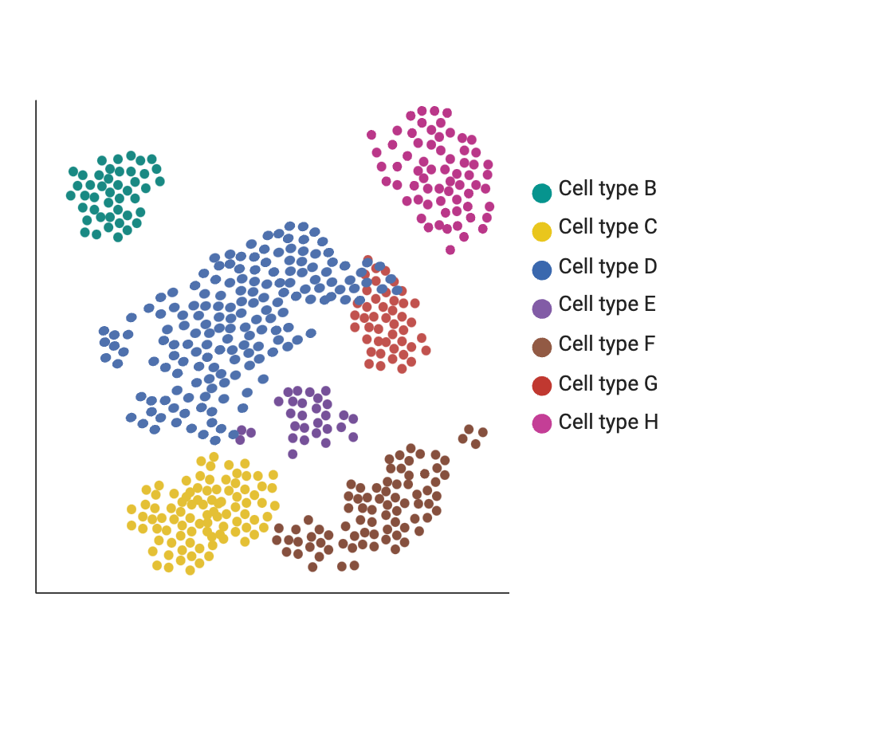
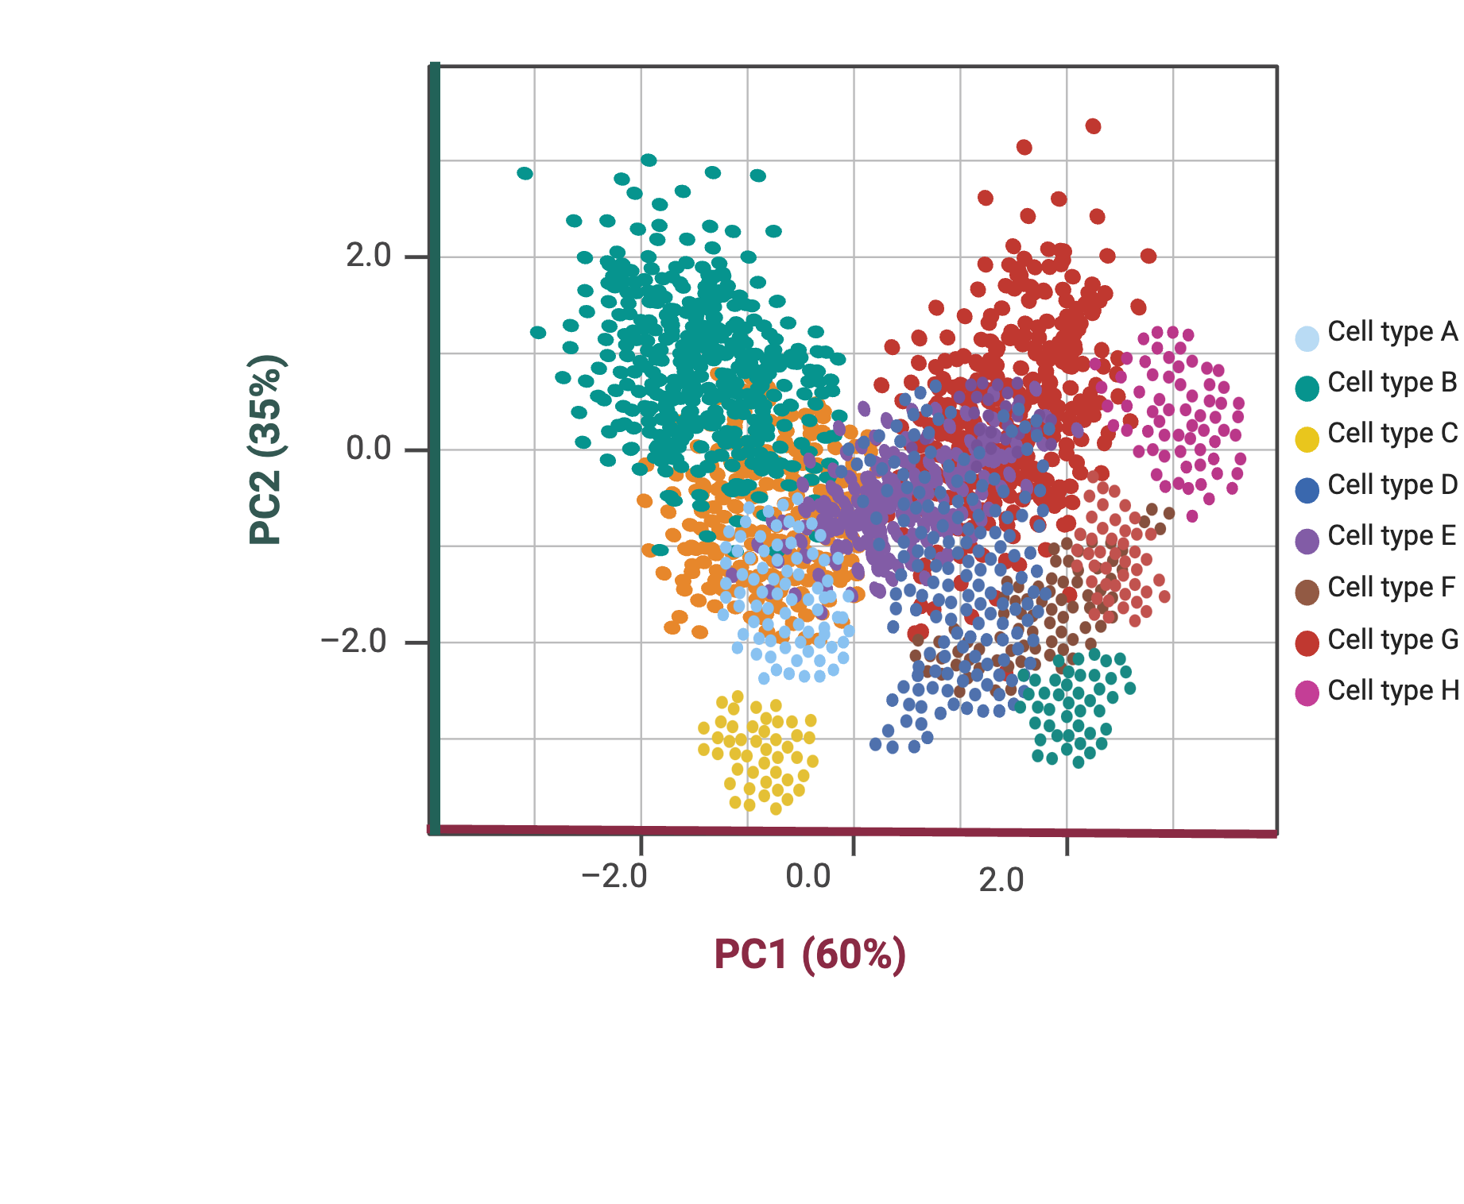
Dimensionality reduction algorithms (“clustering”)
t-SNE
UMAP
Cons
Not apt for non-linear data
Subject to information loss
Pros
Simple linear method
Retains variance
PCA
Background
Hypothesis & Aims
Methods
Feasibility
Conclusions
References
Questions
23
Notes:
Cons
Simple linear method
Retains variance

Slide 8
Dimensionality reduction algorithms (“clustering”)
UMAP
PCA
Pros
Excellent at local structure
Uses t-distribution for spacing
Cons
Computationally expensive
Does not accurately represent global structure of data
t-SNE
Background
Hypothesis & Aims
Methods
Feasibility
Conclusions
References
Questions
24

Slide 9
Dimensionality reduction algorithms (“clustering”)
PCA
t-SNE
Pros
Retains global and local structure well
Computationally efficient
Cons
Sensitive to outliers
Hyperparameters need fine tuning
UMAP
Background
Hypothesis & Aims
Methods
Feasibility
Conclusions
References
Questions
25

