Slide 1

Medical Imaging for Multimodality of Breast Cancer Diagnosis User Interface
(MIMBCD-UI)
Presented by: Francisco Maria Calisto
Research Assistant
Notes:
Title Page Template 2

Slide 2




Universidade de Lisboa
Instituto Superior Técnico
ISR & INESC-ID
Notes:
Title Page Template 3

Slide 3
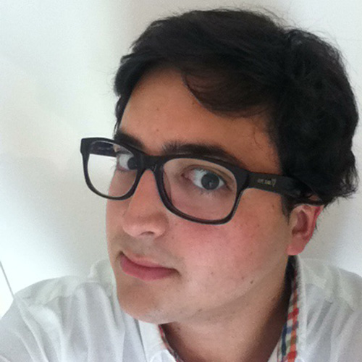
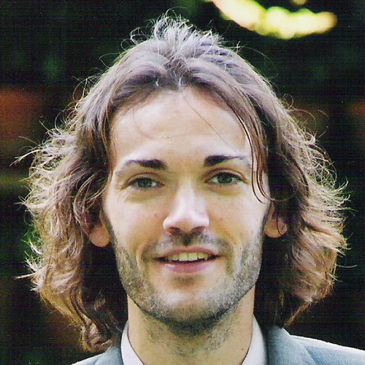
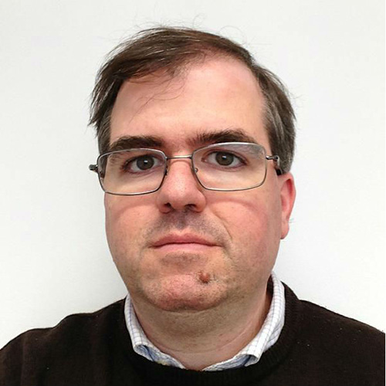
ISR & INESC-ID
Meet the Research Team
Francisco Maria Calisto
Jacinto Carlos Nascimento
Daniel Gonçalves
Research Fellow
Advisor
Co-Advisor
Notes:
This slide will crop your image to a circle automatically. Right click one of the images and choose Change Picture… from the menu. For best results your image should be square.

Slide 4

Amadora Sintra
Notes:
Title Page Template 3

Slide 5
MOTIVATION
Why we are doing the research
01
One:
Build a data-set with annotations in multimodality of medical imaging for breast cancer diagnosis.
02
Two:
Provide the user facility to draw/write down masses, calcifications and the corresponding BI-RADS.
03
Three:
Follow-up of the patient, allowing the user to automate a multimodality inspection of the patient.

Slide 6
Why?
The idea
Breast cancer is one of the most commonly occurring type of cancer among women.

Slide 7
Also…
The idea
The main strategy to reduce morbidity and mortality being early detection and treatment based on medical imaging technologies.

Slide 8
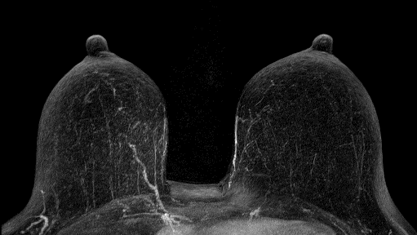

Breast Cancer

Slide 9
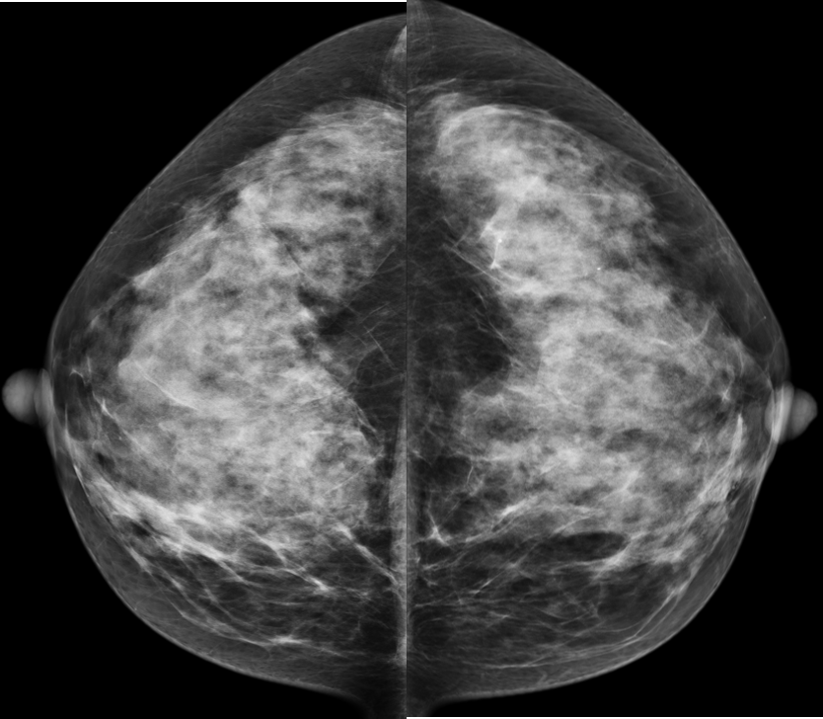
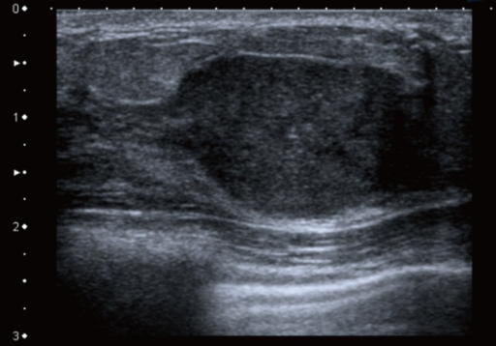
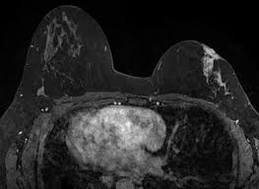
Multimodality
User Interface
No single modality has the specificity and the sensitivity high enough for reliable diagnosis.

Slide 10
Cooperation and Time
What do we need?
Demographic Survey
User Testing
UX Survey
Final Survey
A first survey to understand who are you and what are you doing.
The user interface tests, recording your interactions, time, number of interactions, accuracy and number of errors.
Understand how do you feel using the user interface and how was the user experience.
A final survey to understand preferences, issues and improvements.
Notes:
To change graphs, right-click and choose Edit Data…

Slide 11
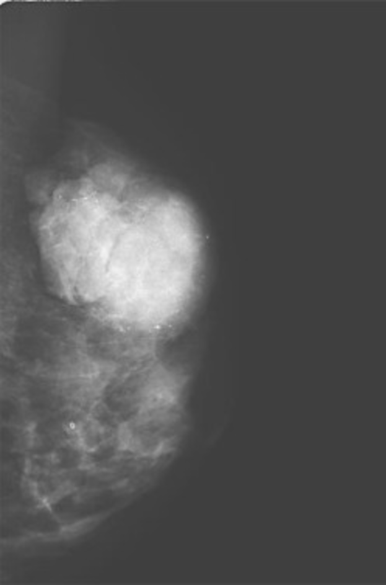
CONCLUSIONS
Breast Cancer
Cancer is projected to become the world’s leading cause of death by 2017, with the burden of disease shifting further towards medically underserved populations in industrialized countries and the developing world.
A map between images of the same scene acquired with different imaging modalities.
A better user interactivity, more efficient and flexible information and to easily diagnose in it.

Slide 12


THANK YOU!
Please visit our research page: mimbcd-ui.github.io

