Slide 1
breath+ breathcount
Breathcount is a device for lung health monitoring

Slide 2

It is like heart rate monitor but for your lungs

Slide 3

What is asthma?

Slide 4

Anytime anywhere

Slide 5
10,000 children
+5,000 adults

Slide 6
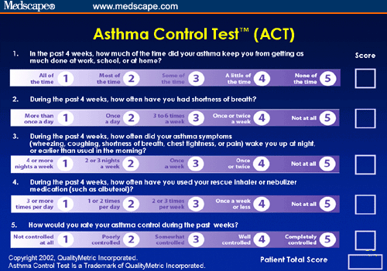
Subjective tests

Slide 7
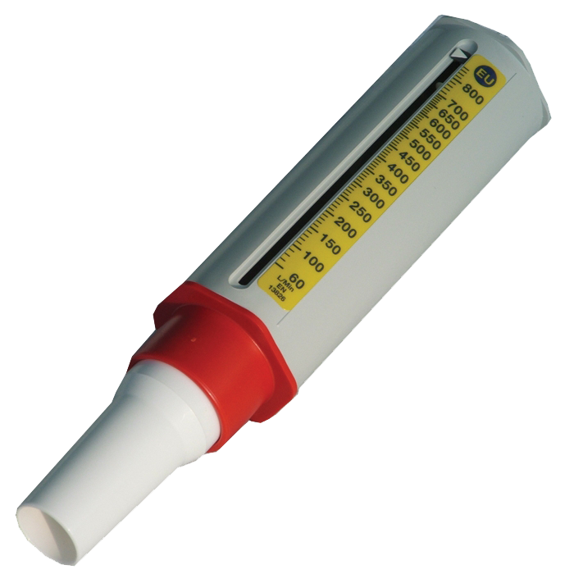
PEFM

Slide 8
$35,000
open for 48 days

Slide 9

Visit our health center/ booth
breath+ breathcount
powered by

