Slide 1
Chessmaster
A new way to play chess

Slide 2
Table of Content
Motivation
State of the Art
Algorithm
Procedure

Slide 3
Motivation

Slide 5
State of the Art

Slide 6
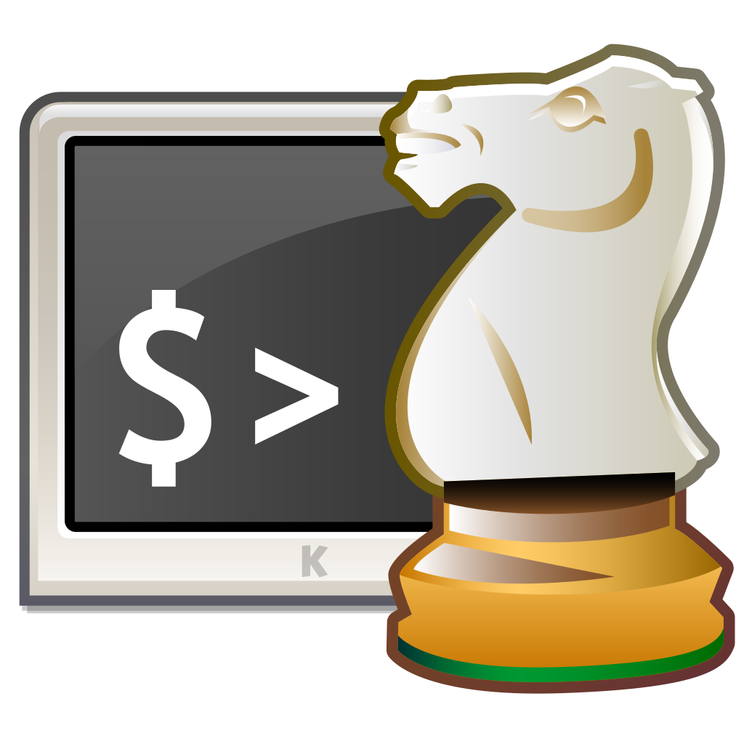
IBM - Deep Blue
First real chess engine to beat a reign world champion
Developed by IBM in 1989
It implemented the alpha beta search on very large-scale integration but in a brut-force method
Developers even denied it being an AI

Slide 7

Stockfish
Open source UCI chess engine
UCI = Universal Chess interface
As of 2018 it has become the world strongest chess entity not relying on AI
It uses Alpha-Beta-Search and Bitboards
Alpha-Beta-Search is a optimized version of the MiniMax Algorithm
A bitboard is a specialized bit array data structure where each bit corresponds to a game board space or piece.
Notes:
Alpha – Beta – Search aims to minimize the number of nodes that are evaluated by the minimax algortihm

Slide 8
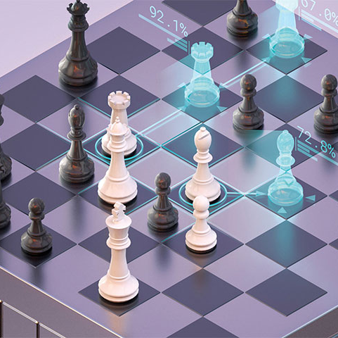
DeepMind - AlphaZero
Uses a Deep Neural Network in combination with a reinforcement learning algorithm
Deep Neural Networks are Neural Networks with two or more hidden layers
The trained network is used to guide the Monte-Carlo Tree Search Algorithm to select the most promising moves
In the beginning the algorithm does not know anything about the game besides the basic rules
After 4 hours of training it was able to beat Stockfish
Besides Chess AlphaZero also learned Shogi and Go
Notes:
Alpha go is Predecessor of Alpha Zero

Slide 9
Algortihm explained

Slide 10
Motnecarlo Tree Search
combines the precision of tree search with the generality of random sampling
Notes:
https://towardsdatascience.com/monte-carlo-tree-search-158a917a8baa

Slide 11
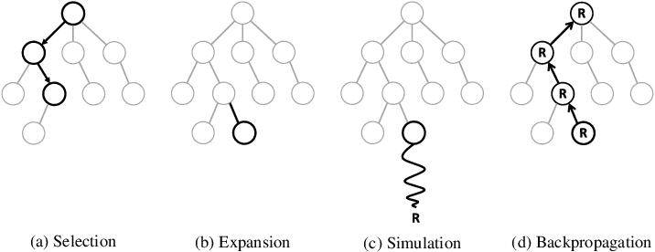
Monte Carlo Tree Search Ctd.

Slide 12
Procedure

Slide 13
Next Steps

Slide 14
Evaluation of Algortihm

Slide 15
Any Questions?

Slide 16

Thank you for your Attention
Killroy jr. Was here

