Slide 1
Chessmaster
A new way to play chess

Slide 2
Table of Content
Motivation
State of the Art
Algorithm
Procedure

Slide 3
Motivation

Slide 4
Main Goal
Create an powerful AI, that is capable to beat the best chessplayers in the world
Provide a platform to train against a strong opponent
Give the „real“ chessplayers the opportunity to step up their gametactics

Slide 5
State of the Art

Slide 6

Stockfish
Open source chess engine
Known as the / one of the most powerful chess engines
which does no rely on AI to predict moves.

Slide 7
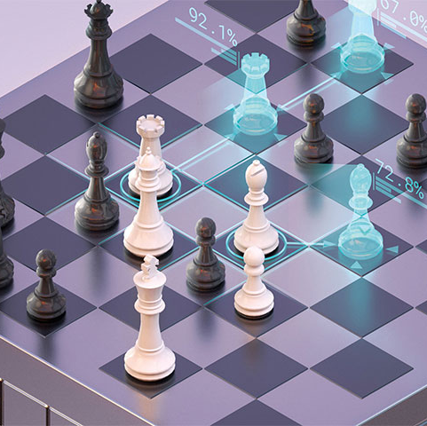
DeepMind - AlphaZero
Deepmind belpngs to google

Slide 8

Deepmind – AlphaGo
A next step for Deepmind was the game „GO“ which is a lot more complicated to compute than chess

Slide 9
Algortihm explained

Slide 10
Monte Carlo Tree Search
Statistical Algorithm for selecting the most promising moves (for chess)
Described in 2006 by Rémi Coulom
Used by various Ais, like AlphaZero or MuZero (by Deepmind)
Improved Efficiency above (true) Tree Search (Brute Force)
Prevents a large Exploration to Exploitation Trade off!
Used to find optimal moves
Notes:
https://towardsdatascience.com/monte-carlo-tree-search-158a917a8baa
émi Coulom (2006). "Efficient Selectivity and Backup Operators in Monte-Carlo Tree Search". Computers and Games, 5th International Conference

Slide 11
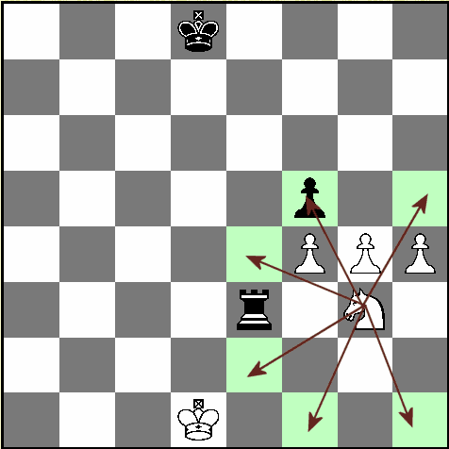
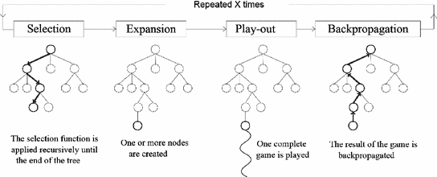


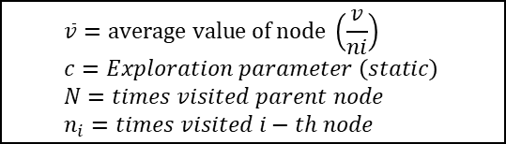

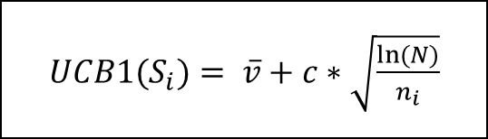




Monte Carlo Tree Search
${UCB1(S}_{i})= \overline{v}+c∗\sqrt{\frac{ln⁡(N)}{n_{i}}}$
$$\overline{v}=average value of node \left(\frac{v}{ni}\right) \\ c=Exploration parameter \left(static\right) \\ N=times visited parent node \\ n_{i}=times visited i−th node$$
Choose child node with highest value (UCB1-Algorithm)
Also called Rollout
$$s_{0}$$
$$s_{3}$$
$$s_{1}$$
$$s_{2}$$
$$s_{4}$$
$$s_{6}$$
After X times:
Return moves with probabilities
$$s_{7}$$
One new node per action (here 14)
Notes:
Exploitation: es werden suboptimale wege genommen, um zu sehen, ob es dort ein besseres ergebnis gibt!
Bei mcts mithilfe der funktion um den höchsten wrt zu berechen (siehe youtube video)
UCB1 = Upper Confident Bound | damit wird die anzahl der beusche bei einem knoten eingerechnet, sodass auch weniger erfolgsversprechende knoten eine chance haben! Darauf eingehen!
Playout heißt auch oft Exploration
Probabilities = probabilities to win the game with this move

Slide 12

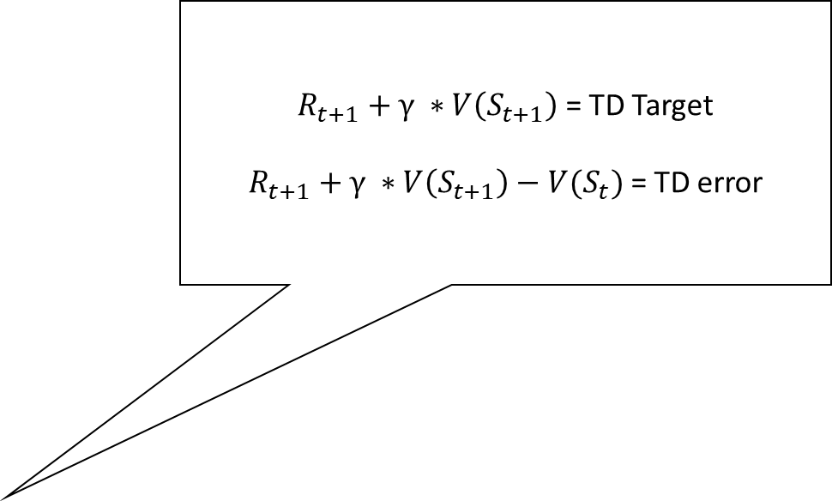
V-Learning (V-Network) | Temporal Difference Learning
$R_{t+1}+γ ∗V\left(S_{t+1}\right)$ = TD Target
$R_{t+1}+γ ∗V\left(S_{t+1}\right)−{V(S}_{t})$ = TD error
V = Value
V-Network
Neural Network (Chess agent)
Should output a policy π (to win the game)
Temporal Difference Learning
Model-Free Reinforcement Learning Algorithm
Learn from experience by incomplete episodes
${V(S}_{t})= {V(S}_{t})+ α ∗\left( G_{t} −{V(S}_{t}) \right)$
$α$ = Learning Rate $∈$ [0,1]
Simplest TD-Algorithm (TD(0))
$G_{t}= R_{t+1}+γ ∗V\left(S_{t+1}\right)$ | Estimated return (of next step)
${V(S}_{t})= {V(S}_{t})+ α ∗\left(R_{t+1}+γ ∗V\left(S_{t+1}\right)−{V(S}_{t}) \right)$
$R_{t}$ = Reward
$γ$ = discount factor $∈$ [0,1]
Notes:
Policy assigns to state s an optimal action
MCTS is used during training for the V-network
Model-dependent: Depends on transition tables (all possible answers for a question → very huge, long time to create)
Model-free: algorithm learns through actual experience
V-network uses temporal difference learning
V-network is updated by using TD-LEarning

Slide 13
Procedure

Slide 14
Next Steps

Slide 15
Evaluation of Algortihm

Slide 16
Any Questions?

Slide 17

Thank you for your Attention
Killroy jr. Was here

