Slide 1
Chessmaster
Der neue Weg Schach zu spielen

Slide 2
Table of Content
Motivation
State of the Art
Algorithm
Procedure

Slide 3
Motivation

Slide 5
State of the Art

Slide 6

Stockfish
Open source chess engine
Known as the / one of the most powerful chess engines
which does no rely on AI to predict moves.

Slide 7
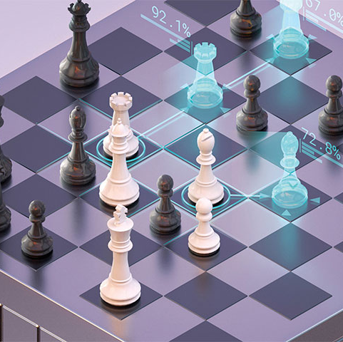
DeepMind - AlphaZero
Deepmind belpngs to google

Slide 8

Deepmind – AlphaGo
A next step for Deepmind was the game „GO“ which is a lot more complicated to compute than chess

Slide 9
Algortihm explained

Slide 10
Motnecarlo Tree Search
combines the precision of tree search with the generality of random sampling
Notes:
https://towardsdatascience.com/monte-carlo-tree-search-158a917a8baa

Slide 11
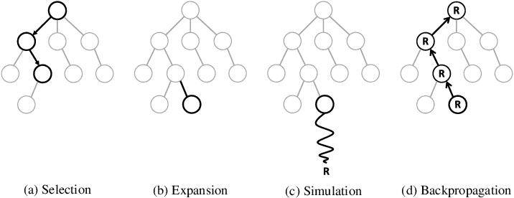
Monte Carlo Tree Search Ctd.

Slide 12
Procedure

Slide 13
Next Steps

Slide 14
Any Questions?

Slide 15

Thank you for your Attention

