Slide 1
Chessmaster
Der neue Weg Schach zu spielen

Slide 2

Inhalt
Motivation
State of the art
Algortihm explained
Vorgehensweise

Slide 3
Motivation

Slide 5
State of the Art

Slide 6
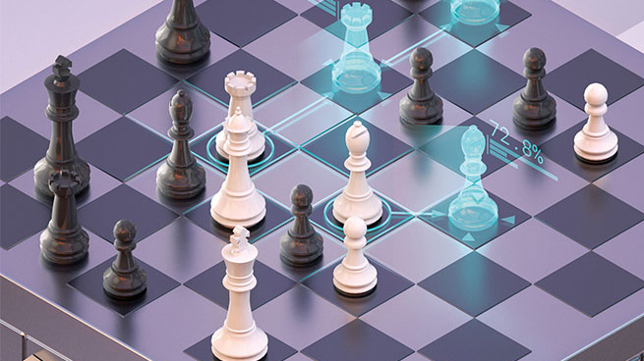
DeepMind - AlphaZero
2017

Slide 7
Algortihm explained

Slide 8
Motnecarlo Tree Search
combines the precision of tree search with the generality of random sampling

Slide 9
Vorgehensweise

