Slide 1
Chessmaster
A new way to play chess

Slide 2
Table of Content
Motivation
State of the Art
Algorithm
Procedure

Slide 3
Motivation

Slide 4
Main Goal
Create an powerful AI, that is capable to beat the best chessplayers in the world
Provide a platform to train against a strong opponent
Give the „real“ chessplayers the opportunity to step up their gametactics

Slide 5
State of the Art

Slide 6

IBM - Deep Blue
First real chess engine to beat a reign world champion
Developed by IBM in 1989
It implemented the alpha beta search on very large-scale integration but in a brut-force method
Developers even denied it being an AI

Slide 7

Stockfish
Open source UCI chess engine
UCI = Universal Chess interface
As of 2018 it has become the world strongest chess entity not relying on AI
It uses Alpha-Beta-Search and Bitboards
Alpha-Beta-Search is a optimized version of the MiniMax Algorithm
A bitboard is a specialized bit array data structure where each bit corresponds to a game board space or piece.

Slide 8
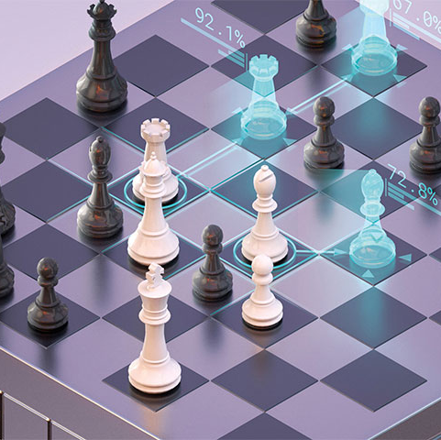
DeepMind - AlphaZero
Uses a Deep Neural Network in combination with a reinforcement learning algorithm
Deep Neural Networks are Neural Networks with two or more hidden layers
The trained network is used to guide the Monte-Carlo Tree Search Algorithm to select the most promising moves
In the beginning the algorithm does not know anything about the game besides the basic rules
After 4 hours of training it was able to beat Stockfish
Besides Chess AlphaZero also learned Shogi and Go

Slide 9
Algortihm explained

Slide 10
Monte Carlo Tree Search
Statistical Algorithm for selecting the most promising moves (for chess)
Described in 2006 by Rémi Coulom
Used by various Ais, like AlphaZero or MuZero (by Deepmind)
Improved Efficiency above (true) Tree Search (Brute Force)
Prevents a large Exploration to Exploitation Trade off!
Used to find optimal moves
Notes:
https://towardsdatascience.com/monte-carlo-tree-search-158a917a8baa
émi Coulom (2006). "Efficient Selectivity and Backup Operators in Monte-Carlo Tree Search". Computers and Games, 5th International Conference

Slide 11
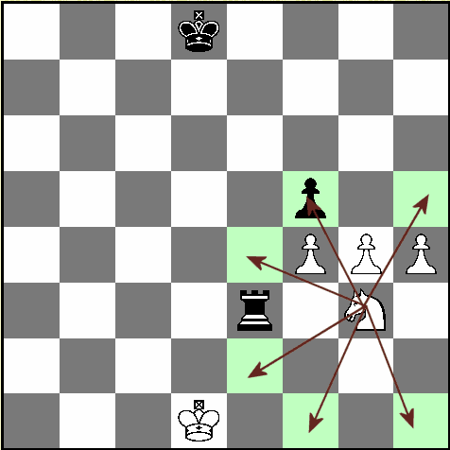
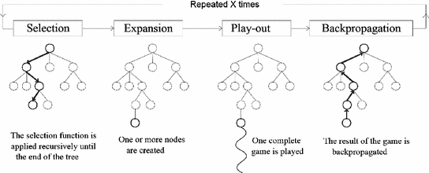


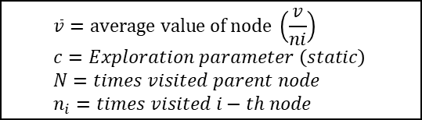

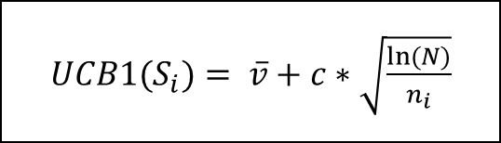




Monte Carlo Tree Search
${UCB1(S}_{i})= \overline{v}+c∗\sqrt{\frac{ln⁡(N)}{n_{i}}}$
$$\overline{v}=average value of node \left(\frac{v}{ni}\right) \\ c=Exploration parameter \left(static\right) \\ N=times visited parent node \\ n_{i}=times visited i−th node$$
Choose child node with highest value (UCB1-Algorithm)
Also called Rollout
$$s_{0}$$
$$s_{3}$$
$$s_{1}$$
$$s_{2}$$
$$s_{4}$$
$$s_{6}$$
After X times:
Return moves with probabilities
$$s_{7}$$
One new node per action (here 14)
Notes:
Exploitation: es werden suboptimale wege genommen, um zu sehen, ob es dort ein besseres ergebnis gibt!
Bei mcts mithilfe der funktion um den höchsten wrt zu berechen (siehe youtube video)
UCB1 = Upper Confident Bound | damit wird die anzahl der beusche bei einem knoten eingerechnet, sodass auch weniger erfolgsversprechende knoten eine chance haben! Darauf eingehen!
Playout heißt auch oft Exploration
Probabilities = probabilities to win the game with this move

Slide 12

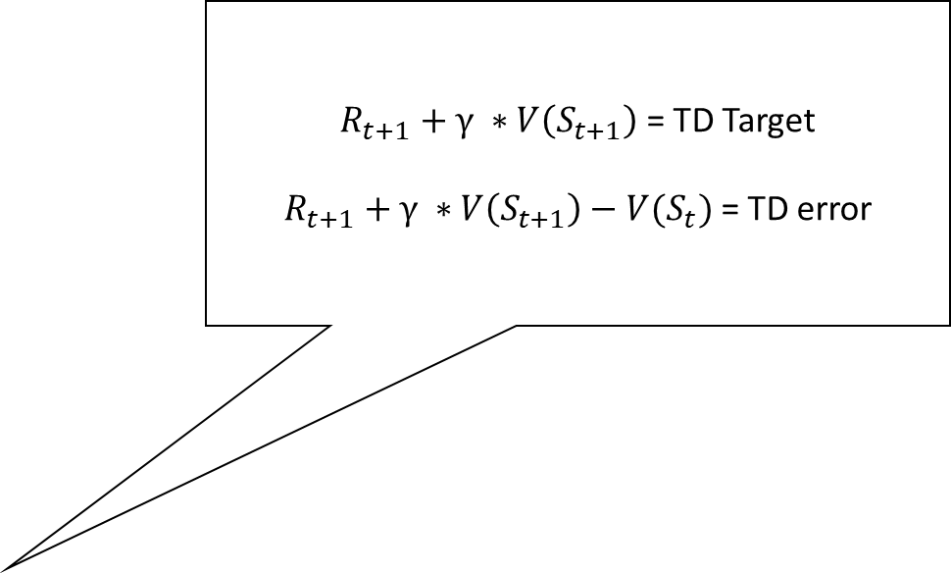
V-Learning (V-Network) | Temporal Difference Learning
$R_{t+1}+γ ∗V\left(S_{t+1}\right)$ = TD Target
$R_{t+1}+γ ∗V\left(S_{t+1}\right)−{V(S}_{t})$ = TD error
V = Value
V-Network
Neural Network (Chess agent)
Should output a policy π (to win the game)
Temporal Difference Learning
Model-Free Reinforcement Learning Algorithm
Learn from experience by incomplete episodes
${V(S}_{t})= {V(S}_{t})+ α ∗\left( G_{t} −{V(S}_{t}) \right)$
$α$ = Learning Rate $∈$ [0,1]
Simplest TD-Algorithm (TD(0))
$G_{t}= R_{t+1}+γ ∗V\left(S_{t+1}\right)$ | Estimated return (of next step)
${V(S}_{t})= {V(S}_{t})+ α ∗\left(R_{t+1}+γ ∗V\left(S_{t+1}\right)−{V(S}_{t}) \right)$
$R_{t}$ = Reward
$γ$ = discount factor $∈$ [0,1]
Notes:
Policy assigns to state s an optimal action
MCTS is used during training for the V-network
Model-dependent: Depends on transition tables (all possible answers for a question → very huge, long time to create)
Model-free: algorithm learns through actual experience
V-network uses temporal difference learning
V-network is updated by using TD-LEarning

Slide 13
Procedure

Slide 14
Next Steps
Comparison of the evaluation possibilities of the algorithm
Human versus computer (Graphical user interface)
Summarize scientific papers
Preparation of the elaboration

Slide 15
Evaluation of Algortihm
Elo rating system (Comparison of two chess players)
Evaluation of the chess game
Evaluation of Position
Material on the board
Pieces Activity

Slide 16
Any Questions?

Slide 17

Thank you for your Attention
Killroy jr. Was here

