Slide 1
Chessmaster
A new way to play chess

Slide 2
Table of Content
Motivation
State of the Art
Algorithm
Procedure

Slide 3
Motivation

Slide 5
State of the Art

Slide 6

Stockfish
Open source chess engine
Known as the / one of the most powerful chess engines
which does no rely on AI to predict moves.

Slide 7
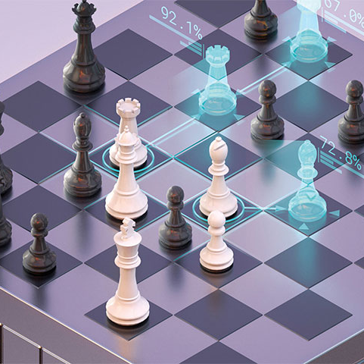
DeepMind - AlphaZero
Deepmind belpngs to google

Slide 8

Deepmind – AlphaGo
A next step for Deepmind was the game „GO“ which is a lot more complicated to compute than chess

Slide 9
Algortihm explained

Slide 10
Motnecarlo Tree Search
combines the precision of tree search with the generality of random sampling
Notes:
https://towardsdatascience.com/monte-carlo-tree-search-158a917a8baa

Slide 11
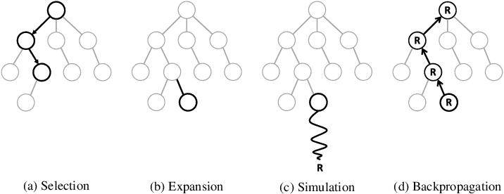
Monte Carlo Tree Search Ctd.

Slide 12
Procedure

Slide 13
Next Steps

Slide 14
Evaluation of Algortihm

Slide 15
Any Questions?

Slide 16

Thank you for your Attention
Killroy jr. Was here

