Slide 1

iNASB iNtelligent Audio Switch Box i{Nikolay, Artyom, Simon, Brecht}
HAMR 2014 @ ISMIR

Slide 2
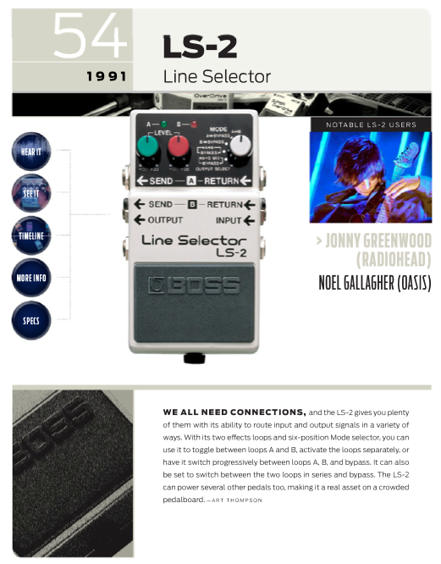
Concept
Line switcher plugin
Auto-switch based on audio feature
Smooth transition between channels (cross-fade)
Learns ‘A’ and ‘B’ examples and classifies accordingly

Slide 3
Tools
C++
Steinberg VST SDK
JUCE plugin development toolkit
Three different platform and IDEs
git (Atlassian BitBucket and SourceTree)
Testing: Audacity, Cockos Reaper, Apple Logic Pro X

Slide 4
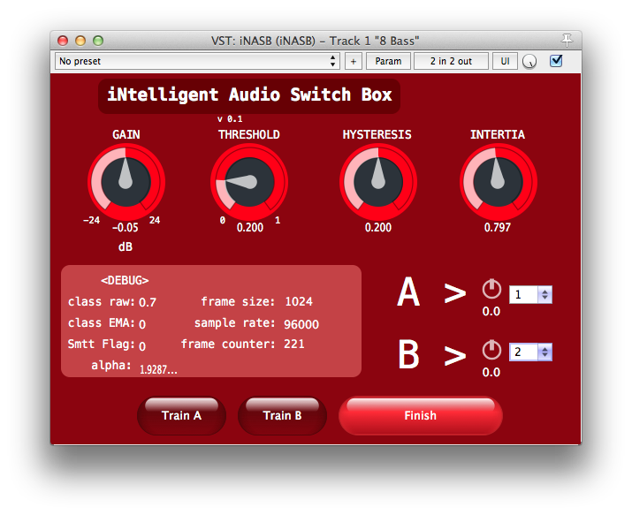
Overview

Slide 5
Implementation: Smoothing
Schmitt trigger
Low pass filter

Slide 6
Implementation: Feature extraction
Based on level: RMS
Based on spectrum: four common spectral features

Slide 7
Implementation: Machine learning

Slide 8
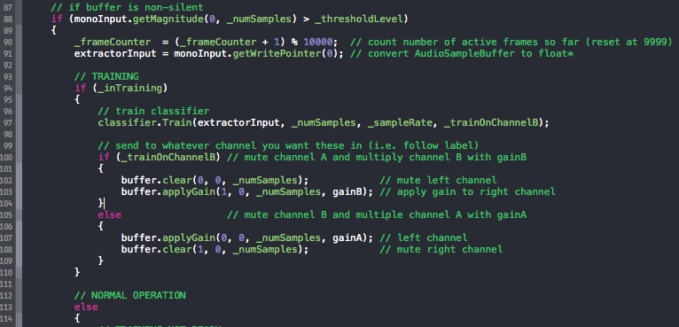
Documentation
BitBucket wiki (incl. this Powerpoint)
Extensive commenting on code
Including test audio
Extensive sensible commenting

