Slide 1
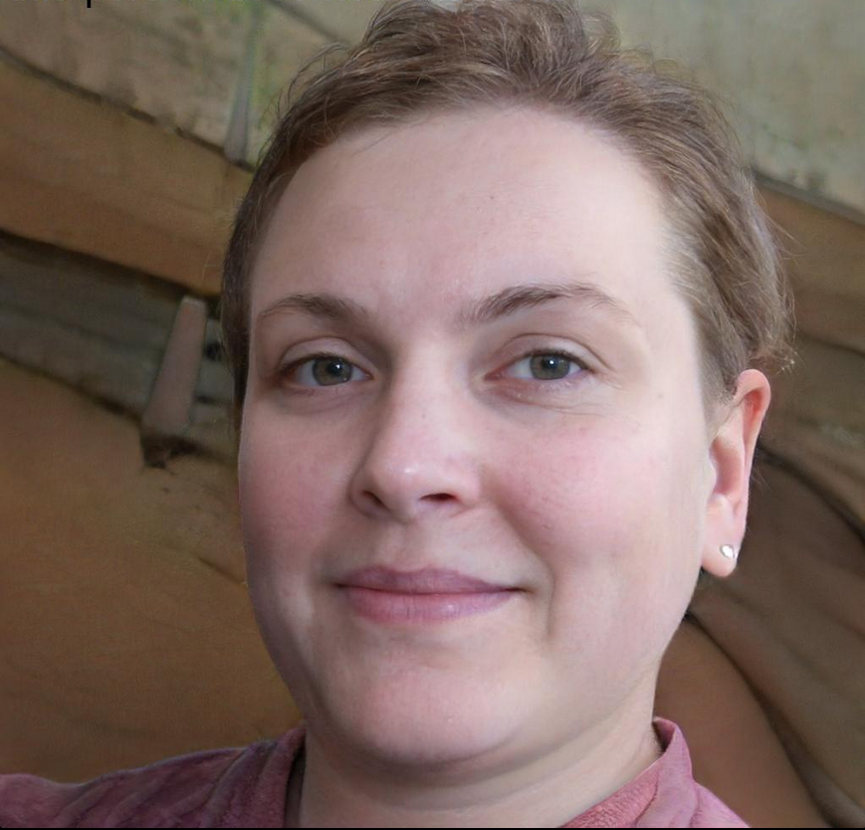
Name: Sarah
Age: 35
Occupation: Owner of a medium-sized grain farm
Location: Rural area in the East Europe
Background:
Sarah is a third-generation farmer who took over the family farm after her father's retirement. She has been running the farm for the past five years and has faced several challenges, including crop damage from wild animals such as deer and raccoons. The farm is located in a rural area with dense forest nearby, which makes it a prime location for wild animals. Sarah is constantly worried about crop damage and has tried several methods to keep wild animals away, including fences and scare tactics, but with little success.
Goals:
Sarah's main goal is to protect her crops and increase her yield without harming wild animals. She is also interested in finding a cost-effective and efficient solution to prevent crop damage.
Challenges:
High cost of traditional animal control methods and the difficulty of monitoring the entire farm for animal activity.
Values:
Sarah values sustainable farming practices and is committed to minimizing harm to the environment and wildlife. She is also interested in innovative and technology-driven solutions that can help her achieve her goals.

