Slide 1
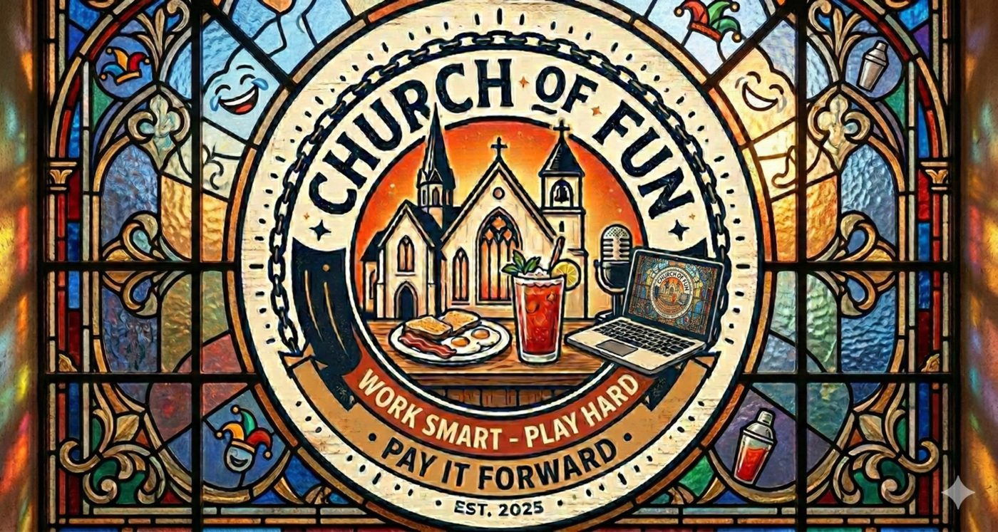
CHURCH OF FUN
A shared workspace for solopreneurs who build, record, and automate.
Work Smart • Play Hard • Pay It Forward
Coworking • Meeting rooms • Podcast & video studios • Vibe coding nights • AI Lab
Work Smart
Play Hard
Pay It Forward
Pitch Deck

Slide 2
The problem
Solopreneurs need momentum, legitimacy, community, and AI leverage — but today it’s fragmented.
Fragmented tools & spaces
Execution gap
• Coworking gives desks, not outcomes
• Studios are separate (and expensive)
• AI learning is online, lonely, and confusing
• People know AI is useful… but don’t have workflows
• Overwhelm → procrastination → churn
• No place to get hands-on help fast
The real unmet need
• A “creator operations hub” where work, recording, and automation happen in one loop
• A social environment that makes showing up feel easy (food/drinks + community)
• Practical classes that end with something that actually runs
Church of Fun • Work Smart • Play Hard • Pay It Forward

Slide 3
The solution
Church of Fun is the clubhouse where solopreneurs ship projects and publish proof.
Work
Meet
• Hot desks + dedicated desks
• Fast, reliable internet
• Quiet zones + collaboration zones
• Zoom-proof meeting rooms
• Client-ready lighting & audio
• Workshops + masterminds
Record
Automate
• Podcast booths (push-button)
• Video studios (multi-cam)
• Editing support options
• Hands-on AI workflow classes
• Vibe coding nights: idea → app
• AI Lab for private local models
Church of Fun • Work Smart • Play Hard • Pay It Forward

Slide 4
The space
A modular layout that scales: start lean, expand as utilization proves demand.
Work Hall
Meeting Sanctuaries
Social Bar (coffee + pints)
Quiet Nooks
Podcast Confessionals
Creator Studios
Workshop / Vibe Coding Classroom
AI Lab (GPU workstations + private workflows)
Signature loop: Work → Record → Publish → Automate
Church of Fun • Work Smart • Play Hard • Pay It Forward

Slide 5
Vibe coding nights
Come in with an idea. Leave with a working app — deployed or running locally.
How the night works (2.5–3 hrs)
Apps that reliably ship
• Pick a small, winnable app shape (3 screens max)
• “Spec on a napkin” → prompts → build sprint
• Deploy + demo (the dopamine ritual)
• Templates + checklists to take home
• Lead tracker + follow-up generator
• Client intake → summary → next steps
• Podcast pipeline: transcript → titles → show notes
• FAQ bot widget for a business site
Guardrails that prevent chaos
• One “happy-path” stack per session (no tool soup)
• Tiny safety ritual: testing, auth, secrets, deployment checklist
• Office-hours + pints for debugging and upgrades
Church of Fun • Work Smart • Play Hard • Pay It Forward

Slide 6
Beer & Bots classes
Practical, hands-on sessions where every attendee leaves with a workflow that runs.
Workflow Labs (beginner-friendly)
Office Hours + Pints
• Draft emails from bullet points
• Meeting notes → follow-ups → tasks
• PDF folder → searchable knowledge bot
• Bring broken automations
• Get unstuck with mentors
• Leave with a fixed system
Curriculum ladder (retention engine)
• Level 1: AI basics for real life
• Level 2: automation (triggers, routing, error handling)
• Level 3: knowledge + RAG (retrieve your stuff, not guesses)
• Level 4: local/private AI (for sensitive work)
Church of Fun • Work Smart • Play Hard • Pay It Forward

Slide 7
AI Lab
Private, bookable compute for local models and heavy workflows — without becoming an IT person.
What members can do
How we keep it sane
• Run local LLMs for privacy-sensitive work
• Transcription, summarization, content repurposing
• RAG: search your own docs + answer accurately
• GPU acceleration for rendering & generation
• Book GPU slots like rooms
• Standardized “reset” environments
• Clear support boundaries (productized, not bespoke)
• Optional onboarding packages
Premium add-on that increases stickiness
• Attracts builders + privacy-conscious professionals
• Creates upsell path from classes → memberships → AI Lab
• Enables “done-with-you” workflow implementation services
Church of Fun • Work Smart • Play Hard • Pay It Forward

Slide 8
Who it’s for
People who sell expertise — and need a repeatable system to create, market, and deliver.
Primary members
Why they join
• Solopreneurs & consultants
• Creators (podcasters, YouTubers, educators)
• Agents & advisors (insurance, real estate, finance)
• Small teams (2–6 people) needing client-ready space
• Momentum: show up → work happens
• Legitimacy: meet & record like a pro
• Community: smart friends, not doomscrolling
• Leverage: automation & AI workflows
Local-first model: start with one location, prove utilization + unit economics, then replicate.
Church of Fun • Work Smart • Play Hard • Pay It Forward

Slide 9
Business model
Base membership + high-margin add-ons (rooms, studios, classes, compute).
Membership tiers (example)
Add-ons (where margin lives)
• Part-time: 8 days/month + community access
• Full-time: unlimited desk access
• Dedicated: reserved desk + storage
• Team: small-team bundle
• Meeting room credits
• Podcast booth hours
• Video studio hours
• Vibe coding nights / classes
• AI Lab GPU time
Services upsell (optional)
• Workflow implementation (“done-with-you”)
• Editing + content repurposing packages
• AI onboarding: private knowledge bots + automations
Church of Fun • Work Smart • Play Hard • Pay It Forward

Slide 10
Go-to-market
Community-led growth powered by classes and a content flywheel.
Launch playbook
Partnership channels
• Founding member cohort (limited spots)
• Weekly Beer & Bots + Vibe Coding Night
• Partner nights with local businesses
• Open house demos: “watch someone ship an app”
• Local creators & podcasts
• Chambers, meetup groups, accelerators
• Software communities (No-code, dev, AI)
• Brewery/coffee collaborations
Content flywheel
• Members record at Church of Fun → publish
• Their content advertises the space
• New members join → more content + classes → more demand
Church of Fun • Work Smart • Play Hard • Pay It Forward

Slide 11
Phased rollout
Start with the backbone, then add differentiated capacity as utilization proves demand.
Phase 1 (MVP)
Phase 2
Phase 3
• Desk + meeting rooms
• Coffee/tea bar
• 1 podcast booth
• Weekly classes
• 2nd booth + 1 video studio
• Membership tiers + credits
• Office hours nights
• Partner events
• AI Lab (GPU pool)
• Workflow onboarding packages
• Replicable playbook
• Second location criteria
Church of Fun • Work Smart • Play Hard • Pay It Forward

Slide 12
The ask
Seeking the right partners to launch the first Church of Fun location.
We’re looking for:
• A great location (or landlord partner)
• Seed capital for buildout (studios + core infrastructure)
• Strategic partners: creators, local business groups, tool communities
• Founding members ready to help shape the culture
Use of funds (example): buildout, sound treatment, studio gear, furniture, booking system, initial marketing.
Church of Fun
Work Smart • Play Hard • Pay It Forward

