Slide 1

Predicting Customer Churn: SyriaTel Telecom Company
Group 9: Alan,Brenda,Jackson,Jared,Rael,Peggy

Slide 2

Overview
With the company experiencing high customer churn, this project aims to develop a predictive model to identify customers likely to churn and identify proactive measures to retain the customers.

Slide 3
Objectives
Identify the key factors influencing customer churn
Develop a predictive ML model to identify customers who are likely to churn and evaluate its performance.
Provide insights and recommendations for effective churn management

Slide 4

Data
The SyriaTel dataset used for this project contains information of 3,333 customers including their account length,usage patters and customer service interactions.
The dataset did not have any missing values
By analyzing this data we developed a predictive model that can identify factors that are likely to make customers churn

Slide 5
Methodology
EDA
Modelling
Evaluation
Exploratory Data Analysis used to gain insights into the data and identify the key factors influencing customer churn
A predictive model developed using a variety of machine learning algorithms
The performance of the predictive models were evaluated using accuracy,precision,recall and F-1 Score

Slide 6
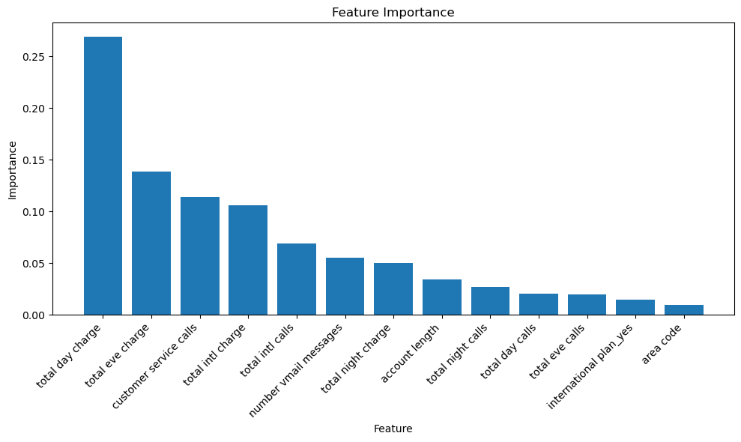
Key Factors Affecting Customer Churn
The most important features for predicting churn are:
Total day charge
Customer service call
Total Evening charge
Total International charge

Slide 7
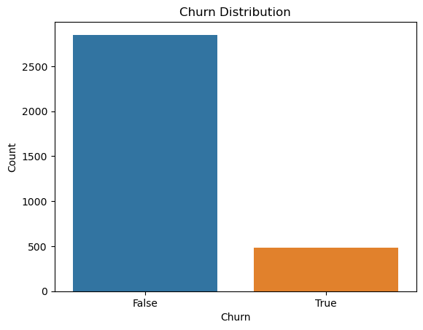
Univariate Analysis: Churn Distribution
The majority of customers in the dataset did not churn (represented by 'False' in the 'churn' variable).

Slide 8
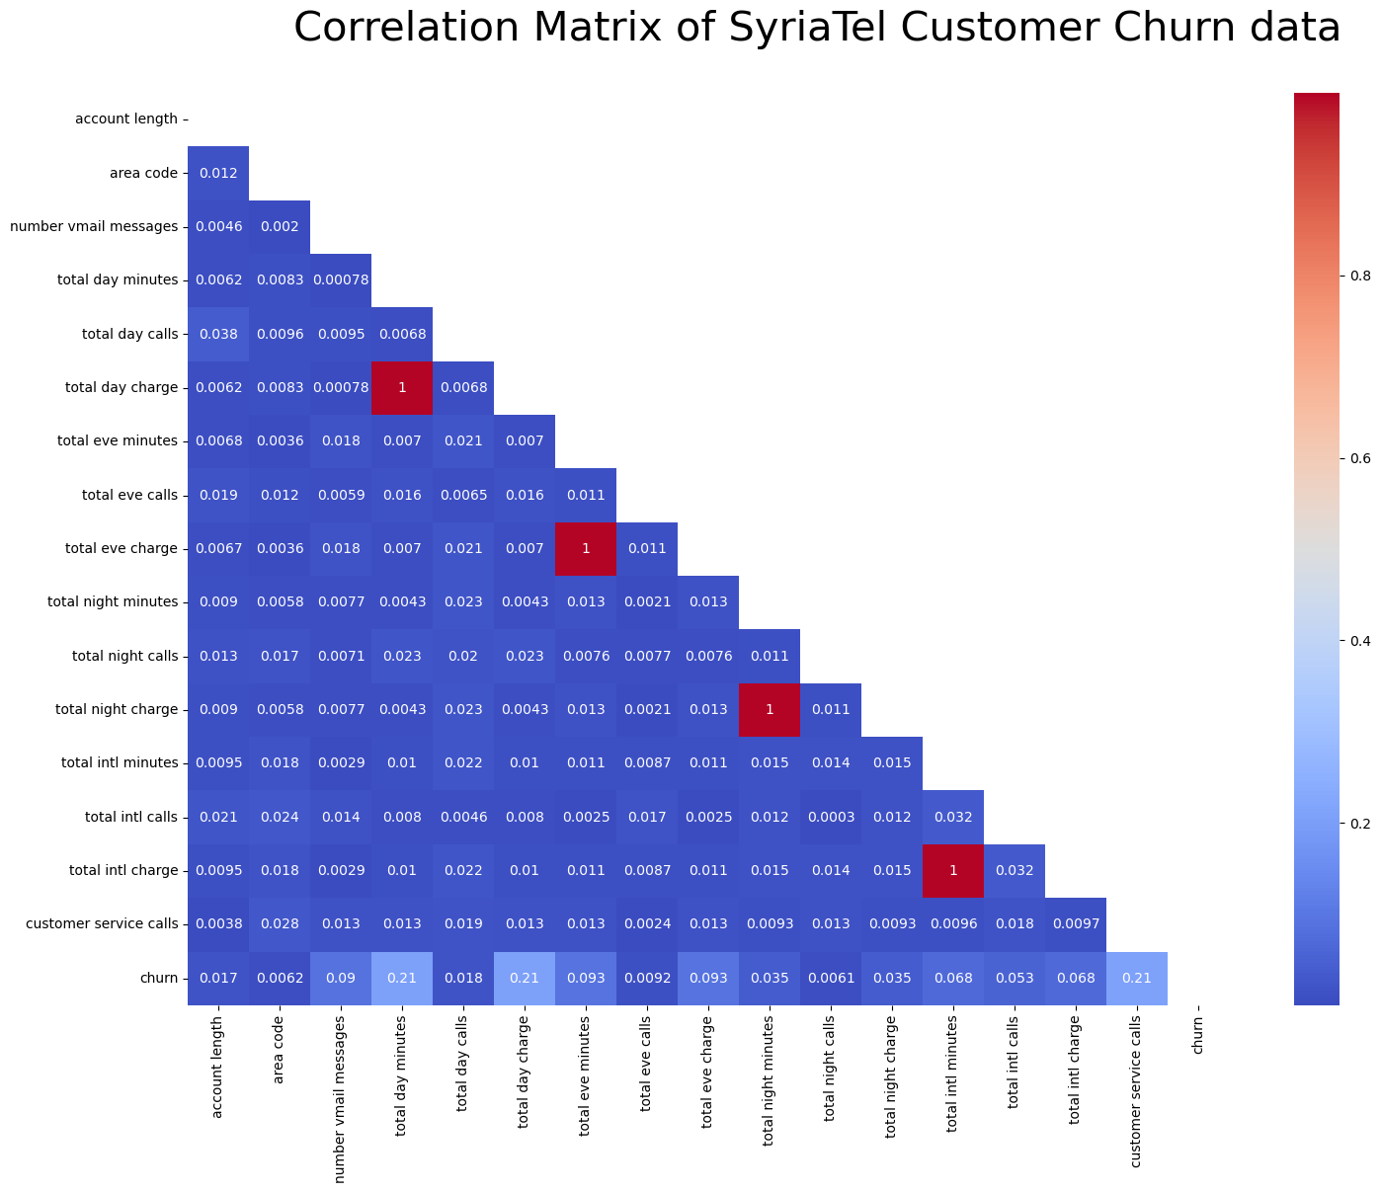
Bivariate Analysis: Dealing with Multicollinearity
Due to high multicollinearity between each other, we dropped the following columns:
total day minutes
total eve minutes
Total intl minutes
total night minutes

Slide 9

Predictive Modelling & Model Evaluation
Model | Accuracy | Precision | Recall | F1 Score | ROC AUC Score
Logistic Regression | 0.850 | 0.515 | 0.168 | 0.254 | 0.799
K-Nearest Neighbors | 0.855 | 1.000 | 0.040 | 0.076 | 0.520
Decision Trees | 0.930 | 0.781 | 0.743 | 0.761 | 0.853
Random Forest | 0.919 | 1.000 | 0.465 | 0.635 | 0.733

Slide 10

Conclusion
The number of churned customers is noticeably smaller compared to the number of customers who did not churn
The most important feature for predicting churn is total day charge. This means that the amount of money a customer spends on day calls is a strong predictor of whether they will churn.
The second most important feature is customer service calls. This means that customers who make more customer service calls are more likely to churn.
Other important features include total eve charge, total intl charge, and international plan. These features all relate to the amount of money a customer spends on their phone service, which is a strong predictor of churn.
The least important features are account length, area code, and number vmail messages. These features do not seem to be very predictive of churn.

Slide 11

Recommendations
Based on our findings, these are our recommendations in order to reduce customer churn::
Reduce the amount of money customers spend on day calls: SyriaTel could offer discounts on day calls, or they could offer a package that includes unlimited day calls.
Reduce the number of customer service calls: SyriaTel could create a knowledge base where customers can find answers to their questions, or they could offer live chat support.
Consider offering international plans. Customers who have international plans are less likely to churn. This could be done by offering more affordable international plans, or by making it easier for customers to sign up for international plans.
Ignore account length, area code, and number vmail messages. These features are not very predictive of churn, so there is no need to focus on them.

Slide 12

Thank you!
Do you have any questions?
Contact Information:
Peggy Obam : https://www.linkedin.com/in/peggy-obam-b96b50187
Brenda Kinoti: https://www.linkedin.com/in/brenda-ntinyari-112007140/
Alan Omondi: https://www.linkedin.com/in/alan-omondi-6875a4148/
Rael Ndonye: https://www.linkedin.com/in/rael-ndonye-655255117/
Jared Bii:https://www.linkedin.com/in/jared-kiprotich-bii
Jackson Maina:https://www.linkedin.com/in/jackson-maina-444977146

