Slide 1
The Effects of Alcohol on the Consumption of Hard Drugs: Regression Discontinuity Evidence from the National Longitudinal Study of Youth, 1997 Monica Deza (2015)

Slide 2
Motivation
Research Question: Are those who heavily drink alcohol more likely to use hard drugs when they turn 21?
Importance: Alcohol is popular among young people so its important for policymakers to understand how drinking alcohol might influence other risky behaviors such as using hard drugs
Notes:
Your 21st birthday is an important milestone because this is the day when Americans are able to drink legally. This leads up to the research question of this paper is: Are those who heavily drink alcohol more likely to use hard drugs when they turn 21? And the reason why this question is importance is because alcohol is popular among young people so its important for policymakers to understand how drinking alcohol might influence other risky behaviors such as using hard drugs.

Slide 3
Overview of Paper
This paper studies the effect of an increase in alcohol consumption as the result of the minimum legal drinking age on using hard drugs.
Regression Discontinuity Design Approach
Study conduced by interviewer through an in-person computer survey or telephone survey
Notes:
To give a quick overview, this paper studies the effect of an increase in alcohol consumption as the result of the minimum legal drinking age on using hard drugs. A regression discontinuity design approach is used to accomplish this task. Lastly, the study is conducted by an interviewer through an in-person computer survey or telephone survey.

Slide 4
Literature Review
Research link between alcohol and marijuana:
Dinardo & Lemieux (2001)
Vehicle accident fatalities - Wagenaar & Toomey (2002)
Effects of alcohol consumption on:
Arrests - Carpenter & Dobkin (2010)
Mortality – Carpenter (2009)
Marijuana & cigarette consumption – Yoruk & Yoruk (2011)
Notes:
We can see that the literature has analyzed the impact of alcohol on a wide range of topics, such as vehicle accident fatalities, arrests, and mortality, but more focus has been given to study the link between alcohol and marijuana. Now what sets this study apart from the rest is that it focuses on the link between alcohol and hard drugs, which often is used more commonly with alcohol than with marijuana. And it looks at three different degrees of using hard drugs such as the whether individuals use it or not, how frequently they use it, and just being initiated into it.

Slide 5
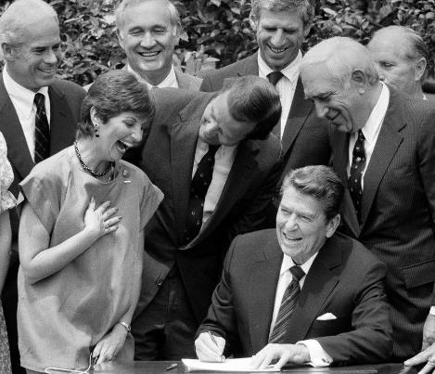
Background Information
1983 - Regan administration
Incentives to raise MLDA from 18 to 21
MLDA changed from 18 to 21 in different states at different times
1988 – All states adopted a MLDA of 21
Notes:
Now lets take a look at some background information on the topic. Changes in the state level minimum legal drinking age started in 1983 when the Regan administration began to offer incentives to increase the minimum legal drinking age from 18 to 21. So the minimum legal drinking age changed from 18 to 21 in different states at different times. By 1988, all states adopted 21 as the minimum legal drinking age.

Slide 6
Data & Experiment Overview
National Longitudinal Survey of Youth 1997 (NLSY 97)
Data gathered on 13 waves between 1997 and 2009
National representative sample
8,984 men & women
1st wave as of Dec. 1996: 12-16 yrs. old
Last wave 2009: 24-30 yrs. old
Includes:
Demographics
Education
College enrollment
Military service
Doesn’t have exact date of birth
Notes:
So the data was collected from the 1997 National Longitudinal Survey of Youth or (NLSY97). The data was gathered on 13 waves between 1997 and 2009. In this case waves just mean that the survey was repeated 2 or more times, for example once a year for 5 years in a row in which the same participants are tracked over time and asked some or all of the same questions in each wave. In our case each wave was repeated each year for 12 years in a row. They took a national representative sample of 8,984 men and women. The first wave consisted of 12-16 year olds in December 1996, while the last wave was in 2009 and consisted of 24 to 30 year olds. Mind you, this analysis is restricted to periods when young adults are between 19 and 23. The survey also includes information on demographics, education, college enrollment, and military service. The public dataset doesn’t have the exact date of birth. It only has the month and year of birth and age in months.

Slide 7
Data & Experiment Overview Cont.
Examples of Questions:
Used hard drugs? How often? Magnitude?
Risky behaviors?
Criminal activity?
Prior to interview
Used alcohol? (year prior)
Frequency? (last month)
Intensity? (past month)
Binge drinking (last month)
Computer-Assisted Personal Interview (CAPI)
Audio Computer-Assisted Self-Interview (ACASI)
Telephone interviews depending on distance
Notes:
Some examples of questions that participants were asked were if they used hard drugs at all? How often did they do so? To what degree did they do this? Did they engage in risky behaviors or criminal activity? And of course there are also questions related to alcohol use such as did you have alcohol the year prior to the interview? How many days did you have at last one alcoholic drink last month? How many drinks did you have on the days you had alcohol? Did you binge drink at all? Meaning did you have 5 or more drinks on one occasion last month? The surveys are taken using in-person computer interviews and depending on the distance participants lived telephone interviews were conducted.

Slide 8
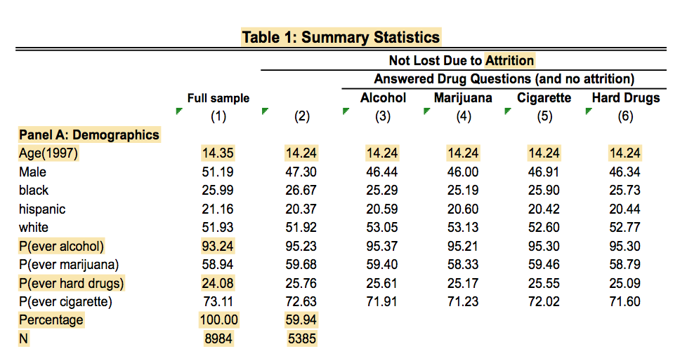
Summary Statistics
Notes:
Now, let’s dive into the summary statistics. There was a lot going on so I decided to break up each panel into 4 slides so that we can zero in on each one and important highlighted points in yellow. First, lets zero in on panel A, which includes demographics of different subsamples. The 1st column represents the full sample, so, it includes all 8,984 participants. Column 2 includes all participants that were not lost to attrition, so 5,385 and attrition just refers to partcipants who dropped out of the study, which is often common in longitudinal studies. Columns 3, 4, and 5 represent the participants who were not lost to attrition and didn`t avoid questions related to alcohol, marijuana, cigarettes and hard drug consumption. So approximately, 40% of the participants were lost and 60% retained of the original 100% in the full sample. A couple of things that are important to note are that the avg. starting age of participants when the study first started in 1997 was around 14, which is pretty young. Another aspect that is pretty significant is the percentage of the individuals who ever used alcohol in the full sample is 93.24% which makes sense since most people will drink alcohol when they turn 21. Now those who ever used hard drugs is a lot smaller at 24% and this makes sense because when individuals go into the labor market using hard drugs often isn’t tolerated and jobs typically screen potential employees for drugs as opposed to a college environment. So it makes sense that the percentage of hard drug use would be much lower especially with age.

Slide 9
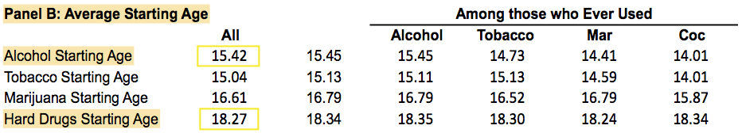
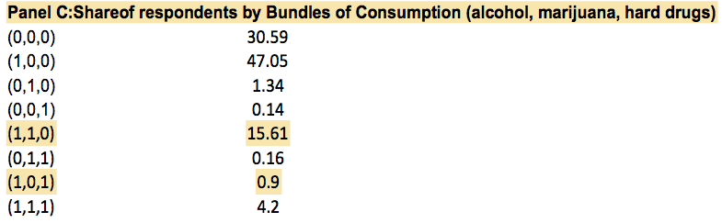
Summary Statistics Cont.
Notes:
When we go to panel B once again same as before. The first column contains the full sample and the second column consists of those not lost to attrition. Now column 3, 4, 5, and 6 correspond to those who ever used alcohol, tobacco, marijuana, and hard drugs such as cocaine whether they were lost to attrition or not. We can see pretty quickly that the average starting age is much younger than 21 with the average starting age of alcohol being approximately 15 and average starting age if using hard drugs is around 18.
In panel C, we have the share of participants who consumed a particular substance bundle where a value of 1 indicates the substance used. If the 1 appears 1st then it means that alcohol was used, if the 1 appears 2nd then marijuana was used, and if the 1 appears last then hard drugs were used. If more than 1, 1 appear then the substances were used together. We can see here that the most popular is 15.61% and the 2nd most popular bundle is alcohol and hard drugs at 0.9%.

Slide 10
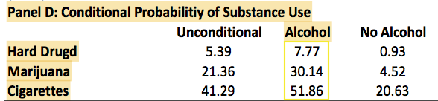
Summary Statistics Cont.
Notes:
Last we have panel D which shows the probability of consuming hard drugs, marijuana, and cigarettes conditional on drinking alcohol and not drinking alcohol. Overall, we can see that substance use increases with alcohol.

Slide 11



Alcohol and Hard Drug Consumption
Basic Model:
Y_{it} – Hard drug consumption for individual i in year t
– Decrease in the cost of accessing alcohol at age 21
D_{it} – Indicator function of individual i being at least 21 years old at the date of the interview in year t
D_{it} = 1[A ≥ 21]
- Polynomial of age centered variable
= (a_{it} – 21)
Interacted with indicator D_{it}
T_{t} - Time fixed effect for year
- Unobserved component
Notes:
Now here’s our basic model with no covariates. To reiterate this study uses a regression discontinuity design approach with three specification. Each specification clusters the standard errors at the individual level and includes year fixed effects. So this is the first specification which uses an OLS model and creates three sub-models using 1st order, 2nd order, and 3rd order polynomials. The reason why we use a polynomial and different orders is to account for non-linear relationships between the dependent and independent variable. For example, in our case substance use may increase with age up to a point and then decline. So Yit is our outcome of interest which is hard drug consumption for individual i in year t. Delta is the decreased cost of accessing alcohol at age 21. Dit is an indicator function of individual I being at least 21 years old at the date of the interview in year t. This function here represents a polynomial of the age centered variable at age 21. The reason why centering the variable is so important is because if we didn’t the intercept would be equal to 0 which wouldn’t make much sense in this case to have 0 as an age. Lastly, T is our time fixed effect and epsilon is our unobserved component.

Slide 12


Specification 2 & 3
Specification 2:
X_{it} – Demographics such as gender & race
X_{i} – Enrolled in 2 or 4 year college, or grad school, or employed, or serving in military at the time of interview or year prior
birthday_{it} - Interview coincided with birthday month
Specification 3:
Includes Fixed effects
Notes:
There are two other specifications which I am going to cover these really quickly because they are important in understanding the results we are going to talk about in a few minutes. Unfortunately, I will not be able to cover every graph and table that the study covers for the sake of time, but I will talk about the ones that yielded the most significant results. The second specification includes some possible determinants that could influence drug usage. The new variables that were added are Xi which represents demographics such as gender and race, Xit represents whether the participant is enrolled in a 2-year college, 4-year college, or grad school, is employed, or serving in the military at the time of the interview or the year prior to the interview. The variable birthday represents whether or not the interview coincided with the participant’s birthday month to account for celebratory effects, For the third and final specification. The demographics variable Xi is not included, but it accounts for fixed effects.

Slide 13
Empirical Strategy
Sharp RDD
Cutoff - Minimum Legal Drinking Age (MLDA)
Running Variable – Age
Treatment – Ability to drink legally
8 bins on each side of the 21 age cutoff
Restricted between the ages of 19 and 23
Notes:
Here’s a preview of some quick notes to be aware of before we jump into the regression discontinuity graphs. So we are going to be looking at different sharp RDD models. The cutoff point is the minimum legal drinking age which is 21. Our running variable is age. The treatment is the ability to drink legally. There are 8 bins on each side of the 21 age cutoff. And for our study purposes the ages are going to be restricted between 19 and 24.

Slide 14
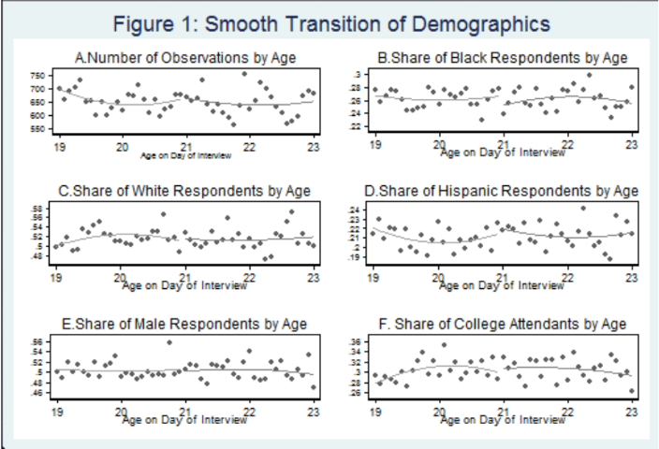
Results: Figure 1
Notes:
So now let’s jump into some figures. The purpose of the first figure is to graphically show that there is a smooth transition of demographics and college attendance through the 21 age cutoff. We see that there really isn’t any big jump around the 21 age cutoff point. Because these other determinants of alcohol consumption and hard drug use transition smoothly before and ager age 21 this means that we can attribute a jump in any particular risky behavior such as hard drug consumption to the discontinuous increase in alcohol consumption.

Slide 15
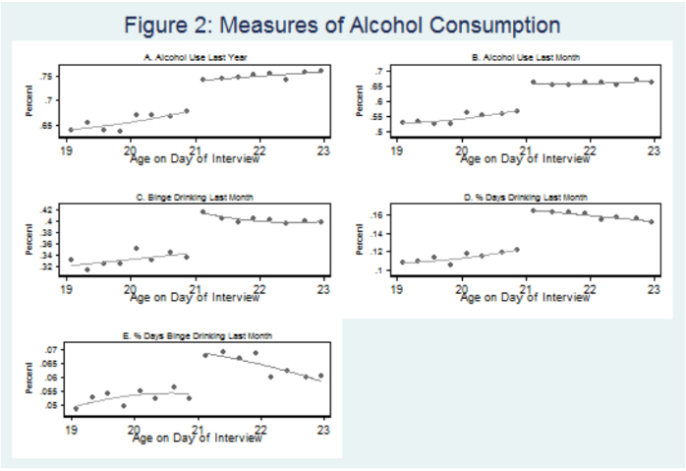
Results: Figure 2
Notes:
Now we are taking about one of the more important figures in this study which is figure 2 which showcases different measures of alcohol consumption in panels A through E. We have alcohol use last year, alcohol use last month, binge drinking last month, meaning having 5 or more drinks on one occasion at least one day in the past month, share of days drinking last month (which is where we take the number of days that participants drank alcohol and divided it by 30), and the share of days binge drinking last month which we once again take how many days participant said they engaged in binge drinking and divided it by 30. In each of these panels we can automatically see a drastic increase in alcohol consumption by these huge discontinuity jumps. And this makes sense since 21 is the legal drinking age. In panel A we can see that there a discontinuous increase from approximately 68% to 75%. Similarly in panel B, consuming alcohol the previous month spiked from about 57% to 65%.

Slide 16
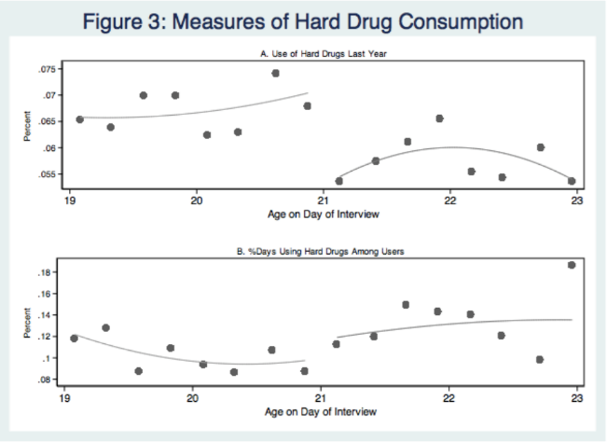
Results: Figure 3
Notes:
Now panel A of figure 3 is really important and interesting because we see a discontinuous decrease from approximately 7% to 5.5% in the consumption of hard drugs before and after the 21 age cutoff. One of the big reasons for this is that the workplace environment often doesn’t allow employees to consume hard drugs and requires potential employees to take drug tests, which is a different setting compared to a college setting. However, panel B of figure 3 illustrates a slight increase in the frequency of hard drug consumption, but this increase turns out to be statistically insignificant across specifications.

Slide 17
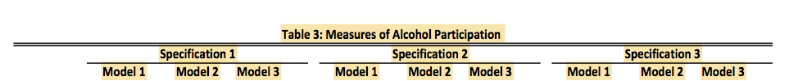

Table 3: Results Robustness
Notes:
Since there was a lot going on in each of the tables in the studies I just cut out and highlighted the most important points in yellow. Panel D of table 3 has of course our 3 specifications and 3 models corresponding to the first, second, and third degree polynomials which pertains to the share of days a respondent consumed alcohol in the last month, which increased by about 4 percentage points. I quick thing to note of is the three asterisks which indicate robustness across specifications and order of the age centered polynomial. Panel E in table 3 shows the share of days in which respondents binged on alcohol in the last month increased by about 1.5 percentage points and we can see these estimates are pretty significant.

Slide 18
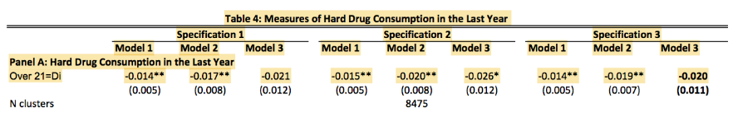
Table 4: Results Robustness
Notes:
Panel A of table 4 shows the resulting estimates of hard drug consumption in the last year once again under the same three specifications and models. We can see that there is a statistically significant decrease by approximately 1.5 to 2 percentage points. And we can also see that this discontinuous decrease is robust to the several different specifications we talked about earlier such as order of the age-centered polynomial, and the inclusion of birthday celebratory effects, demographics, etc. Again a possible reason for this decrease is a labor force setting differs from a college environment.

Slide 19
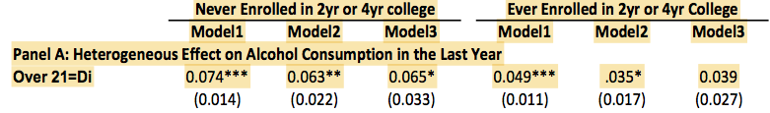

Table 6: Results Heterogeneity
Notes:
Table 6 serves as an illustration of heterogeneous discontinuities at age 21 using only the second specification. One in particular that stood out was those who never enrolled in college actually had consumed more alcohol than those who were used in the survey between the period 1997 and 2009. We can see that those who did attend college reported an increase in their alcohol consumption of 6-7 percentage points and most of these estimates were pretty significant as indicated by the three asterisks. While those who reported that they consumed alcohol since the last interview increased only by 3.5 to 5 percentage points among those who were enrolled in college during the survey period between 1997 and 2009 regardless of the age centered polynomial. A possible reason for this is that those who don’t enroll in college potentially have less income, possibly work in a less desirable job, and are more likely to drink alcohol or use hard drugs due to stress. Panel B of table 6 shows that the heterogeneous effects of a person’s 21st birthday on alcohol consumption translate into the consumption of hard drugs. The results show that there is a decrease between 1.6 and 4 percentage points in the consumption of hard drugs among those who never enrolled in college. These results are statistically significant at the 5% level for the first and third polynomial.

Slide 20
Caveats
Self-reported data = measurement error
Participants were more likely to report alcohol as soon as they turned 21
Exact date states comply with MLDA is potentially nonrandom
The dataset did not include exact birthdate or date participant used hard drugs
More likely to consume alcohol in public places
= More costly to consume hard drugs
Clarification issues
Term & variable definitions? Mislabeling? Typo? How much did the study cost? Left with questions.
Notes:
Some caveats of the study is that the survey data is self-reported which can result in measurement error. Because the study is self-reported means that the participants may not be truthful about their drug consumption. The next issue is that participants were more likely to report alcohol as soon as they turn 21 because 21 is the legal drinking age so those drank alcohol are less likely to report it because it is considered to be illegal. Another potential limitation is that the exact date sates comply with the minimum legal drinking age is potentially nonrandom because they all accepted 21 as the minimum legal drinking age in 1988. Unfortunately, even though the dataset is still valuable it didn’t include the exact birthdate or date participants had used hard drugs. An ideal dataset what be to include the exact dates which can open the door for future research and maybe to conduct the research in a more nature setting. People who turn 21 are more likely to consume alcohol in public places which means it is much more costly to consumer hard drugs because its out in the open. A final minor caveat is that there were a lot of clarification issues in the paper. For example, I have never heard of the word attrition before which I think should have been defined in the paper. Also, I had to triple check myself three times but in two of the tables the paper referred to a panel C but there was no panel C there were only panels A and B so what the author meant to put is panel B. I even got a misspelling on the year which definitely hurts credibility. Instead of putting 2009 they accidently used a 1 instead of a 2. I also was left with a lot of questions such as how much did the study cost? Since there must have been some incentive to get people to take the survey because most people don’t really want to complete a survey for free especially since time is costly.

Slide 21
Conclusion
Number of people who use hard drugs decreased discontinuously at age 21 by approx. 2 percentage points
Robust across different specifications
Drastic increase in alcohol consumption at age 21
Alcohol consumption isn’t a gateway to hard drug use
Alcohol and hard drugs are substitutes NOT complements
Robust to inclusion of covariates, birthday effects, & different specifications and polynomial degrees.
Notes:
In conclusion, the study results of the study revealed that the number of people who use hard drugs decreased discontinuously at 21 by approximately 21 percentage points and was robust across specifications. We also saw ta drastic increase in alcohol consumption at age 21. But overall, alcohol consumption isn’t a gateway to hard drug use and alcohol and hard drugs are substitutes not complements. We saw as well that the results were robust to the inclusion of covariates, birthday effects, and different specifications and polynomial degrees.

Slide 22
Reference
Deza, M. (2015). The effects of alcohol on the consumption of hard drugs: regression discontinuity evidence from the National Longitudinal Study of Youth, 1997. Health economics, 24(4), 419-438.

