Slide 1
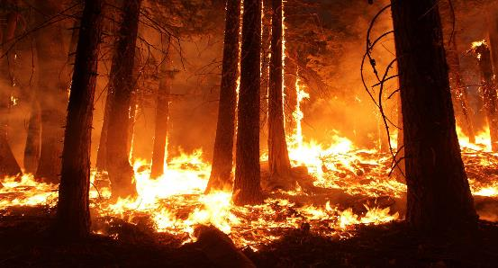
A Synthetic Control Approach to Evaluating the Impact of Electric Utility Company Liability on Wildfire Risk
Notes:
Hi, everyone, for my final project I decided to choose the research proposal option based off of a project I’ve been working on with professor Abman on a topic that I feel many of you will find pretty relatable. So the title of my research is “A Synthetic Control Approach to Evaluating the Impact of Electric Utility Company Liability on Wildfire Risk.”

Slide 2
Motivation
Research Question: Did a 1999 California Supreme Court Ruling on electric utility company liability played a role in fire management in California?
Importance: Wildfires are becoming worse and more frequent every year as a result of global warming especially during the summer months in California.
Direct damage: Property damage & fire suppression costs
Indirect damage: Lost tax revenue, negative health effects from smoke & carbon emissions
Notes:
So my research question is if a 1999 California Supreme Court ruling on electric utility company liability played a role in fire management in California? And in a little bit I`m going to be talking about why I chose this court ruling in the background slide. And he reason why this is such a serious policy issue is because each year wildfire occurrences are not getting better, but worse. Each year especially during the summer months in California they are becoming more common and dangerous mainly because of global warming. And the reason why this is so baf is because not only do wildfires cause direct damage such as property damage and can be costly to put out they also can cause indirect damage as well such as lost tax revenue, and smoke and carbon emissions can negatively effect health.

Slide 3
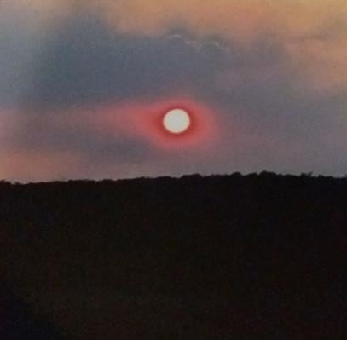
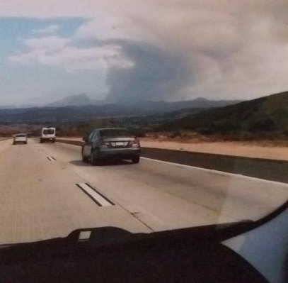
Recent Wildfire Images
Notes:
To show you the severity of the wildfire problem here are two recent pictures of a wildfire that I was able to capture after leaving Alpine in Septeme. On the left is what the sun looked like that day and the photo on the right shows all of the smoke coming from the fire. Which is really bad.

Slide 4
Background
1999 (Barham V. Southern California Edison Company)
First time California Supreme Court found a privately owned utility company liable for wildfire damages from its powerlines
Inverse Condemnation
Not unique to California, but the way it is applied is
Against utility companies because they provide a public service
In article 1, section 19 of of California’s Constitution, utility companies are accountable for any wildfire damage caused by their equipment, whether negligent of not
“[Even though] only 5% of wildfire ignitions in California are attributed to electric utilities,” they are the most dangerous and massive (Hafez, 2020)
Notes:
Here`s some important background information for this research. I chose the 1999 California Supreme Court ruling because it was the first time a privately owned utility company was liable for fire damages from its powerlines. And this just shows whether utility companies are public or private they are not free from accountability. This along with the practice of inverse condemnation sets the stage for a synthetic control analysis. So what`s inverse condemnation? Inverse condemnation means property owners are entitled to compensation if their property is damaged by a public use. This practice is not unique to California but the way its applied is. This practice typically applies to government agencies. But in our Golden State the argument it can be used against utility companies because they provide a public service. And this is why they`re liable for any wildfire damage caused by their equipment, whether they were negligent or not. Now even though only 5% of wildfires caused by powerlines in California, they are the most dangerous and massive. The reason why is because when the wind picks up, it can lower power lines or conductors which pushes animals or vegetation into them, sparking wildfires. And strong winds spread the fires, causing more damage.

Slide 5
Literature Review
Contribution to literature: Liability & precaution is a big topic in law and economics
The economics of law
(Veljabovski, 2006)
Wildfire risk
(Donovan et al., 2011)
(Gradwohl 2019; Hafez 2019; Kousky et al. 2018; Nordman and Hall 2020)
Notes:
I’m not going to spend too much time on the literature. The only thing I wanted to say is that this paper contributes to the literature since liability and precaution is a big topic in law and economics. And Even though there is a lot written about the growing increase in wildfire risk, there`s not too much about wildfire suppression.

Slide 6
Data
United States of Agriculture (USDA) Forest Service website
National Interagency of Fire Occurrence dataset
CDC Wonder
Number of Heat Wave Days in May-September
Bureau of Economic Analysis (BEA)
Annual Gross Domestic Product (GDP): All industry total (Millions of Current Dollars)
State-Year level
1992-2009
882 Observations
Notes:
The main dataset I used is the National Interagency of Fire Occurrence dataset from the United States of Agriculture (USDA) Forest Service website, which has a lot of really good public datasets covering a bunch of environmental topics such as, forest management, vegetation, and so on. I also control for changes in state-level GDP, and heat wave days. The data on the number of heat wave days in May through September is from the CDC Wonder and the Annual GDP data is from the Bureau of Economic Analysis. I collapsed all of these datasets to the state-year level except for the main dataset I collapsed it by state-year level for number of fires, area burned, and fires caused by powerlines and then merged all of them together. All of the data is from 1999 through 2009 and includes 882 observations.

Slide 7
Synthetic Control Approach
Panel Setting
1 Treated unit – California
Synthetic California - Match on weighted avg. of different control observations (Other U.S. States)
Donor pool
No court ruling or harsh measures against electric utility wildfire liability as in California
“Apples–to apples–comparison”
Notes:
As we remember from our Econ 641 class A synthetic control analysis approach is a good choice in this setting since we have a panel dataset and 1 treated unit which in this case is California and match it on the weighed average of different control observations which in this case is the other U.S. states to create a synthetic California. This synthetic control group represents our donor pool. The other states did not have the 1999 California court case or as harsh measures against electric utility wildfire liability as in California. And we’re going to try to do all of this to try get an apples to apples comparison.

Slide 8
Empirical Strategy
Synthetic Control Analysis Approach
Basic Model: Y_{it}= δD_{it}+ GDP_{it}β+φheatwave_{it} + ε_{it}
Y_{it} – Outcome of interest, Fire frequency and area
D_{it} – Treatment indicator =1 if state i receives the treatment prior to time t and 0 if otherwise
δ_{it} – Heterogenous treatment effect on state at time t
ε_{it} – Unobservable component
Notes:
Here`s my basic model. I’m going to be using two models with the only difference being the dependent variables. The first one uses fire frequency as the dependent variable, while the other one uses acres burned. Dit represents the treatment indicator which is equal to 1 if state i receives the treatment prior to time t and 0 if otherwide. Delta it is the heterogenous treatment effect on state at time t and epsilon is the unobservable component.

Slide 9
Results
Notes:
Unfortunately, I don’t have time to show all of my graphs because there`s are a lot of them. So here are my main graphs with controls, which are pretty much the same as the ones without controls. The top one shows how many acres the fire burned over time along with the weighted average from the synthetic control group, while the bottom graph is the exact same except fire frequency is used as a dependent variable instead. As we can see the court case really didn’t have an effect since the lines in the pre-treatment aren`t really close together and there is not a clear divergence in the post-treatment period.

Slide 10
Placebo Test
Notes:
I also did do some placebo tests for the same two graphs. These show the estimated effects year-by-year for California in black and all of the other donor states in blue. Once again we see that California is not really well-fit prior to 1999, and does not diverge more than most of the other states.

Slide 11
Discussion & Policy Implications
Insignificant results with and without controls in the graphs, placebo tests and MSPE values
Opens the door to future research opportunities
Wildfires are an inevitable reality!
Policy wise more stringent measures need to be taken to hold those who cause them accountable to preserve the environment and decrease the cost it imposes on society.
Notes:
So even though I got insignificant results with and without controls in the graphs, placebo tests, and MSPE values, it opens the door to future research opportunities especially since wildfires are an inevitable reality. And more policies need to be made to hold those who cause them accountable to preserve the environment and decrease the cost it imposes on society.

