Slide 1

The Value of the Heuristic: Rotten Tomato Category
Notes:
Hi everyone! I’m going to be talking about the importance of heuristics, which are mental shortcuts that can alter a person’s decision before they make them. My study is based on the positive and negative icons used in Rotten Tomatoes that signal to individuals if a specific movie is worth seeing. A move critic’s rating determines whether or not a movie will earn a positive or negative rating, which influences the amount of money a specific movie title could earn. I’m going to be using the concept of heuristics by applying it to the effect these icons have on opening weekend box office revenues before the film is released and after it hits theaters using a regression discontinuity design. In theory we shouldn’t expect them to.

Slide 2


Economic Literature
“Analyzing Dynamic Review Manipulation and its Impact on Movie Box Office Revenue” by Haoxiang Ma, Jong Kim, and Eunkyung Lee
“Learning from the Cloud: Regression Discontinuity Estimates of the Effects of an Online Review Database” by Michael Anderson and Jeremy Magruder
“The Value of a Tomato: Examining the Impact Impact of Review Aggregation Sites On Box Office Revenues in the United States” by Sofia Licata
“Consumer and Expert Reviews Affect the Length of Time a Film is Kept on Screens in the USA” by Thaís L. D. Souza, Marislei Nishijima, and Ana C. P. Fava
Notes:
So as far as the economic literature goes there are studies out there that use RDD models that center more around the topic of moviegoing and how a move review on rotten tomatoes effects how much movies make or how long they are kept on screens rather than the icons themselves or they tend to focus on how much total revenue a movie raked in as in the first, third, and fourth articles I have listed here. Closely related studies just as the one in the second article I have here use yelp reviews to see if they affect the number of people who go to a specific restaurant. What sets this study apart and its contribution to the literature is that it uses opening weekend revenue and compares it to how much a movie made once it hits theaters over the years 2009-2018, has over 3,300 observations, focuses more on the effect these icon/heuristics have on movie profits, and uses some interesting control variables which we will see in a bit.

Slide 3



Data Sources
Notes:
My main dataset came from kaggle.com which is a website that has a lot of really cool and interesting datasets that can be used for research purposes and I merged it with a dataset that combined franchise data from Box Office Mojo and opening weekend box office revenue data from The Numbers website both of which are really good websites that have a lot of information on statistics relating to the movie industry.

Slide 4


Highest & Lowest Opening Weekend Revenue
Notes:
I wanted to share a fun fact of something that really stood out to me in my descriptive statistics and that was which movies made the most and which movies made the least on opening weekend. So now I have a question for all of you. Which movie do all of you think made the most on opening weekend between 2009 and 2018. If you were thinking of Avengers Infinity War than you guessed right! It made about 260 million on opening weekend, which is crazy. Now which movie do you think made the least? It turned out to be a Tom Cruise movie! called Oblivion which only raked in a meager $75,000 on opening weekend.

Slide 5



What Determines a Tomatometer Rating?
“Rotten Status”- Less than 60% of critic reviews for a movie are positive
“Fresh Status” - At least 60% of critic reviews for a movie are positive
Notes:
Before we jump into the variables used in this study its important to understand what determines a tomatometer rating, which is going to be our running variable. So if less than 60% of movie critic reviews are positive then a movie will earn the title rotten and receive a green splat icon. If at least 60% of critic reviews are positive then a movie earns the title fresh and receives a red tomato icon. Therefore our threshold for our RDD is going to be 60%.

Slide 6
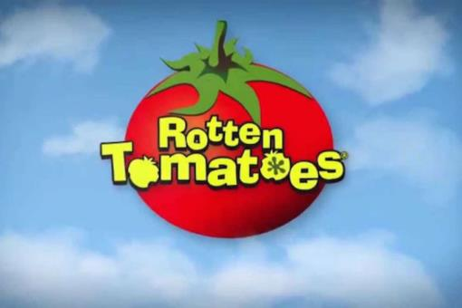

Two Important Assumptions of RDD
There cannot be perfect manipulation of the running variable, which in this case is rotten tomato ratings
Nothing else changes at the threshold
Notes:
Let’s not forget before we start the two most important assumptions that must hold in an RDD is that there cannot be perfect manipulation of the running variable, which in this case in rotten tomato ratings and the second assumption is nothing else changes at the threshold besides the fact that rating determines whether a movie receives a positive or negative icon. We’ll find out later on if these two assumptions are going to hold.

Slide 7

Variables of Interest
Over 3,300 Observations
Cross Sectional Dataset
2009-2018
Dependent Variable: Log of Opening Box Office Revenues
Running Variable: Tomatometer Rating
Treatment Variable: Tomatometer Status
Controls:
Year
Franchise
Genre
MPAA Rating
Notes:
As mentioned previously there are over 3,300 observations used I this study. The dataset’s going to be cross sectional since different movies are collected between the years 2009-2018. Our dependent variable is going to be the log of opening weekend box office revenues, which is measured in thousands of dollars. A log linear model is used because the distribution of opening weekend revenue is highly skewed. As I said before, our running variable’s going to be tomatometer rating. So if a movie has positive reviews of at least 60% and above its fresh and if they are 60% and below its rotten. Our treatment variable is tomatometer status so as I said before if a movie is fresh it gets a red tomato icon and if its rotten it gets a green splat icon. The controls include year, the dummy variable franchise which equals 1 if a movie is part of a franchise and 0 if not. The genres comedy and action particular because they are popular and should positively impact the money a movie makes. And the movie ratings PG-13 and R since the movies with these ratings tend to earn more.

Slide 8
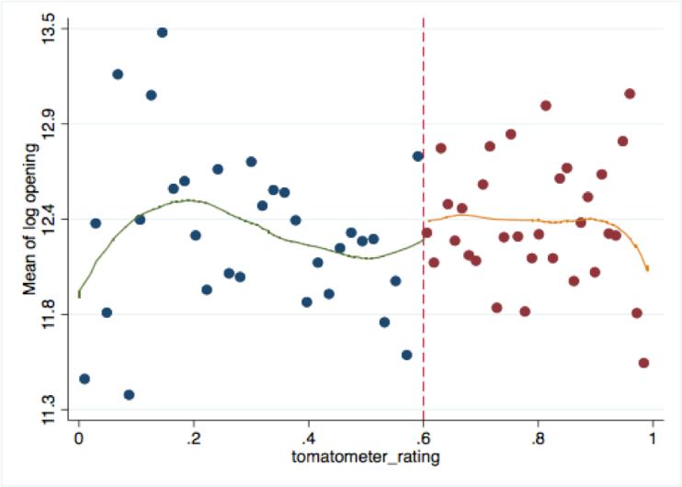
Figure 1: Log Opening Weekend Box Office Revenue by Tomatometer Rating
Notes:
So In our first figure, we have the tomatometer rating on the x-axis and mean of log opening weekend box office revenue on the y-axis. Our threshold is 60%. So the movies to the left of 60% are rotten. And the movies to the right from 60% and above are fresh. And we see here that the discontinuity jump is rather small, which is what we were expecting since the tomatometer icons do not play a huge role influencing the money a movie earns once it hits theaters.

Slide 9
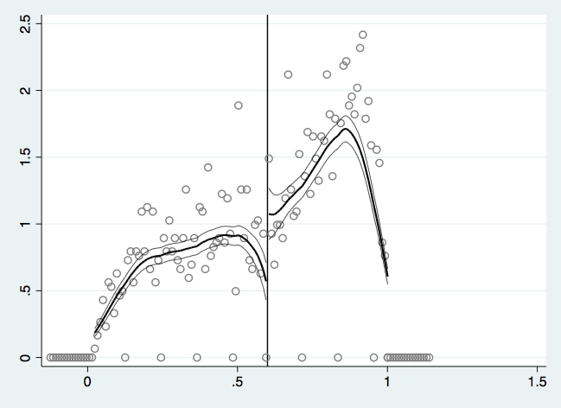
Figure 2: Observation Density by Tomatometer Rating – McCrary Plot
Notes:
Our second figure is a McCrary plot of observation density by tomatometer rating. The first thing that stands out right away that is kind of concerning is the bunching of observations here and here and the discontinuity in the density of the running variable, both of which as we know mean that there is manipulation of the running variable. So to check if there’s manipulation of the running variable or not, we are going to run an RD density in the next slide.

Slide 10
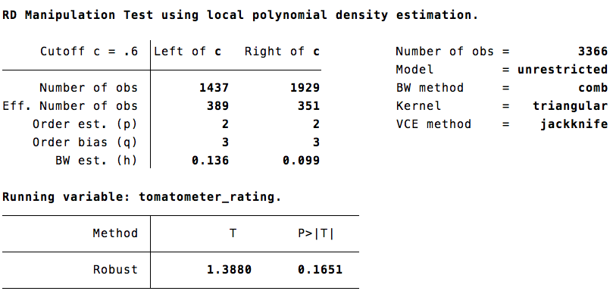
McCrary Density Test
Notes:
As we can see the p-value is about 0.17 which means we fail to reject the null hypothesis of no density change it the cutoff and there is not manipulation of the running variable.

Slide 11
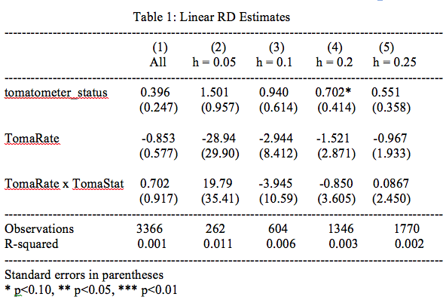
Notes:
Now we get into the fun stuff which is our models and results. In our first table we estimate a linear regression model with the full sample and bandwidths of 0.5, 0.1, 0.2, and 0.25 without controls. Our dependent is the log of opening weekend box office revenue and our independent variables are tomatometer status, tomatometer rating and the interaction term tomatometer rating and tomatometer status. Beta 1 is the effect of tomatometer status on the log of opening weekend box office revenues. By looking at our coefficent estimates narrowly earning the title fresh resulted in a 40%-1.5% increase in opening weekend revenue. Beta 2 is the marginal effect of a tomatometer rating that earned rotten status, which we can see has a negative effect on the money a movie makes. And beta 3 which is our interaction term is the marginal effect of tomatometer rating and tomatometer status on opening box office revenue for films with fresh status relative to those with rotten status. As we can see none of our estimates are really statistically significant especially at the 5% level.

Slide 12
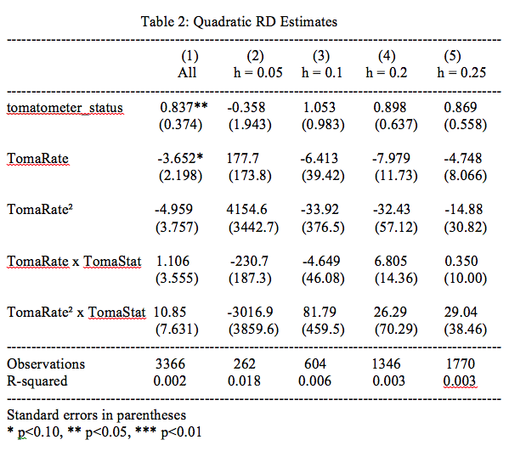
Notes:
Now we have a table with Quadratic Rd estimates with the same bandwidths as before. So the two new variables that were added are tomatometer rating squared and the interaction between tomatometer rating squared and tomatometer status. For tomatometer status the magnitude of the full sample changed from 40% to 80%. The coefficient that changed the most for tomatometer status was the once assigned a bandwidth 0.05 which is -0.3% when before it was 1.5%.The coefficient estimates for tomatometer rating became larger than they were in table 1. Once again none of the estimates turned out to be really significant as we can see from the p-values.

Slide 13
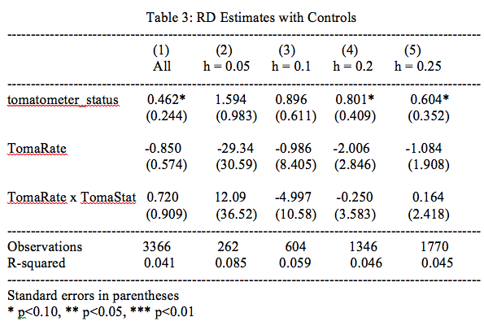
Notes:
Now let’s see what happens when we introduce controls to our linear RD estimates, which allows our estimates to be more precise. The dummy variable franchise if a movie is part of one or not. The ones that are should bring in more cash. Movies PG-13 and above tend to earn more than any other rating categories. All of these controls should have a positive impact on the log of opening weekend box office revenue. Interestingly if we go back to table 1 we will see that the RD estimates with controls are pretty much the same as those from table 1. This is a good sign because if they would have changed drastically that would meant that perfect manipulation is present, but since they didn’t there is not.

Slide 14
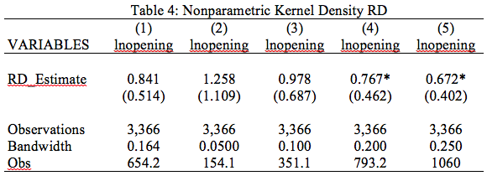
Notes:
In our final table we have the coefficient estimates using the local kernel estimator, RDROBUST. The first column provides the CCT optimal bandwidth and the second through fourth columns use the same bandwidths as above and we can see the estimates are similar to those in the other tables in size and significance.

Slide 15
Limitations + Opportunities for Future Research
Include additional controls such as,
Film’s production budget
Distributor of a film
Particular actors
Analyze impact of movies reviews from a longer time period.
August 12,1998 onward
Impact of Covid-19 on movie theater data
Notes:
In this study there’s a list of limitations and opportunities for future research. It would be interesting if additional controls such as, a film’s production budget, distributor of a film, and/or particular actors of a movie were used. Since we would expect films with higher production budgets, well known distributors such as, Warner Bros, and more popular actors will do better in the box office. I also think it would be great if future researchers extended the study starting from August 12, 1998 since this is when Rotten Tomatoes first started out and examine its impact on movie revenues over time as it gradually gained popularity over the years. In my data critic reviews that are made before opening weekend are only available for new movie releases. In my case, the critic reviews that came out after the movie was released were close to 0, so it served as a strong proxy for ratings made just before movies are released to theaters. So to increase accuracy of the data it would be great for researchers to scrape these reviews for newly released movies. Because of the Covid-19 pandemic unfortunately a downside for future researchers who maybe want to include movies for 2020 is that films that were supposed to premiere this year are being postponed until next year such as the new Batman movie with Robert Pattiinson as the lead role or because there is not an audience to watch films as the result of movie theaters being temporarily closed so there is a lack of data.

Slide 16

The Main Takeaways
No presence of perfect manipulation
Nothing else changing at the cutoff
Most of the estimates weren’t very significant
Notes:
The main takeaways from the study is that from the evidence provided there was not a presence of perfect manipulation found and there was not anything else changing at the cutoff besides the rating that determines what category a movie falls into. So out two assumptions for RDD hold. Most of the coefficient estimates didn’t turn it out to be very significant which is what we were expecting since rotten tomato icons in theory do not have a significant impact on opening weekend box office revenues when the general public is fully informed. I hope you enjoyed my presentation and thank you so much for listening!

Slide 17
References
Anderson, M., & Magruder, J. (2012). Learning From the Crowd: Regression Discontinuity Estimates of the Effects of an Online Review Database. The Economic Journal, 122(563), 957-989. https://doi.org/10.1111/j.1468-0297.2012.02512.x
Ma, H., Kim, J. M., & Lee, E. (2019). Analyzing Dynamic Review Manipulation and Its Impact on Movie Box Office Revenue. Electronic Commerce Research and Applications, 35, 100840. https://doi.org/10.1016/j.elerap.2019.100840
Souza, T. L., Nishijima, M., & Fava, A. C. (2019). Do Consumer and Expert Reviews Affect the Length of Time a Film Is Kept on Screens in the USA?. Journal of Cultural Economics, 43(1), 145-171. https://doi.org/10.1007/s10824-018-9332-6
Sweigart, M. (2018). The Value of a Tomato: Examining the Impact of Review Aggregation Sites on Box Office Revenues in the United States [Senior thesis, Princeton University]. DataSpace. https://dataspace.princeton.edu/handle/88435/dsp01t435gg711

