Slide 1


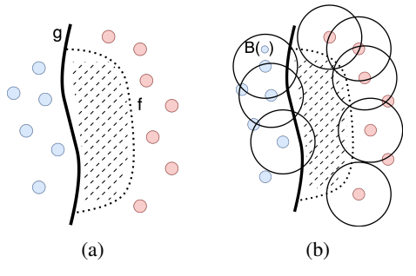
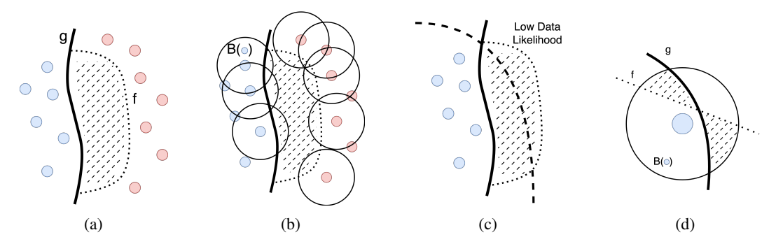
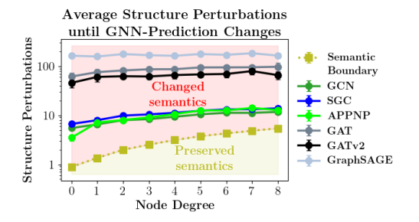
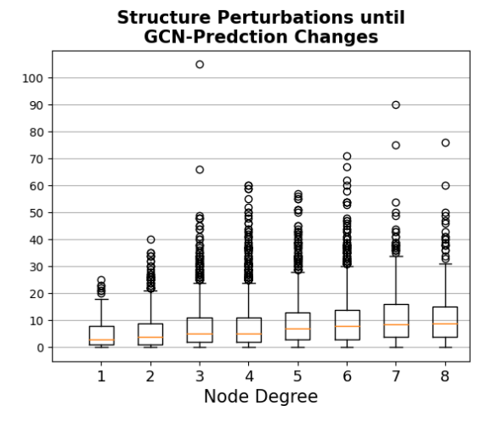
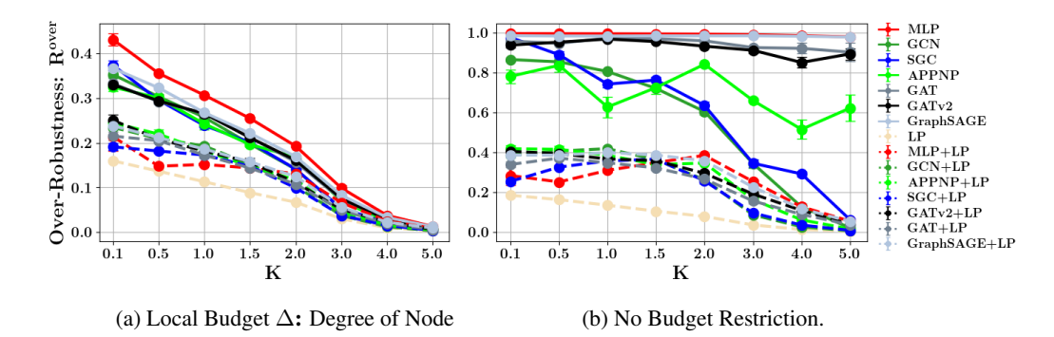
Revisiting Robustness in Graph Machine Learning
L. Gosch, D. Sturm, S. Geisler, S. Gunnemann
Robustness Problem
Semantics-Aware Method
Key Findings
• Novel Framework: Semantics-aware robustness using reference classifier g
  ◦ Definition 1: Adversarial graphs preserve semantics, change predictions
  ◦ Definition 2: Over-robustness captures unwanted semantic robustness
• Key Innovation: Bayes classifier provides semantic oracle for robustness
• Prevalent Issue: Threat models include semantic changes (>50% for K≤3)
• Universal Finding: All GNNs show over-robustness (30.3% GCN at K=0.5)
• Effective Solution: LP reduces over-robustness while maintaining accuracy
• Core Issue: GNNs show unrobustness to small graph structure changes
  ◦ Manual graph inspection makes semantic preservation unclear
  ◦ Current threat models may violate semantic content assumptions
• Key Finding: All assessed GNNs exhibit over-robustness beyond semantic change points
Theoretical Results
Performance Impact
Background Setup
• Graph Notation: Inductive node classification with feature matrix X, adjacency A, labels y
• Label Propagation: Combines GNN predictions with graph structure via iterative updates
• CSBMs: Provide controllable synthetic graphs with analytically tractable distributions
• LP Effectiveness: GCN+LP reduces over-robustness to 20.9% (K=0.5)
• Real-world Validation: Cora-ML shows degree-multiple robustness
• Best Performance: MLP+LP achieves optimal robustness in hard regime
• Theorem 1: Bayes optimal classifier for inductive classification
• Theorem 2: No robustness-accuracy tradeoff for graph data
  ◦ Combined optimization yields Bayes optimality
  ◦ Contrasts with i.i.d. settings

