Slide 1


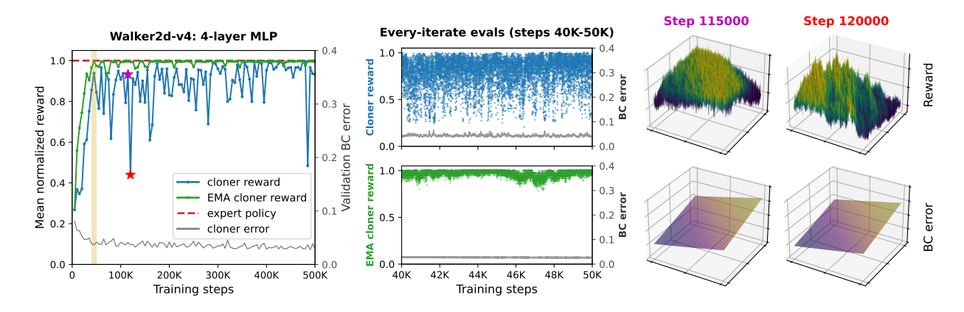
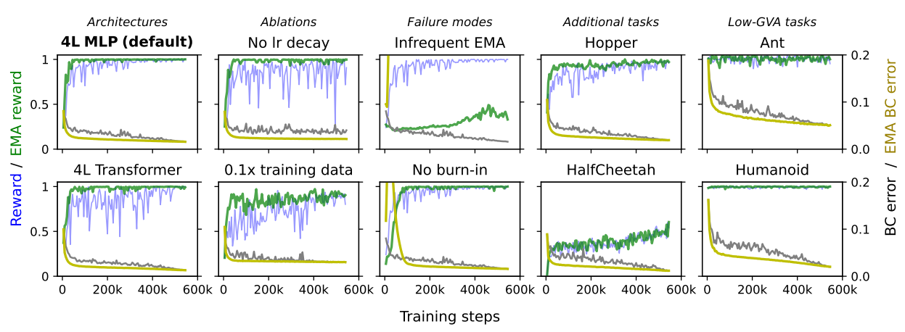
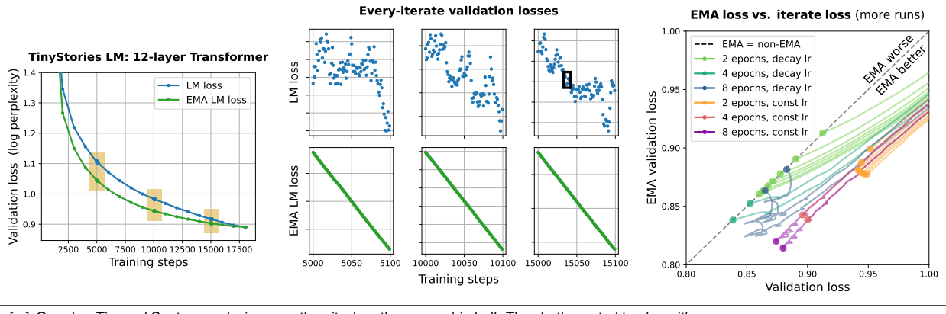
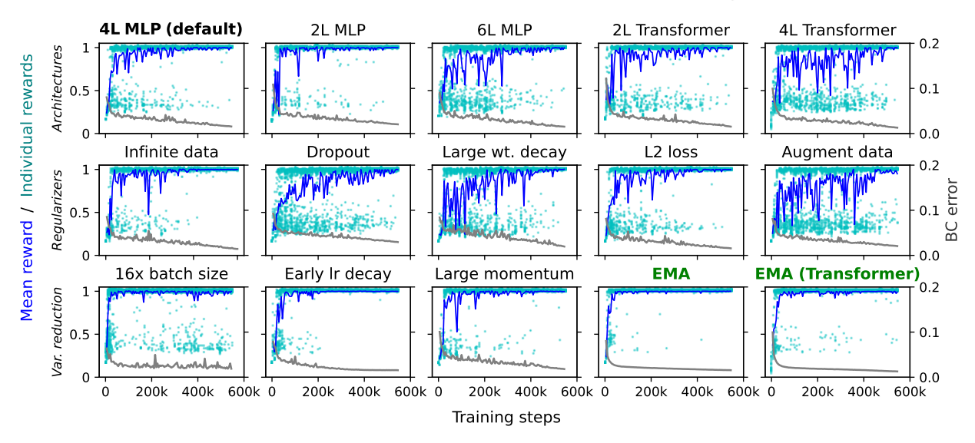
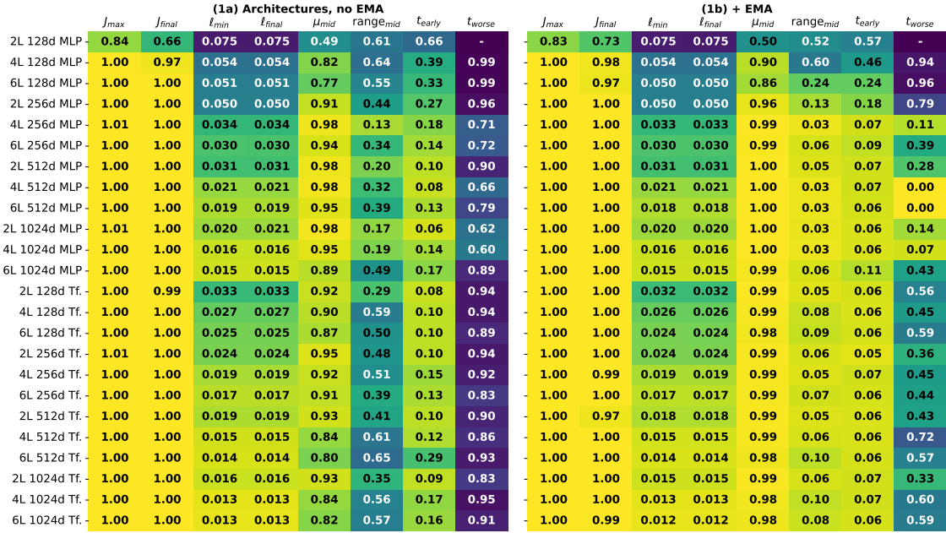
Butterfly Effects of SGD Noise: Error Amplification in Behavior Cloning and Autoregression
A. Block, D.J. Foster, A. Krishnamurthy, M. Simchowitz, C. Zhang
Training Instabilities
EMA Stabilizer
Language Models
• Core Observation: SGD noise causes reward oscillations despite stable BC loss
  ◦ Long-horizon rewards swing between consecutive gradient iterates
  ◦ Fractal reward landscapes invisible in single-step objectives
• Root Cause: Chaotic propagation of minibatch noise through feedback loops
• Core Innovation: Exponential Moving Average as variance reduction technique
  ◦ Updates every iterate with burn-in phase and γ(t) = t^(-α) decay schedule
  ◦ Dramatically reduces reward oscillations without changing optimization
• Impact: Enables stable training trajectories and improved sample efficiency
• Theoretical Basis: EMA reduces gradient variance amplification in closed-loop systems
• GVA in Autoregression: Same phenomenon in 270M-parameter Transformers
  ◦ Consecutive checkpoints disagree on >50% of generated text
  ◦ EMA reduces disagreement to <5% of iterates
• Key Benefit: EMA enables training without learning rate decay
Algorithmic Pathology
Architecture Comparison
• GVA Identified: Gradient Variance Amplification as algorithmic phenomenon
  ◦ Oscillations persist across architectures and regularizers
  ◦ Diminish only as learning rate decays to zero
• Key Insight: Standard mitigation techniques fail to address GVA
• Universal Stabilization: EMA benefits across diverse architectures
  ◦ MLPs, Transformers, CNNs all show reduced oscillations
  ◦ Most pronounced in smaller dataset regimes
• Practical Impact: Consistent improvements in sample efficiency

