Slide 1
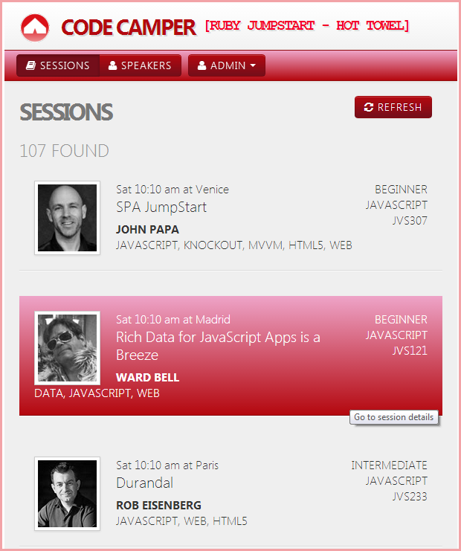
Single Page Apps
with
Breeze and Ruby

Slide 2
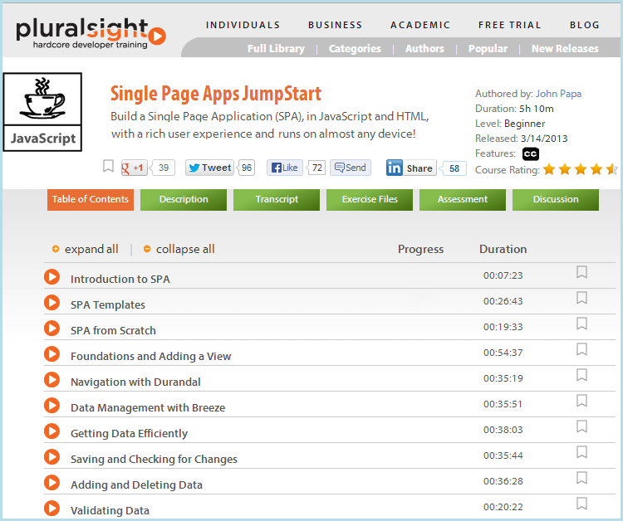
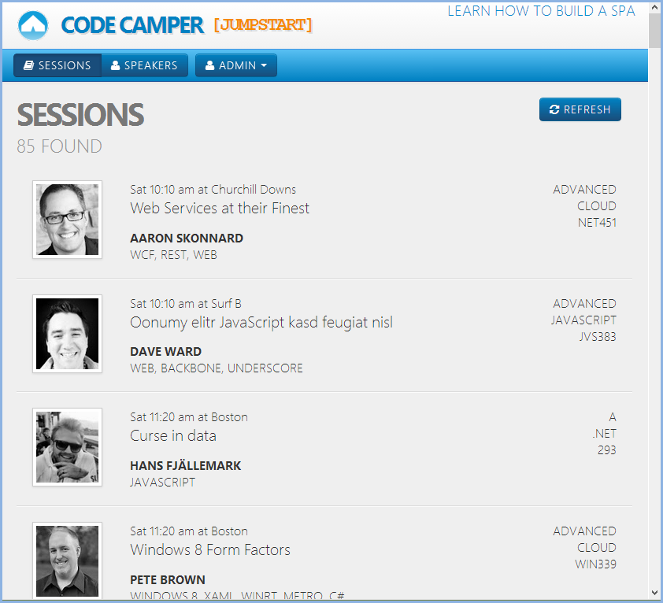
John Papa’s Code Camper Jumpstart
http://pluralsight.com/training/Courses/TableOfContents/single-page-apps-jumpstart
https://github.com/johnpapa/PluralsightSpaJumpStartFinal

Slide 3
Features
Multi-entity model
Navigation properties / cached lookup lists
Projections / partial entities
Change notification
Dirty checking
Validation
Save
Local storage

Slide 4
Keys
Client app is server agnostic (almost)
Ruby on Rails (RoR) server
Straight rails; no breeze.ruby components
“REST” API
Python web server
No MS

Slide 5
Not anti-Microsoft

Slide 6
If it works in Ruby
it can work for you

Slide 7
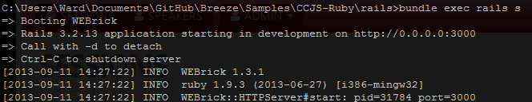

Run it
~\ccjs_ruby\rails>bundle exec rails s
Download from GitHub
Setup install gems and create sample MySQL database
Start rails server bundle exec rails s
Start client application server python –m http.server
Launch in browser http://localhost:8000

Slide 8
Demo

Slide 9
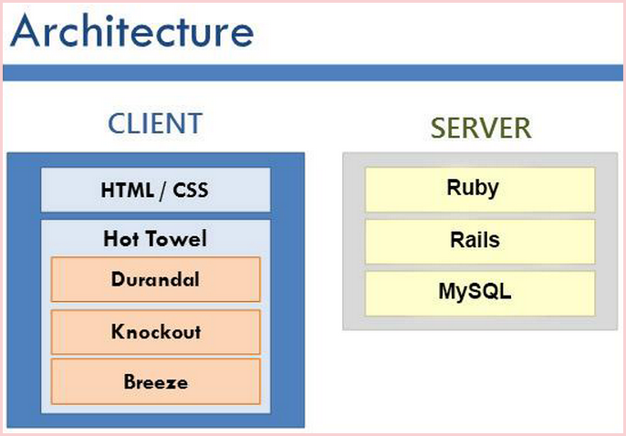
Web Server
HTML, JavaScript, CSS, images

Slide 10
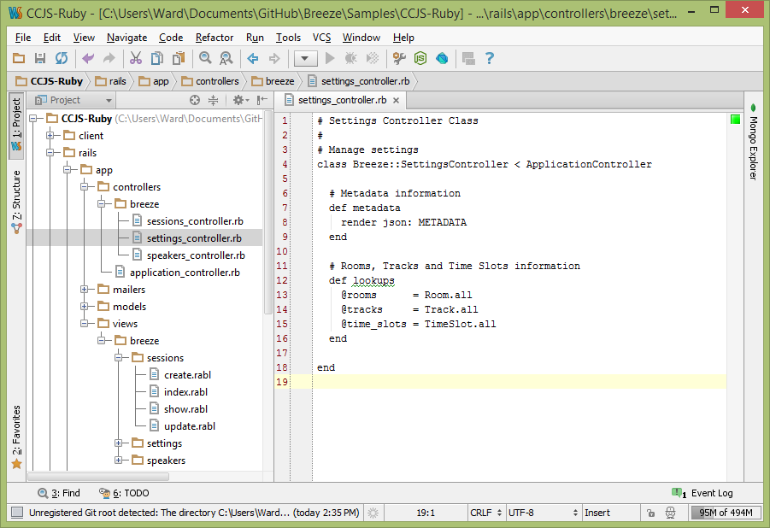
Code Tour

Slide 11
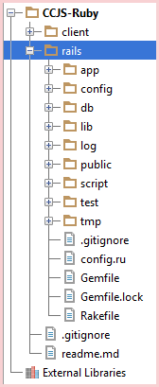
RoR Server

Slide 12
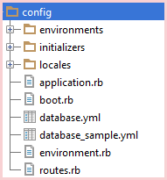
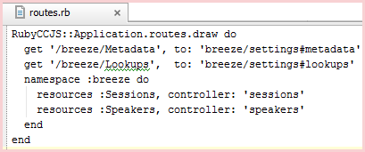
RoR Server – Configuration
Locate the My SQL database

Slide 13
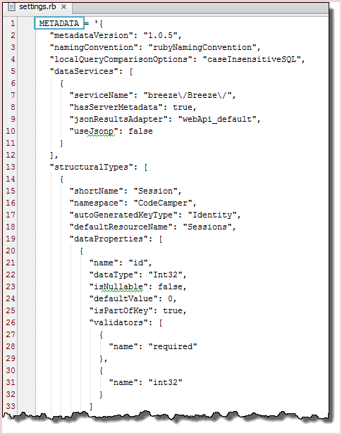

RoR Server – Configuration
Breeze Metadata

Slide 14
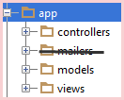
RoR Server – Model View Controller

Slide 15
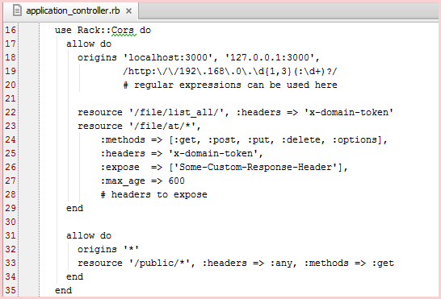

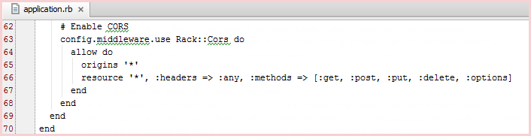
RoR Server – Controllers
Cross Origin Resource Sharing

Slide 16
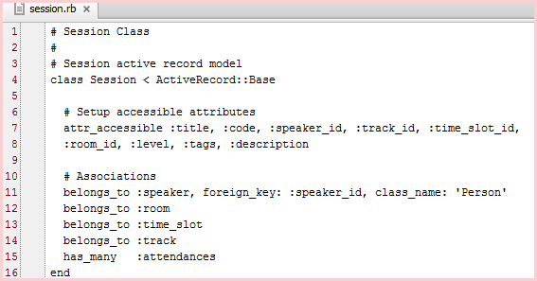
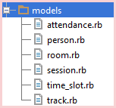
RoR Server – Models

Slide 17
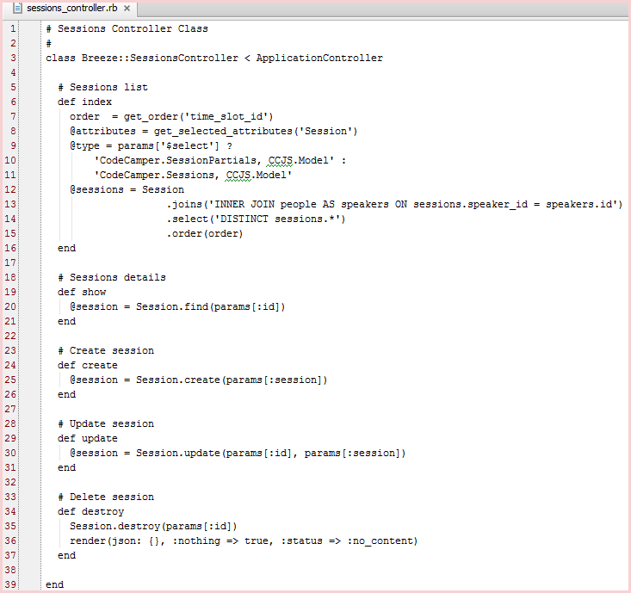
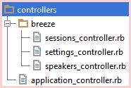
RoR Server - Controllers
Sessions Controller
GET all
GET by id
PUT
POST
DELETE

Slide 18
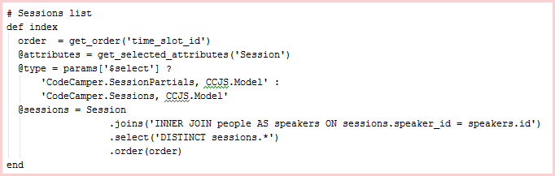
Sessions Controller – Index (get all)
Default sort order is time_slot_id
but client typically wants by ‘timeslot, track, speaker name’
Projection (selected fields)
Partial entity if $select in query
Make speaker available in case sorting on speaker name

Slide 19


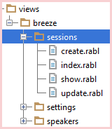


RoR Server – Session Views

Slide 20
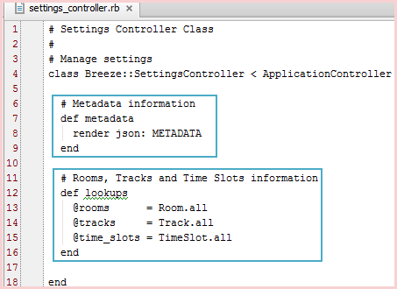

RoR Server – Controllers

Slide 21
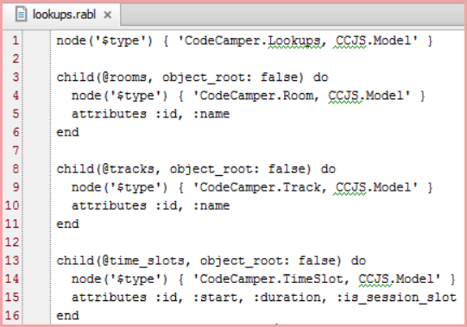
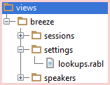
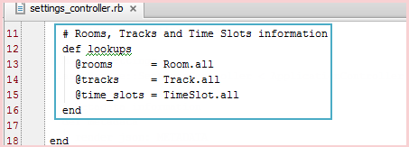
RoR Server - Views

Slide 22
API Differences

Slide 23
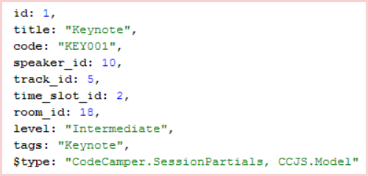
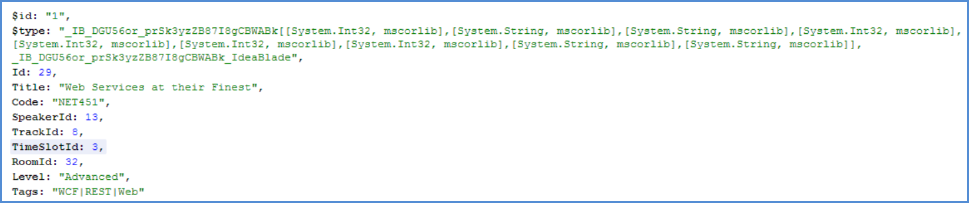
Rails serialization vs JSON.NET serialization
Rails Session
Rails-style entity property_names
No $id node property
$type node property is readable (v. anonymous type)
JSON.NET Session

Slide 24
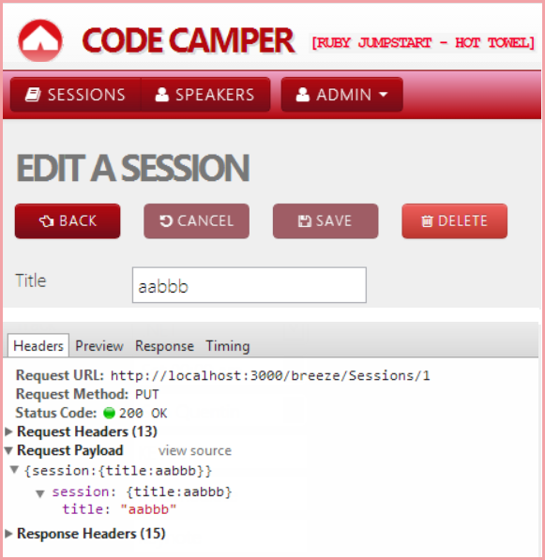
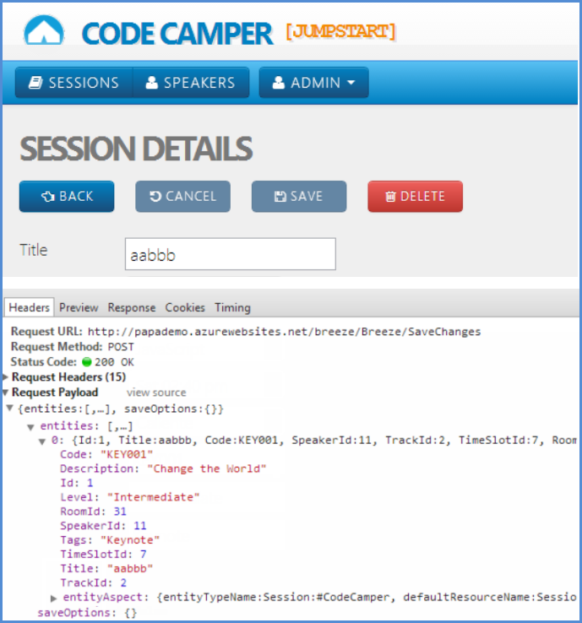
Rails REST update vs Breeze “save changes”
POST to SaveChanges
PUT to resource w/ id=1
Send entire entity
Send only the changed values

Slide 25
Adjust breeze client
for Rails API

Slide 26
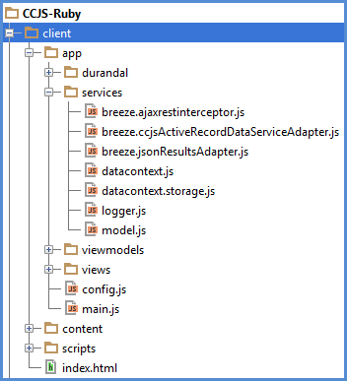
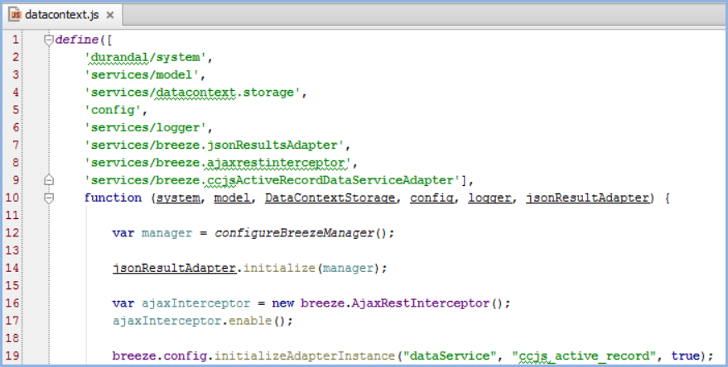
Configure adapters
Breeze extension points
Inject with RequireJS

Slide 27
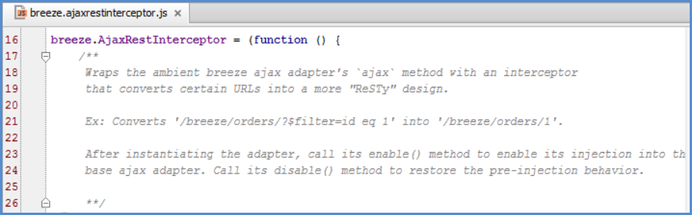
AjaxRestInterceptor
Tweak the breeze ajax adapter to convert OData id-query into a REST URL
e.g., /breeze/Sessions/?$filter=id eq 1 → /breeze/Sessions/1

Slide 28
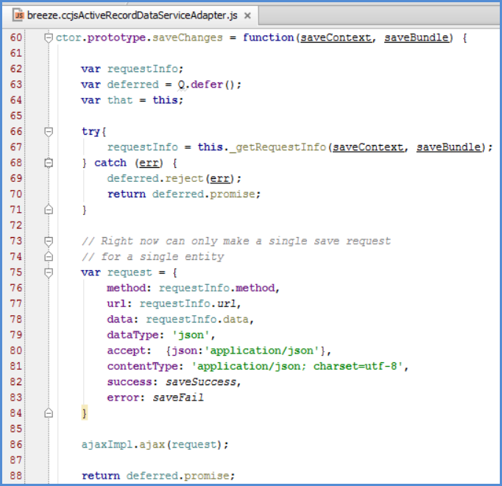
DataServiceAdapter
Replace POST to “SaveChanges” with REST PUT/POST/DELETE to entity type controllers

Slide 29
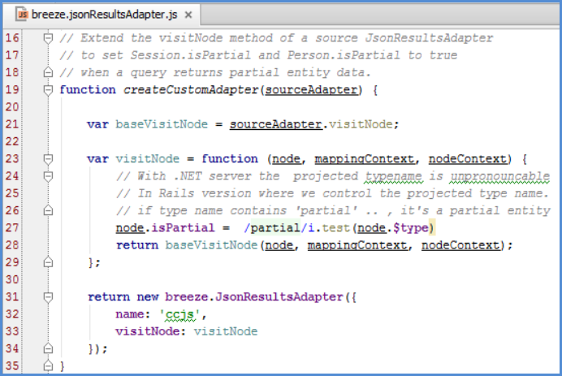
JsonResultsAdapter
Identify “partial entity” JSON data nodes

Slide 30
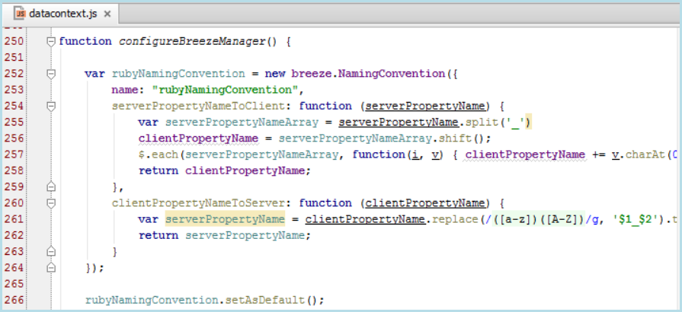
NamingConvention
Convert property names e.g., timeSlotId ←→ time_slot_id

Slide 31
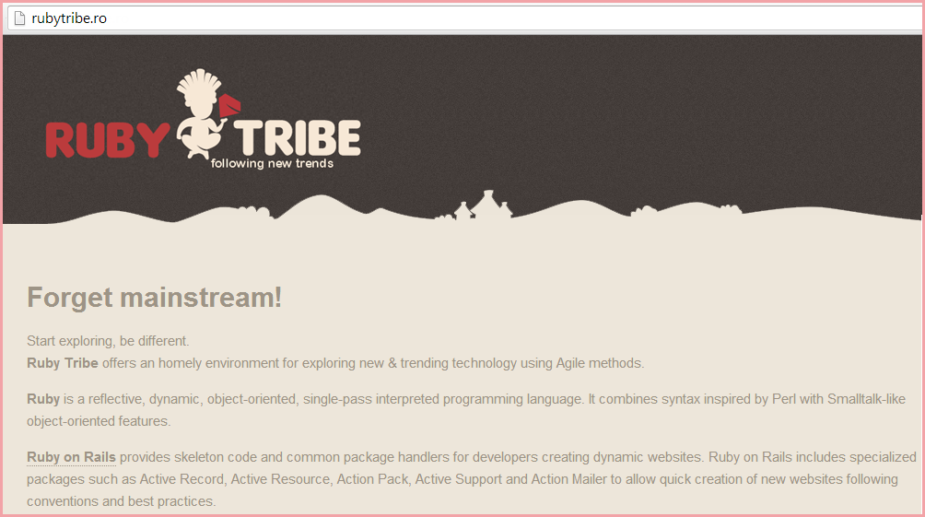
Thank you, RubyTribe

