Slide 1

Salaries Data Engineering
Ana Brissa Miranda espinosa
Sofia garrido
Santiago ayala
ENTER

Slide 2



Data jobs salaries objectives
The primary goal is to provide data that can be a better guidence in regards to what´s being paid globally.
Get the average salary according the job title.
Get 3 countries and review the mínimum and máximum wage and compare them.
Show the average salarie of the top 25 countrys.
Show the % of the ratio through the years (2020-2024).
Show in a map the countries avg salaries and job titles.
Show the size of the company and how many employees have.
01
02
03
04

Slide 3
Overview
This dataset was retrieved from the page https://ai jobs.net/salaries/download/
This site collects salary information anonymously from professionals all over the world in the AI, ML, Data Science space and makes it publicly available for anyone to use, share and play around with.
The primary goal is to have data that can provide better guidance in regards to what's being paid globally. So newbies, experienced pros, hiring managers, recruiters and also startup founders or people wanting to make a career switch can make better informed decisions.
01
02
03
04

Slide 4
Ethical Consideration
01
02
03
Transparency
Anonymity and Privacy
Informed Consent
Data Accuracy and Reliability
04

Slide 5
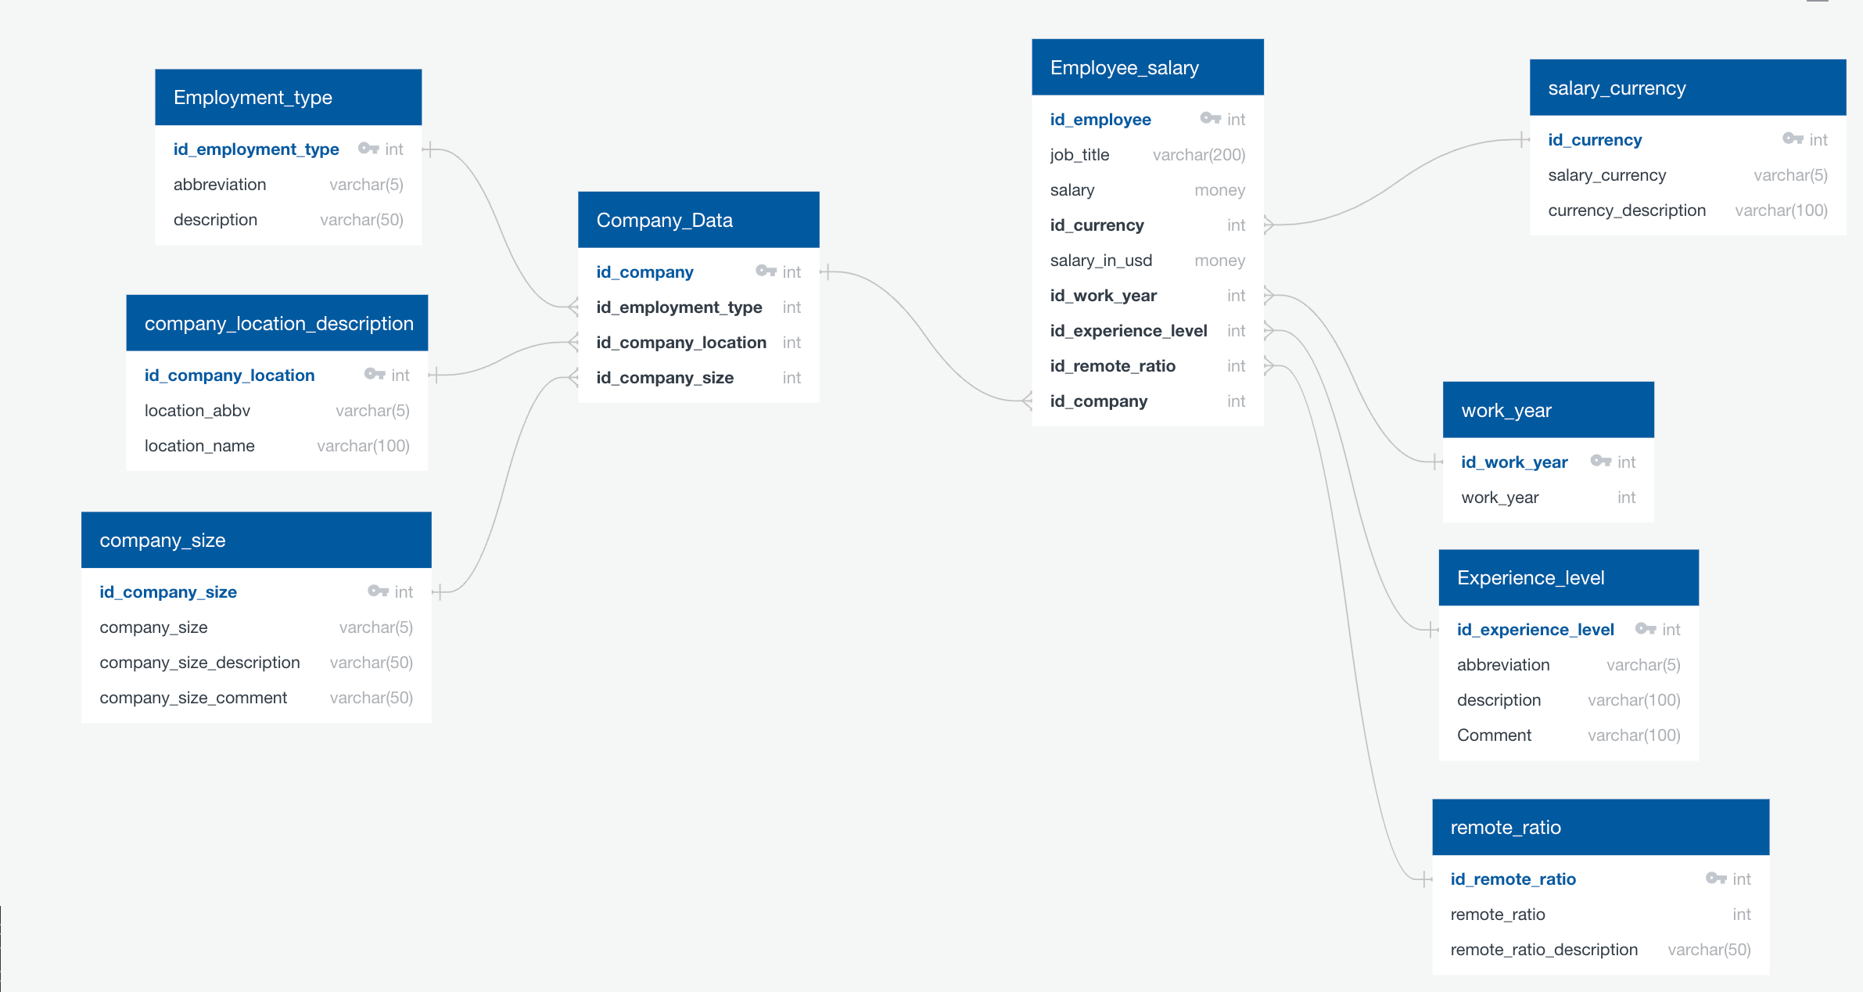
“This is a quote, words full of wisdom that someone important said and can make the reader get inspired.”
—SOMEONE FAMOUS
01
02
03
04

Slide 6
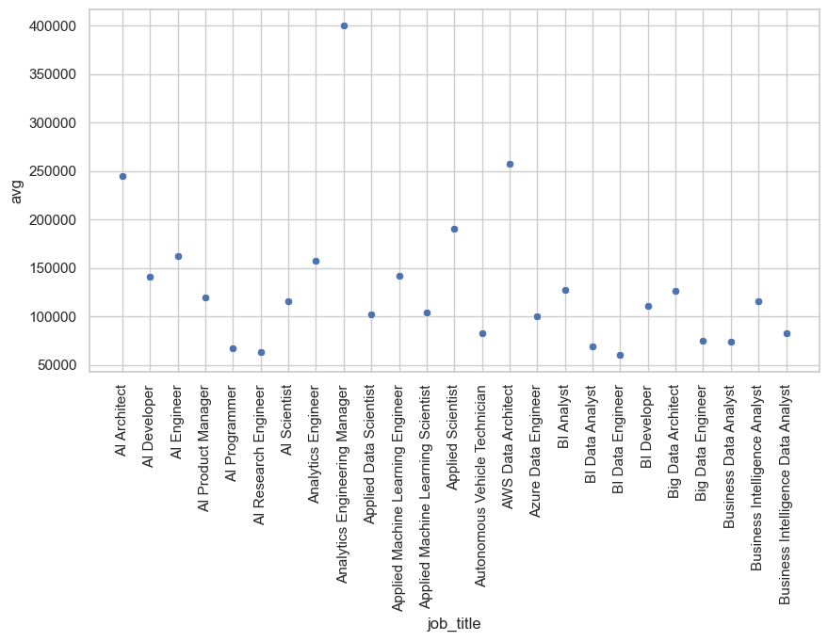
Average Salary for the Job Titles
INTRODUCTION
01
Here you could describe the topic of the section
02
03
04
ANALYSIS
Here you could describe the topic of the section

Slide 7
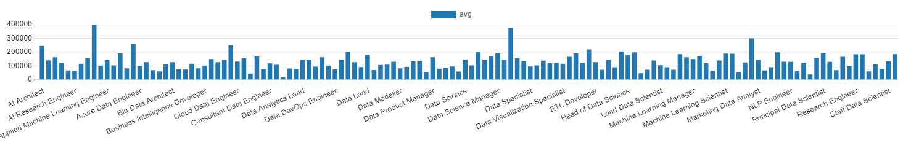
Average Salary for the Job Titles
01
02
03
04

Slide 8
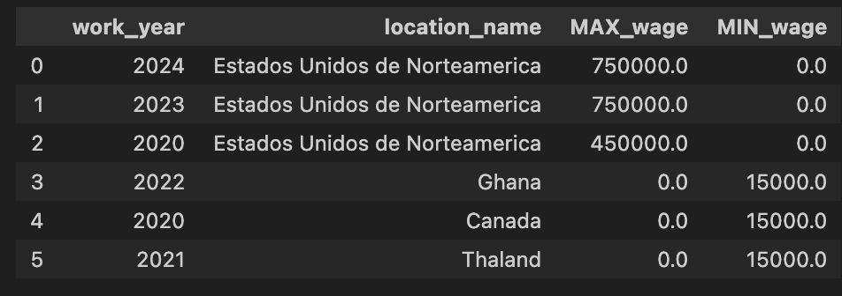
Min vs. Max salary of the top 3 countrys
01
02
03
04

Slide 9
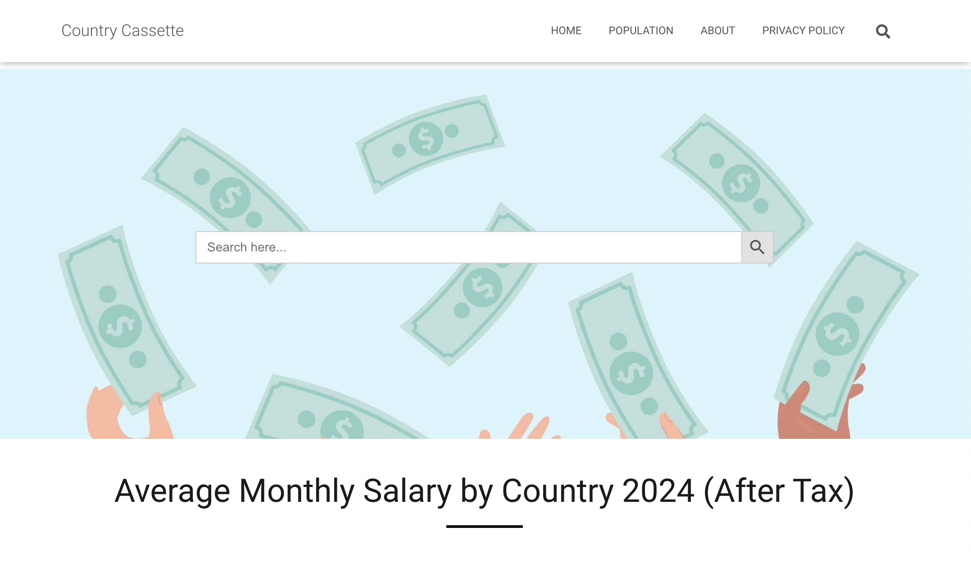
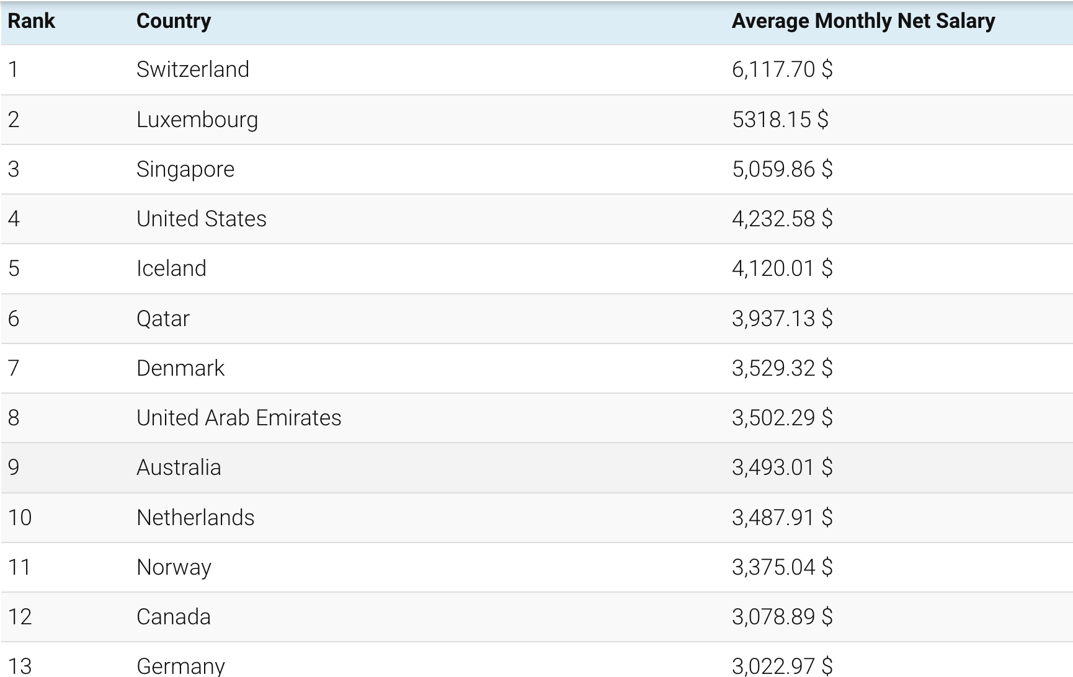
Comparison
01
02
03
04

Slide 10
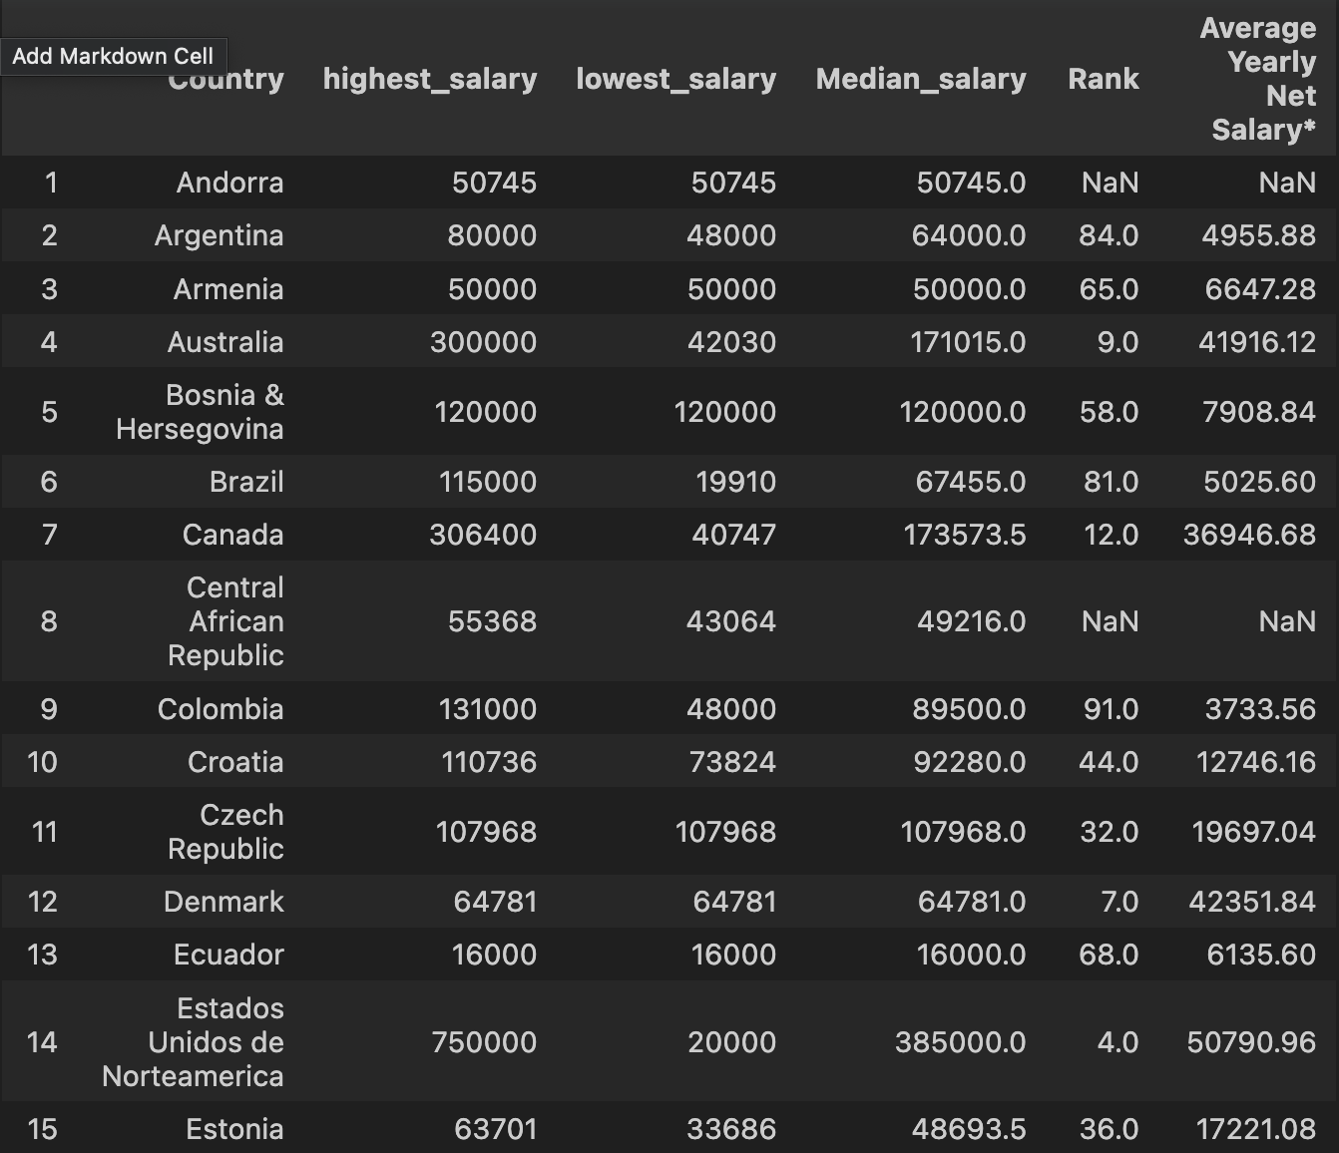
Comparison
01
02
03
04

Slide 11
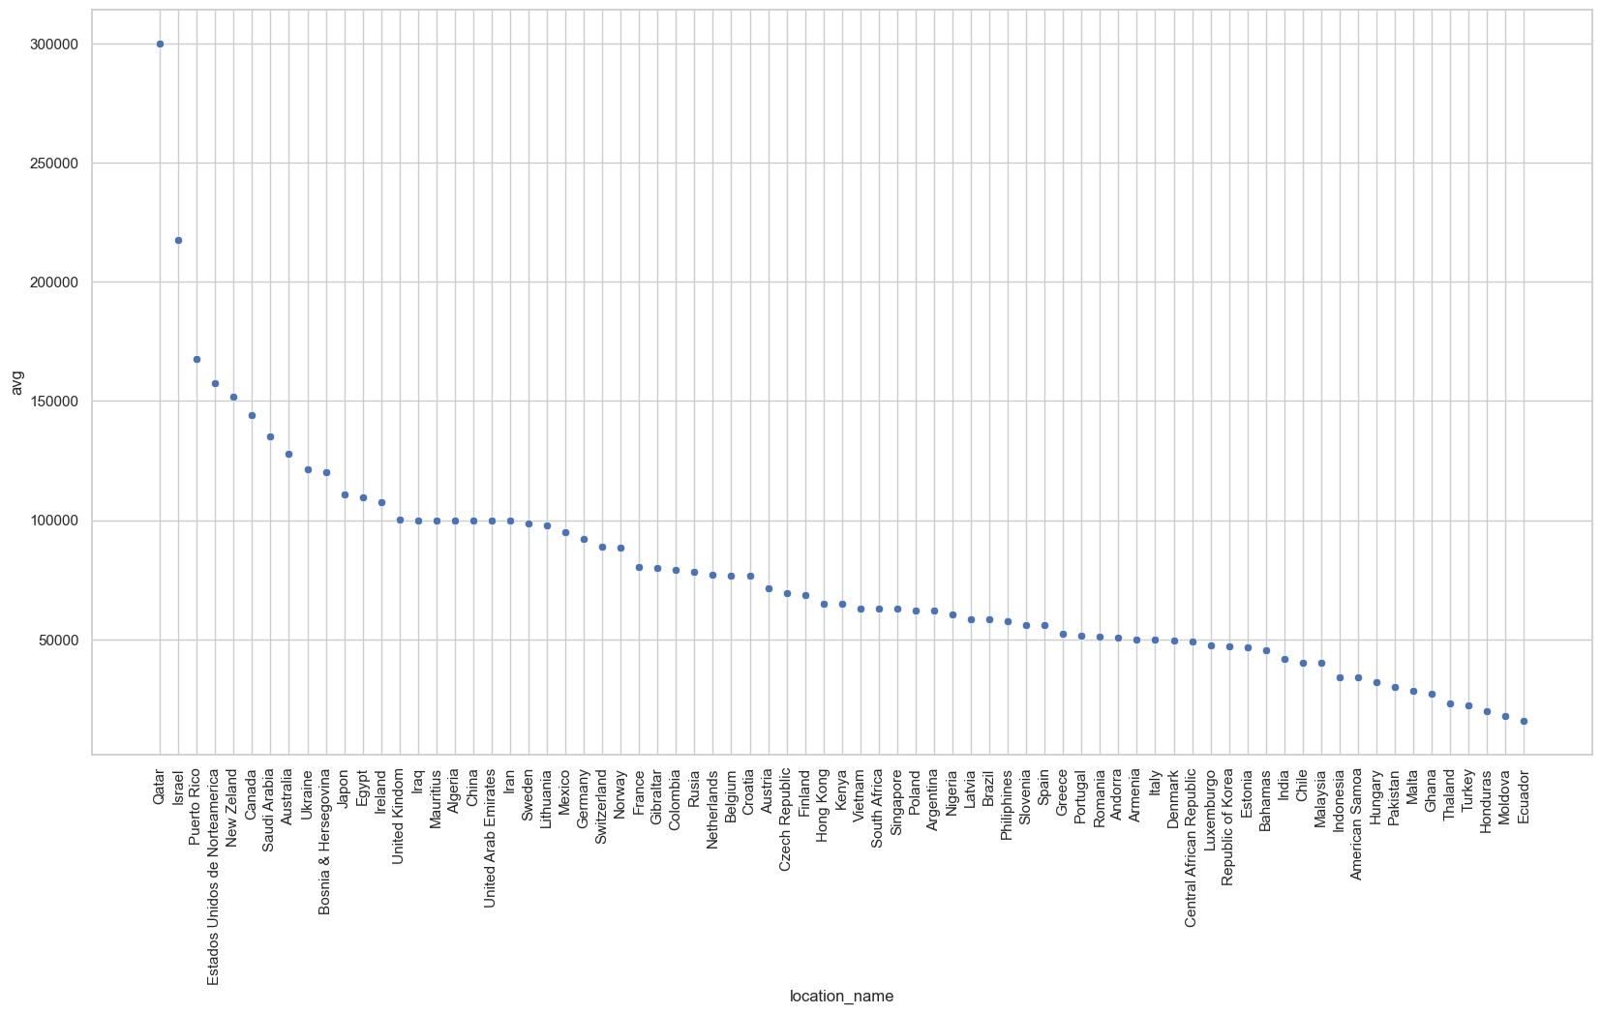
Avg salaries of some countrys
01
02
03
04

Slide 12
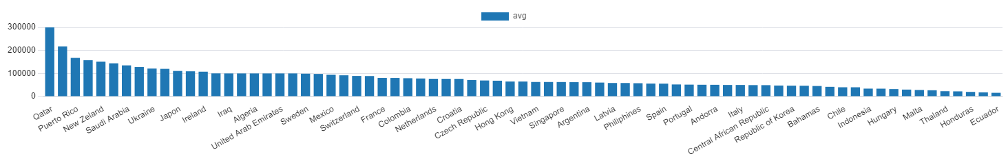
Avg salaries of the countrys
01
02
03
04

Slide 13
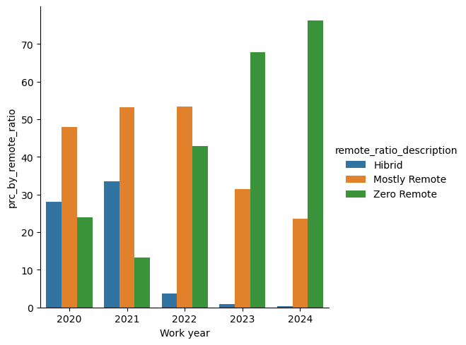
% of the ratio work through the years (2020-2024)
01
02
03
04

Slide 14
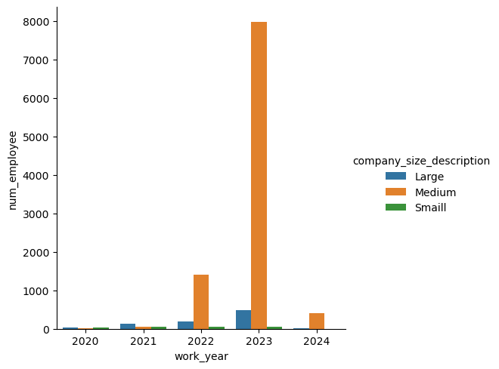
Number of employees by Company Size

Slide 15
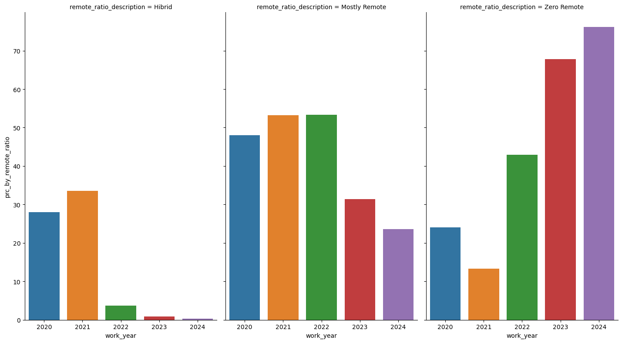
% of the ratio work through the years (2020-2024)

Slide 16
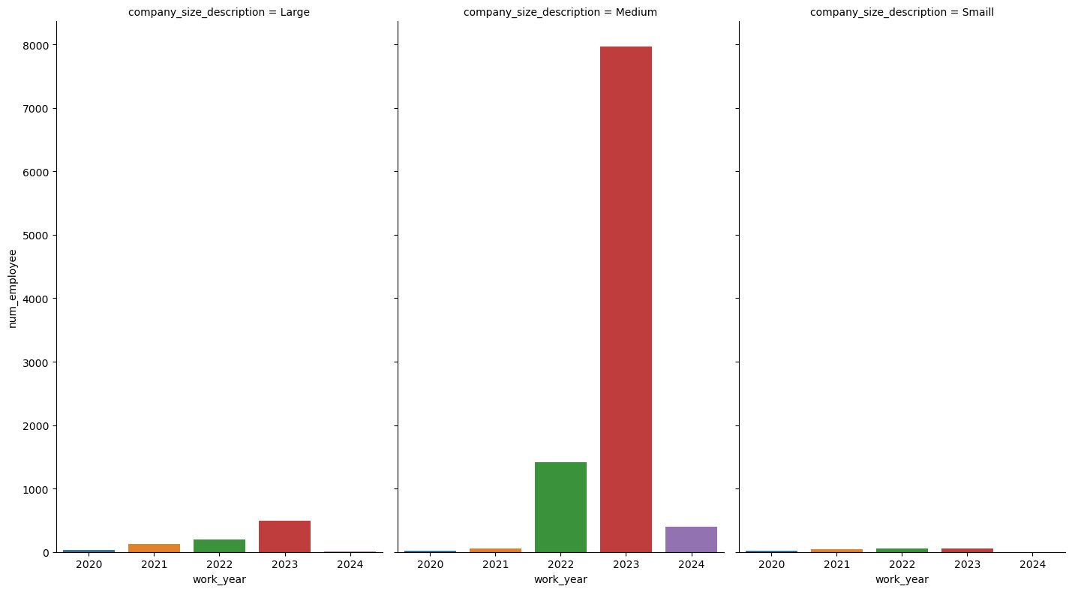
Number of employees by Company Size

Slide 17
