Slide 1
Weekly meeting 17/03

Slide 2
Decoding technique
Technique taken from Jensen and Gran (﻿Spatial Encoding Using a Code Division Technique for Fast Ultrasound Imaging)
Simultaneous Tramission of PN sequences in STA (same framework as us)
Received data is decoded thanks to the knowledge of the transmitted code sequences, based on Maximum Likelihood estimation of the scattering function (equivalent to the medium impulse response)

Slide 3
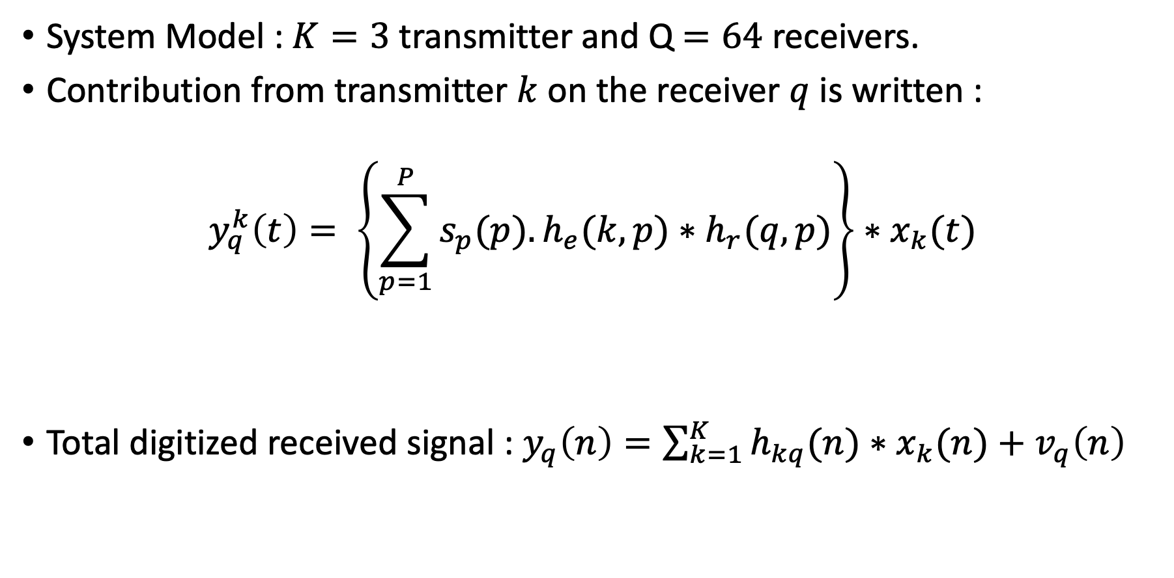

Decoding technique
System Model : $K=3$ transmitter and Q$=64$ receivers.
Contribution from transmitter $k$ on the receiver $q$ is written :
$$y_{q}^{k}\left(t\right)= \left\{\sum_{p=1}^{P}{s_{p}(p).h_{e}(k,p)∗h_{r}(q,p)}\right\}∗x_{k}(t)$$
Total digitized received signal : $y_{q}\left(n\right)=\sum_{k=1}^{K}{h_{kq}(n)∗x_{k}(n)}+v_{q}\left(n\right)$
$$h_{kq}(t)$$

Slide 4

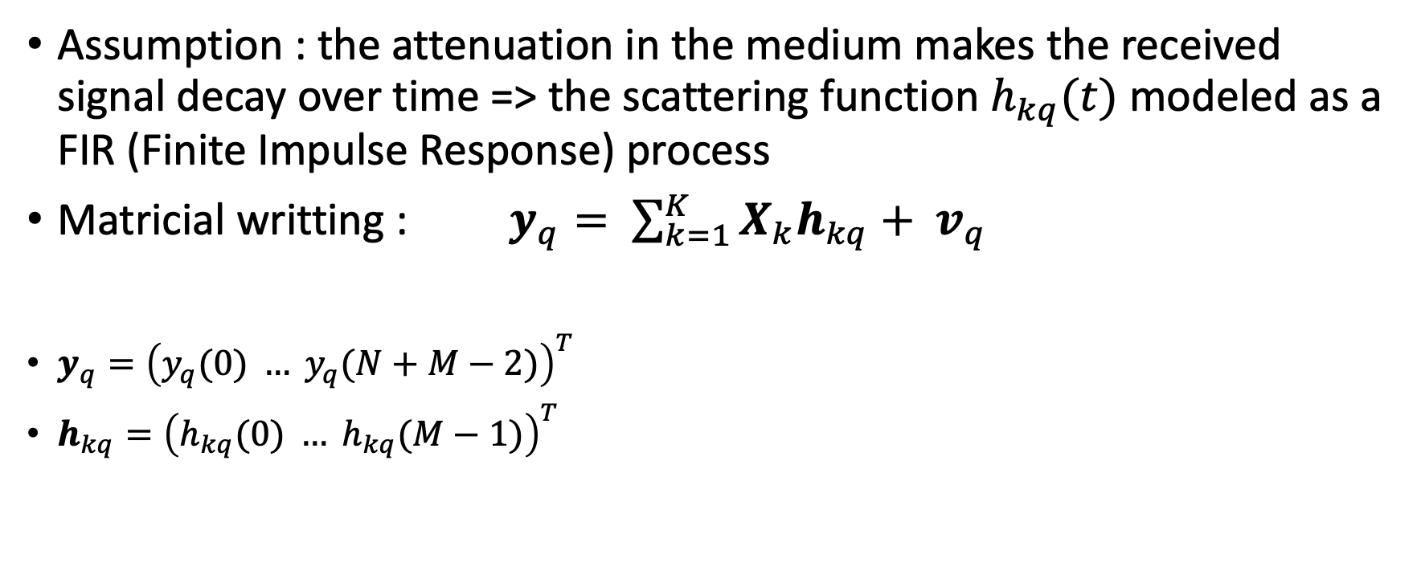


Decoding technique
Assumption : the attenuation in the medium makes the received signal decay over time => the scattering function $h_{kq}(t)$ modeled as a FIR (Finite Impulse Response) process
Matricial writting : $y_{q}= \sum_{k=1}^{K}{X_{k}h_{kq}+ v_{q}}$
$y_{q}={\left(y_{q}(0) … y_{q}(N+M−2)\right)}^{T}$
$h_{kq}={\left(h_{kq}(0) … h_{kq}(M−1)\right)}^{T}$
$$M$$
$$X_{k}= \left[\begin{matrix}\begin{matrix}x_{k}\left(0\right) \\ x_{k}\left(1\right)\end{matrix} & \begin{matrix}\begin{aligned} \\ 0\end{aligned} \\ \begin{matrix}x_{k}\left(0\right) \\ x_{k}\left(1\right)\end{matrix}\end{matrix} & \begin{matrix}\begin{matrix}0\begin{matrix} & 0\end{matrix} \\ 0\begin{matrix} & 0\end{matrix}\end{matrix} & \begin{matrix} \\ \end{matrix}\end{matrix} \\ ⋮ & ⋮ & ⋮ \\ \begin{matrix}x_{k}\left(N−1\right) \\ \begin{matrix}0 \\ \begin{matrix}⋮ \\ 0\end{matrix}\end{matrix}\end{matrix} & \begin{matrix}x_{k}\left(N−1\right) \\ \begin{matrix}0 \\ \begin{matrix}⋮ \\ 0\end{matrix}\end{matrix}\end{matrix} & \begin{matrix}\begin{matrix}⋱ & \begin{matrix}x_{k}\left(0\right) \\ x_{k}\left(1\right)\end{matrix}\end{matrix} \\ \begin{matrix}\begin{matrix} & ⋮\end{matrix} \\ \begin{matrix} & x_{k}\left(N−1\right)\end{matrix}\end{matrix}\end{matrix}\end{matrix}\right]$$
$$M+N−1$$

Slide 5

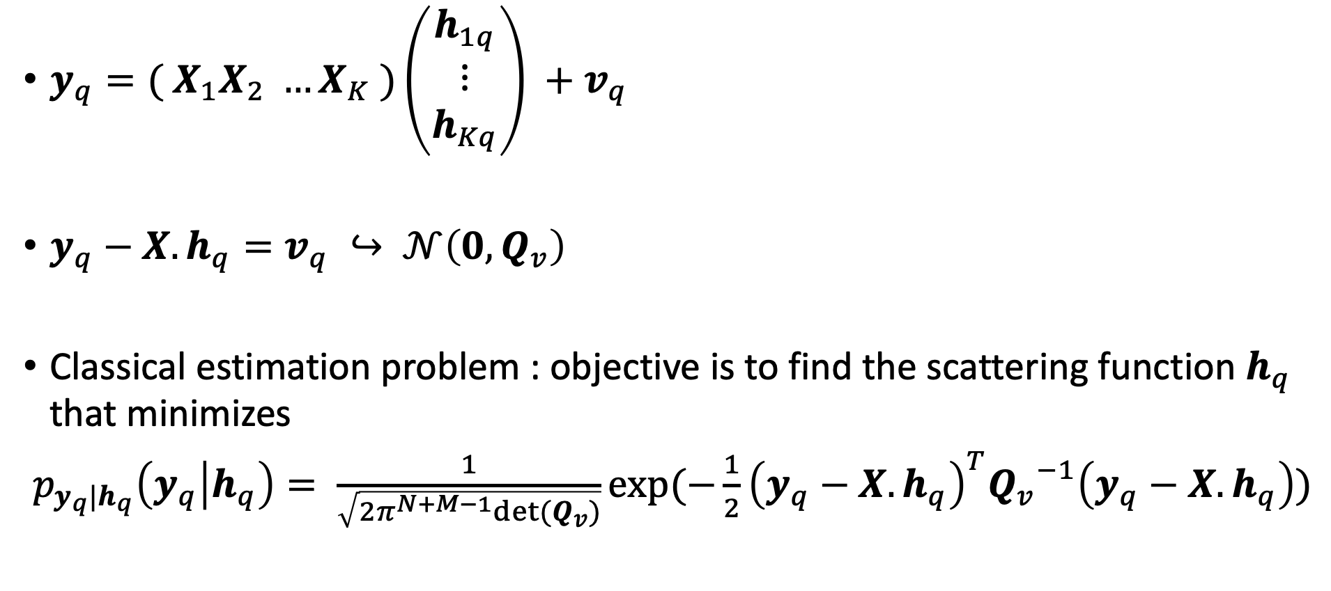

Decoding technique
$y_{q}={( X}_{1}X_{2} …X_{K} )\left(\begin{matrix}h_{1q} \\ ⋮ \\ h_{Kq}\end{matrix}\right) +v_{q}$
$y_{q}−X.h_{q}=v_{q} ↪ 𝒩\left(0,Q_{v}\right)$
Classical estimation problem : objective is to find the scattering function $h_{q}$ that minimizes
$p_{y_{q}|h_{q}}\left(y_{q} | h_{q}\right)= \frac{1}{\sqrt{{2π}^{N+M−1}det⁡(Q_{v})}}exp⁡(−\frac{1}{2}{\left(y_{q}−X.h_{q}\right)}^{T}{Q_{v}}^{−1}\left(y_{q}−X.h_{q}\right))$
$$X$$
$$h_{q}$$

Slide 6
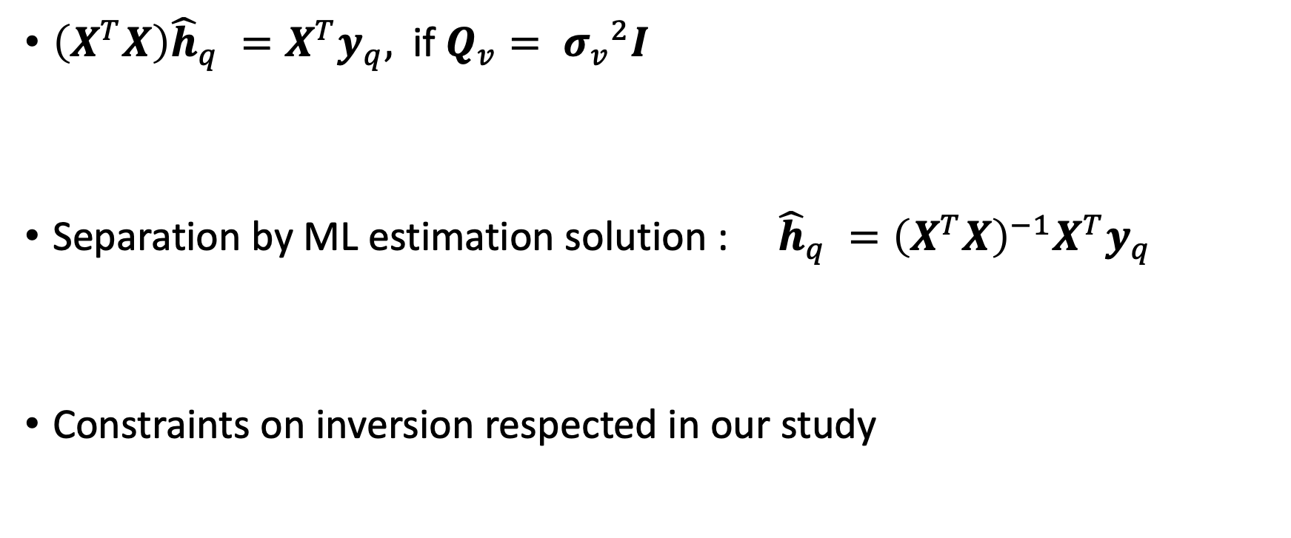
Decoding technique
$﻿\left(X^{T}X\right){\hat{h}}_{q} =X^{T}y_{q},$ if $Q_{v}= {σ_{v}}^{2}I$
Separation by ML estimation solution : ${\hat{h}}_{q} ={{﻿\left(X^{T}X\right)}^{−1}X}^{T}y_{q}$
Constraints on inversion respected in our study

Slide 7
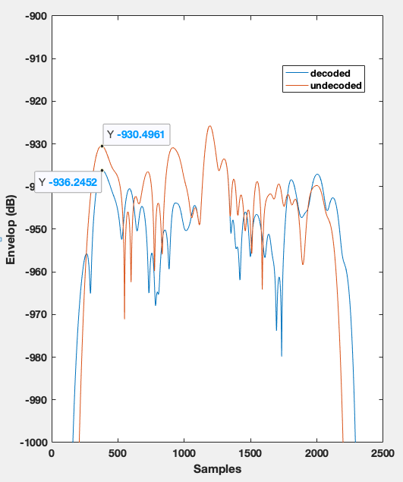
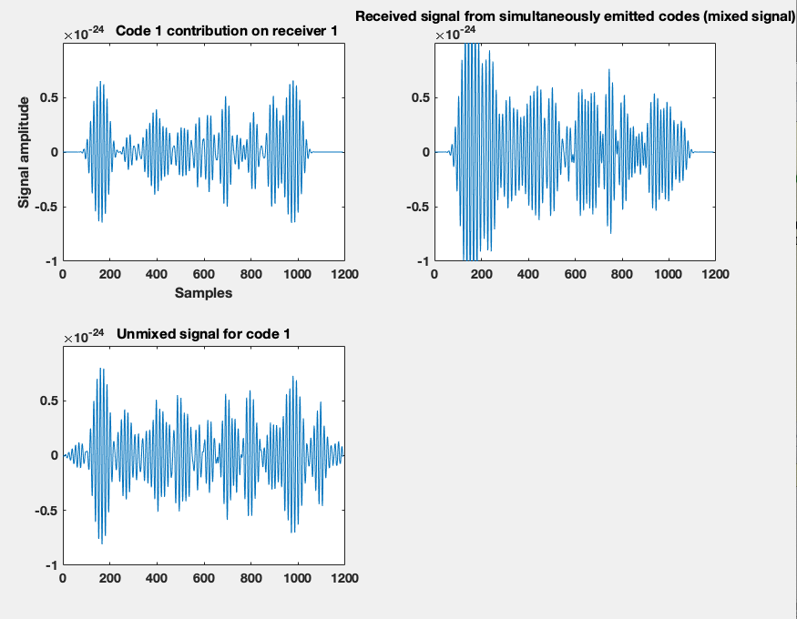




Results
$$y_{q}^{k}\left(t\right)=h_{kq}(t)∗x_{k}(t)$$
Matched filter
$$y_{1}^{1}\left(t\right)$$
$$y_{1}$$
$${\hat{y}}_{1}^{1}= {\hat{h}}_{11}∗x_{1}$$

Slide 8
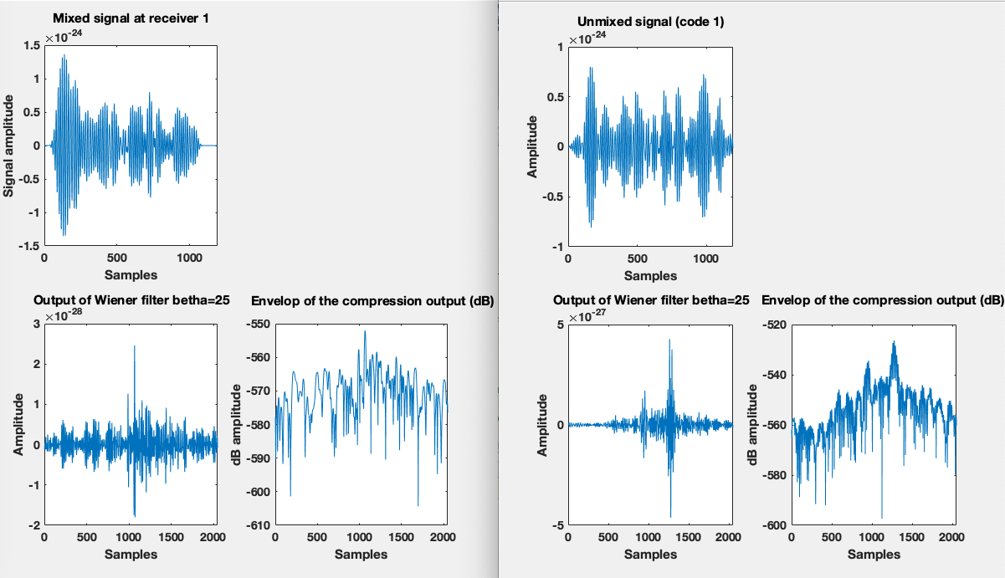
Results

Slide 9
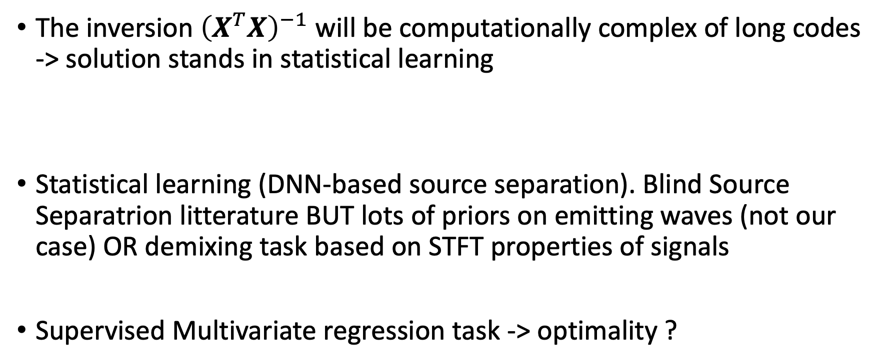
Future work
The inversion ${﻿\left(X^{T}X\right)}^{−1}$ will be computationally complex of long codes -> solution stands in statistical learning
Statistical learning (DNN-based source separation). Blind Source Separatrion litterature BUT lots of priors on emitting waves (not our case) OR demixing task based on STFT properties of signals
Supervised Multivariate regression task -> optimality ?

Slide 10
Mismatch filtering
Changing the tradeoff between the SNR optimality of the matched filter and the PSL (or ISL).
Algorithms based on PSL minimization criteria exist in the radar litterature (﻿Quadratically Constrained Quadratic Programs for Mismatched Filter Optimization with Radar Applications O. Rabaste, L. Savy)

Slide 11

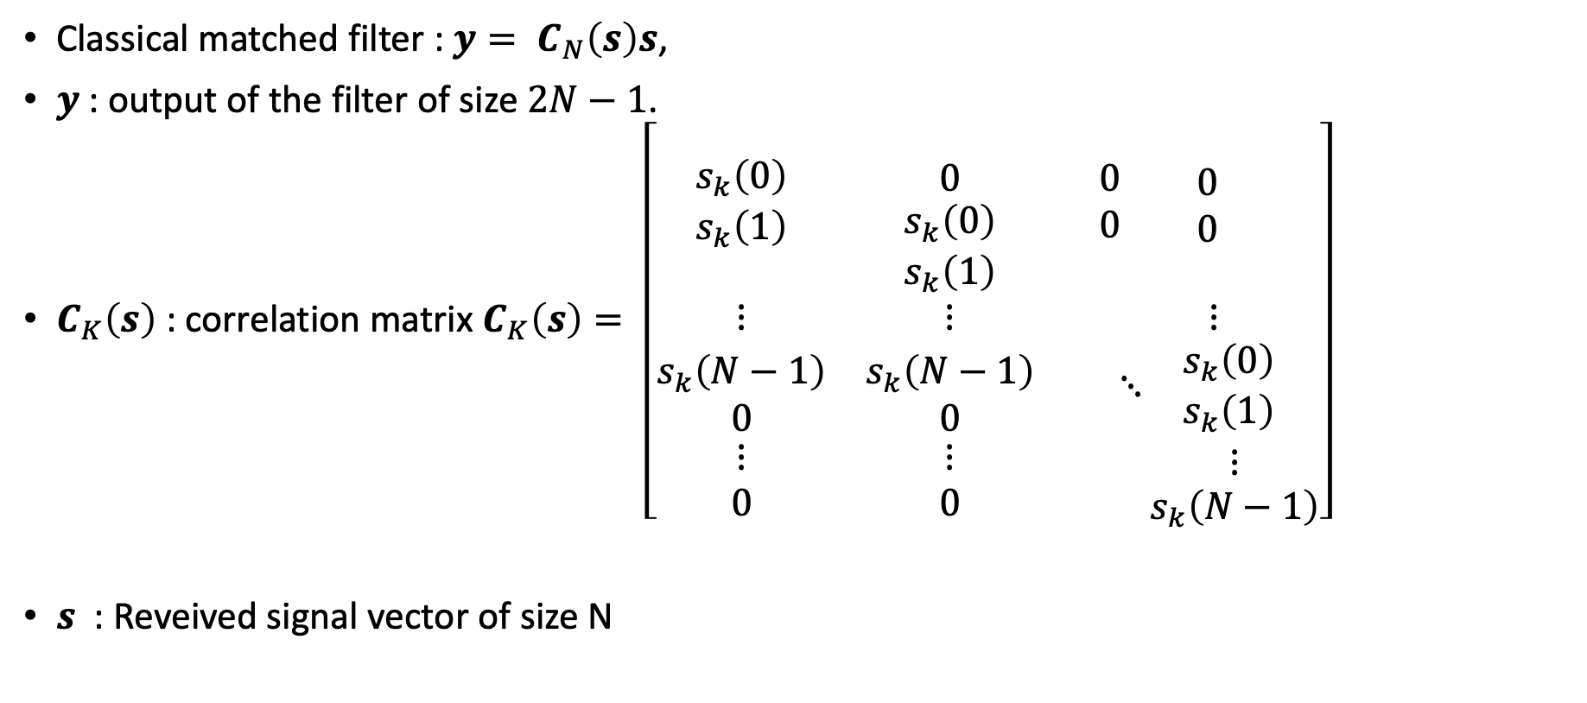

Mismatch filter optimization
Classical matched filter : $y= C_{N}\left(s\right)s$,
$y$ : output of the filter of size $2N−1$.
$C_{K}\left(s\right)$ : correlation matrix $C_{K}\left(s\right)= \left[\begin{matrix}\begin{matrix}s_{k}\left(0\right) \\ s_{k}\left(1\right)\end{matrix} & \begin{matrix}\begin{aligned} \\ 0\end{aligned} \\ \begin{matrix}s_{k}\left(0\right) \\ s_{k}\left(1\right)\end{matrix}\end{matrix} & \begin{matrix}\begin{matrix}0\begin{matrix} & 0\end{matrix} \\ 0\begin{matrix} & 0\end{matrix}\end{matrix} & \begin{matrix} \\ \end{matrix}\end{matrix} \\ ⋮ & ⋮ & ⋮ \\ \begin{matrix}s_{k}\left(N−1\right) \\ \begin{matrix}0 \\ \begin{matrix}⋮ \\ 0\end{matrix}\end{matrix}\end{matrix} & \begin{matrix}s_{k}\left(N−1\right) \\ \begin{matrix}0 \\ \begin{matrix}⋮ \\ 0\end{matrix}\end{matrix}\end{matrix} & \begin{matrix}\begin{matrix}⋱ & \begin{matrix}s_{k}\left(0\right) \\ s_{k}\left(1\right)\end{matrix}\end{matrix} \\ \begin{matrix}\begin{matrix} & ⋮\end{matrix} \\ \begin{matrix} & s_{k}\left(N−1\right)\end{matrix}\end{matrix}\end{matrix}\end{matrix}\right]$
$s$ : Reveived signal vector of size N
$$K$$
$$K+N−1$$

Slide 12
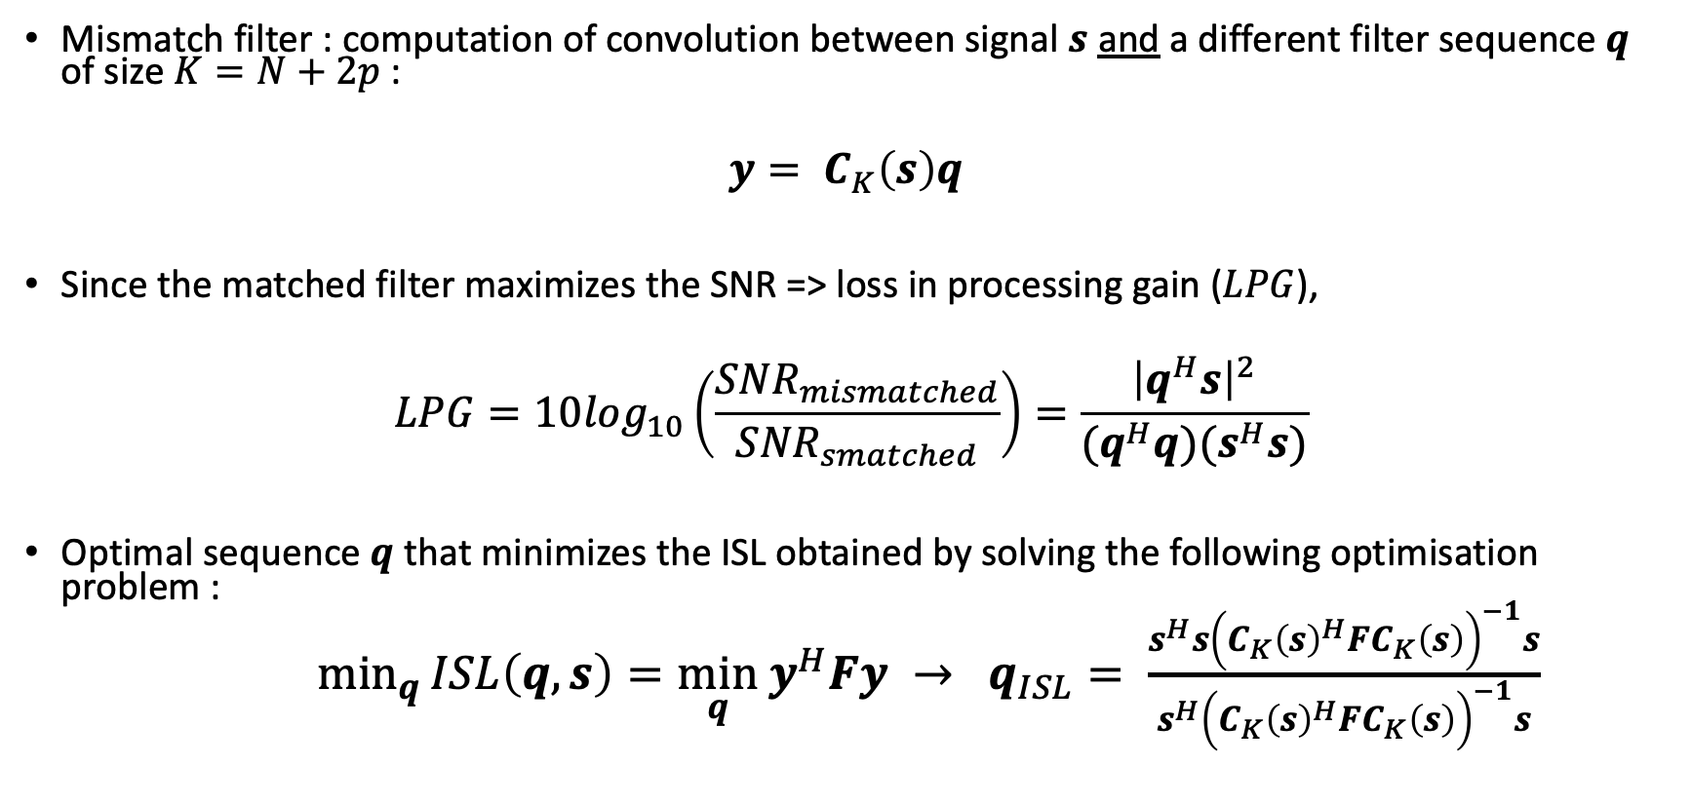

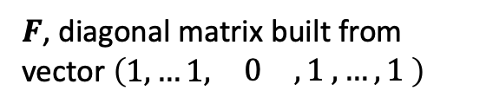
Mismatch filter optimization
Mismatch filter : computation of convolution between signal $s$ and a different filter sequence $q$ of size $K=N+2p$:
$$y= C_{K}\left(s\right)q$$
Since the matched filter maximizes the SNR => loss in processing gain ($LPG$),
$$LPG=10\log_{10}\left(\frac{{SNR}_{mismatched}}{{SNR}_{smatched}}\right)=\frac{{\left|q^{H}s\right|}^{2}}{{(q}^{H}q)(s^{H}s)}$$
Optimal sequence $q$ that minimizes the ISL obtained by solving the following optimisation problem :
$\min_{q}{ISL\left(q,s\right)=\min_{q} y^{H}Fy} → q_{ISL}= \frac{s^{H}s{\left({{C_{K}\left(s\right)}^{H}FC}_{K}\left(s\right)\right)}^{−1}s}{s^{H}{\left({{C_{K}\left(s\right)}^{H}FC}_{K}\left(s\right)\right)}^{−1}s}$
$$s.t{ s}^{H}q{=s}^{H}s$$
$F$, diagonal matrix built from vector $\left(\begin{matrix}1,…1, & \begin{matrix}0 & , 1 , …, 1 \end{matrix}\end{matrix}\right)$

Slide 13
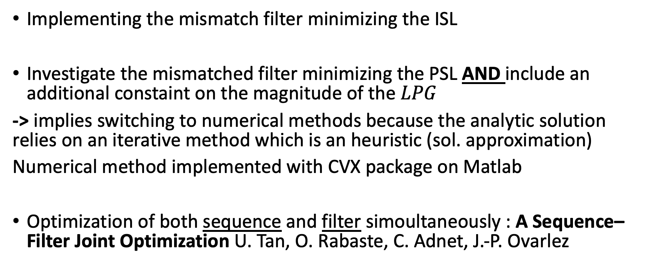
Futur work
Implementing the mismatch filter minimizing the ISL
Investigate the mismatched filter minimizing the PSL AND include an additional constaint on the magnitude of the $LPG$
-> implies switching to numerical methods because the analytic solution relies on an iterative method which is an heuristic (sol. approximation)
Numerical method implemented with CVX package on Matlab
Optimization of both sequence and filter simoultaneously : ﻿A Sequence–Filter Joint Optimization ﻿U. Tan, O. Rabaste, C. Adnet, J.-P. Ovarlez

