Slide 1
AI Efficiency Benchmarking for Cybersecurity Analysis
Does the AI in security tools earn what it costs?
Nicole Welch | Network Security | SIP311 | SME: Briant Becote
Notes:
Hi, I'm Nicole Welch, a Network Security major at UAT. My project is AI Efficiency Benchmarking for Cybersecurity Analysis. The short version: I want to find out if the AI being added to security tools is actually worth what it costs.

Slide 2
PROBLEM
AI is being added to security tools without proof
Vendors are building AI into security products by default
No one publishes the energy cost of these AI features
No one shows whether a traditional tool would catch the same threats
SOC teams pay for tools they cannot evaluate, and junior analysts lose hands-on reps
Notes:
Security vendors are building AI into everything right now, and SOC teams are buying it based on marketing. Nobody publishes how much energy these features use, or whether a well-tuned traditional tool would have caught the same threats. So teams pay for AI they can't evaluate, and junior analysts lose the hands-on work that builds real skill.

Slide 3
INNOVATION CLAIM
Accuracy and energy, measured side by side
This framework runs the same network traffic through an AI pipeline and a traditional pipeline, then scores both on detection accuracy, false positives, processing time, and carbon emissions. No existing tool compares AI and non-AI security analysis on both accuracy and energy cost.
Notes:
My framework runs the same network traffic through an AI pipeline and a traditional pipeline, then scores both on detection accuracy, false positives, processing time, and carbon emissions. No existing tool compares AI and non-AI security analysis on both accuracy and energy cost.

Slide 4
TECHNICAL EXPERTISE
Tools and coursework behind the build
TOOLS
UAT COURSES
Python
Zeek
scikit-learn
CodeCarbon
CSC235 Python Programming I
NTS370 Shell Scripting
CSC338 Statistical Data Science
NTS350 Network Security Monitoring
NTS465 Security Evaluation and Assessment
Notes:
The build uses Python, Zeek, scikit-learn, and CodeCarbon. It pulls from my coursework in Python, shell scripting, statistical data science, network security monitoring, and security assessment.

Slide 5
PROJECT DESCRIPTION AND SCOPE
One task, two pipelines, one report
SCOPE
BUDGET
TIMELINE
One analysis task, two pipelines, one comparison report
$0. Every tool is open source
SIP311 plan and prototype
SIP408 working build
SIP409 showcase
Notes:
The scope is one analysis task, two pipelines, and one comparison report. The budget is zero, since every tool is open source. I plan and prototype this semester, build the working version in SIP408, and showcase it in SIP409.

Slide 6
TARGET MARKET
Who needs this
SOC analysts and managers
Security leaders making purchasing decisions
Security educators
Organizations with sustainability goals
Notes:
The users are SOC teams, security leaders making purchasing decisions, security educators, and organizations with sustainability goals.

Slide 7
PRIOR ART
What exists, and what is missing
Existing work | What it does | What is missing
CodeCarbon | Measures emissions from code | No measure of whether the work was any good
MLPerf Power (MLCommons) | Compares AI systems on energy | No comparison against non-AI methods
NIST AI RMF | Guides AI risk management | No way to measure environmental cost
Sources: CodeCarbon (n.d.), codecarbon.io; MLCommons (n.d.), Power, mlcommons.org; NIST (2023), AI RMF 1.0, doi.org/10.6028/NIST.AI.100-1
Notes:
CodeCarbon measures emissions but can't tell you if the work was any good. MLPerf Power compares AI systems against each other, not against non-AI methods. The NIST AI Risk Management Framework covers AI risk but gives no way to measure environmental cost. My project fills the gap between all three.

Slide 8
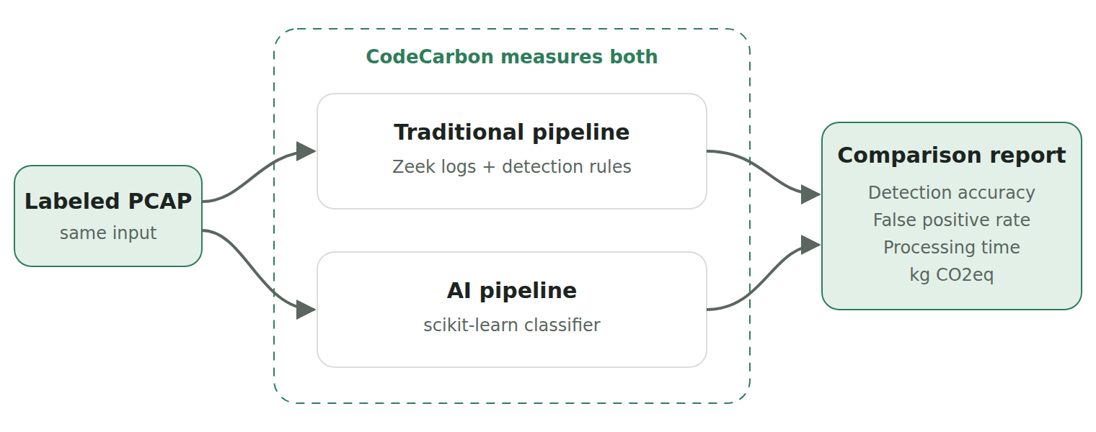
DESIGN-PHASE PROTOTYPE
How it works
Notes:
Here's how it works. A labeled packet capture goes into both pipelines. Zeek with detection rules on one side, a machine learning classifier on the other, and CodeCarbon measuring both.

Slide 9
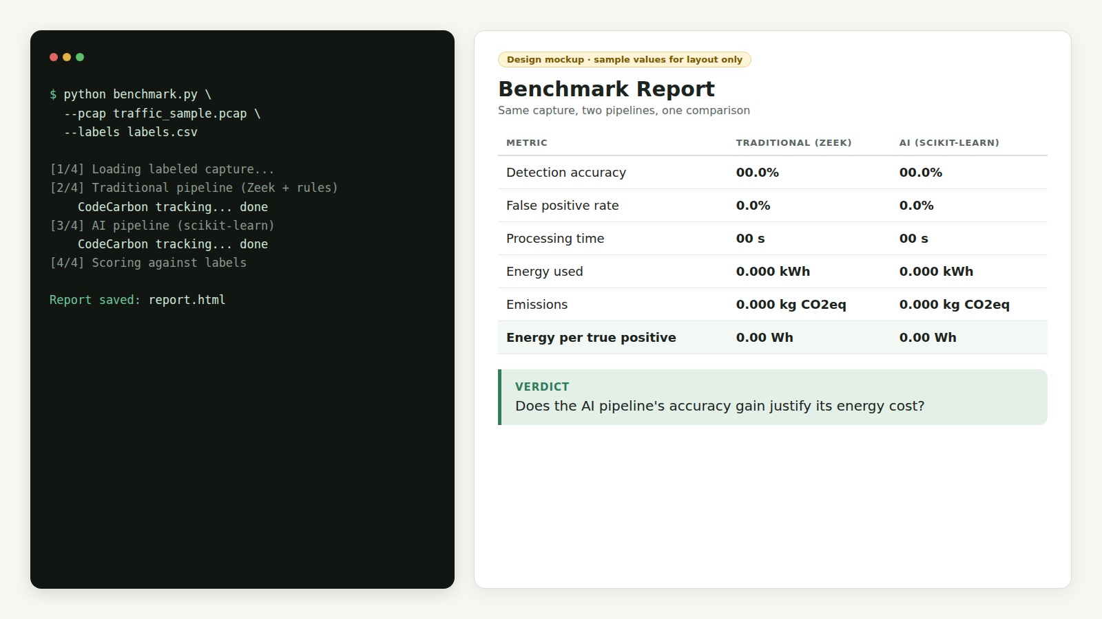
DESIGN-PHASE PROTOTYPE
What you get
Run one command
Get one report
Key number: energy per true positive
Notes:
You run one command, and you get this report: accuracy, false positives, time, energy, and emissions side by side. The key number is energy per true positive, meaning how much energy each method spends to catch one real threat. That answers the actual question: is the AI's gain worth its cost?

Slide 10
Thank you
breezebrise.github.io/SIP-Website
Nicole Welch | Network Security | University of Advancing Technology
Notes:
Thanks for watching. My full project page is on my SIP website.

