Slide 1
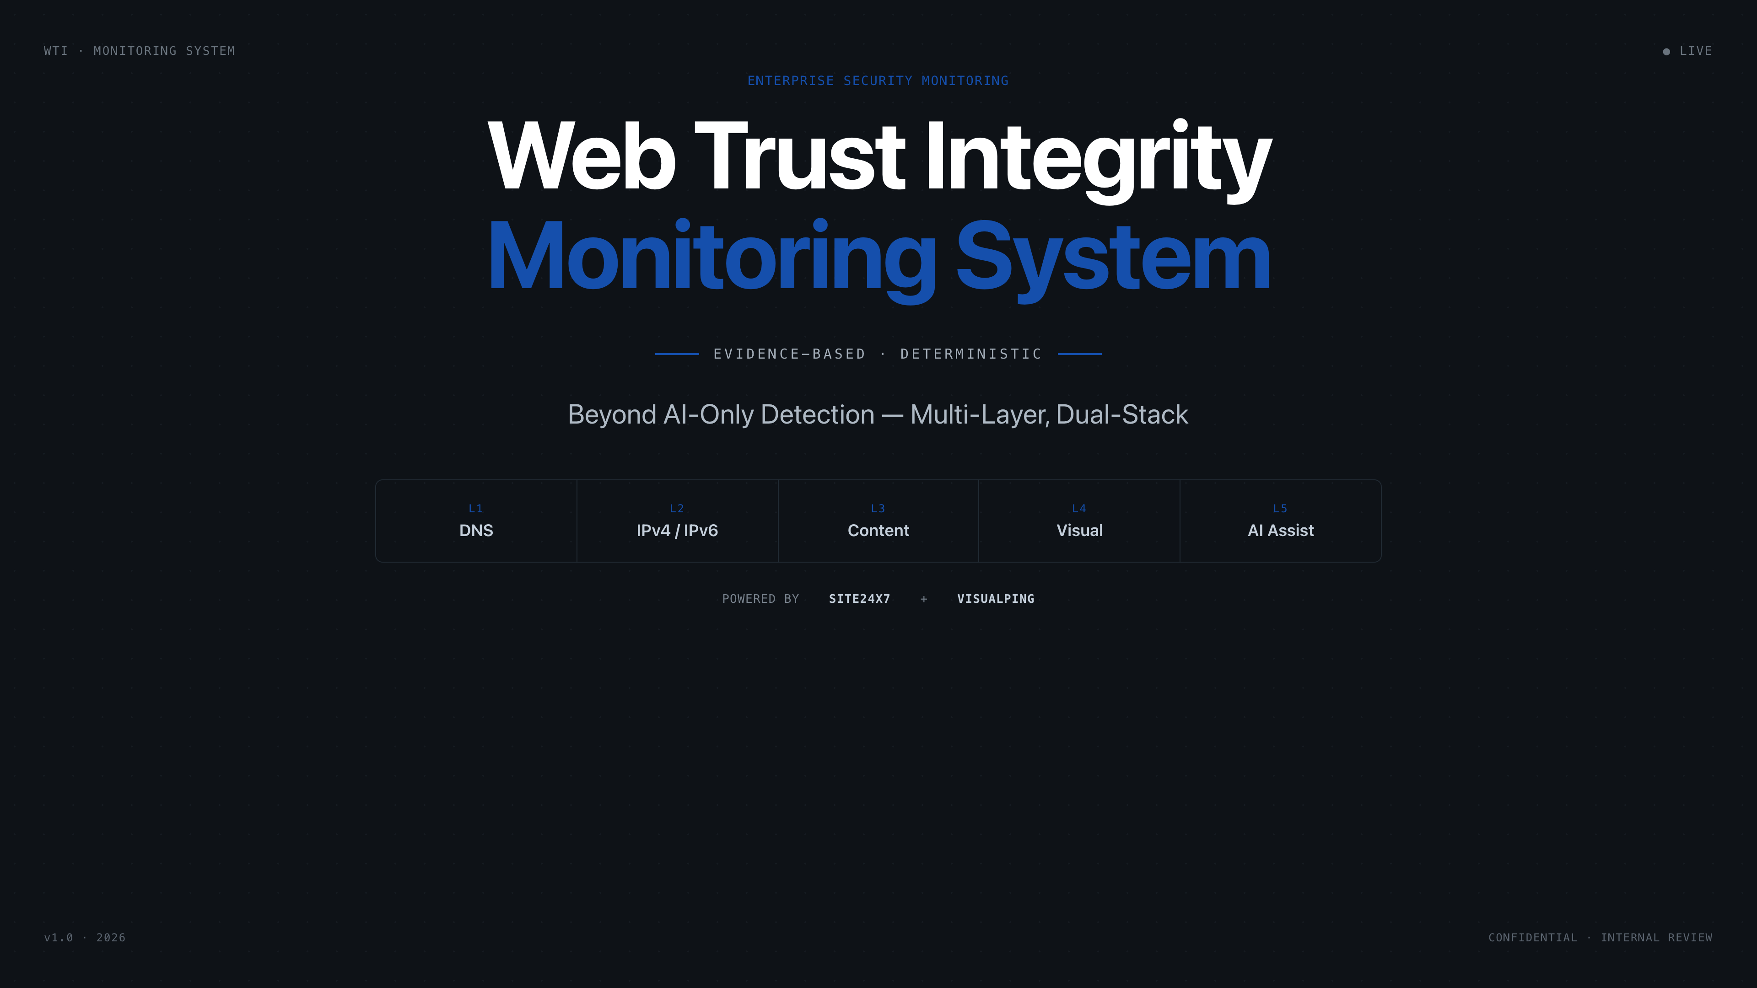
Notes:
01 Title Open with the problem space. Emphasize that this is not 'yet another monitoring tool' — it's a trust architecture. Mention Site24x7 + Visualping partnership.

Slide 2
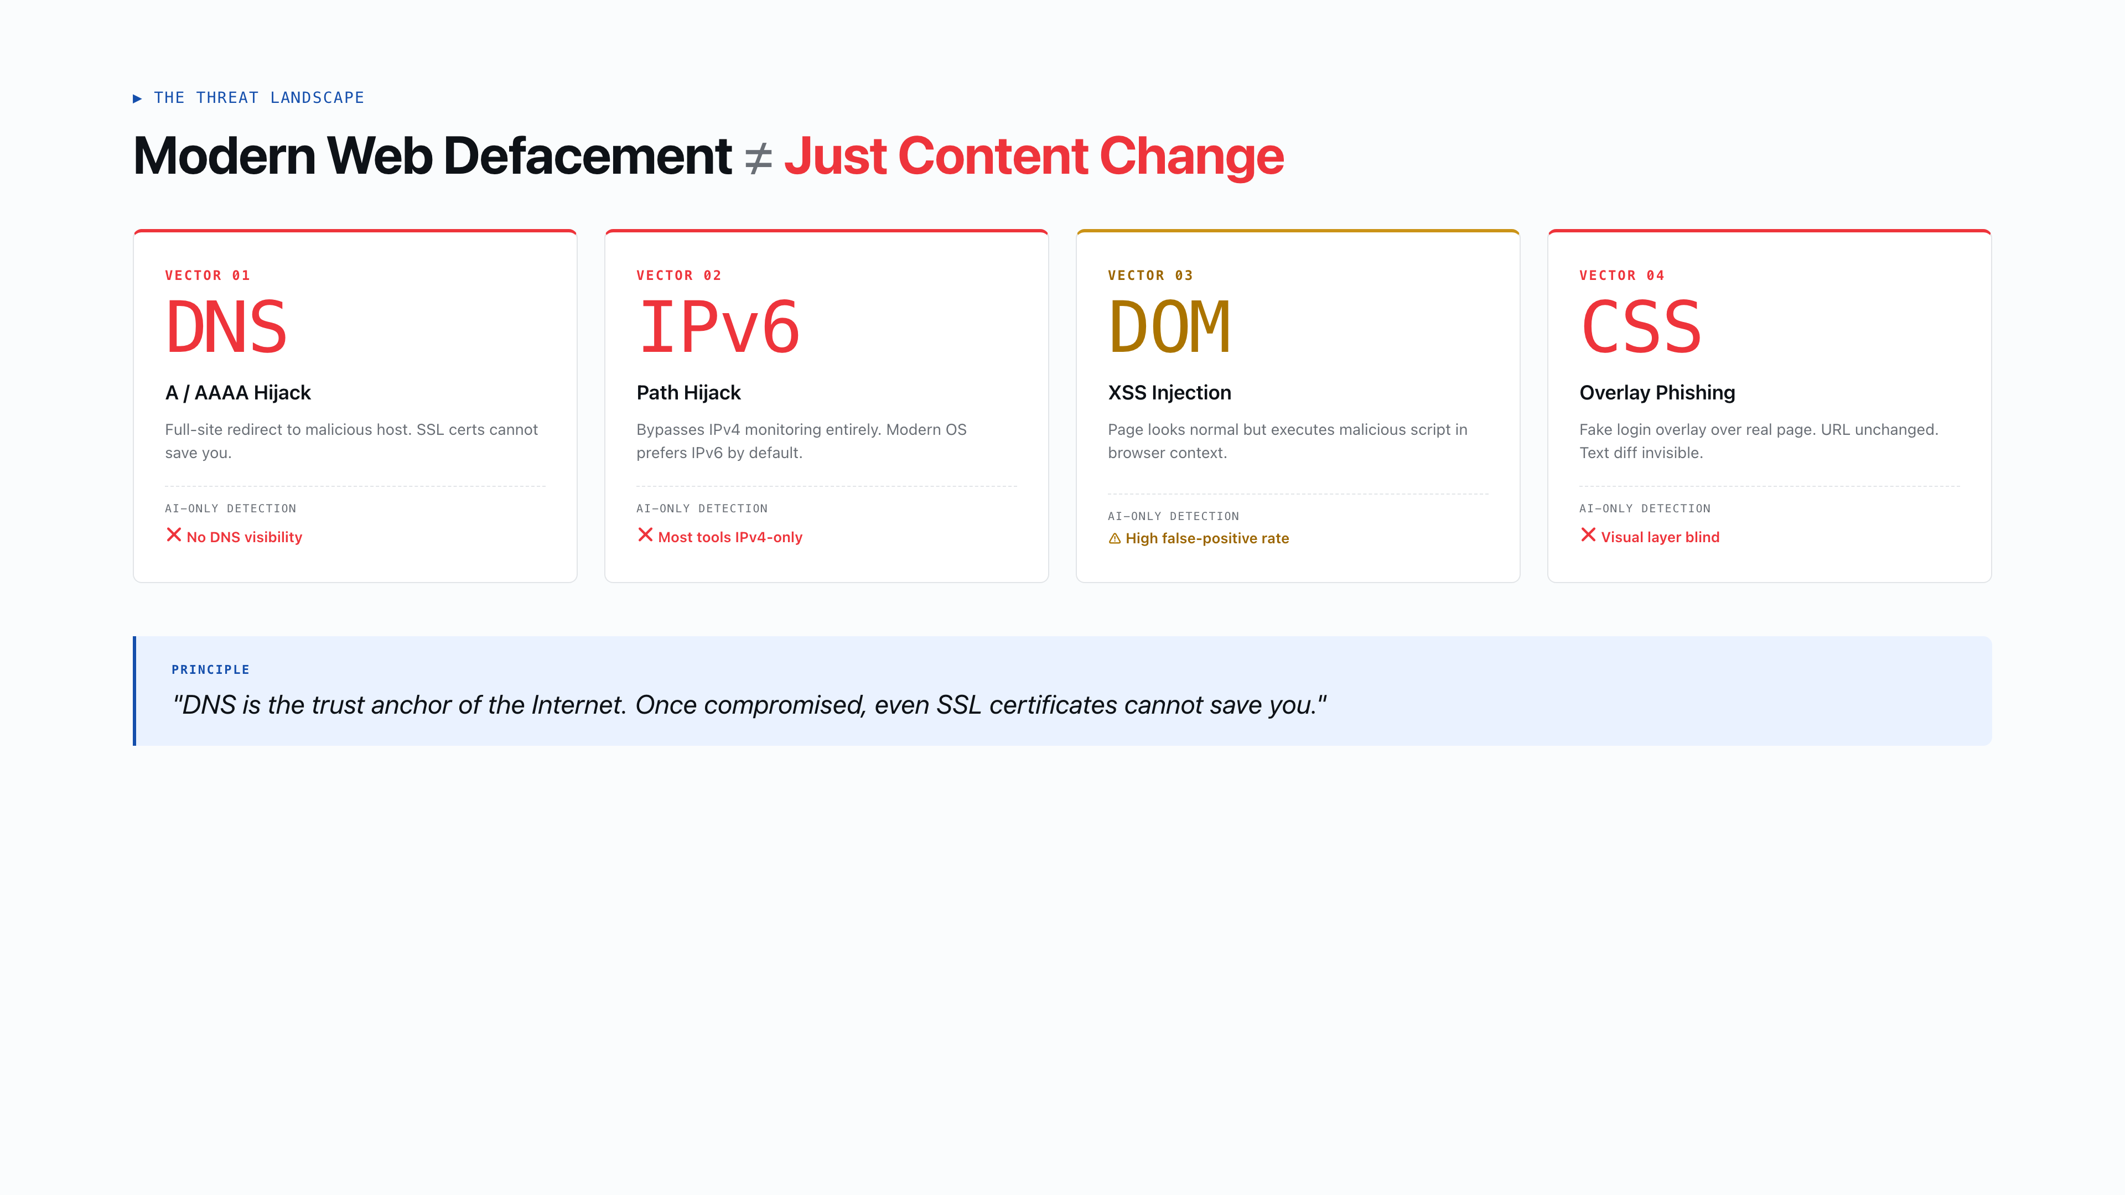
Notes:
02 The Real Problem Set the stakes. Modern defacement is not just 'content changed' — it's multi-layered. The 4 attack vectors show what AI-only tools miss. Emphasize DNS as the trust anchor.

Slide 3
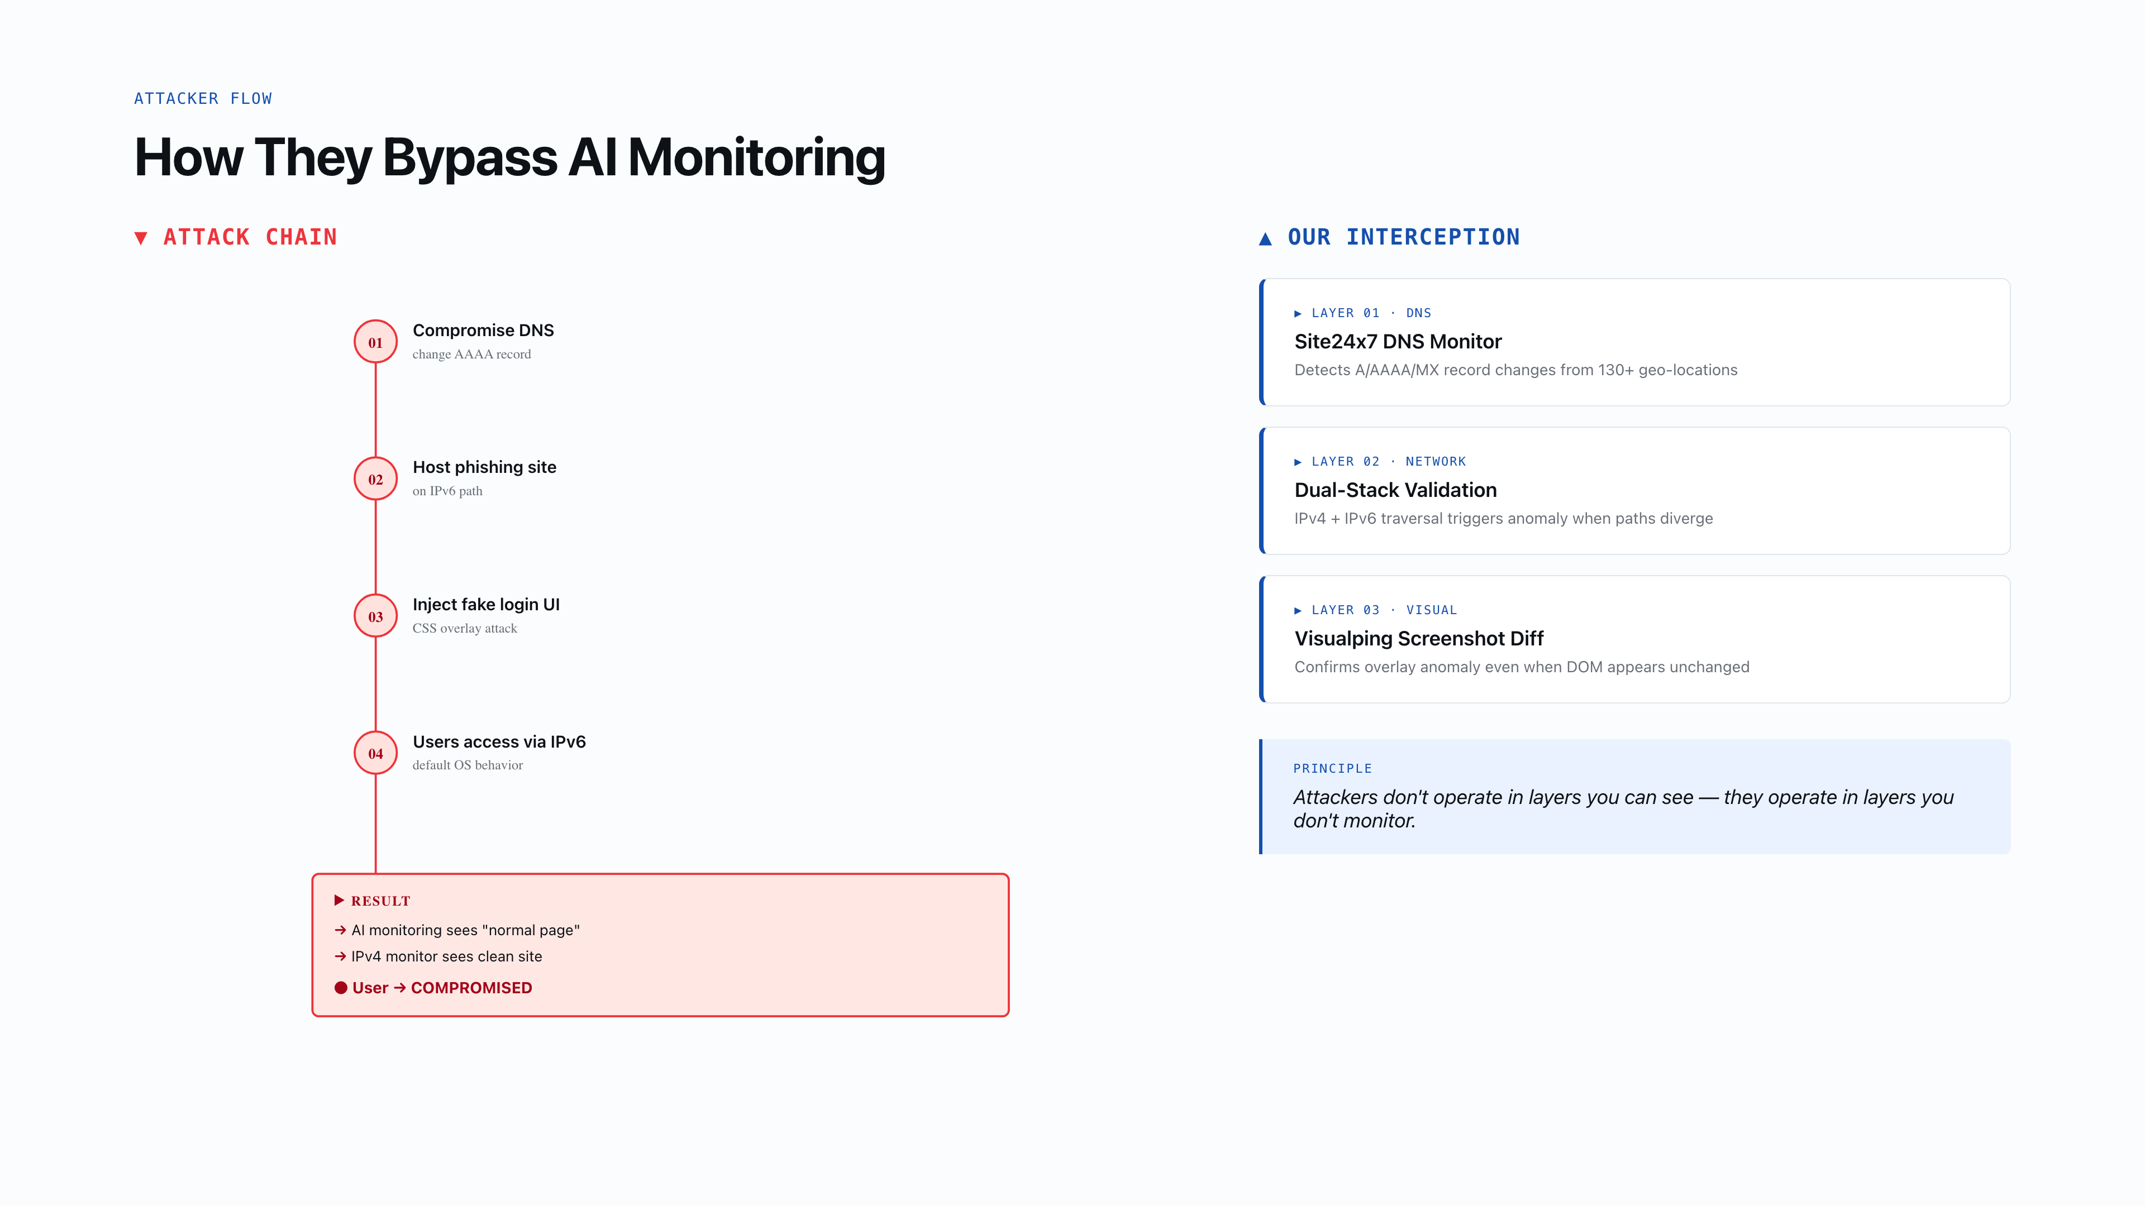
Notes:
03 Attack Simulation This is the soul slide. Walk through the attacker flow step by step. The animated path shows how each stage flows into the next. Then reveal our 3-layer interception. Use the animation to build tension.

Slide 4
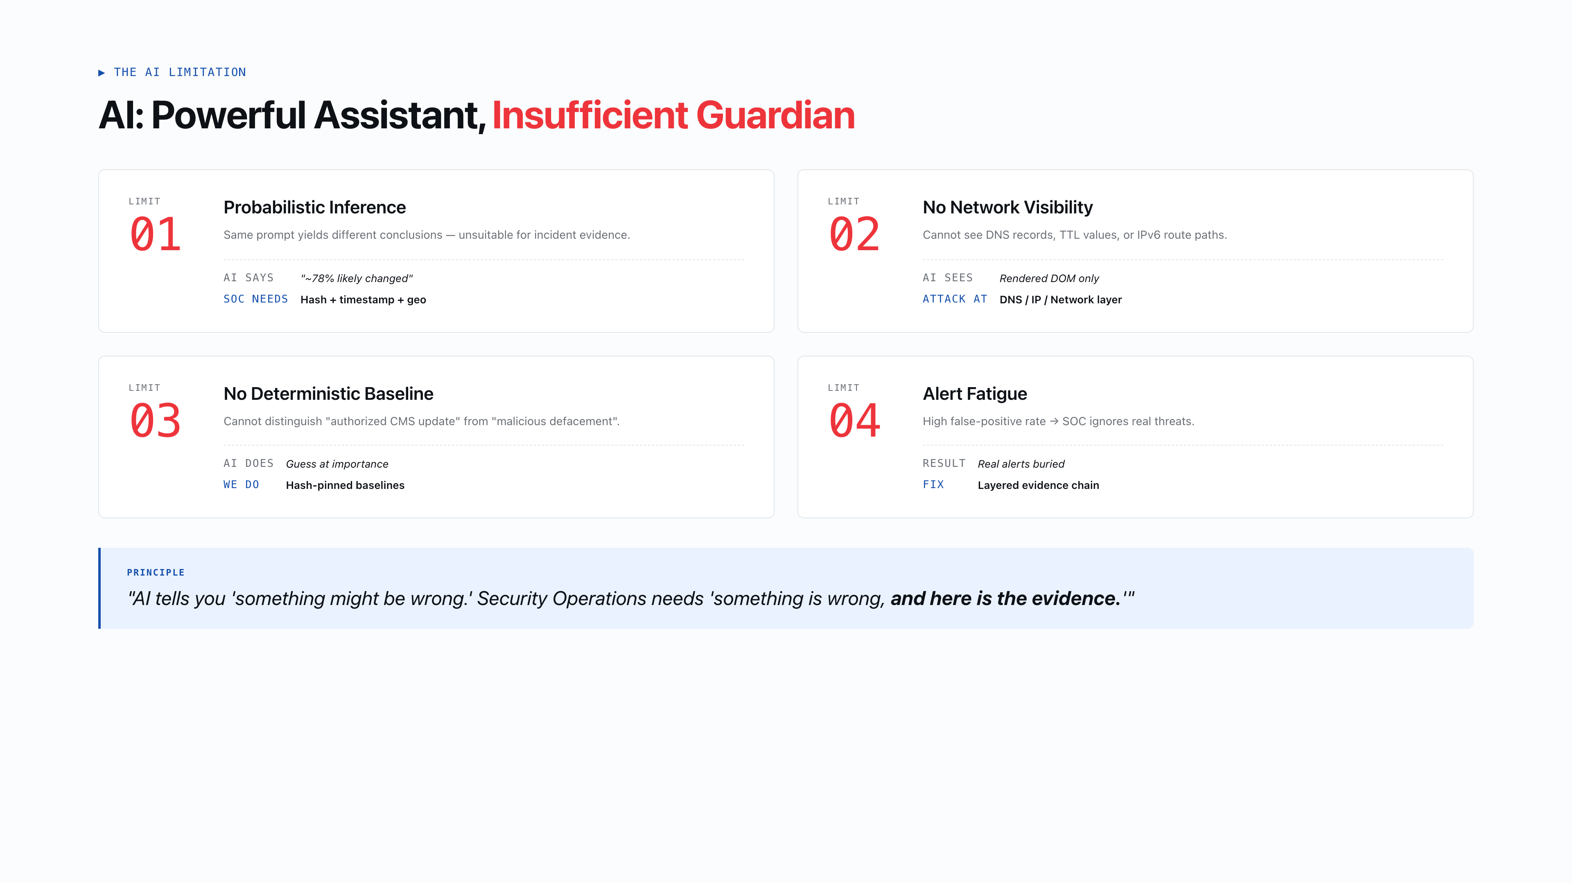
Notes:
04 AI-Only Fails Position AI as assistant, not guardian. The 4 limitations show why probabilistic inference is insufficient for incident response. Emphasize the evidence gap — SOC needs certainty, not probability.

Slide 5
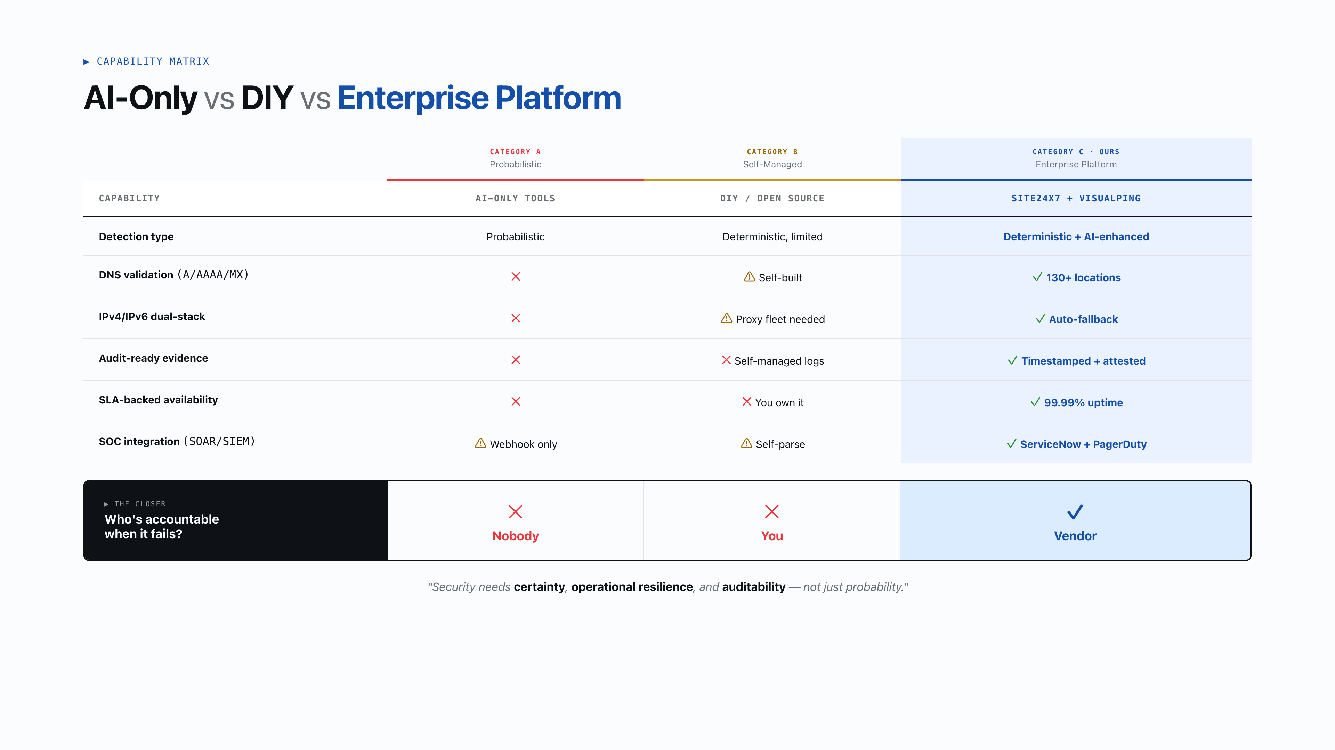
Notes:
05 Capability Comparison The kill slide. Walk through each row slowly. The 'Who is accountable?' row is the closer. Pause here — let the weight land. Enterprise buyers care about liability transfer.

Slide 6
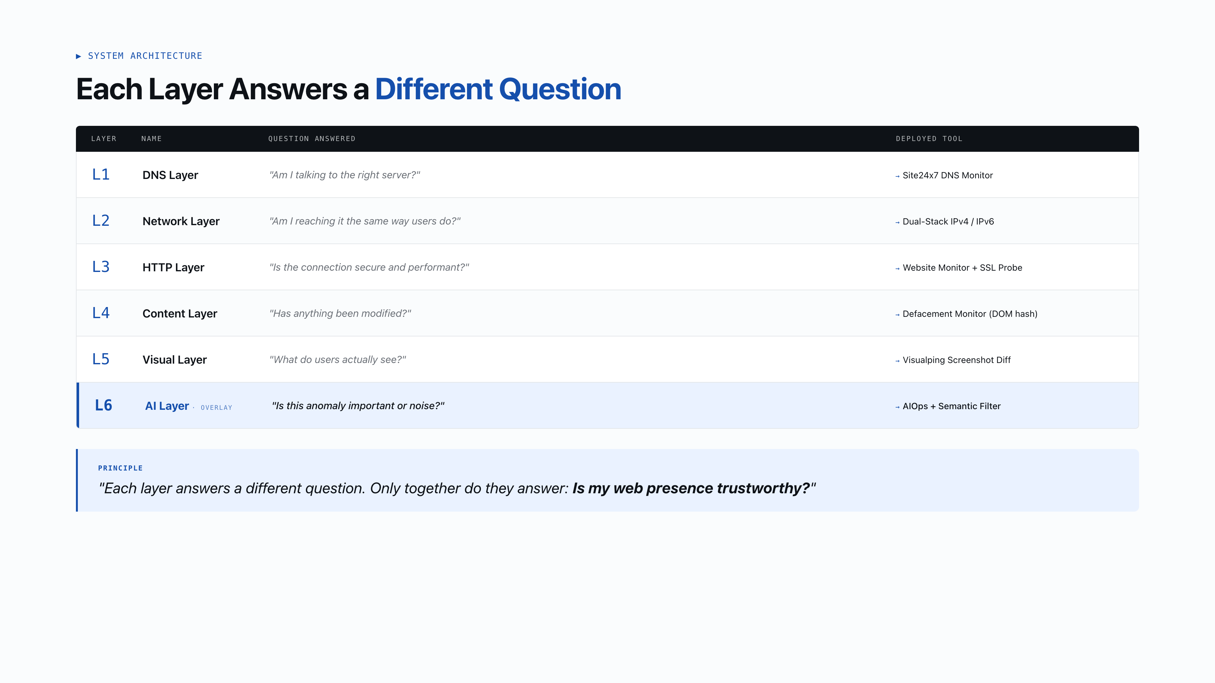
Notes:
06 Architecture The philosophy slide. Each layer answers ONE question. Don't rush — let the audience absorb the vertical flow. The tool mapping at the bottom is the practical hook. Close with the quote.

Slide 7
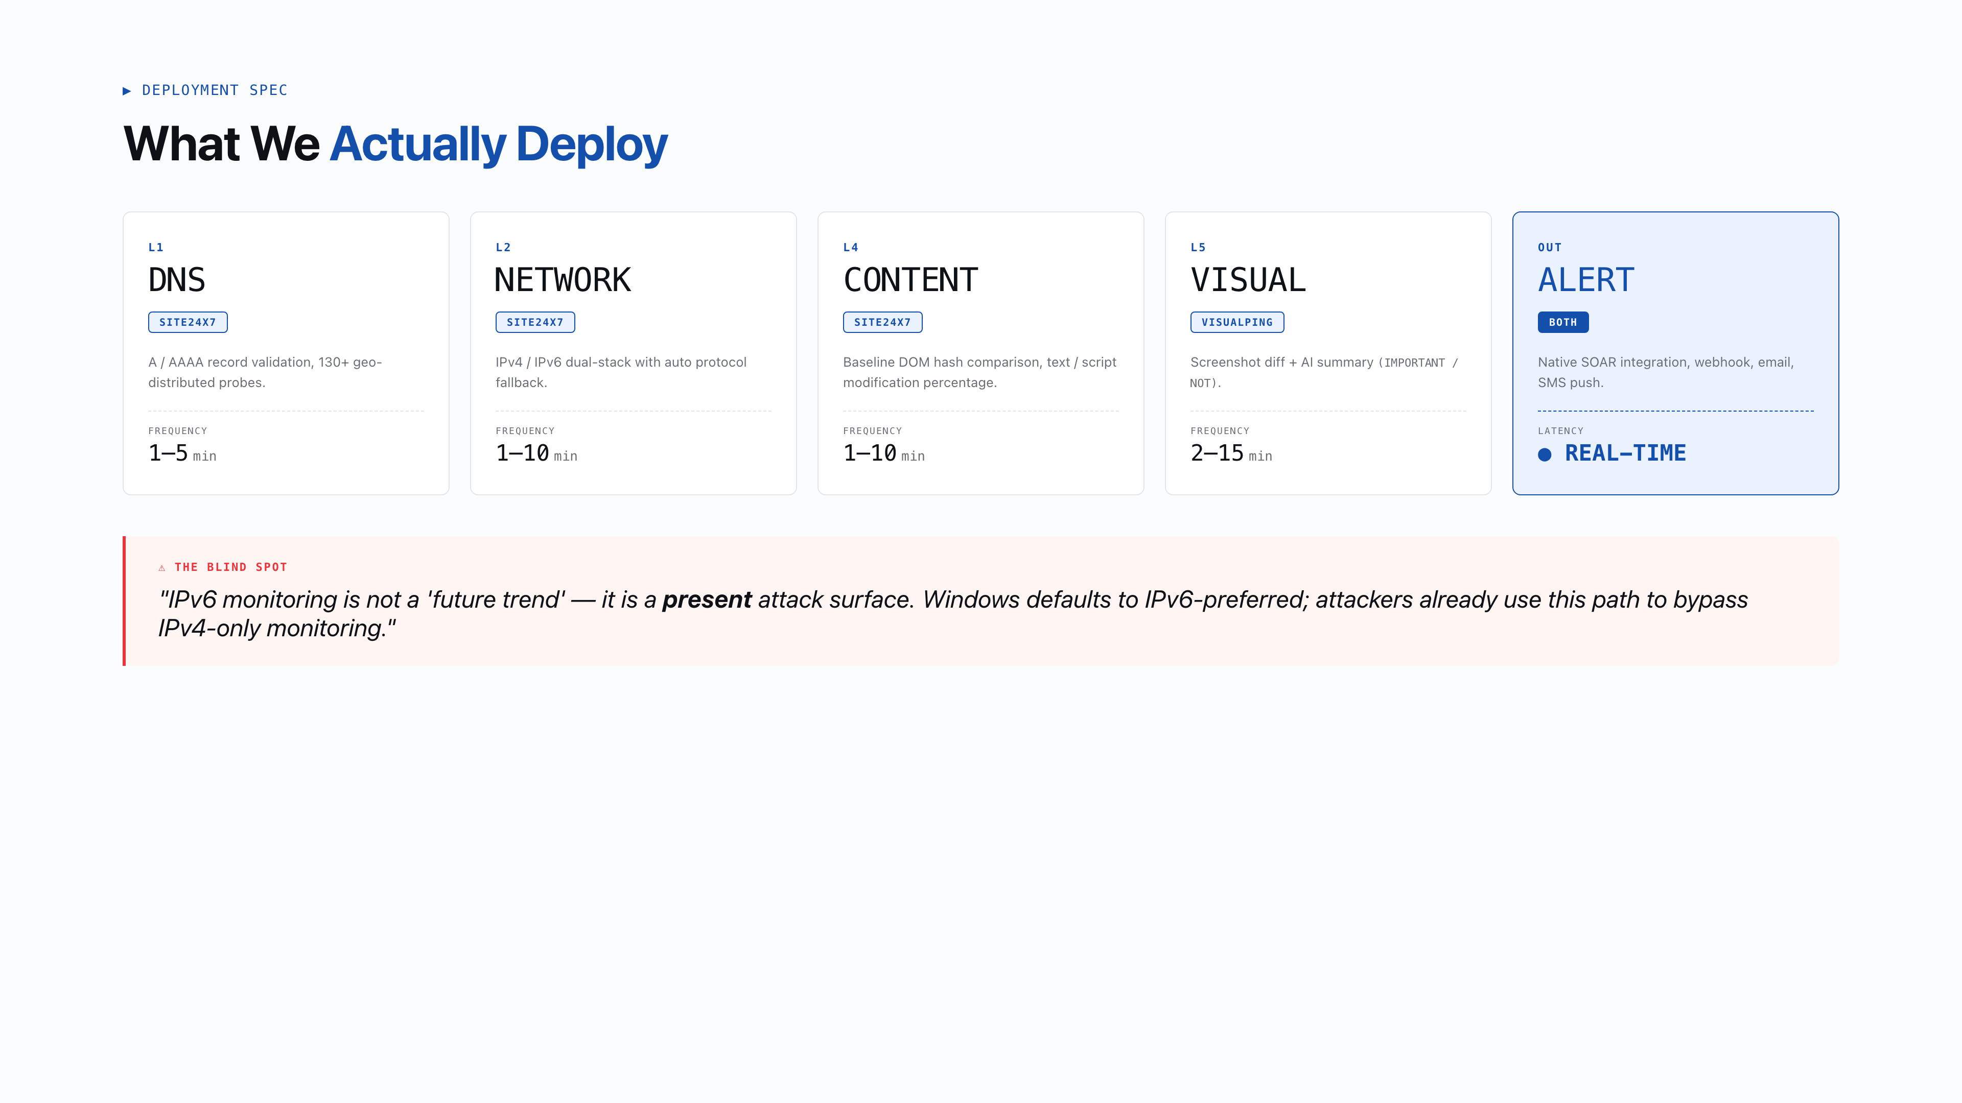
Notes:
07 Layer Breakdown The practical deployment slide. Show what actually gets deployed, with frequencies. The IPv6 quote is the punchline — most enterprises are blind to this attack surface.

Slide 8
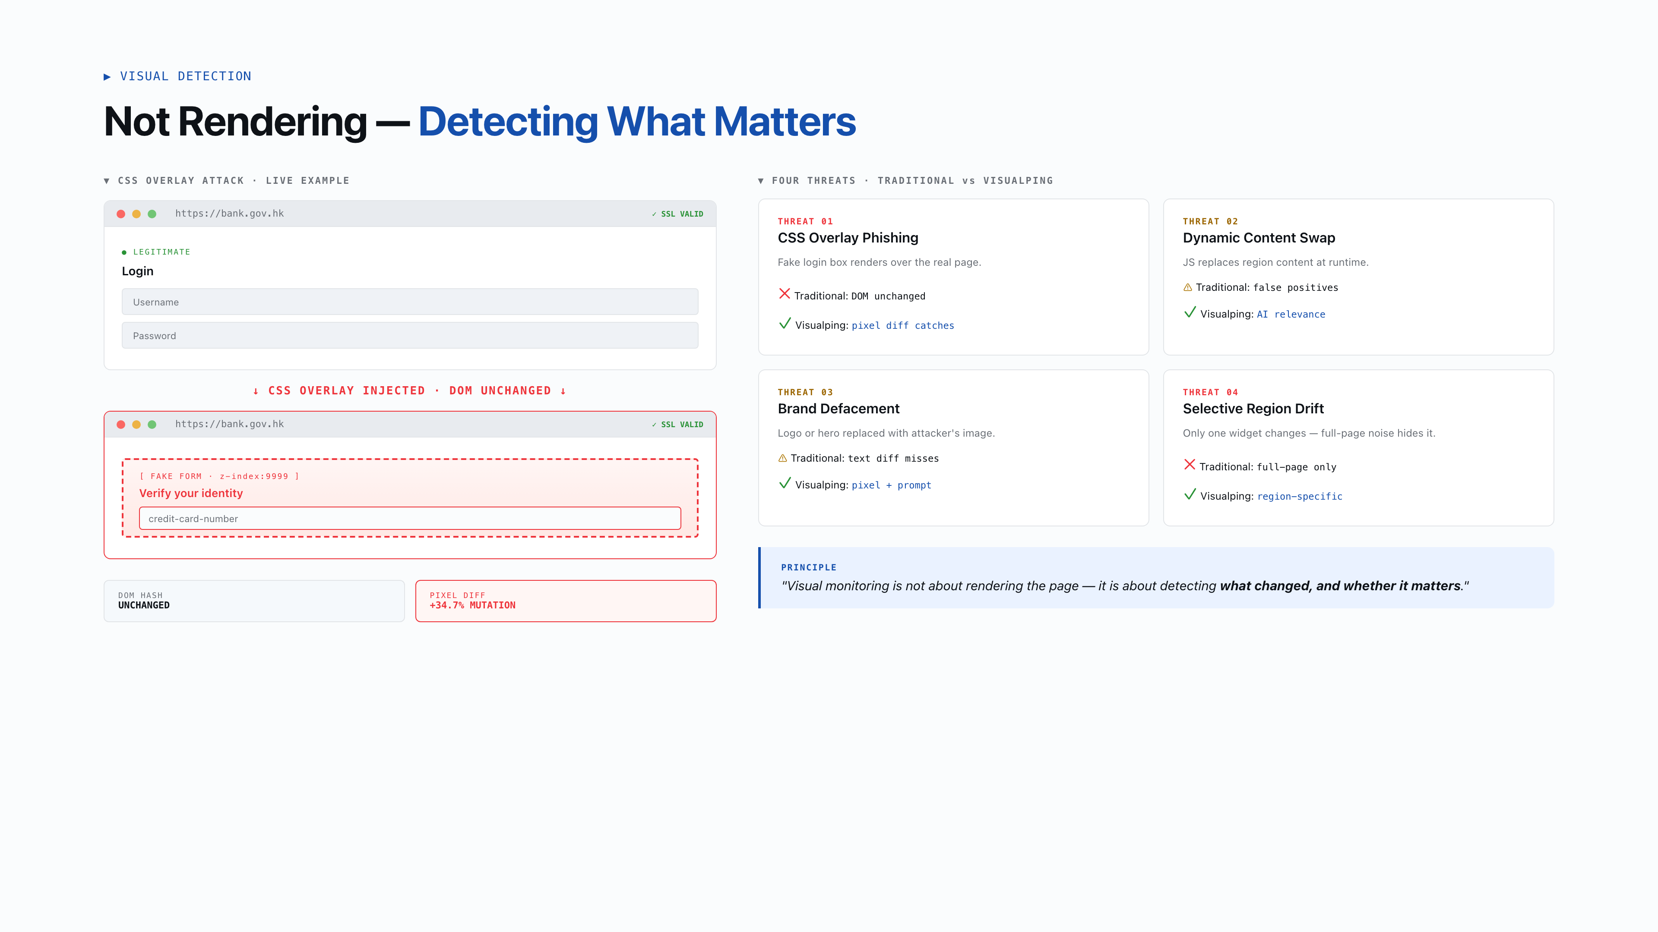
Notes:
08 Visual Deep Dive Visualping is not a screenshot tool — it's a detection layer. The 4 threats show why DOM monitoring is insufficient. CSS overlay phishing is the scariest because the DOM doesn't change.

Slide 9
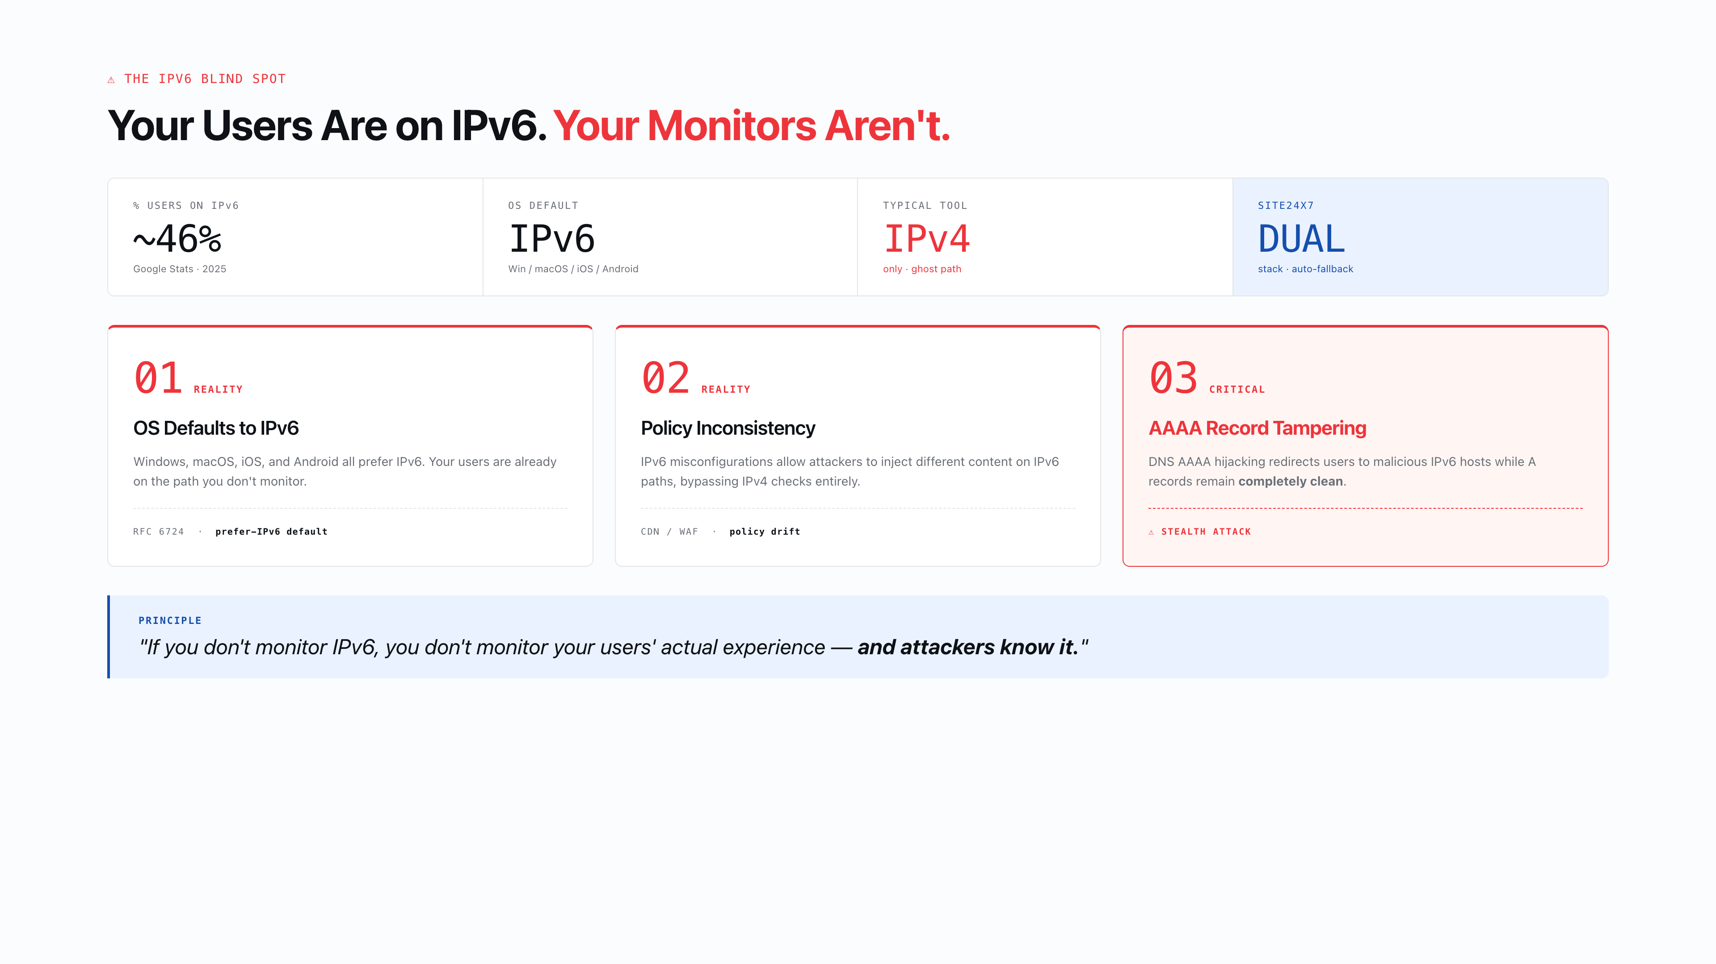
Notes:
09 IPv6 Blind Spot The blind spot slide. Three hard facts about IPv6 preference. This is technical but critical — CISOs need to understand that their IPv4-only monitoring is monitoring a ghost path.

Slide 10
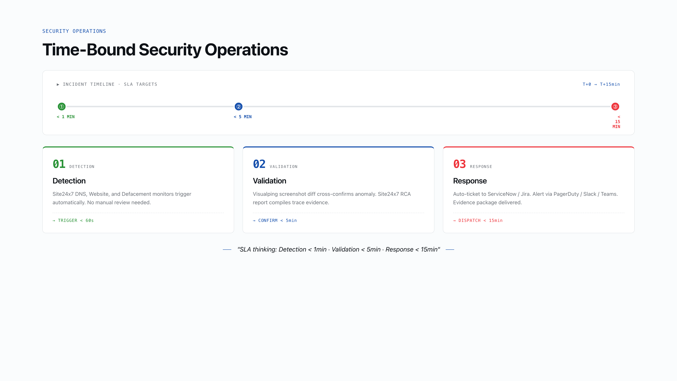
Notes:
10 SOC Model Time-bound SLA slide. The 1-5-15 model is the operational promise. Walk through the workflow tree. This is what separates a tool from a security operations platform.

Slide 11
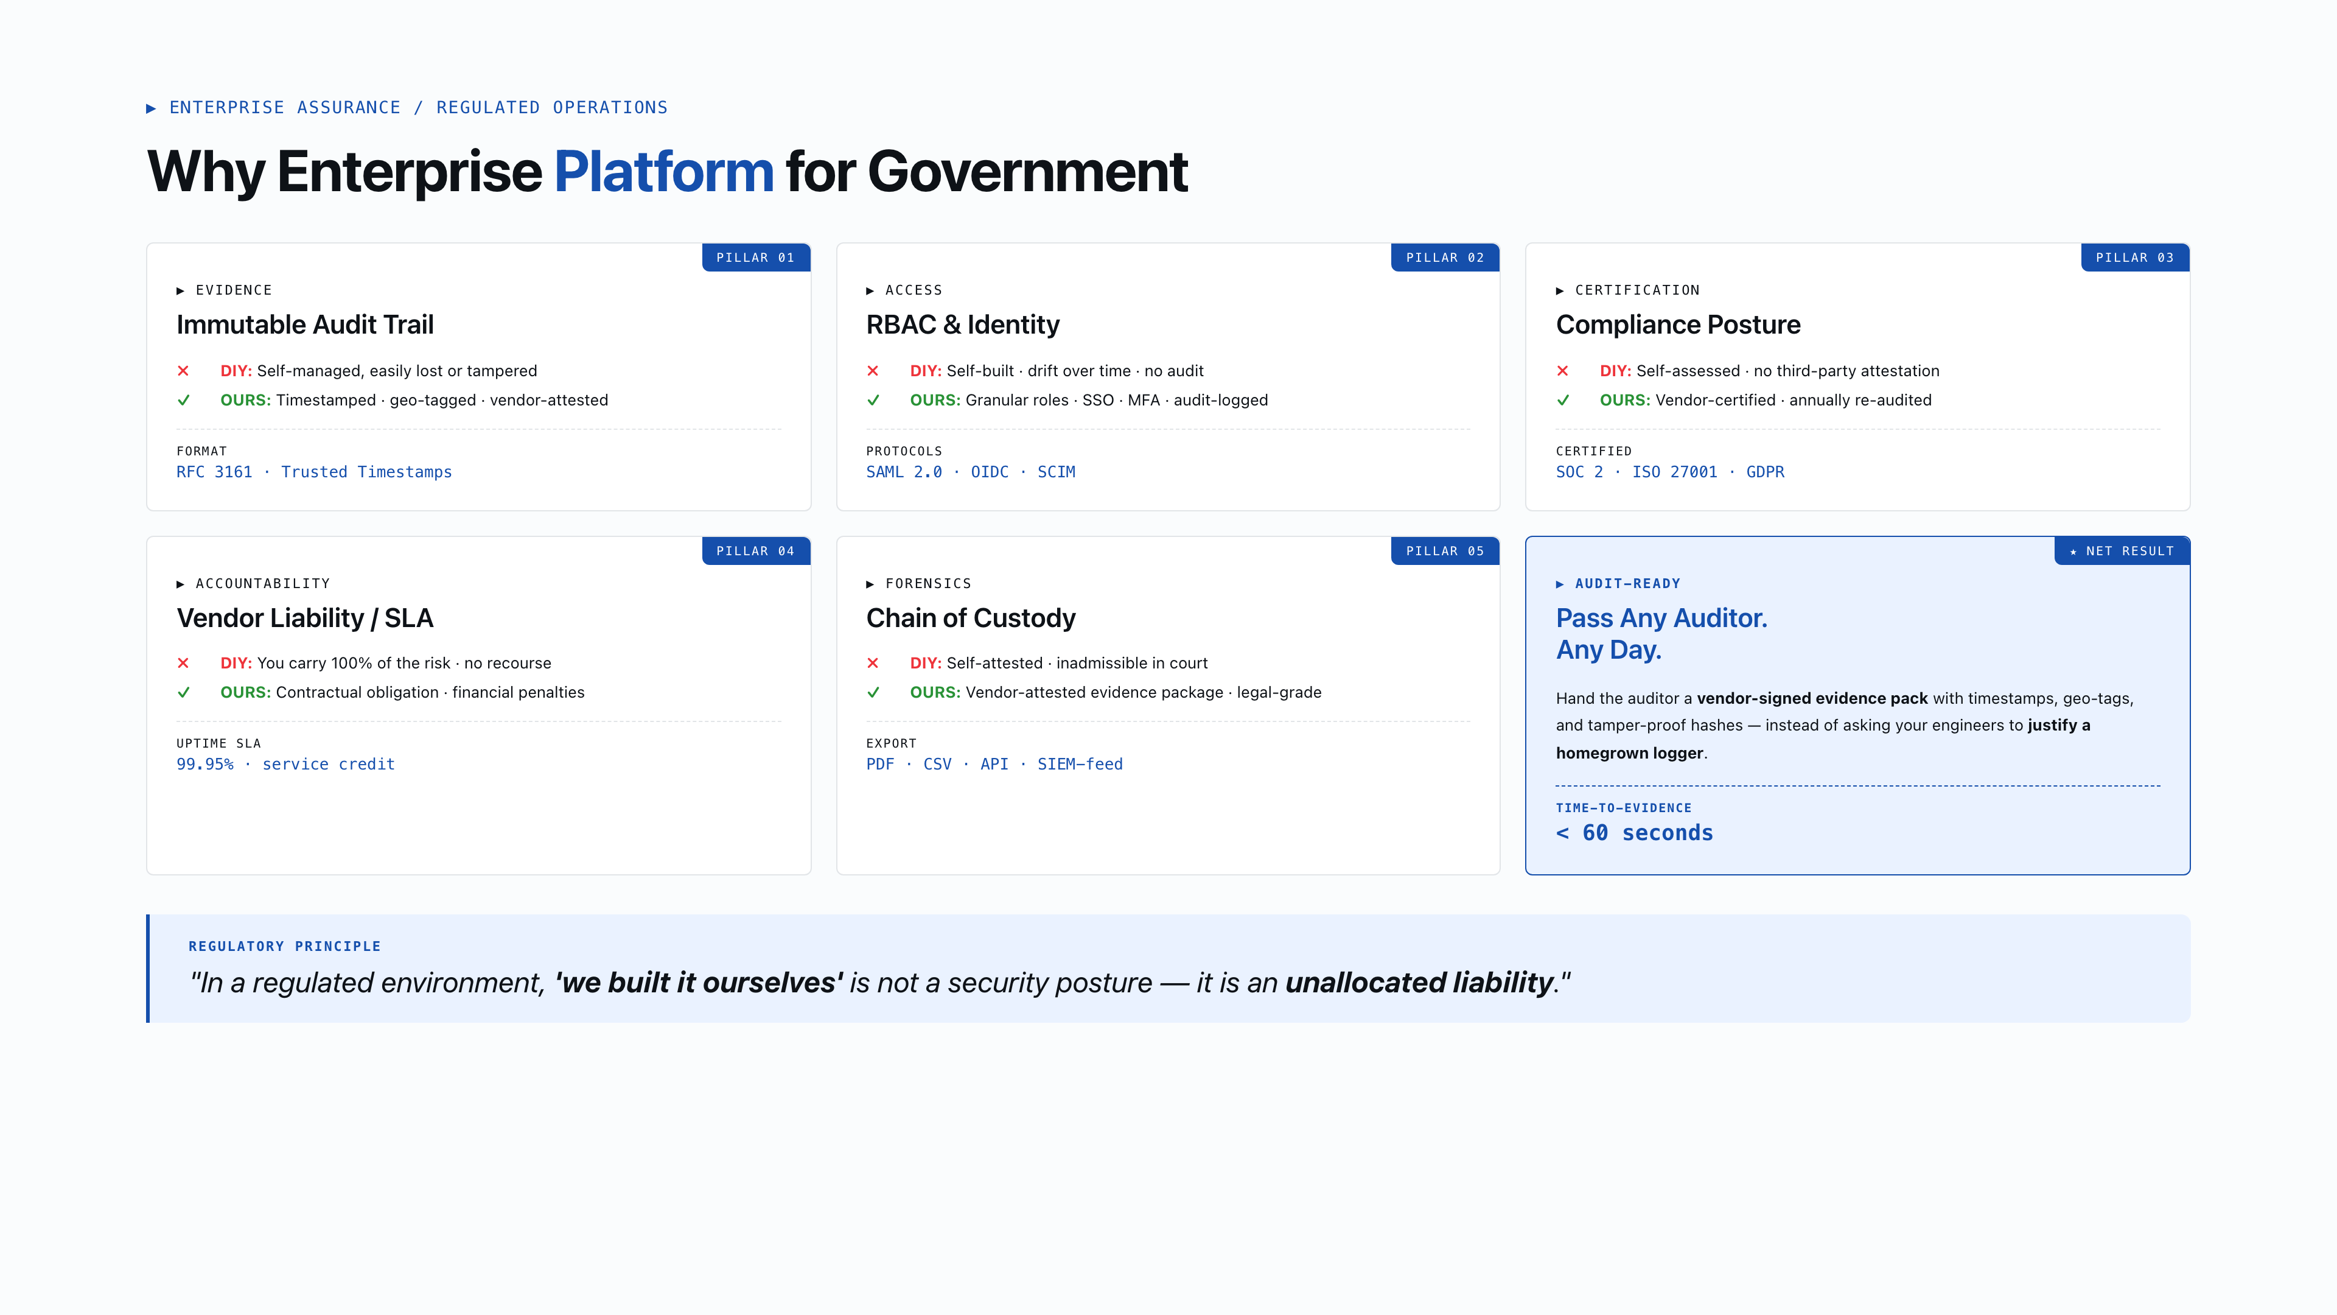
Notes:
11 Audit & Compliance Government/HA compliance slide. Immutable audit trail and vendor liability are the decision factors for regulated industries. RBAC and SOC 2 are table stakes.

Slide 12
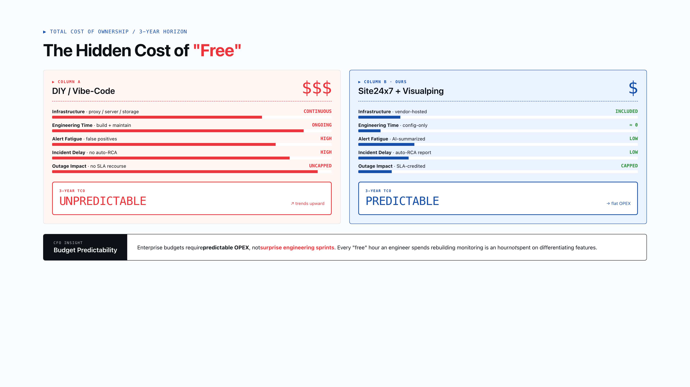
Notes:
12 TCO Reality The money slide. DIY is never free — engineering time is the hidden cost. Emphasize predictability: enterprise budgets need predictable OPEX, not surprise engineering sprints.

Slide 13
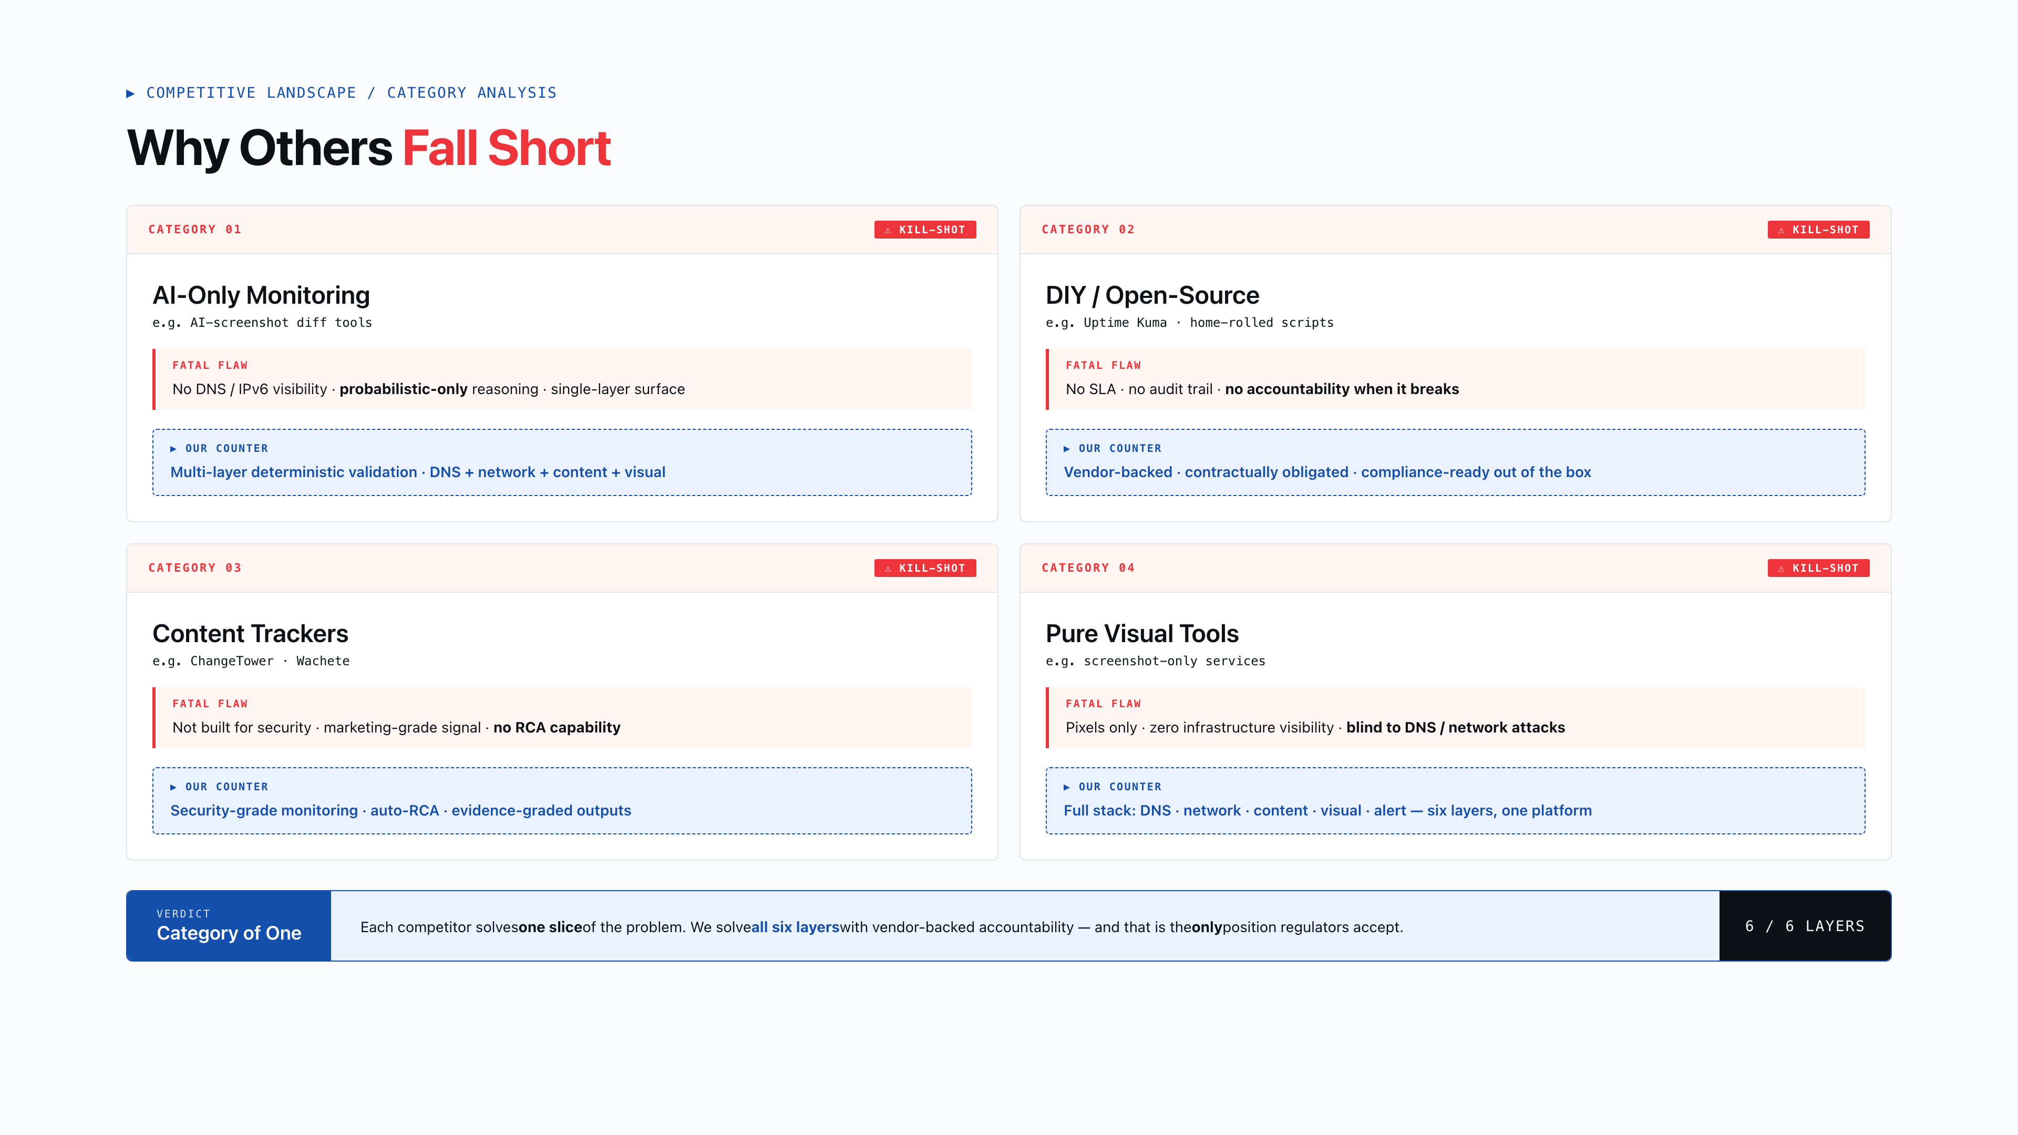
Notes:
13 Why Others Fall Short Optional but powerful. Map competitor categories to their fatal weakness. Don't name specific competitors — categories are safer and more professional. Close each row with our advantage.

Slide 14
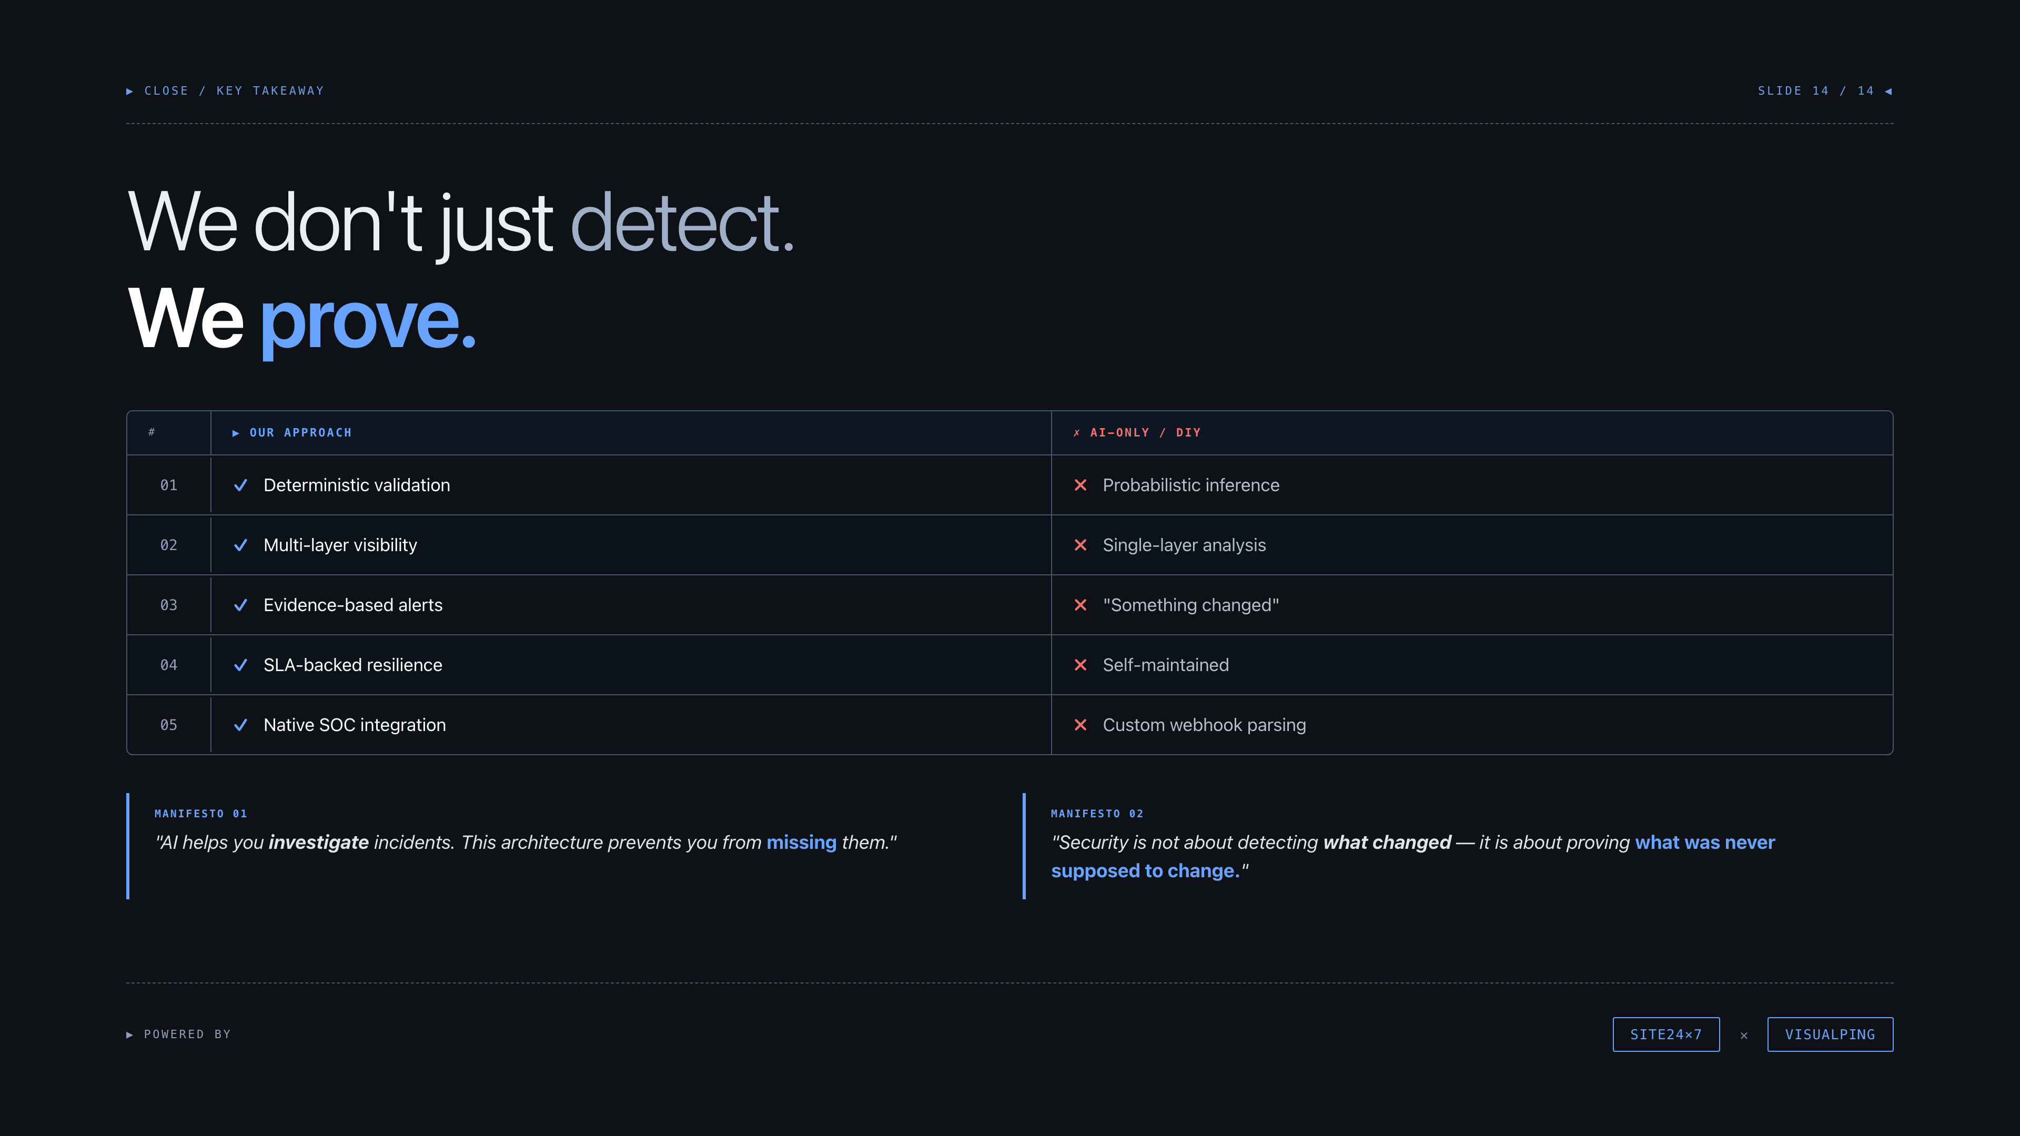
Notes:
14 Conclusion The closing. Three powerful quotes. The comparison strip is the final anchor. Leave the audience with: we don't just detect — we prove. We don't just monitor — we guarantee.

