Slide 1
The Future of AI
Exploring Innovations and Impacts

Slide 2
Current Trends in AI
Artificial Intelligence is rapidly evolving with advancements in machine learning, natural language processing, and robotics. These technologies are becoming increasingly integrated into various industries including healthcare, finance, and transportation.

Slide 3
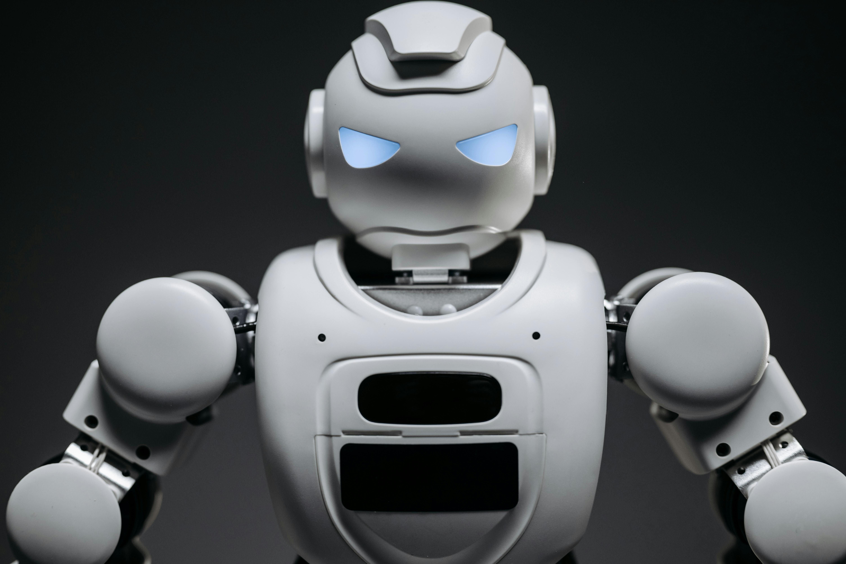

AI in Robotics
Robots powered by AI are transforming manufacturing and service sectors by improving efficiency and precision.

Slide 4
AI Benefits vs. Challenges
Benefits
Challenges
Increased productivity, Improved decision-making, Enhanced user experiences
Ethical concerns, Data privacy issues, Job displacement risks

Slide 5
Looking Ahead
The future of AI promises even more sophisticated technologies such as general AI and advanced autonomous systems. It is vital to address ethical considerations and foster inclusive development to maximize positive impacts.
Balancing innovation with responsibility

