Slide 1
The Future of AI
Exploring Tomorrow's Intelligent Technologies

Slide 2
Current Trends in AI
Artificial intelligence is rapidly evolving with advancements in machine learning, natural language processing, and robotics. These technologies are transforming industries such as healthcare, finance, and transportation.

Slide 3
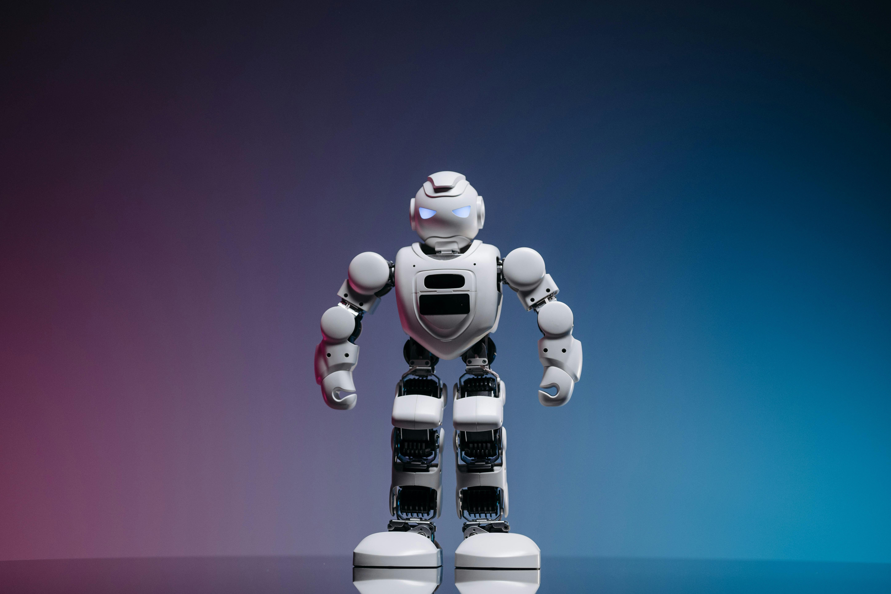
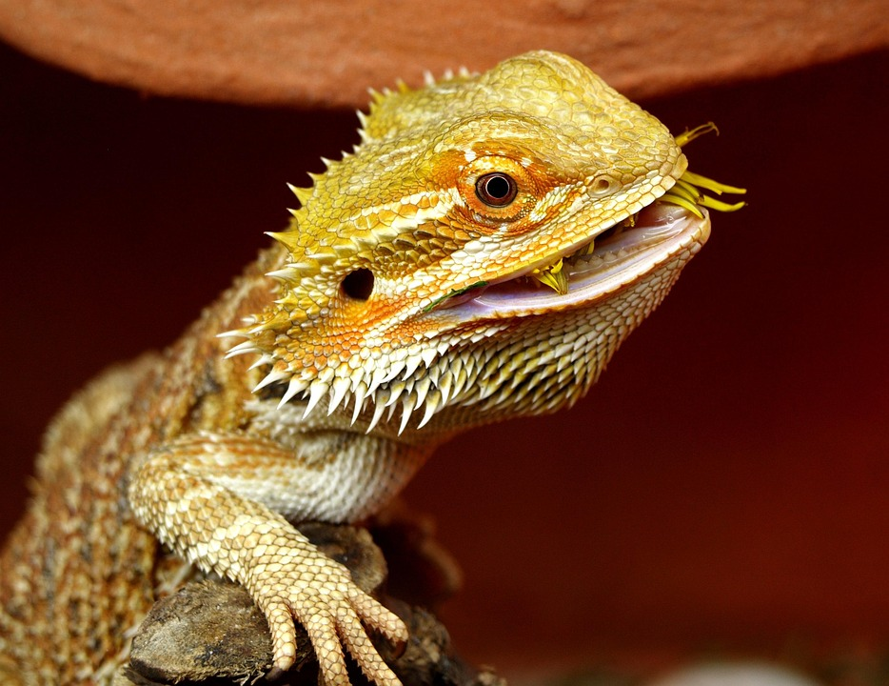
AI in Everyday Life
AI-powered robots and assistants are becoming common in homes and workplaces, enhancing productivity and convenience.

Slide 4
Challenges vs Opportunities in AI
Challenges
Opportunities
Ethical concerns, job displacement, data privacy issues, and the need for regulation.
Automation of tasks, improved decision-making, personalized experiences, and new industry creation.

Slide 5
Looking Ahead
The future of AI holds promise for even deeper integration into human life, with developments in general AI, enhanced creativity, and expanded collaboration between humans and machines.
Innovation today shapes tomorrow's AI landscape.

