Slide 1


Accelerating the Sparse Blossom algorithm on FPGA for Quantum Error Correction
Niccolò Brembilla
niccolo1.brembilla@mail.polimi.it
July, 26 2024
Sala Conferenze Emilio Gatti – Politecnico di Milano

Slide 2
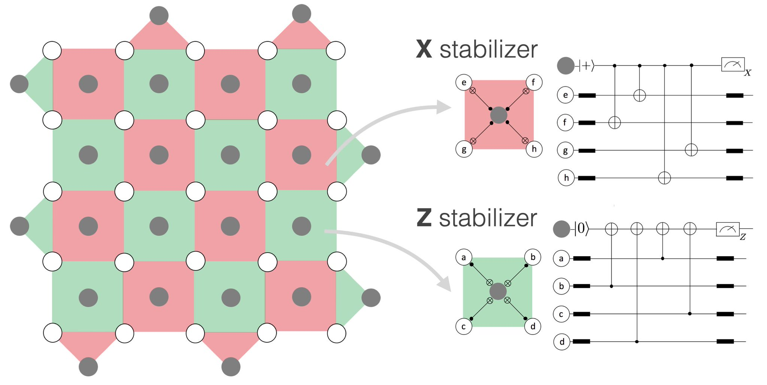
QEC
The role of QEC in Quantum Computing is to mitigate the errors, mantaining the quantum state to ensure reliable quantum computations
Image ref: Qubit fractionalization and emergent Majorana liquid in the honeycomb Floquet code induced by coherent errors and
weak measurements, Guo-Yi Zhu and Simon Trebst. arXiv:2311.08450

Slide 3
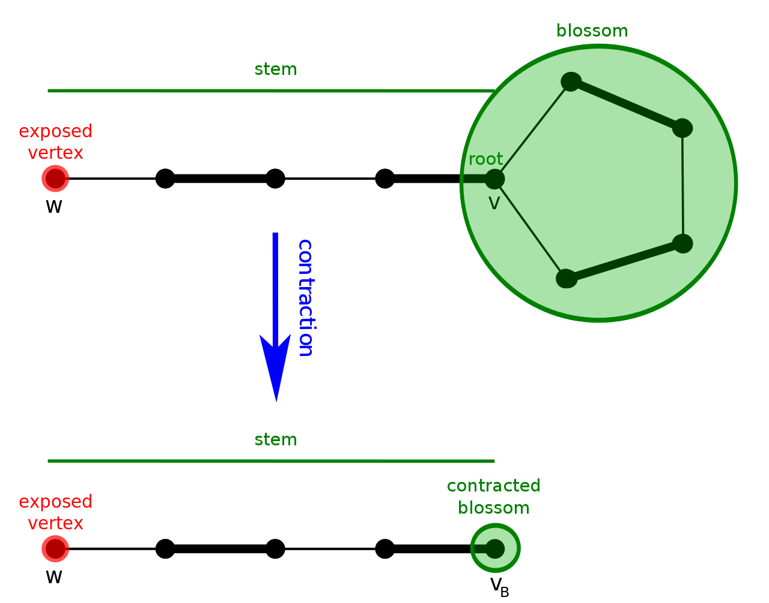
Blossom algorithm
Used to identify and collapse the odd length nodes loops into one node
Image ref: https://en.wikipedia.org/wiki/Blossom_algorithm

Slide 4
State of the Art
Using the Blossom algorithm (CPU based):
Fusion blossom⁽¹⁾
PyMatching (sparse blossom)⁽²⁾
FPGA implementations:
Helios (distributed Union-Find) ⁽³⁾
Astrea (MWPM on max decoding distance = 7) ⁽⁴⁾
(1) Y. Wu and L. Zhong, "Fusion Blossom: Fast MWPM Decoders for QEC," 2023 IEEE International Conference on Quantum Computing and Engineering (QCE), Bellevue, WA, USA, 2023, pp. 928-938, doi: 10.1109/QCE57702.2023.00107.
(2) Higgott, O. and Gidney, C., 2023. Sparse blossom: correcting a million errors per core second with minimum-weight matching. arXiv preprint arXiv:2303.15933.
(3) N. Liyanage, Y. Wu, A. Deters and L. Zhong, "Scalable Quantum Error Correction for Surface Codes Using FPGA," 2023 IEEE International Conference on Quantum Computing and Engineering (QCE), Bellevue, WA, USA, 2023, pp. 916-927, doi: 10.1109/QCE57702.2023.00106.
(4) Suhas Vittal, Poulami Das, and Moinuddin Qureshi. 2023. Astrea: Accurate Quantum Error-Decoding via Practical Minimum-Weight Perfect-Matching. In Proceedings of the 50th Annual International Symposium on Computer Architecture (ISCA '23). Association for Computing Machinery, New York, NY, USA, Article 2, 1–16. https://doi.org/10.1145/3579371.3589037

Slide 5
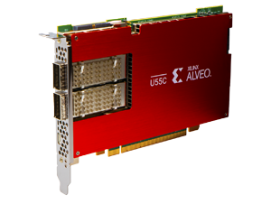
Objectives
Compute the MWPM solver on one round of correction solving it in t < 1 μs
Solve graph with decoding distance up to 9
Image ref: https://www.eejournal.com/article/xilinx-unveils-u55c-data-center-card/

Slide 6
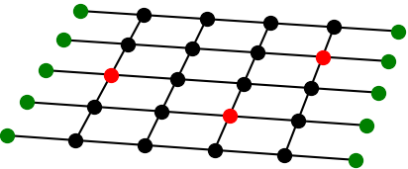
Model graph & Syndrome graph
Model graph (Decoding graph)

Slide 7
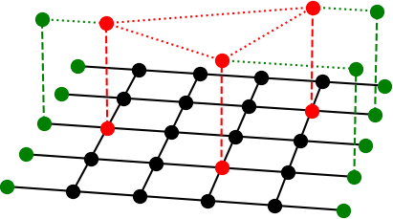
Model graph & Syndrome graph
Syndrome graph
Model graph (Decoding graph)

Slide 8
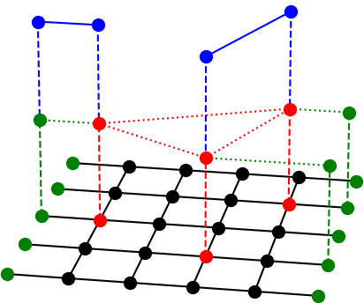
Model graph & Syndrome graph
Pairs result
Syndrome graph
Model graph (Decoding graph)

Slide 9
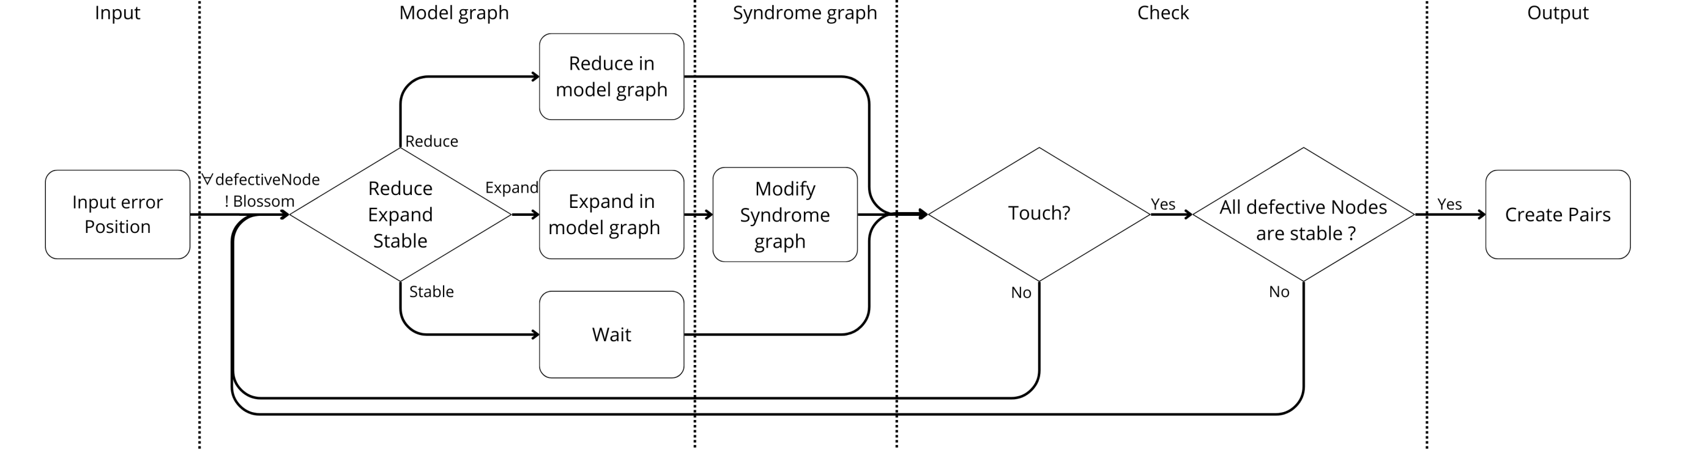
Architecture overview

Slide 10

Experimental setup
SW implementation:
Intel core i7-11700K
HW implementation:
AMD-Xilinx Alveo U55C High Performance
Image ref: https://www.wasserman.eu/en/p/intel-core-i7-11700k-processor-36-ghz-16-mb-smart-cache-box-94672
Image ref: https://www.eejournal.com/article/xilinx-unveils-u55c-data-center-card

Slide 11
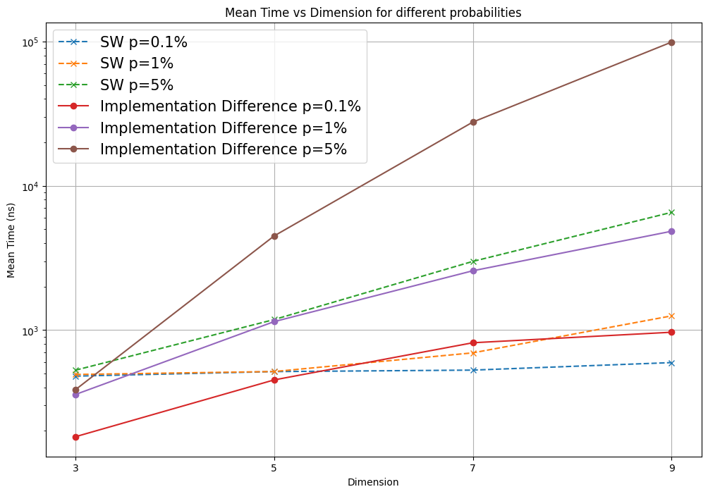
Results
Frequency | 150MHZ
LUT | 14.6% (190320)
Register | 9.11% (237585)
BRAM | 10.3% (207)
DSPs | 7.2% (652)

Slide 12
Future works
Optimize the partitioning of the main data structures for faster access
Increase the parallelization of the expansion and retraction modules
Expand the algorithm to higher distances

Slide 13


Thank you for your attention
Niccolò Brembilla
niccolo1.brembilla@mail.polimi.it
July, 26 2024
Sala Conferenze Emilio Gatti – Politecnico di Milano

