Slide 1
AI LABS ASSESSMENT
Stratpoint
Case Study Presentation
Bren Jay Magtalas
March 2026 · Python · XGBoost · LangChain · Gemini 2.5 Flash · Pydantic · EasyOCR · LangGraph · Gradio
CHALLENGE 1
Predicting Solar Output
CHALLENGE 2
Extracting Receipt Data
https://github.com/BrenJay23/ai_labs_assessment

Slide 2
01
CHALLENGE
Predicting Solar Output
DataScience · XGBoost · LangChain ReAct Agent · Gemini 2.5 Flash · Gradio
Bren Jay Magtalas | AI Labs Assessment | March 2026

Slide 3
The Problem: Predicting Solar Output from Weather
CHALLENGE 1
The Stakes
Goal
Solar power is highly susceptible to weather. Unlike fossil fuel or nuclear plants, fluctuating solar output directly threatens grid stability for communities that depend on solar farms. Grid operators need advance predictions to deploy mitigation strategies — spinning up reserves, load shedding.
1 Predict daily solar energy yield (kWh) for Australian cities given weather conditions
2 Expose predictions via an LLM-powered agent answering natural language questions
DATA SOURCES
Global Solar Atlas
Kaggle Australia Daily Weather
Monthly PVOUT TIFFs (EPSG:4326)
12 raster files · kWh/kWp/day · Australia
145,460 rows · 49 locations · 2007 – 2017
Tabular weather regressors for solar yield prediction
Bren Jay Magtalas | AI Labs Assessment | March 2026

Slide 4
Solution Architecture
CHALLENGE 1
TWO-PHASE SYSTEM
OFFLINE — Training Phase
ONLINE — Agent Serving Phase
Global Solar Atlas TIFFs
User Question (Natural Language)
12 monthly PVOUT rasters
via Gradio Chat UI
Rasterio Extraction
LangChain ReAct Agent
Bounding box average per city
Gemini 2.5 Flash backbone
Kaggle weatherAUS.csv
Tool: get_city_weather_stats
2009 train · 2010 holdout
rapidfuzz city match · historical lookup
Monthly Aggregation
Tool: predict_solar_yield
528 rows · 44 cities × 12 months
WeatherInput → XGBoost → yield formula
XGBoost Regressor
LangGraph MemorySaver
Optuna tuned · 100 trials · R² = 0.726
Persists weather context across turns
Saved Artifacts
Gradio Chat UI
model · encoders · feature_cols · holdout
Tool call observability panel
Bren Jay Magtalas | AI Labs Assessment | March 2026

Slide 5
Assumptions and Limitations
CHALLENGE 1
KEY DATA ASSUMPTIONS
Original dataset was used w/ dates
Monthly PVOUT as target
The provided dataset does not contain date column and is a random interleaved sample, making it impossible to extract a specific year. The Original dataset with dates included was utilized instead
12× more target variation than yearly. Model learns genuine seasonal patterns. Yearly averages collapse all months into one number.
2009 train / 2010 holdout
Per city per month aggregation
Sunshine feature has best quality in these years — 30 cities, ~37% missingness. KDE plots confirm no distribution shift.
528 rows (44 cities × 12 months). Eliminates granularity mismatch between daily rows and monthly PVOUT targets.
KNOWN LIMITATIONS
Theoretical Yield
Sunshine Missingness
Single-Year Solar Data
Predictions = theoretical yield.
PVOUT is from Global Solar Atlas simulation with assumed losses
36–37% missing in training data. XGBoost handles natively; correlated features (MaxTemp, Humidity9am) compensate.
Assessment requirement. True year-to-year solar irradiance variation is not captured in the model.
Bren Jay Magtalas | AI Labs Assessment | March 2026

Slide 6
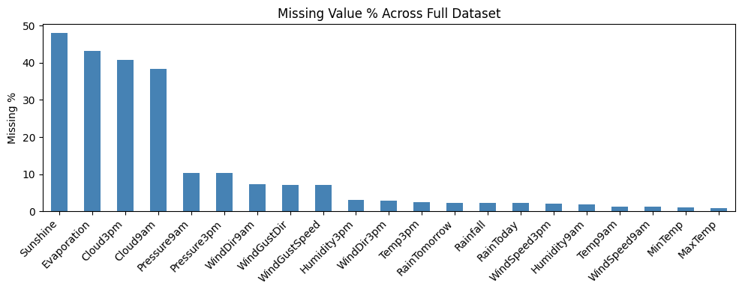
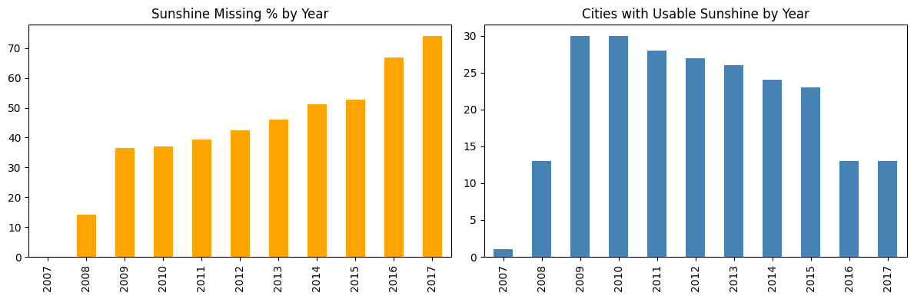
Data Preparation
CHALLENGE 1
2009 train / 2010 holdout
Sunshine feature has best quality in these years — 30 cities, ~37% missingness. KDE plots confirm no distribution shift.
Sunshine Missingness
36–37% missing in training data. XGBoost handles natively; correlated features (MaxTemp, Humidity9am) compensate.
Bren Jay Magtalas | AI Labs Assessment | March 2026

Slide 7
Data Preparation
CHALLENGE 1
MONTHLY PVOUT EXTRACTION (Rasterio)
WEATHER FEATURE ENGINEERING
1
Geocode cities
Dropped columns:
geopy Nominatim — 44/46 resolved (NorfolkIsland out-of-bounds; MountGinini bbox too small)
Date · Year · Location · RainTomorrow
Aggregation method:
Numeric → mean · Categorical → mode · Result: 528 rows (44 cities × 12 months)
2
CamelCase normalization
re.sub(r"([a-z])([A-Z])", r"\1 \2") — splits compound city names for Nominatim
Encoding: WindGustDir, WindDir9am, WindDir3pm, RainToday
3
Bounding box average
Distribution Validation
All raster pixels within city's OSM bounding box averaged — semantically correct vs. point sampling or fixed-radius buffer
KDE plots confirm train (2009) and holdout (2010) feature distributions are comparable across all 20 numeric features — no distribution shift detected.
4
Map to aggregated rows
Monthly PVOUT joined to weather aggregates by city + month — clean semantic match
20 final features · 20 weather columns
Bren Jay Magtalas | AI Labs Assessment | March 2026

Slide 8
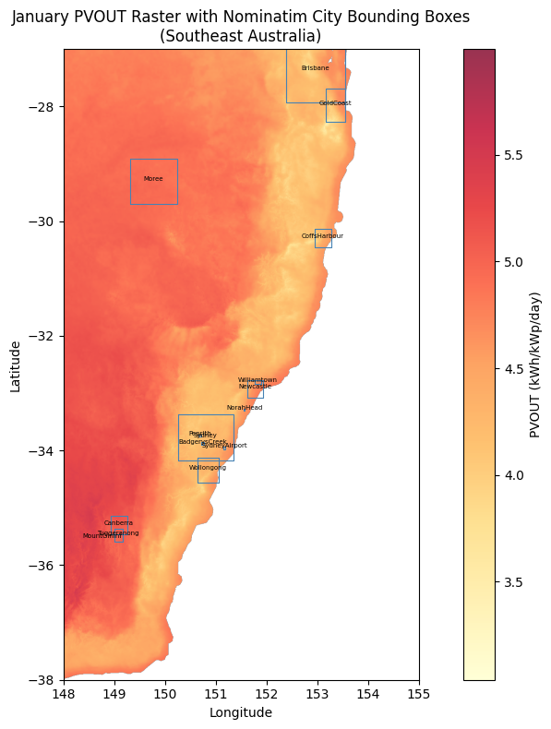
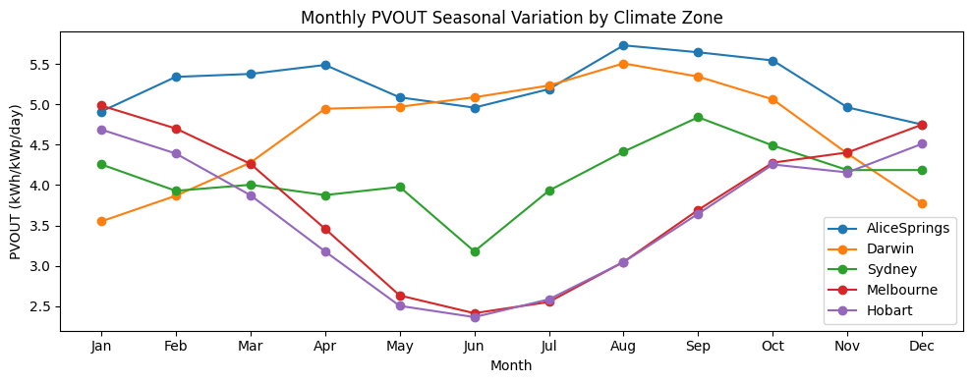
Data Preparation
CHALLENGE 1
MONTHLY PVOUT EXTRACTION (Rasterio)
Bren Jay Magtalas | AI Labs Assessment | March 2026

Slide 9
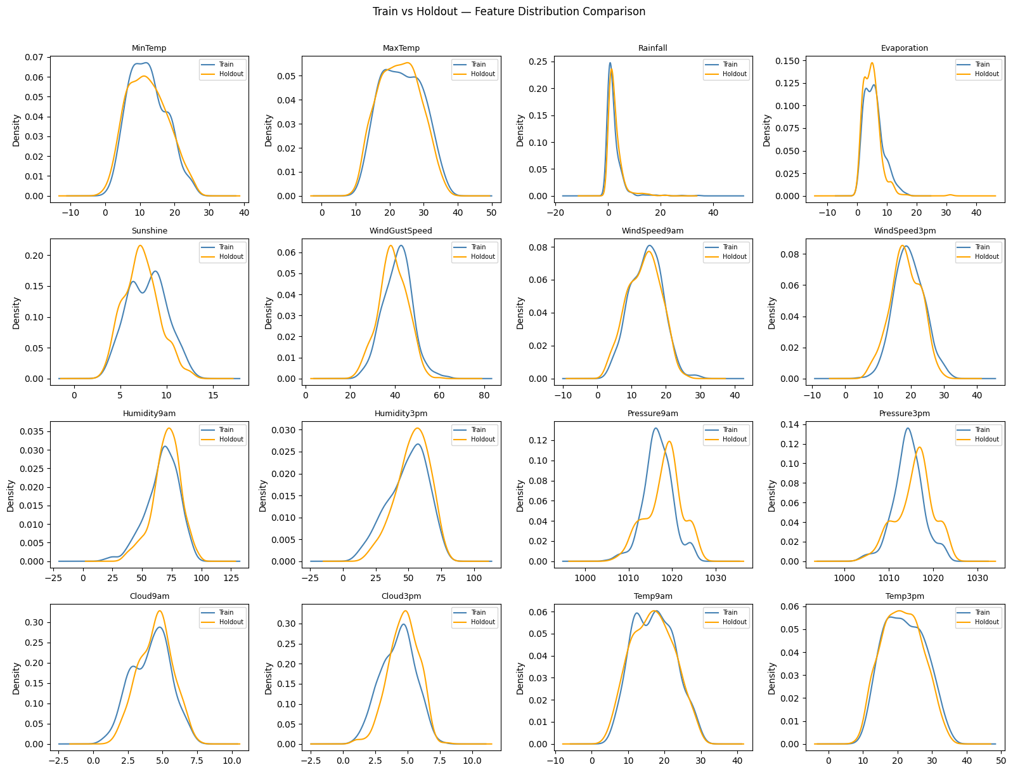
Data Preparation
CHALLENGE 1
Distribution Validation
KDE plots confirm train (2009) and holdout (2010) feature distributions are comparable across all 20 numeric features — no distribution shift detected.
Bren Jay Magtalas | AI Labs Assessment | March 2026

Slide 10

XGBoost Model — Tools, Algorithm & Tuning
CHALLENGE 1
MODEL SELECTION RATIONALE
BASELINE → OPTUNA TUNED
Handles missing values natively — critical for 36% Sunshine missingness
Parameter | Baseline | Optuna Tuned
n_estimators | 500 | 949
max_depth | 6 | 10
learning_rate | 0.05 | 0.0196
subsample | 0.8 | 0.85
colsample_bytree | 0.8 | 0.77
min_child_weight | — | 9
Robust to correlated features (weather variables are highly correlated)
Fast training with interpretable feature importances
Strong tabular regression baseline without feature scaling
YIELD FORMULA
Panel area (m²) = farm_area_ha × 10,000 × GCR
Installed kWp = Panel area × panel_efficiency
Daily yield (kWh) = Installed kWp × PVOUT
Defaults: GCR = 0.35 · Panel efficiency = 18%
Bren Jay Magtalas | AI Labs Assessment | March 2026

Slide 11
Results and Discussion
CHALLENGE 1
R²
RMSE
MAE
0.726
0.417
0.320
Holdout (2010)
BASELINE VS TUNED
KEY OBSERVATIONS
Metric | Baseline | Optuna Tuned
RMSE | 0.4295 | 0.4168
MAE | 0.3309 | 0.3204
R² | 0.7091 | 0.7261
Strong result without location features
R² of 0.73 with no city name feature — model learned the genuine weather → solar signal, not city-level memorisation.
Sunshine ranks 3rd (not 1st)
TOP FEATURE IMPORTANCES
MaxTemp and Humidity9am rank higher because monthly aggregation dilutes Sunshine's 36% missingness, surfacing its true signal.
MaxTemp
0.275
Optuna tuning: marginal but consistent
Humidity9am
0.175
All three metrics improved. TPE sampler, 100 trials, MedianPruner. Largest gain in R² (+0.017).
Sunshine
0.124
Theoretical max, not real-world
Temp3pm
0.111
Predictions represent theoretical yield.
Humidity3pm
0.056
Bren Jay Magtalas | AI Labs Assessment | March 2026

Slide 12
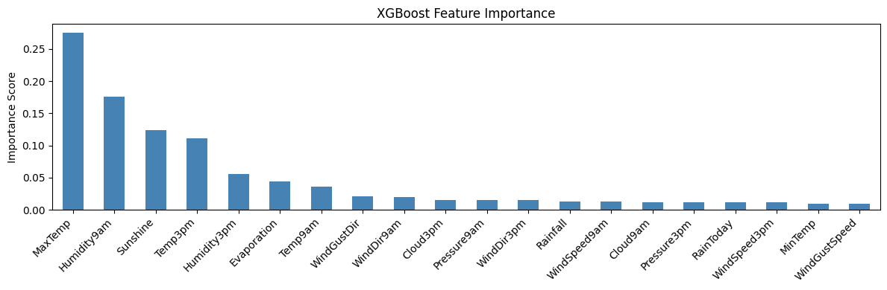
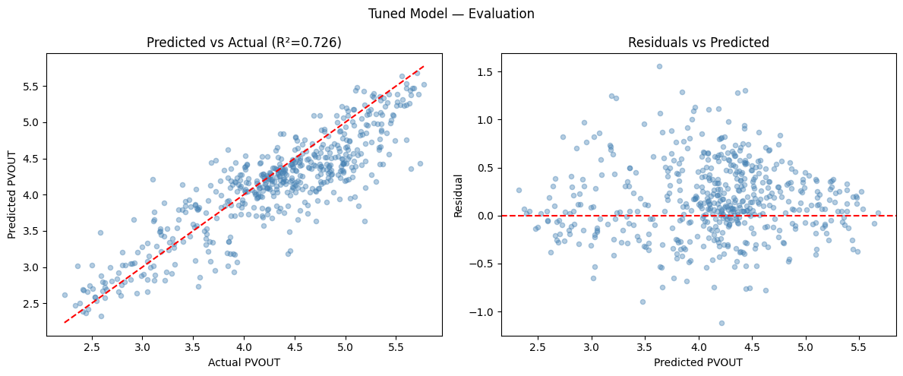
Results, Discussion and Recommendations
CHALLENGE 1
Recommendations
Multi-year weather data
Incorporate multiple years of weather data for seasonal + annual trend modeling
Real-time weather API
Integrate live forecasts (e.g. Bureau of Meteorology API) for genuine forward-looking predictions
Bren Jay Magtalas | AI Labs Assessment | March 2026

Slide 13
Agent System Flow
CHALLENGE 1
REACT AGENT PIPELINE
MEMORY & RE-FETCH LOGIC
User Question
Re-fetches weather (calls get_city_weather_stats again):
Natural language via Gradio Chat
City changes
LangChain ReAct Agent
Date or month changes
Gemini 2.5 Flash · LangGraph MemorySaver
get_city_weather_stats
rapidfuzz ≥80 · date / month / year avg (2010)
Reuses memory context (occasional no re-fetch):
Only farm size changes
Qualitative Override (pydantic shema)
Only GCR or panel efficiency changes
"scorching hot" → high MaxTemp, low Humidity
Only qualitative weather description changes
predict_solar_yield
WeatherInput → XGBoost → PVOUT → yield
Agent synthesizes final response → Gradio UI
Tool call observability panel in Gradio — panel can see agent reasoning in real time
Bren Jay Magtalas | AI Labs Assessment | March 2026

Slide 14
5 Agent Questions with Analysis
CHALLENGE 1
Q1
What is the expected daily yield for a 50ha solar farm in Sydney tomorrow?
DATE RESOLUTION
Tests core prediction pipeline with date resolution. Agent resolves 'tomorrow' → calls get_city_weather_stats with that date → fetches 2010-equivalent historical row → predicts yield.
Q2
100ha farm in Darwin, scorching hot and perfectly clear day, what's my yield?
QUALITATIVE OVERRIDE
Tests qualitative weather inference. Agent fetches Darwin yearly baseline → overrides fields from description (high MaxTemp, high Sunshine, low Cloud, low Humidity).
Q3
Heavy storms expected in Melbourne next Monday for my 75ha farm. How bad is my yield?
ADVERSE WEATHER
Tests negative weather scenario. Agent resolves 'next Monday' → overrides storm-correlated fields (near-zero Sunshine, max Cloud, high Humidity, high Rainfall).
Q4
Best city for a 100ha solar farm, Alice Springs or Melbourne? And why?
MULTI-CITY COMPARE
Tests multi-city comparison requiring two sequential tool call pairs. Agent explains difference in terms of latitude, sunshine hours, cloud cover — not just two numbers.
Q5
Can you explain how my daily solar yield is actually calculated?
SELF-AWARENESS
Tests system self-awareness — no tool calls expected. Agent explains: weather features → XGBoost → PVOUT → yield formula, and notes theoretical maximum before performance ratio.
Bren Jay Magtalas | AI Labs Assessment | March 2026

Slide 15
02
CHALLENGE
Extracting Data From Receipts
Computer Vision · EasyOCR · Gemini 2.5 Flash · LangGraph · Gradio · Docker
Bren Jay Magtalas | AI Labs Assessment | March 2026

Slide 16
The Problem: Automated Receipt Data Extraction
CHALLENGE 2
The Stakes
Goal
Businesses rely on receipts and invoices across accounting, reimbursement, and supply-demand modelling. Manually processing hundreds of documents is slow, expensive, and error-prone. Automating extraction of key fields (company, date, address, total) is a high-value practical problem.
1 Extract 4 entities from receipts
2 Use LLMs to correct OCR errors
3 Evaluate across 4 required pipeline configurations
4 Expose as Gradio app with image upload and Q&A
DATASET — SROIE V2 (ICDAR 2019)
973
626
347
4
Total Receipts
Train split
Test split
Ground truth fields
Ground truth fields: company · date · address · total
Bren Jay Magtalas | AI Labs Assessment | March 2026

Slide 17
Five-Tier Progressive Pipeline
CHALLENGE 2
CORE IDEA — each tier adds one LLM component; each addition is measurable
T1
Raw EasyOCR
Raw OCR
EasyOCR → raw text blob. No LLM. Baseline.
T2
Gemini Multimodal OCR
Improved OCR (LLM)
Image → Gemini multimodal → improved text blob. LLM as OCR replacement.
T3
EasyOCR + Entity LLM
Raw OCR + Entity LLM
EasyOCR raw text → Entity LLM → ReceiptEntities. Traditional OCR + LLM extraction + correction.
T4
Gemini OCR + Entity LLM
Improved OCR + Entity LLM
Gemini OCR improved text → Entity LLM → ReceiptEntities. Multimodal + extraction.
T5
Unified Gemini (Single Call)
BONUS: Unified
Image → Gemini → ReceiptEntities. One prompt handles OCR + extract + correct simultaneously.
Assessment mapping: T1 = Raw OCR ✓ · T2 = Improved OCR ✓ · T3 = Raw OCR + Entity LLM ✓ · T4 = Improved + Entity LLM ✓ · T5 = Bonus ✓
Bren Jay Magtalas | AI Labs Assessment | March 2026

Slide 18
SROIE V2 Dataset — Known Issues & Handling
CHALLENGE 2
KNOWN DATASET ISSUES
"tan woon yann" watermark
Impact:
Artificially depresses company score in Tiers 1 & 2 — entity appears in every OCR output
Handling:
Noted in evaluation; Entity LLM ignores it — knows it's a watermark, not the company name
Receipt #104 missing address
Impact:
One ground truth entry has no address field — skews address metric if included
Handling:
Excluded from all address metric calculations
Inconsistent date formats
Impact:
DD/MM/YYYY, DD-MM-YY, DD MMM YYYY — exact match would fail most correct extractions
Handling:
Fuzzy matching (token_sort_ratio) chosen over exact match — evaluates semantic correctness
Inconsistent total formats
Impact:
Values with and without '$' prefix — exact match unfair
Handling:
Fuzzy matching handles currency formatting differences
Bren Jay Magtalas | AI Labs Assessment | March 2026

Slide 19
Technical Stack and Architecture
CHALLENGE 2
TECHNOLOGY STACK
OCR Engine
EasyOCR
Fuzzy Matching
rapidfuzz
Stable on M2; good quality on thermal receipts; confidence threshold 0.2
Evaluation metric — token_sort_ratio and partial_ratio
Multimodal LLM
Gemini 2.5 Flash
Web Application
Gradio
Via langchain-google-genai; Tiers 2, 3, 4, 5
Image upload, tier selection, Q&A chat, cached pipeline results
Pipeline Orchestration
LangGraph
Containerization
Docker + Compose
State machine; extensible for tracing
Production-ready deployment; CPU fallback for EasyOCR
Structured Output
Pydantic
LANGGRAPH PIPELINE FLOW
ReceiptEntities schema — company, date, address, total
Entry → [ocr | improved_ocr | unified]
↓ ↓
[entity_extraction?] → context_node
↓
END
PYDANTIC SCHEMA
class ReceiptEntities(BaseModel):
company: Optional[str] # full legal business name
date: Optional[str] # transaction date only
address: Optional[str] # full address, single string
total: Optional[str] # final total amount payable
Bren Jay Magtalas | AI Labs Assessment | March 2026

Slide 20
Key Design Decisions
CHALLENGE 2
DECISION 1 — OCR Engine Selection
REJECTED
PaddleOCR
REJECTED
Tesseract
CHOSEN
EasyOCR
Known Apple Silicon stability issues — occasional hangs, dependency conflicts on M2
Inferior quality on low-contrast thermal receipt scans
Stable on M2 · good receipt quality · Python-native · MPS accelerated
Confidence threshold: 0.2 (not default 0.5) — At 0.5, critical entity text from low-quality thermal scans was discarded. At 0.2, we retain more text — the Entity LLM downstream filters and corrects the noise. Validated empirically.
DECISION 2 — Correction Inside Entity LLM (not a separate step)
DECISION 3 — Why LangGraph for a Simple Pipeline
Why combined?
Production-readiness thinking:
One LLM call handles both extraction and correction simultaneously. Fewer calls = lower latency & cost. Same quality. Aligned with assessment framing of 'entity analysis LLM'.
Easy to add Phoenix tracing without restructuring
Retry logic and error handling as graph nodes
Three correction types:
Parallel processing nodes for batch scaling
1 OCR misreads (0↔O, 1↔l, rn↔m, broken words like 'To tal')
2 Compound entity completion (MYDIN MO → MYDIN MOHAMED HOLDINGS SDN BHD)
3 General normalisation — spacing, split lines, currency formatting
Bren Jay Magtalas | AI Labs Assessment | March 2026

Slide 21
Evaluation Design — Why Two Tables
CHALLENGE 2
KEY POINT — Tiers 1–2 and Tiers 3–5 measure fundamentally different things
TABLE 1 — OCR Quality (Tiers 1 & 2)
TABLE 2 — Extraction Quality (Tiers 3, 4 & 5)
What:
Raw text blob quality — does the ground truth value appear anywhere in the OCR output?
What:
Structured field accuracy — how close is the extracted field to ground truth?
Metric:
fuzz.partial_ratio — needle-in-haystack search
Metric:
fuzz.token_sort_ratio — order-insensitive comparison
Threshold:
score ≥ 30 (presence-based — was the entity in the text at all?)
Threshold:
pred is not None (structural — did the LLM return a value at all?)
Why partial_ratio:
Appropriate for finding a short entity within a long, noisy text blob
Why token_sort_ratio:
Handles word order variation in addresses and multi-word company names
Critical Distinction:
T1/T2 'extracted' = presence-based (score ≥ 30) · T3/T4/T5 'extracted' = structural (pred is not None) — These are intentional differences measuring different pipeline stages, not the same thing on different tiers.
Bren Jay Magtalas | AI Labs Assessment | March 2026

Slide 22
Evaluation Results — SROIE V2 Combined (973 Receipts)
CHALLENGE 2
OCR QUALITY — Tiers 1 & 2
Field | T1 Extracted | T1 Score | T2 Extracted | T2 Score
company | 100.0% | 88.7 | 99.3% | 98.7
date | 100.0% | 95.1 | 99.4% | 98.6
address | 99.9% | 84.6 | 99.3% | 95.9
total | 99.9% | 89.5 | 99.1% | 98.6
overall | 99.9% | 89.5 | 99.3% | 97.9
EXTRACTION QUALITY — Tiers 3, 4 & 5
Field | T3 Extracted | T3 Score | T4 Extracted | T4 Score | T5 Extracted | T5 Score
company | 97.6% | 85.4 | 99.3% | 92.9 | 100.0% | 95.0
date | 96.8% | 94.3 | 98.6% | 97.5 | 100.0% | 98.3
address | 99.6% | 87.1 | 99.3% | 94.4 | 100.0% | 94.7
total | 99.7% | 95.0 | 98.5% | 96.1 | 100.0% | 97.5
overall | 98.4% | 90.5 | 98.9% | 95.2 | 100.0% | 96.4
Tier 5 achieves 100% extraction rate and highest overall score (96.4) — single unified Gemini call wins across all fields
Bren Jay Magtalas | AI Labs Assessment | March 2026

Slide 23
Discussion and Recommendations
CHALLENGE 2
PRODUCTION RECOMMENDATION — Tier 5
RECOMMENDATIONS FOR PRODUCTION
 | Tier 4 | Tier 5 ✓
LLM calls / receipt | 2 | 1
Latency | Higher | Lower
Overall score | 95.2 | 96.4
Extraction rate | 98.9% | 100%
Complexity | More modular | Simpler
Production fit | Good | Best
1
Confidence Flagging
Add a confidence score per field — flag low-confidence extractions for human review. Prevents silent errors in downstream systems.
2
Watermark Filtering
For known artifact datasets, a preprocessing crop of the top portion of receipts would improve company extraction on noisy scans.
3
Structured Output Validation
Tier Progression
Add Pydantic field validators — date format normalization, currency amount parsing — for downstream system compatibility.
Clear tier progression confirms the progressive architecture design: each LLM addition measurably improves results. T5's unified approach (OCR, extraction, and correction in a single Gemini call) achieves best accuracy (96.4), 100% extraction rate, lowest latency, and fewest failure points.
4
Async Batch Processing
For high-volume production, implement async batching to Gemini API with retry logic. LangGraph makes this straightforward to add as new nodes.
Bren Jay Magtalas | AI Labs Assessment | March 2026

Slide 24
AI Tool Usage Documentation
Tool | How & Where Used
Claude (Anthropic) | Primary development assistant throughout both challenges (code snippet generation, architecture decision-making, debugging, and markdown documentation)
Context7 MCP | Real-time API documentation lookup for Python libraries
Claude Cowork | Generated initial slide deck structure (heavily modified and tailored manually)
All code was reviewed, modified, integrated, and tested manually. Claude was used in a chat interface only and had no direct access to the codebase.
AI-generated outputs were treated as a starting point, not a final product.
Thank you — ready for Q&A
Bren Jay Magtalas · magtalasbrenjay23@gmail.com · March 2026

Slide 25
References
https://github.com/BrenJay23/ai_labs_assessment
https://www.kaggle.com/datasets/jsphyg/weather-dataset-rattle-package/data
https://globalsolaratlas.info/download/australia
https://globalsolaratlas.info/support/faq
https://globalsolaratlas.info/global-pv-potential-study
https://solartechonline.com/blog/pvwatts-calculator-complete-guide/
https://samrepo.nrelcloud.org/help/pv_system_design.html
https://www.kaggle.com/datasets/urbikn/sroie-datasetv2
https://github.com/JaidedAI/EasyOCR
Thank you — ready for Q&A
Bren Jay Magtalas · magtalasbrenjay23@gmail.com · March 2026

