Slide 1
CS6493 NLP PROJECT
VOL.02
BEHAVIOR-AWARE EVALUATION
Prompting Small Math LLMs
Prompting accuracy and response efficiency
A classroom report on experiment design, prompt mechanisms, joint scoring, and agentic extensions.
Deck promise
English report deck, independent from the old PPT, with editable text and shapes.
SMALL OPEN-WEIGHT LLMS FOR MATH REASONING
2026

Slide 2
ACT I · THESIS
02 / 18
THE CORE QUESTION
Not just whether the answer is right.
The report reframes accuracy and response length as a designed joint score.
Gate
Modifier
Diagnosis
Incorrect answers receive zero, so a short wrong answer is never rewarded.
Correct answers keep most credit, then behavior separates concise and unstable trajectories.
Length, answer stability, and reflection factors explain why rankings move.
THESIS
CORRECTNESS-GATED SCORE

Slide 3
EXPERIMENT · MAP
03 / 18
DESIGN SURFACE
Two models, three datasets, six reasoning methods.
Models
Data
Methods
Qwen2.5-Math-1.5B-Instruct DeepSeek-R1-Distill-Qwen-1.5B
MATH-500 and GSM8K: 50 fixed samples each AIME 2024: 30 fixed samples
CoT, Self-Refine, Self-Consistency, Plan-and-Solve, and TIR
EXPERIMENT MAP
130 QUESTIONS PER RUN

Slide 4
PROMPT TAXONOMY
04 / 18
THE METHODS ARE NOT THE SAME KIND OF INTERVENTION
Prompting changes context, trajectory, or system boundary.
Context
Trajectory
System boundary
CoT zero-shot and CoT few-shot guide the local reasoning style but keep a single interaction.
Self-Refine, Self-Consistency, and Plan-and-Solve alter the internal path through critique, voting, or decomposition.
TIR crosses the boundary by allowing executable Python and observations.
METHOD DESIGN
CONTEXT -> TRAJECTORY -> BOUNDARY

Slide 5
ACT II · PROMPT DESIGN
05 / 18
PROPOSED PROMPT-ONLY EXTENSION
Plan first. Solve second.
Plan-and-Solve attacks missing-step errors before they happen, without multiplying samples or adding tools.
Why this is the main extension
It is fair against other prompt-only methods, easy to explain pedagogically, and transparent in extra cost.
PLAN-AND-SOLVE
PROMPT-ONLY AND FAIR

Slide 6
PLAN-AND-SOLVE
06 / 18
TWO-TURN STRUCTURE
The innovation is a small contract, not a bigger prompt.
01 Plan
02 Suppress answer
03 Solve under plan
04 Final contract
Ask for at most three short numbered steps.
The planning turn cannot solve or reveal the final answer.
The second turn follows the plan and keeps reasoning concise.
End exactly as Final Answer: boxed{...} for parsing.
PROMPT CONTRACT
PLAN -> SOLVE -> PARSE

Slide 7
TIR · AGENTIC CONTRAST
07 / 18
TOOL-INTEGRATED REASONING
TIR turns prompting into a small agent loop.
Reason
Emit Python
Execute
Observe
Continue
->
->
->
->
Decide if computation is useful
Stop after fenced code
Run in cs_hw
Return output block
Finish with answer contract
AGENTIC METHOD
TIR IS NOT PROMPT-ONLY

Slide 8
EVALUATION ACCOUNTING
08 / 18
WHY FINAL ANSWER LENGTH IS INSUFFICIENT
Hidden work must be counted.
Final response
Multi-stage methods can display a short final response while spending generation in planning, critique, sampling, or tool transcripts.
Text submitted to the grader.
Total generation
Plan + solve, critique + refine, all samples, or full tool transcript.
Joint score
Accuracy first, efficiency second, behavior visible.
METRIC ACCOUNTING
FINAL RESPONSE != TOTAL WORK

Slide 9
METRIC FORMULA
09 / 18
CORRECTNESS GATE + BEHAVIOR MODIFIER
The joint score is accuracy-first.
Incorrect samples get zero. Correct samples keep a 0.6 floor; only the remaining 0.4 is adjusted by efficiency.
SCORE DEFINITION
DESIGNED METRIC ONLY

Slide 10
ACT III · FACTOR DESIGN
10 / 18
WHAT EACH FACTOR MEANS
Length. Answer stability. Reflection.
The scalar score ranks methods; factor decomposition explains why the ranking moves.
Interpretability
Low length factor means over-generation. Low answer factor means unstable answer signaling. Low reflection factor means excessive self-correction language.
FACTOR DESIGN
INTERPRETABILITY BEFORE RANKING

Slide 11
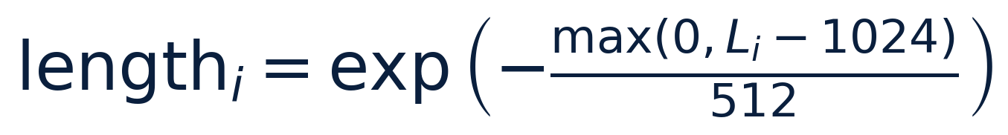
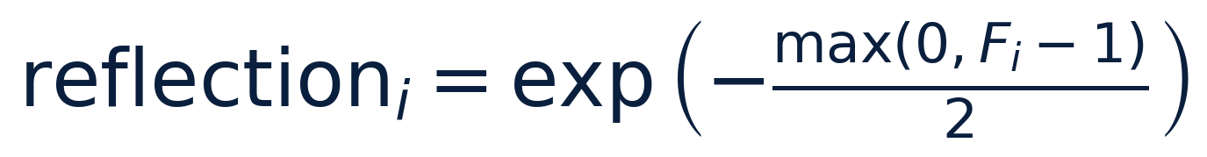
FACTOR VARIABLES
11 / 18
VARIABLES BY FAILURE MODE
Each factor targets a different bad behavior.
L_i
Total generated tokens, not only final answer tokens.
A_i and R_i
Answer-signal count and tail ratio after the first answer signal.
F_i
Reflective cue count: wait, check, verify, rethink, and equivalents.
VARIABLES
L_I, A_I, R_I, F_I

Slide 12
PROTOCOL
12 / 18
CONTROLLED COMPARISON
Formatting drift should not become evaluation drift.
Sampling
Parsing
Grading
Aggregation
Same fixed data slices across methods.
Shared answer parser extracts final predictions.
Normalized prediction compared with normalized target.
When duplicates exist, report the highest joint-score run.
EXPERIMENTAL PROTOCOL
SAME PARSER, SAME SCORE

Slide 13
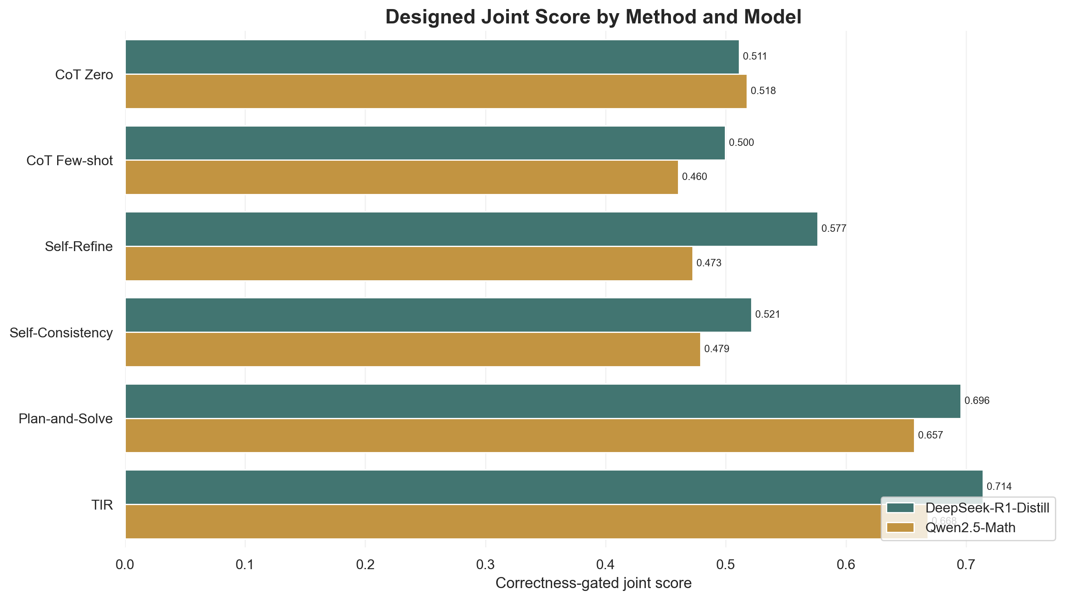
RESULTS · OVERALL
13 / 18
DESIGNED SCORE RANKING
Plan-and-Solve is the strongest prompt-only extension.
How to read
This is a correctness-gated joint score. It includes behavior penalties. No standalone accuracy axis is shown.
OVERALL RESULTS
JOINT SCORE

Slide 14
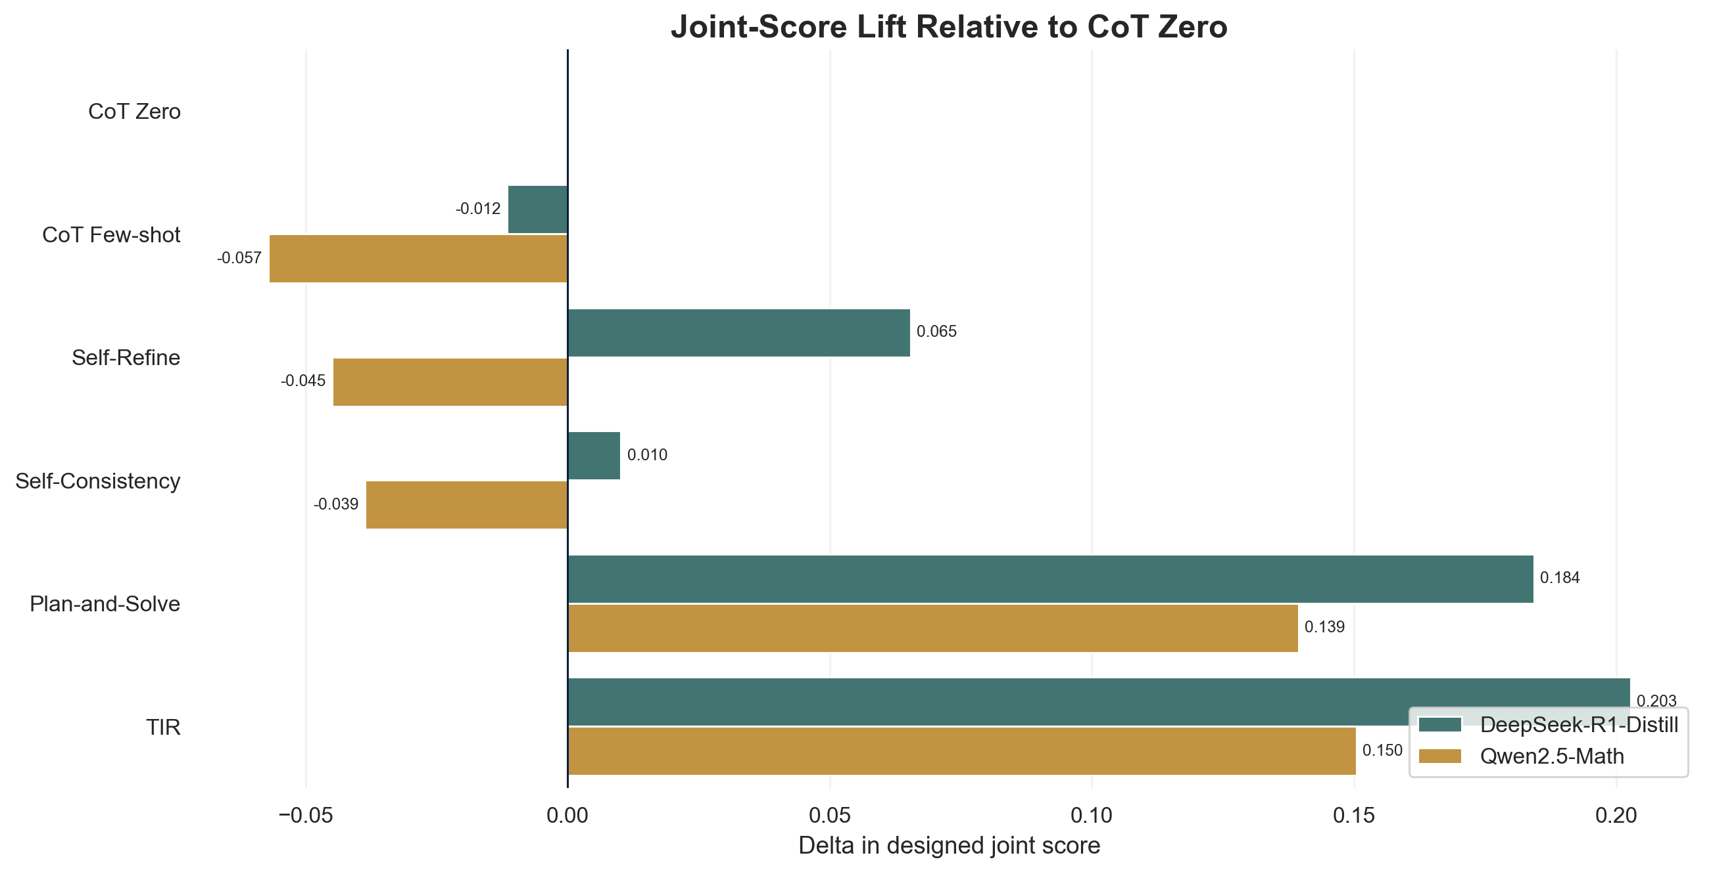
RESULTS · METHOD LIFT
14 / 18
RELATIVE TO COT ZERO
Structure helps more than simply asking for reasoning.
Interpretation
Self-Consistency buys robustness with hidden generation. Plan-and-Solve improves the trajectory without repeated samples.
METHOD ANALYSIS
JOINT-SCORE LIFT

Slide 15
ACT IV · RESULT DISCUSSION
15 / 18
MULTI-DIMENSIONAL READING
Method. Dataset. Model.
The same designed score can be sliced across intervention style, data difficulty, and model behavior.
Discussion rule
Compare joint score and factor decomposition together, not a standalone metric.
RESULT DISCUSSION
THREE DIMENSIONS

Slide 16
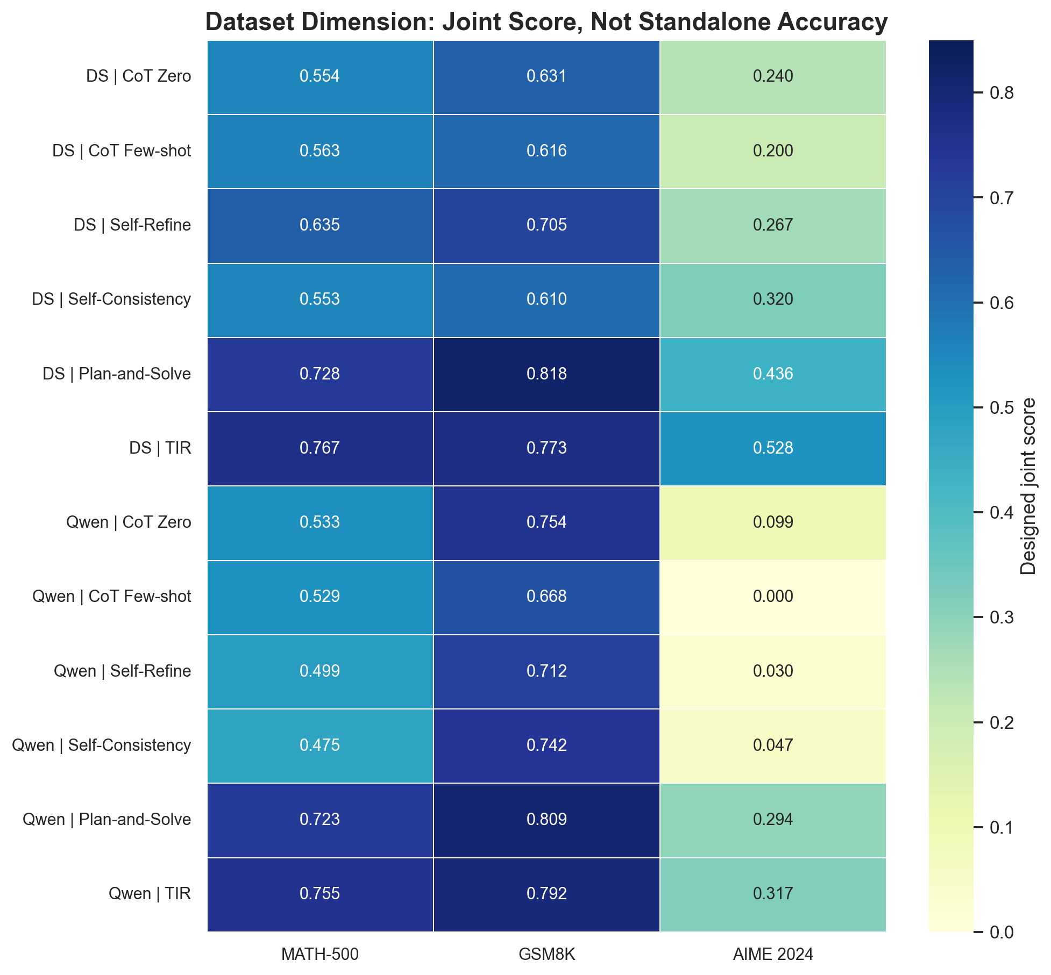
DATASET DIMENSION
16 / 18
DATA DIFFICULTY UNDER THE SAME SCORE
AIME remains the stress test.
Reading
GSM8K is more controllable. AIME exposes deeper reasoning gaps. The chart keeps both correctness and behavior in one designed score.
DATASET ANALYSIS
JOINT SCORE BY SPLIT

Slide 17
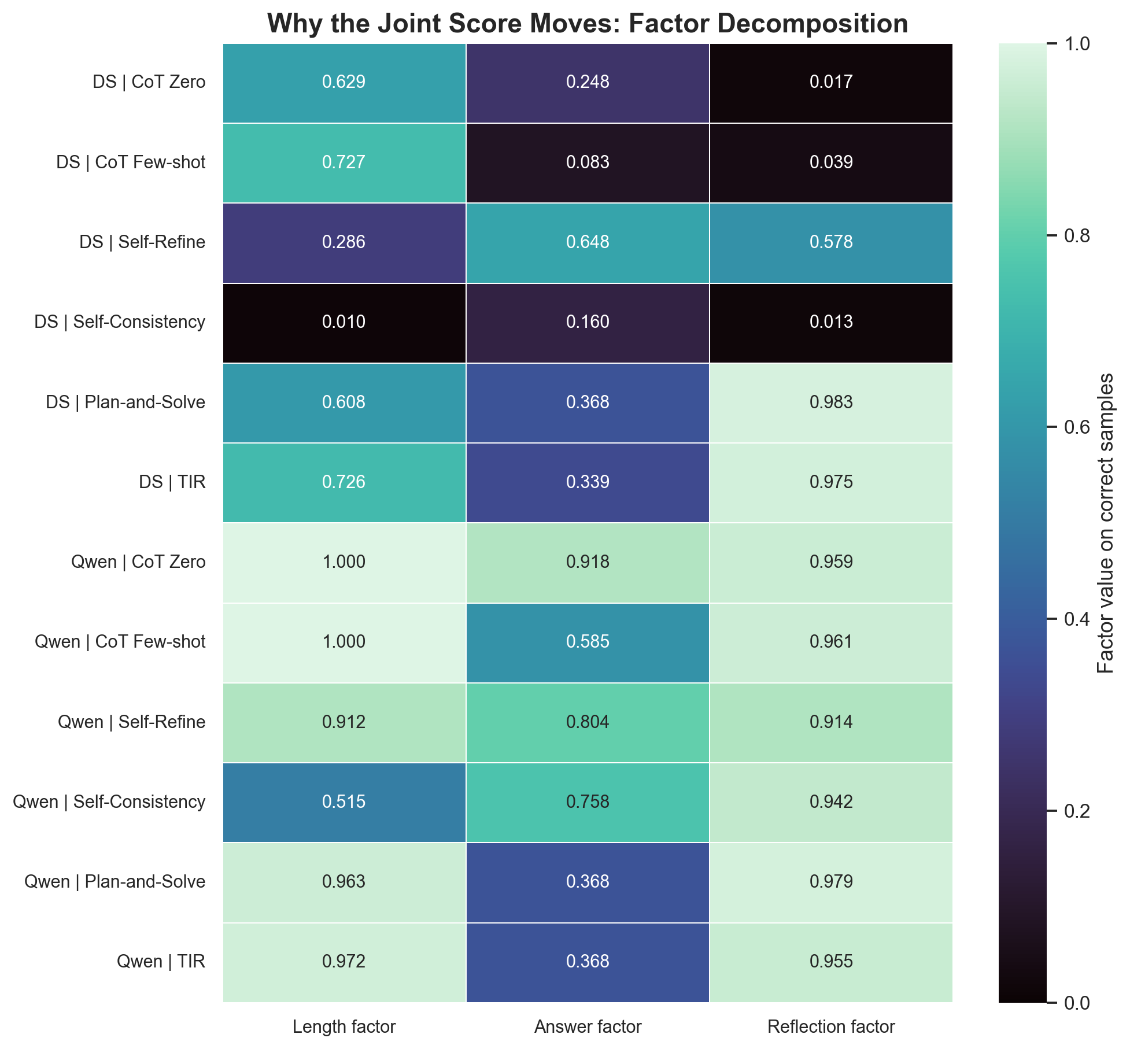
MODEL BEHAVIOR
17 / 18
WHY THE SCORE MOVES
Factor decomposition separates verbosity from instability.
Reading
DeepSeek gains more but can over-generate in baseline CoT. Qwen is weaker overall, yet Plan-and-Solve and TIR still improve its designed score.
BEHAVIOR FACTORS
LENGTH / ANSWER / REFLECTION

Slide 18
FUTURE · AGENTIC HARNESS
18 / 18
WHERE THIS PROJECT POINTS NEXT
A thin harness for better math agents.
Harness prompt
ReAct-style loop
Verifier layer
Define answer contract, tool policy, observation memory, and budget controller.
Reason, act, observe, then stop when the answer is stable.
Use parser, symbolic checks, and early exit to reduce wasted reasoning.
Main lesson: prompt design and evaluation design must be built together.
TAKEAWAY
PROMPTING BECOMES SYSTEM DESIGN

