Slide 1
Aviation Risk Analysis & Recommendations

Slide 2
Project overview
Finding low-risk aircraft models for a business looking to enter the aviation sector is the goal of this project. We looked at patterns, trends, and aircraft safety records by examining aviation accident data from 1962 to 2023. Our objective is to minimize risks and guarantee operational efficiency by offering data-driven insights and recommendations that will

Slide 3
Problem statement
The corporation wants to engage in aviation, but in order to identify the safest aircraft types for both private and commercial use, a risk assessment is required.
Goals:
Examine trends in aircraft accidents.
Determine which aircraft models are low risk.
Make data-based investing suggestions.
Interested parties
Executives in business
Leaders of the aviation division

Slide 4
Understanding data
Source of Data
Understanding Civil aviation incidents from 1962 to 2023 are included in the dataset, which comes from the National Transportation Safety Board (NTSB).
Important Features
Model of Aircraft: The kind of aircraft that is involved in mishaps.
Accident Severity : Sorting the results of accidents into three categories: minor, major, and fatal.
Fatalities: The quantity of people killed in each incidence.
Aviation safety is impacted by external risk variables, such as location and weather.
Flight Phase: At the time of the accident, the aircraft was either taking off, cruising, or landing.

Slide 5
Data cleaning
Missing data: Incomplete columns were eliminated
Where feasible, missing values were removed. Data formats that are standardized for uniformity.
Outliers: Extreme values in accident records were located and dealt with. Important Findings & Illustrations

Slide 6
Data visualization
1. Accident Trends Over Time
Visualization: Line chart showing accident trends from 1962 to 2023.
Finding: Aviation accidents peaked in certain decades but have declined over time.
Implication: Safety regulations and technological advancements have improved aviation safety.

Slide 7
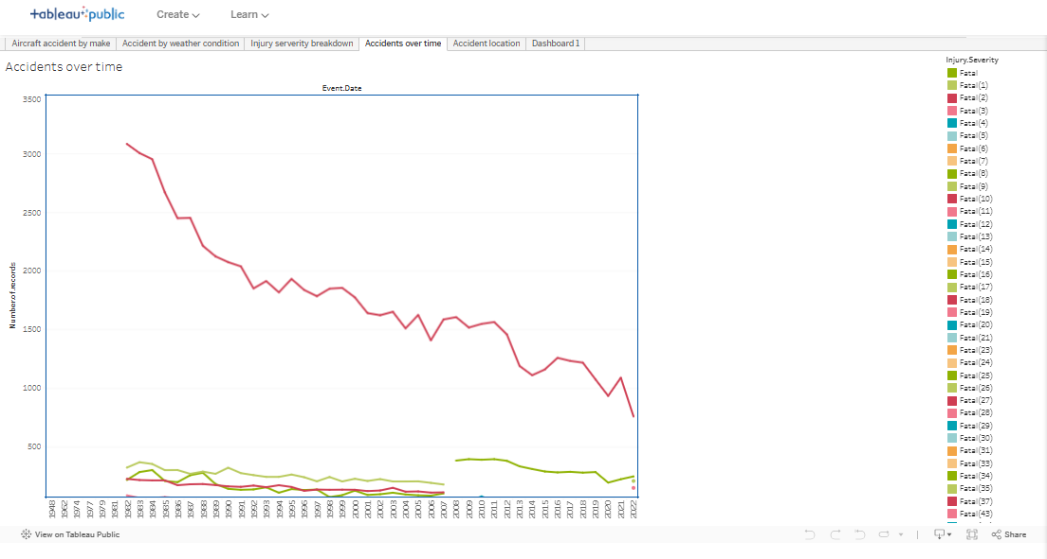
Accident over time

Slide 8
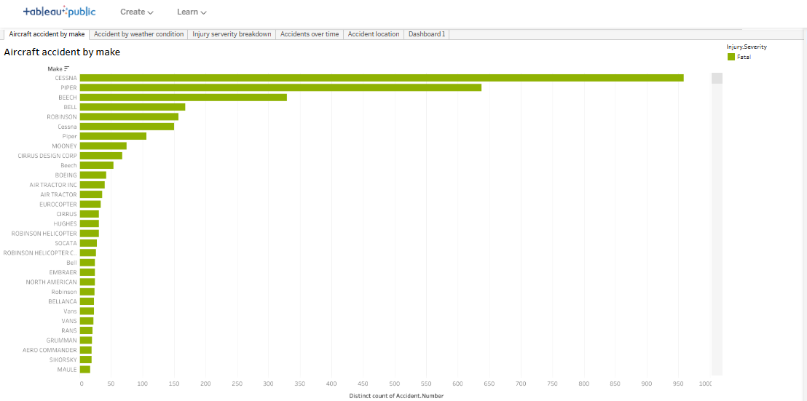
Aircraft accident by make

Slide 9
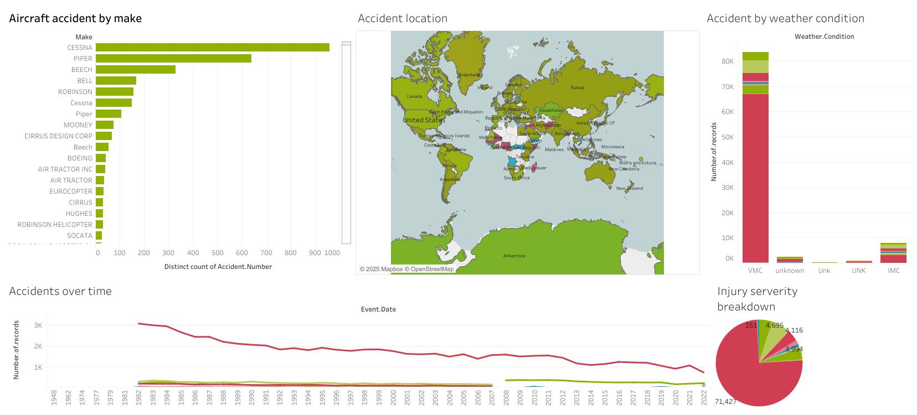

Slide 10
Recommendations and findings
Certain aircraft models have higher accident rates → Avoid purchasing them.
Bad weather is a key risk factor → Improve pilot training for adverse weather.
Accidents have decreased over time → Aviation safety has improved.
Actionable Insights for the Company
Invest in low-risk aircraft models
Prioritize aircraft with good safety records
Implement pilot training for poor weather conditions

Slide 11
THANK YOU
BRENDA CHEMUTAI
www.linkedin.com/in/brendamesis

