Slide 1
BancAlpes
Segmentación de clientes
Sofía Álvarez
Alvaro Plata
Brenda Barahona

Slide 2
Agenda
01
Perfiles de negocio
02
Visualizacion de los datos
03
Conclusiones y recomendaciones

Slide 3
Visualización de los datos
Here you could describe the business’s mission. A clear message is a good way to reach your audience

Slide 4
Visualización de los datos
Here you could describe the business’s mission. A clear message is a good way to reach your audience

Slide 5
Perfil #1
Recomendaciones
Personas con
Poco cupo de crédito
Poco poder adquisitivo
Poco número de compras
Hacer llegar a estos clientes alianzas y diferentes descuentos que se pueden aprovechar al hacer uso de la tarjeta de crédito

Slide 6
Perfil #2
Recomendaciones
Son los que más compras realizan.
Tienen un balance bajo
Su frecuencia de compras es la más elevada.
Orientarse en incrementar el número de compras que ellos realizan, por ejemplo acumular puntos o millas al usar la tarjeta de crédito.

Slide 7
Perfil #3
Recomendaciones
Son los que mejor balance primero, no realizan muchas compras
porque son los de mayor poder adquisitivo
Hacer llegar a estos clientes alianzas y diferentes descuentos que se pueden aprovechar al hacer uso de la tarjeta de crédito

Slide 8
Conclusiones
You could enter a subtitle here if you need it

Slide 9
OUR PROCESS
Mars
Saturn
Mercury
Jupiter
Mars is a cold place
It has several rings
1
2
3
4
It’s larger than the Moon
It’s the biggest planet

Slide 10
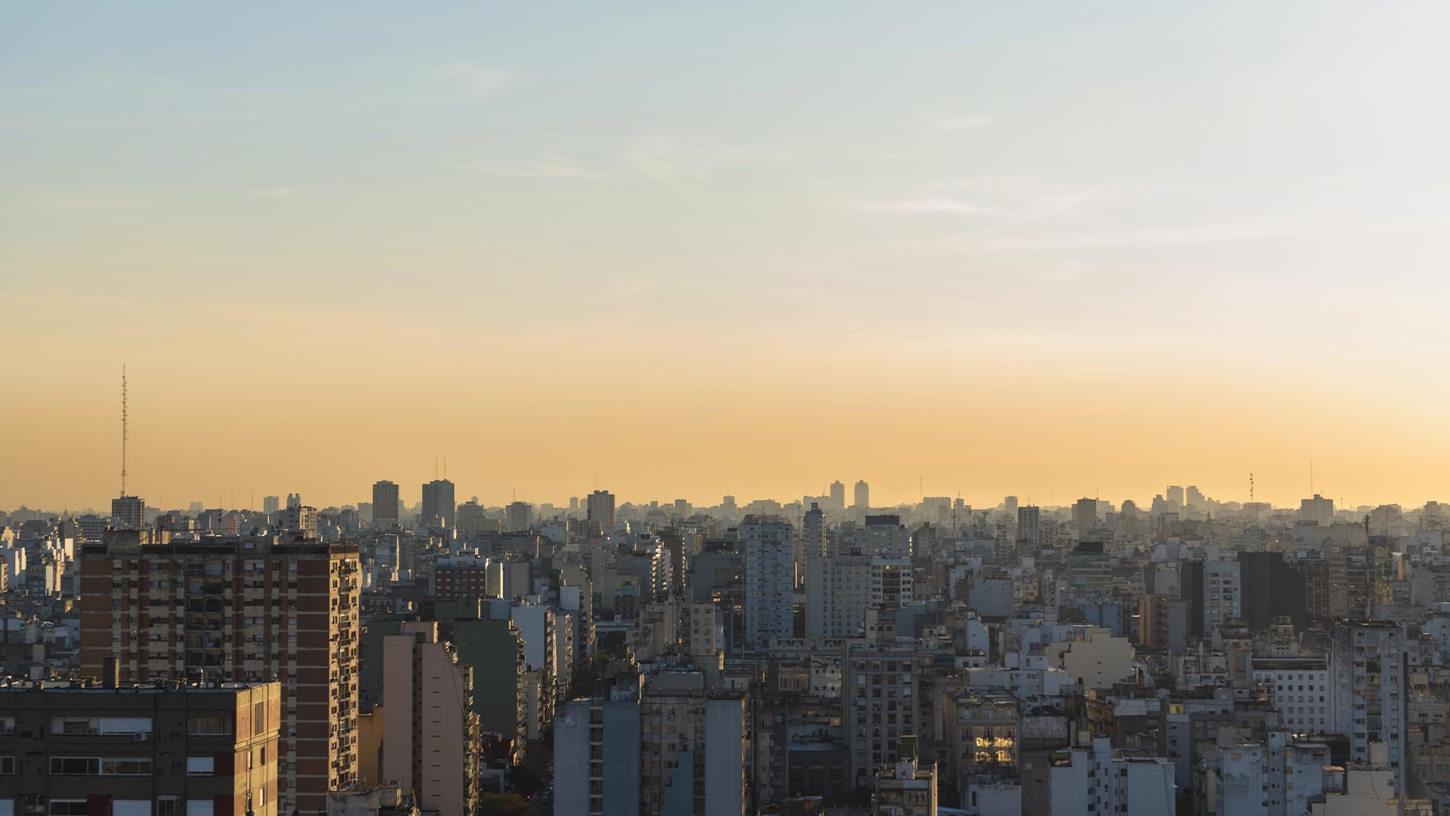
AWESOME WORDS

Slide 11
06
FINANCIAL PLAN
You could enter a subtitle here if you need it

Slide 12
PREDICTED GROWTH
Venus
Jupiter
Mars
Saturn
Venus has a beautiful name, but it’s hot
Jupiter is the biggest planet in our System
Despite being red, Mars is actually a cold place
It is composed mostly of hydrogen and helium

Slide 13
BALANCE SHEET
3M
1M
2M
INCOME
What the company owns
EXPENSES
What the company owes
BALANCE
Difference between assets and liabilities

Slide 14
THANKS!
Do you have any questions?
youremail@freepik.com
+91 620 421 838
yourcompany.com
Please keep this slide for attribution.

Slide 15
ALTERNATIVE ICONS

Slide 16
ALTERNATIVE RESOURCES

Slide 17
RESOURCES
Did you like the resources on this template? Get them for free at our other websites
VECTORS:
Background of businessman with bag of money
Colleagues working together at the office pack
People buying christmas presents
Colleagues working together collection
Colleagues working together illustrated
Connecting teams concept for landing page
PHOTOS:
View of wide-spread urban area cityscape
High angle corporate electronic devices
Smiley senior lady looking at the camera
Front view man holding a tablet
Woman at work holding her notes with copy space
ICONS:
Urban Icon Pack

Slide 18
Instructions for use
In order to use this template, you must credit Slidesgo by keeping the Thanks slide.
You are allowed to:
- Modify this template.
- Use it for both personal and commercial projects.
You are not allowed to:
- Sublicense, sell or rent any of Slidesgo Content (or a modified version of Slidesgo Content).
- Distribute Slidesgo Content unless it has been expressly authorized by Slidesgo.
- Include Slidesgo Content in an online or offline database or file.
- Offer Slidesgo templates (or modified versions of Slidesgo templates) for download.
- Acquire the copyright of Slidesgo Content.
For more information about editing slides, please read our FAQs or visit Slidesgo School:
https://slidesgo.com/faqs and https://slidesgo.com/slidesgo-school

Slide 19
Fonts & colors used
This presentation has been made using the following fonts:
Righteous
(https://fonts.google.com/specimen/Righteous)
Open Sans
(https://fonts.google.com/specimen/Open+Sans)
#a3caf7
#eb573d
#5fa4ab
#f8c379
#fa9778
#051934

Slide 20
Use our editable graphic resources...
You can easily resize these resources without losing quality. To change the color, just ungroup the resource and click on the object you want to change. Then, click on the paint bucket and select the color you want. Don’t forget to group the resource again when you’re done.

Slide 23
JANUARY
FEBRUARY
MARCH
APRIL
MAY
JUNE
PHASE 1
Task 1
Task 2
PHASE 2
Task 1
Task 2
JANUARY
FEBRUARY
MARCH
APRIL
PHASE 1
Task 1
Task 2

Slide 26
...and our sets of editable icons
You can resize these icons without losing quality.
You can change the stroke and fill color; just select the icon and click on the paint bucket/pen.
In Google Slides, you can also use Flaticon’s extension, allowing you to customize and add even more icons.

Slide 27
Educational Icons
Medical Icons

Slide 28
Business Icons
Teamwork Icons

Slide 29
Help & Support Icons
Avatar Icons

Slide 30
Creative Process Icons
Performing Arts Icons

Slide 31
Nature Icons

Slide 32
SEO & Marketing Icons

Slide 33


