Slide 1
VisualEYES Technology Review
McKenzie Hagen
Bahar Sener
Brenda Qiu
Lydia Zhang

Slide 2
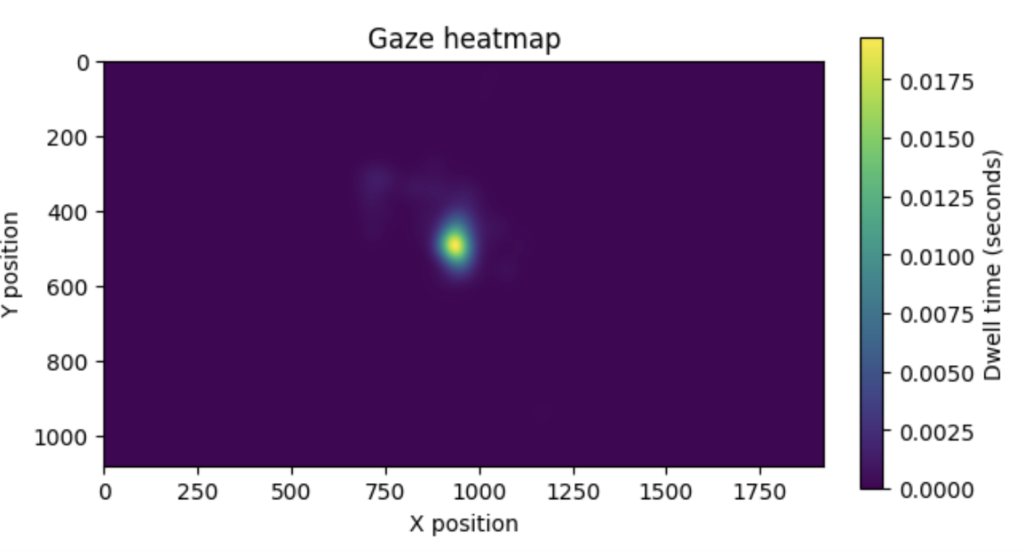
Goal: Quality control of Eyetracking experimental data
.
Researchers use eye movements to infer cognitive and visual processing
Collecting data from human participants is difficult, and ensuring quality is vital

Slide 3
Problem: Proprietary File I/O
To visualize the data, first the data needs to be read into Python
Eyetracking software outputs data in proprietary “Eyelink Data Format”
Eyelink distributes edf2asc to handle conversion to an ASCII file
.

Slide 4
Option 1: eyelinkio
A lightweight library to import SR Research EDF files into Python.
.
Pros:
Few dependencies
Directly reads edf
Export to pandas
Under development
Cons:
Lightly documented
Under development

Slide 5
Option 2: MNE-Python
Open-source Python package for exploring, visualizing, and analyzing human neurophysiological data
.
Pros:
Heavily documented
Large user base
Very mature
Cons:
More focused on EEG/MEG
Steep learning curve
Only reads asc

Slide 6
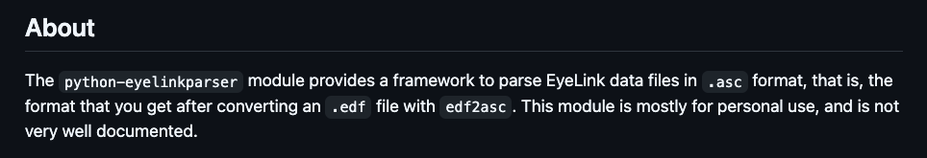
Option 3: eyelinkparser
.
Pros:
Easy to understand tutorial
Utilizes DataMatrix objects similar to pandas
Built-in functions for data manipulations
Cons:
Default settings require specific data acquisition parameters
Lightly documented
Only reads asc

Slide 7
Decision: eyelinkio
eyelinkio is the most straightforward with fewest dependencies.
For other components of our project, we may consider some functions from mne
.

