Slide 1
VisualEyes
Visualization of eyetracking data for quality control
Lydia Zhang, Brenda Qui, Bahar Sener, McKenzie Hagen
Notes:
Main points to cover: purpose of the software is, what user you are trying to address and what's the intention for that user and what larger problem you are trying to solve, what technology did you select, what are things that are difficult for your team (e.g., we were using branches but we should use forks), what are the next steps
Technology: the feature(s) eyelinkio missed and what we did to fix; the trial information extracted with eyelinkio are different from the csv - there’s a timing difference (for adults 20-25 ms offset for babies 94 ms offset)
Future direction: parse trial information and add a column to the dataframe and if have more time will improve
Object-oriented programming - instead of inputting screen dimensions just do screen.plot()
current quality control focuses on fixations and samples (‘axp’ or ‘ayp’) but haven’t figured out a better way to visualize saccades (two coordinates ‘sxp’ ‘exp’ ‘syp’ ‘eyp’)
CI is only set up to test on MacOS the process of dealing with github workflow is hard when you don’t have access to other OSs
Visual eyes visualize visualeyes

Slide 2
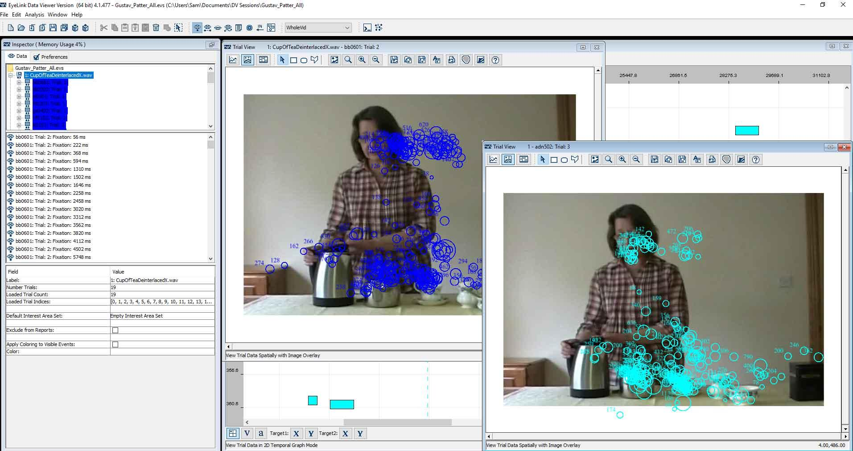
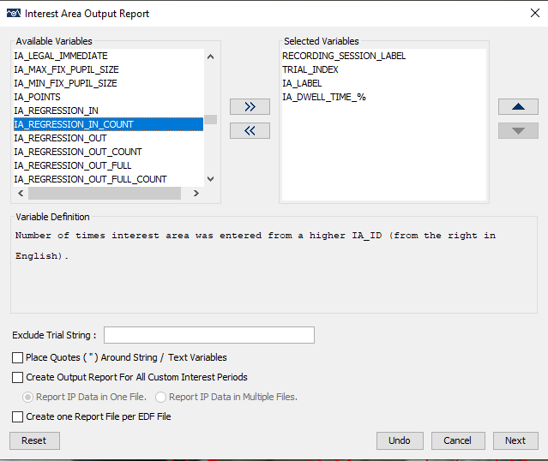
Why we developed VisualEyes
Eye trackers often come with proprietary, opaque, GUI-based software to visualize, group, process and report gaze data
VisualEyes allows you to achieve all of the above, AND visualize data recorded with eye trackers for:
Between-run Quality Control: efficient assessment of eye-tracking data between experiment runs
Post-Hoc Quality Control: review data after experiment to inform exclusion criteria
Notes:
For users:
Main goal is to be used between runs, during the experiment. Mostly we can instruct participants and we can check if they are following directions and if calibration is good. It is realistic to do this between runs, it doesn’t take long to run. It also is not meant to be used for detailed data analysis but rather a first pass control.

Slide 3
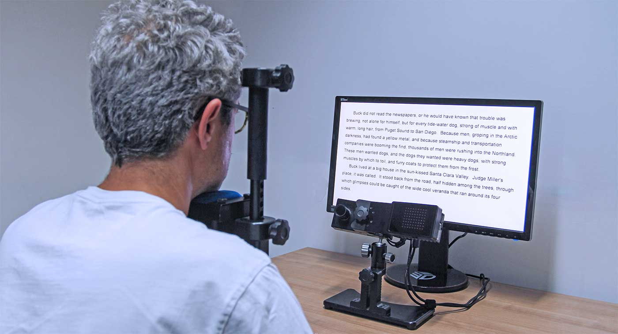
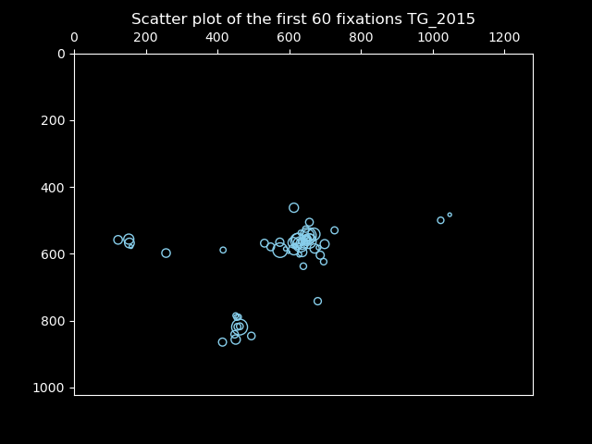
Example Use Case 1
Vision Scientist
Vision scientists often collect multiple runs of gaze data in experiments requiring participants to fixate on specific screen locations. They need to quickly inspect data between runs to catch and address issues, ensuring future data isn’t compromised.
SR Research, https://www.sr-research.com/eyelink-1000-plus/
Notes:
For users:
Another useful application is using this package for post-hoc quality control. This is best for situations for which we cannot instruct the participants. For example, young infants generally have lower attention spans and will not have long, continuous fixations. This makes it difficult to make decisions on how to define the quality of the data for exclusions. For example, currently I exclude the test trial pairs for my 6-month-old participants who look at either test trial for less than 5-seconds (cumulative). Although this is the approach I chose, it is possible that I would end up excluding trials for which an infant is attentive and looking at the stimuli for 4.5 seconds, and including trials for which an infant is mostly attending to a blank area on the screen but reaches the 5-second minimum requirement. Using a different criteria for which I look at how infants attend to the stimuli could help me set better exclusion criteria!
- when I tried to do this just by plotting and looking at the data, I felt that I was making arbitrary decisions on what seems attentive to me. By using the thresholding function I can see the percentage looking to

Slide 4
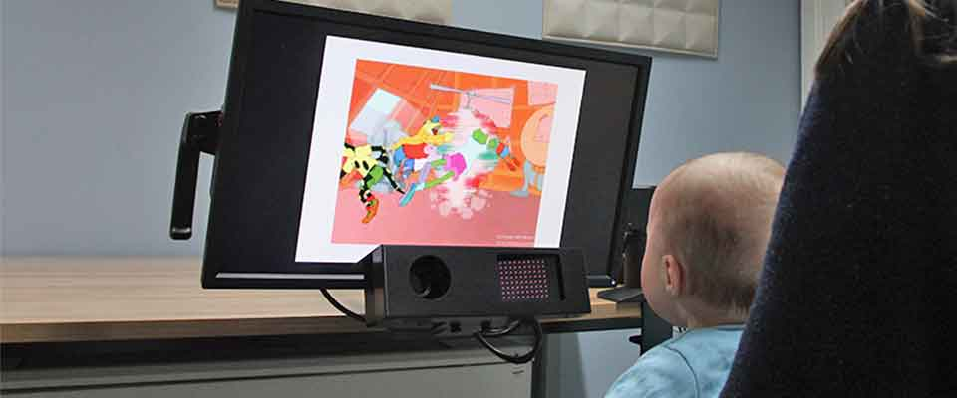
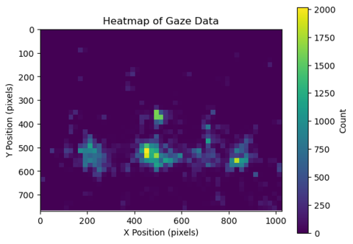
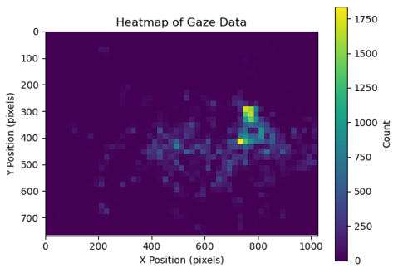
Example Use Case 2
Developmental Research Scientist
Children are less likely to follow experimental instructions, and sessions must be quick. While in-session quality controls are less needed, developmental researchers rely on post-hoc analysis to identify outliers in looking behavior.
SR Research, https://www.sr-research.com/solutions/developmental-solutions/
Notes:
Great pic :))

Slide 5
Technology - Eyelinkio and SR Research Developers Kit
SR Research Developers Kit
C Libraries provided by SR Research for working with proprietary “Eyelink Data Format” data output by the eye tracker;
Eyelinkio
Open source “alpha”-stage Python package with wrapper functions around SR Research Developers Kit

Slide 6
Major Challenges
SR Research Developers Kit must be downloaded from login-protected forums, and install instructions vary significantly by OS
Resolved with more complicated Github Actions Workflow
eyelinkio omits some trial information
Resolved by adding that feature to eyelinkio ourselves (PR pending)
Discovered discrepancy between trial information extracted by SR Research Eyelink EDF Access API vs. Data Viewer.

Slide 7
Next Steps
Resolve trial information discrepancy
Object oriented programming for efficiency
Avoid giving the same information (e.g. screen dimensions) to every single function
Supports more data
Currently supports only samples and fixations, where each data point has one pair of coordinates; other data, for example saccades, has multiple pairs of coordinates → ideas for visualization?
Support more eye tracker vendors, like Tobii
Continuous integration on operating systems other than MacOS

