Slide 1
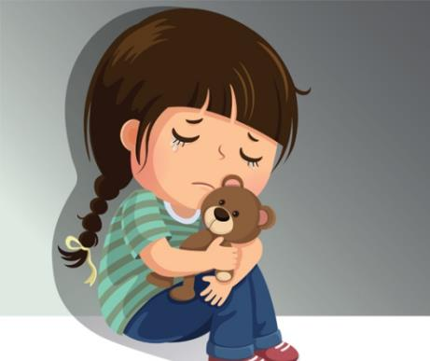
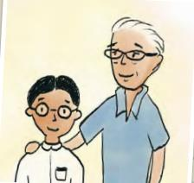
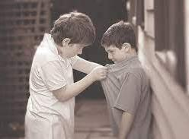
[TITLE]
Continuous WritingWrite a composition of at least 150 words abouta kind actThe pictures are provided to help you thinkabout this topic. Your composition should bebased on one or more of these pictures.Consider the following points when you planYour composition.• What was the kind act?• Why was it kind?You may use the points in any order and include other relevant points as well.

Slide 2

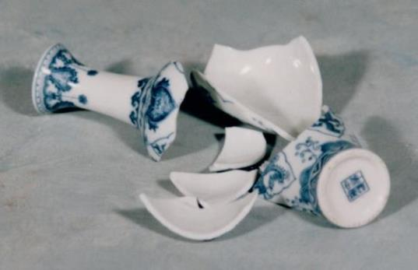

[TITLE]
Continuous WritingWrite a composition of at least 150 words aboutan apology.The pictures are provided to help you thinkabout this topic. Your composition should bebased on one or more of these pictures.Consider the following points when you planYour composition.• What wrong had been done?• Who was at fault?• What happened in the end?You may use the points in any order and include other relevant points as well.

Slide 3



[TITLE]
Continuous WritingWrite a composition of at least 150 words about a fear.The pictures are provided to help you think about this topic.Your composition should be based on one or more of these pictures.Consider the following points when you plan your composition:• What was the fear? • What was done to overcome thefear?You may use the points in any order and include other relevant points as well.

