Slide 1

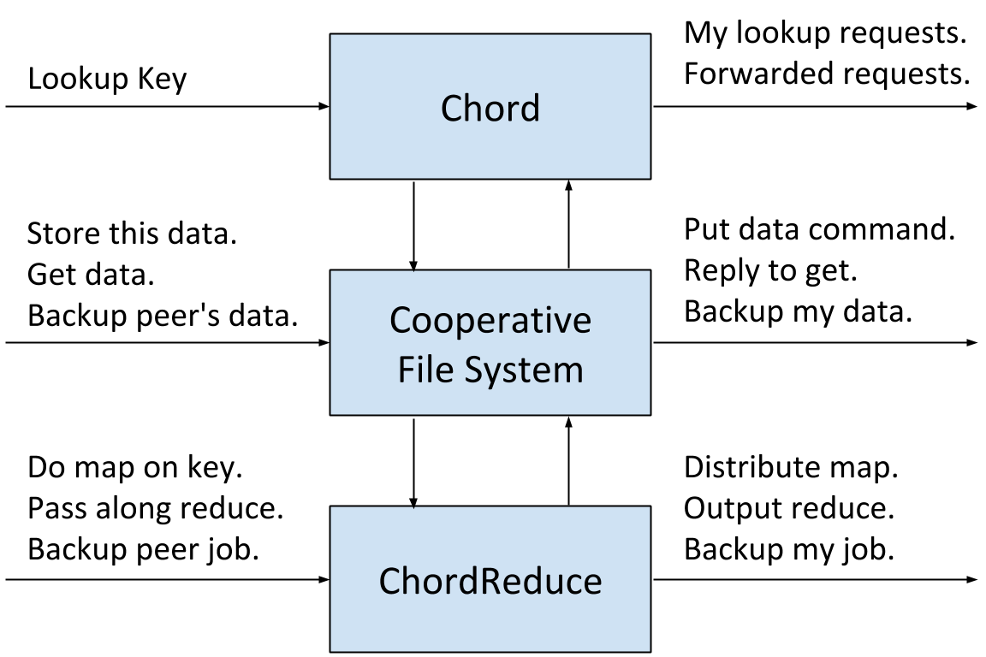
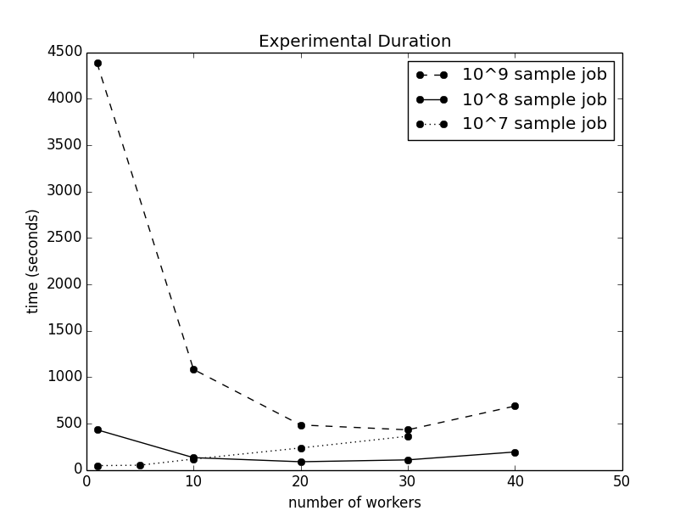
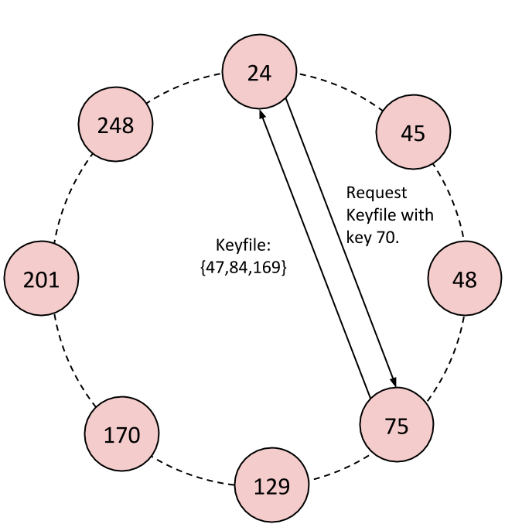
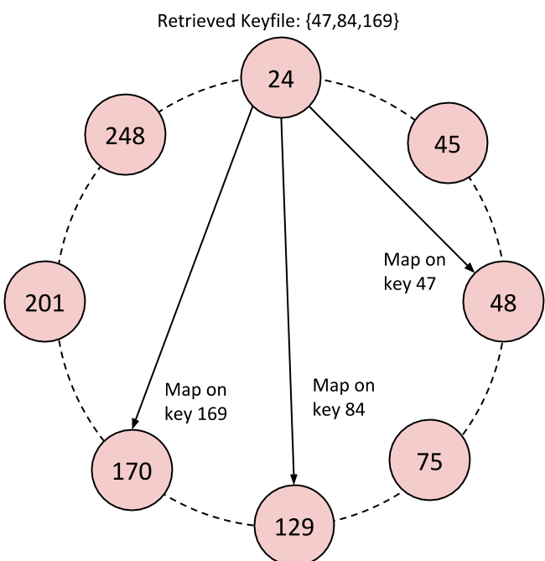
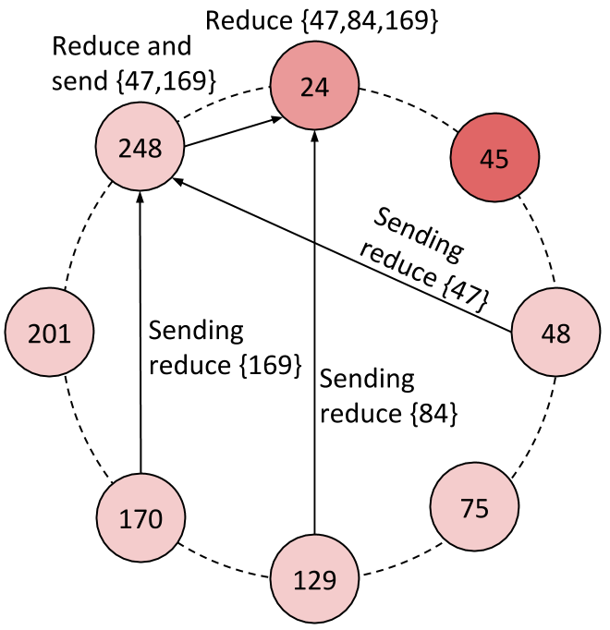
MapReduce on a Chord Distributed Hash Table Andrew Rosen, Brendan Benshoof, Robert W. Harrison, and Anu G. Bourgeois Department of Computer Science – Georgia State University
Motivation
System Architecture
Results
MapReduce platforms are designed for datacenters, which are highly centralized in nature. These platforms require a centralized source to manage the network, which leads to a single point of failure. We present ChordReduce, a generalized and completely decentralized MapReduce framework which utilizes the peer-to-peer protocol Chord. ChordReduce’s robustness, scalability, and lack of a single point of failure allows gitto be easily deployed in a greater variety of contexts, including cloud and loosely coupled environments.
Motivation
Implementation
Conclusions
ChordReduce has three layers: the Chord lookup and overlay, the file system layer, and the MapReduce processing layer.
Chord handles is
Motivation
References
J. Dean and S. Ghemawat, “Mapreduce: Simplified DataProcessing on Large Clusters,” Communications of the ACM,vol. 51, no. 1, pp. 107–113, 2008.
I. Stoica, R. Morris, D. Karger, M. F. Kaashoek, and H. Balakrishnan, “Chord: A Scalable Peer-to-Peer Lookup Service for Internet Applications,” SIGCOMM Comput. Commun.
F. Dabek, M. F. Kaashoek, D. Karger, R. Morris, and I. Stoica, “Wide-Area Cooperative Storage with CFS,” ACM SIGOPS Operating Systems Review, vol. 35, no. 5, pp. 202–215, 2001.
K. Lee, T. W. Choi, A. Ganguly, D. Wolinsky, P. Boykin, and R. Figueiredo, “Parallel Processing Framework on a P2P System Using Map and Reduce Primitives,” in Parallel and Distributed Processing Workshops and Phd Forum (IPDPSW), 2011

