Slide 1

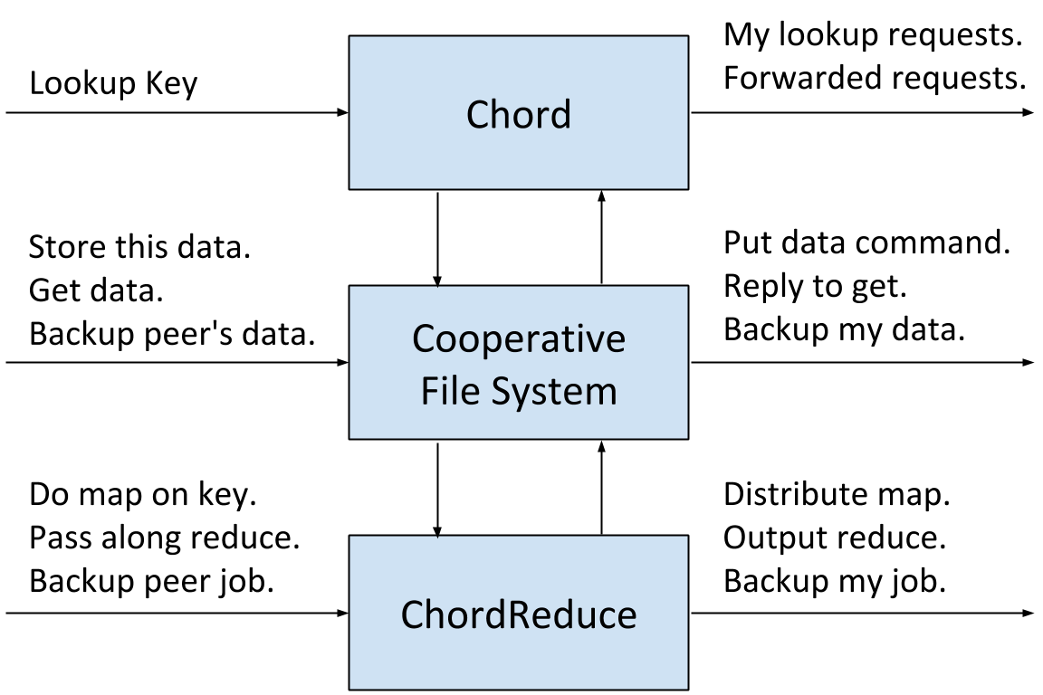
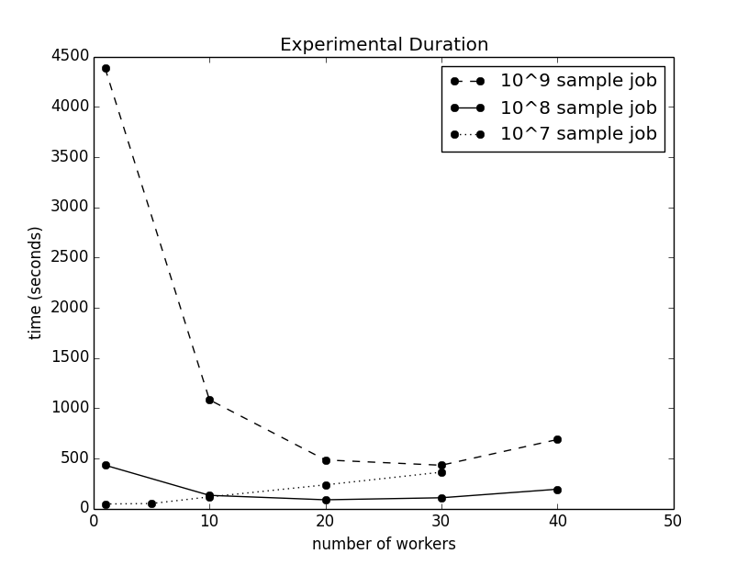
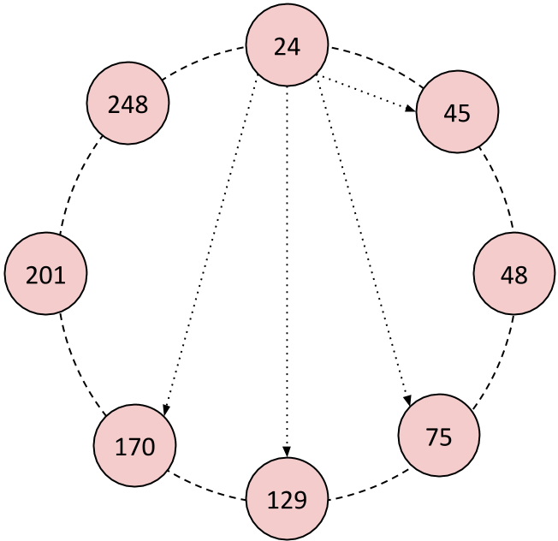
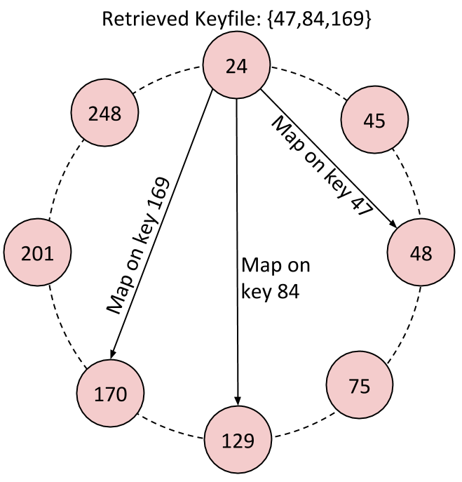
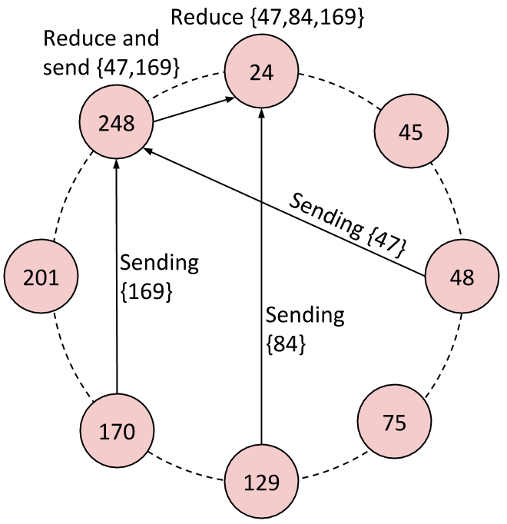
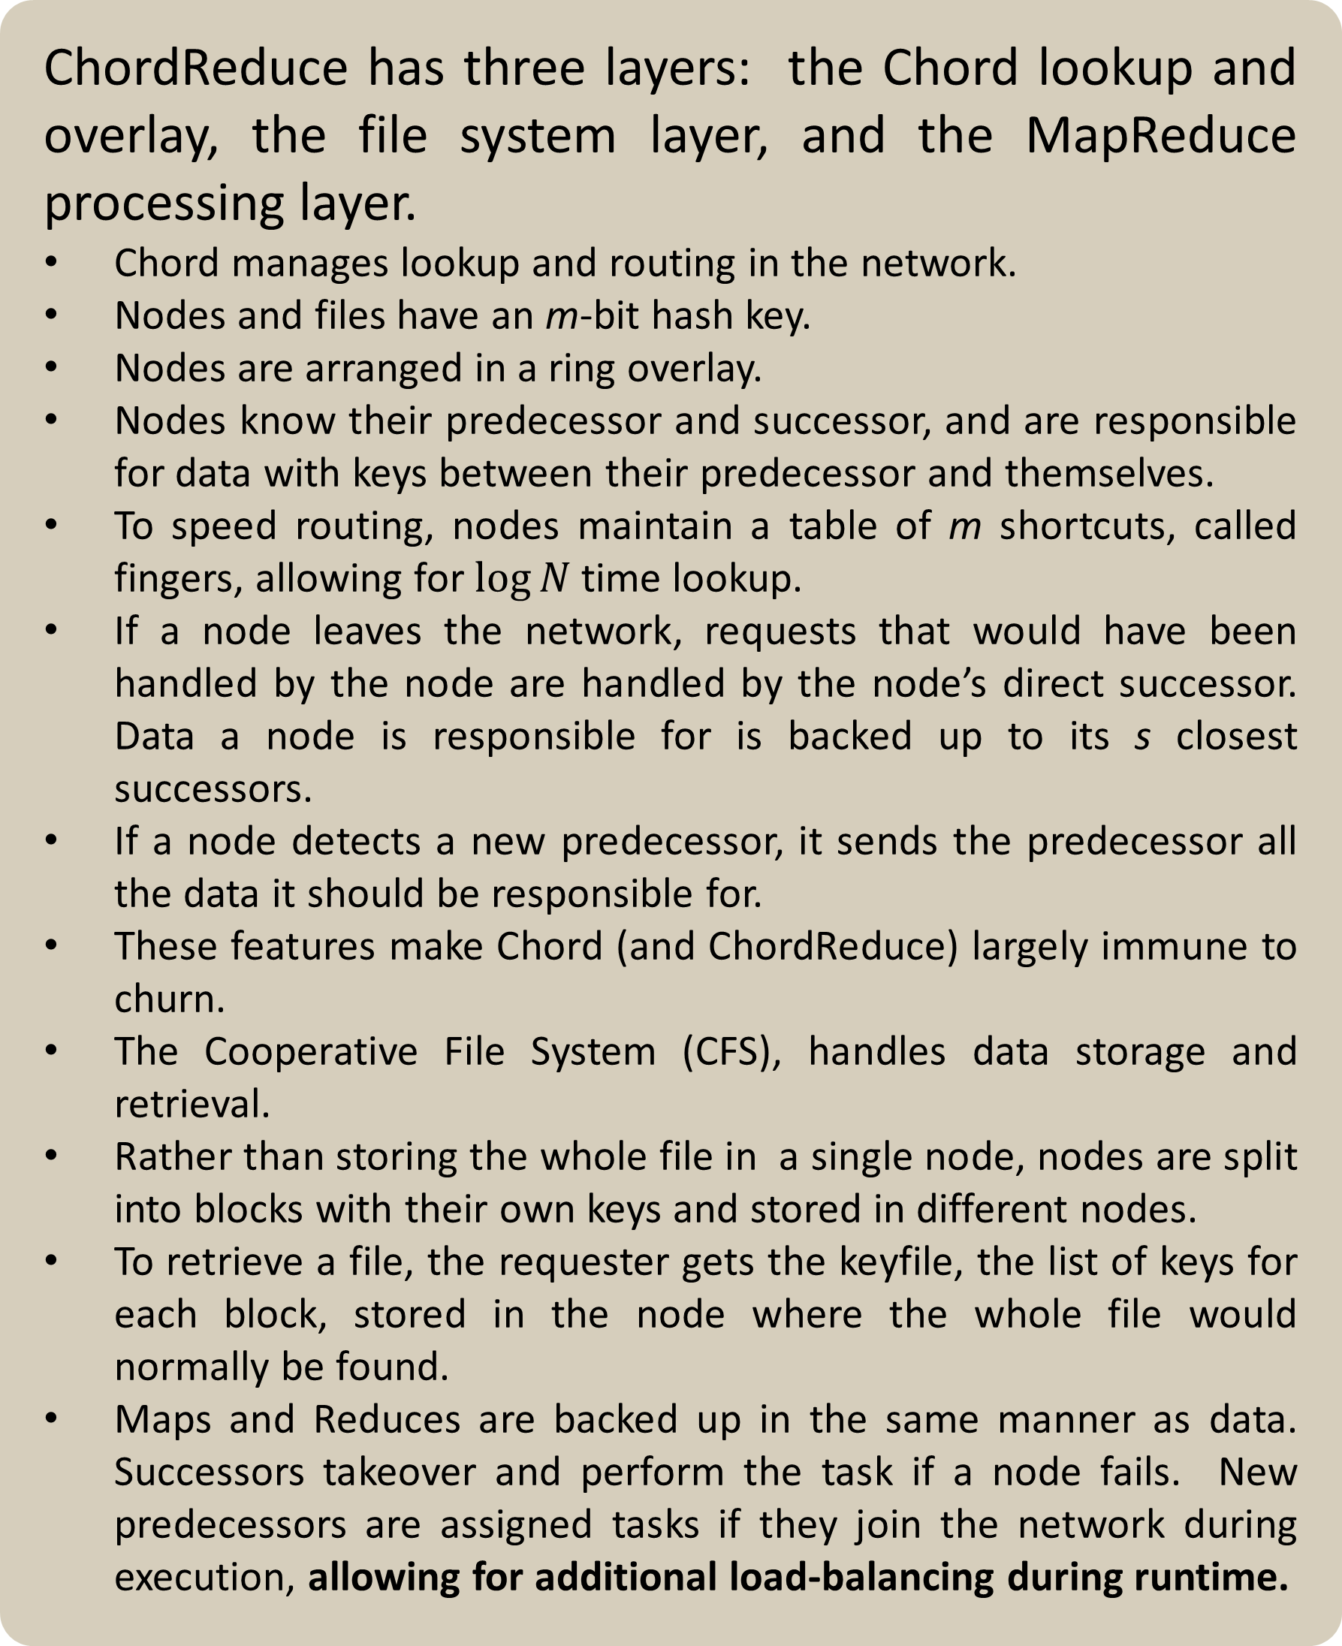
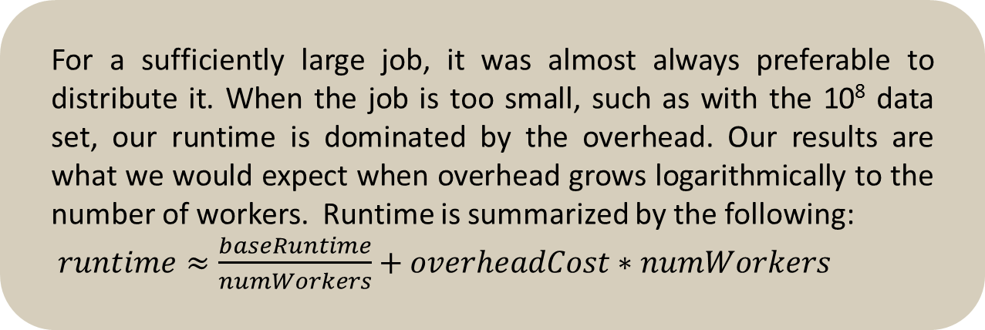
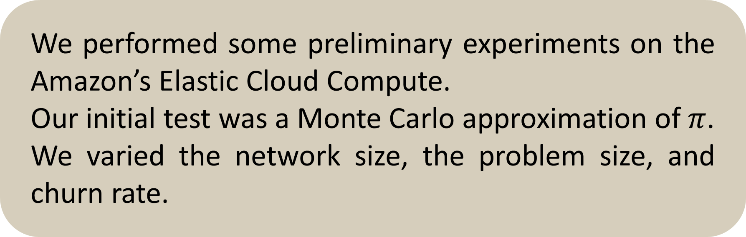
MapReduce on a Chord Distributed Hash Table Andrew Rosen, Brendan Benshoof, Robert W. Harrison, and Anu G. Bourgeois Department of Computer Science – Georgia State University
Motivation
System Architecture
Experiments and Results
MapReduce platforms are designed for datacenters, which are highly centralized in nature. These platforms require a centralized source to manage the network, which leads to a single point of failure. We present ChordReduce, a generalized and completely decentralized MapReduce framework which utilizes the peer-to-peer protocol Chord. ChordReduce’s robustness, scalability, and lack of a single point of failure allows it to be easily deployed in a greater variety of contexts, including cloud and loosely coupled environments.
We performed some preliminary experiments on the Amazon’s Elastic Cloud Compute.
Our initial test was a Monte Carlo approximation of $π$.
We varied the network size, the problem size, and churn rate.
Implementation
Churn Rate per second | Average runtime (s) | Speedup vs 0% Churn
0% | 441.577 | 1.00
0.0025% | 331.80 | 1.24
0.00775% | 445.47 | 0.92
0.025% | 431.86 | 0.95
0.4% | 329.20 | 1.25
0.8% | 191.25 | 2.15
ChordReduce has three layers: the Chord lookup and overlay, the file system layer, and the MapReduce processing layer.
Chord manages lookup and routing in the network.
Nodes and files have an m-bit hash key.
Nodes are arranged in a ring overlay.
Nodes know their predecessor and successor, and are responsible for data with keys between their predecessor and themselves.
To speed routing, nodes maintain a table of m shortcuts, called fingers, allowing for $\log{N}$time lookup.
If a node leaves the network, requests that would have been handled by the node are handled by the node’s direct successor. Data a node is responsible for is backed up to its s closest successors.
If a node detects a new predecessor, it sends the predecessor all the data it should be responsible for.
These features make Chord (and ChordReduce) largely immune to churn.
The Cooperative File System (CFS), handles data storage and retrieval.
Rather than storing the whole file in a single node, nodes are split into blocks with their own keys and stored in different nodes.
To retrieve a file, the requester gets the keyfile, the list of keys for each block, stored in the node where the whole file would normally be found.
Maps and Reduces are backed up in the same manner as data. Successors takeover and perform the task if a node fails. New predecessors are assigned tasks if they join the network during execution, allowing for additional load-balancing during runtime.
For a sufficiently large job, it was almost always preferable to distribute it. When the job is too small, such as with the 10⁸ data set, our runtime is dominated by the overhead. Our results are what we would expect when overhead grows logarithmically to the number of workers. Runtime is summarized by the following:
$runtime≈\frac{baseRuntime}{numWorkers}+overheadCost∗numWorkers$
The results of calculating π by generating 10 8 samples under churn. Churn is the chance for each node to join or leave the network. The large speedup is from joining nodes acquiring work during experimental runtime.
Conclusions
Our experiments established that ChordReduce operates under high rates of churn and that we gain the desired speedup on sufficiently large problems. This makes ChordReduce an excellent platform for distributed and concurrent programming in cloud and loosely coupled environments.
References
The stager sends a map task for each key in the keyfile. In larger networks, this process is streamlined by recursively bundling keys and sending them to the best finger.
Results are sent back via the Chord overlay. If a node receives multiple results, they are reduced before being sent on.
J. Dean and S. Ghemawat, “Mapreduce: Simplified DataProcessing on Large Clusters,” Communications of the ACM,vol. 51, no. 1, pp. 107–113, 2008.
I. Stoica, R. Morris, D. Karger, M. F. Kaashoek, and H. Balakrishnan, “Chord: A Scalable Peer-to-Peer Lookup Service for Internet Applications,” SIGCOMM Comput. Commun.
F. Dabek, M. F. Kaashoek, D. Karger, R. Morris, and I. Stoica, “Wide-Area Cooperative Storage with CFS,” ACM SIGOPS Operating Systems Review, vol. 35, no. 5, pp. 202–215, 2001.
K. Lee, T. W. Choi, A. Ganguly, D. Wolinsky, P. Boykin, and R. Figueiredo, “Parallel Processing Framework on a P2P System Using Map and Reduce Primitives,” in Parallel and Distributed Processing Workshops and Phd Forum (IPDPSW), 2011

