Slide 1

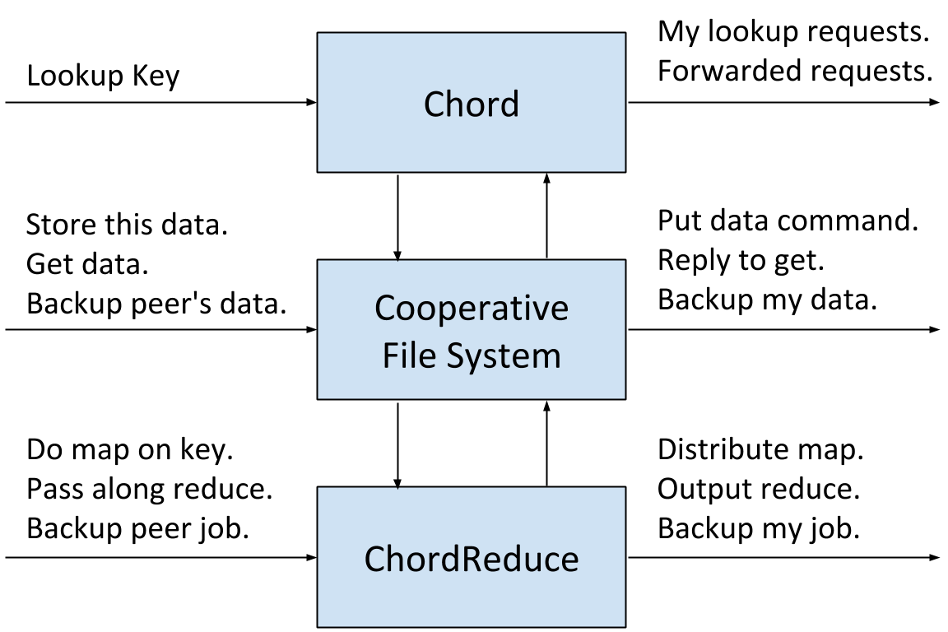
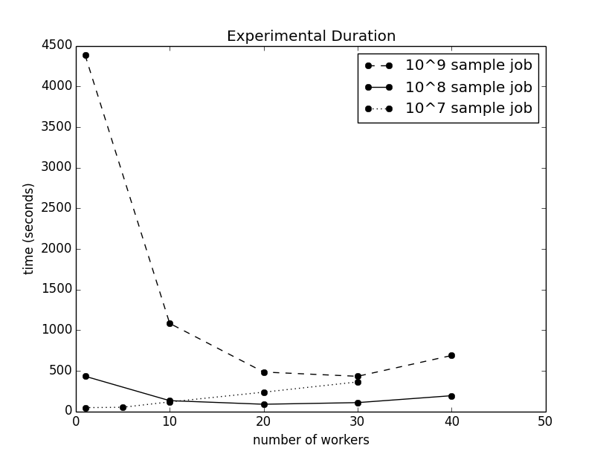
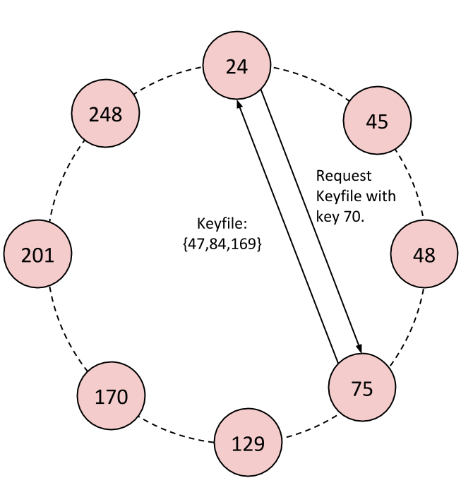
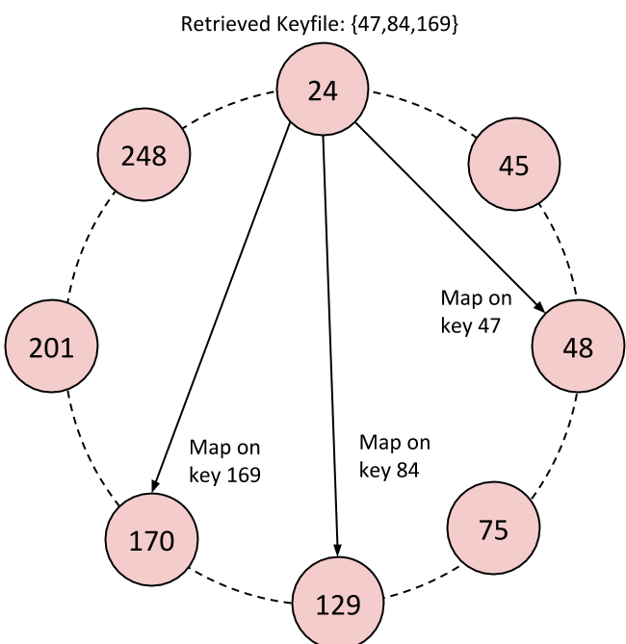
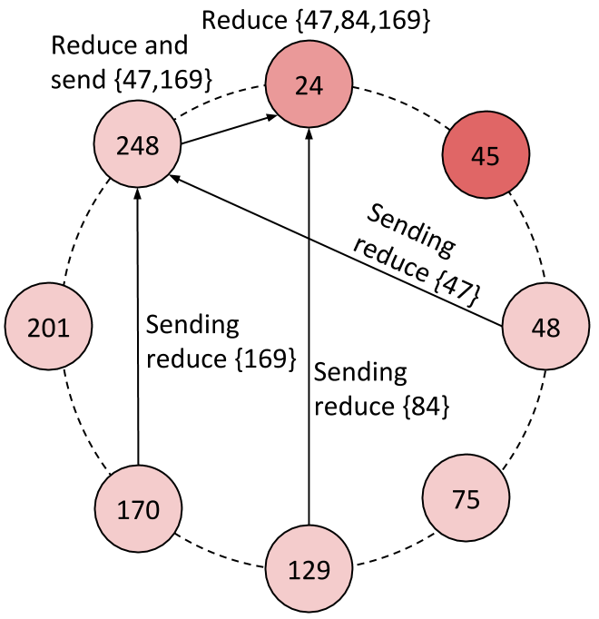
MapReduce on a Chord Distributed Hash Table Andrew Rosen, Brendan Benshoof, Robert W. Harrison, and Anu G. Bourgeois Department of Computer Science – Georgia State University
Motivation
System Architecture
Results
MapReduce platforms are designed for datacenters, which are highly centralized in nature. These platforms require a centralized source to manage the network, which leads to a single point of failure. We present ChordReduce, a generalized and completely decentralized MapReduce framework which utilizes the peer-to-peer protocol Chord. ChordReduce’s robustness, scalability, and lack of a single point of failure allows gitto be easily deployed in a greater variety of contexts, including cloud and loosely coupled environments.
Motivation
Implementation
Conclusions
ChordReduce has three layers: the Chord lookup and overlay, the file system layer, and the MapReduce processing layer.
MapReduce platforms are designed for datacenters, which are highly centralized in nature. These platforms require a centralized source to manage the network, which leads to a single point of failure. We present ChordReduce, a generalized and completely decentralized MapReduce framework which utilizes the peer-to-peer protocol Chord. ChordReduce’s robustness, scalability, and lack of a single point of failure allows gitto be easily deployed in a greater variety of contexts, including cloud and loosely coupled environments.
Motivation

