Slide 1
Course Introduction
Info5126 :
Mobile Development Advanced

Slide 2
Course Description
The third mobile development course includes topics on: current technologies and architectures for mobile-enable enterprise applications, multi-media programming, and multi-threaded programming. Students get practical experience with the unique advantages, capabilities, and challenges of mobile development, building reliable and secure mobile-based solutions.

Slide 3
Professor
Lianne Wong
Office: G3001
Please e-mail:
lwong@fanshawec.ca
Office Hours:
Tuesdays 1:00pm-3:30pm. G3001

Slide 4
Important Dates
Task | Due Date | Grade
Quiz 1 | 3rd lecture | 5%
Quiz 2 | 5th lecture | 5%
Assignment | 6th lecture | 5%
Midterm | 7th lecture | 25%
Quiz 3 | 9th lecture | 5%
Quiz 4 | 11th lecture | 5%
Project | Before 12th lecture | 20%
Final Exam | Week 15 | 30%

Slide 5
Kotlin Programming language – the good
Developed by JetBrains
Programming language of choice for Android Development (May 7, 2019)
Kotlin mainly targets the JVM, but also compiles to JavaScript (for e.g. frontend web applications using React) or native code (via LLVM), e.g. for native iOS apps sharing business logic with Android apps.
Used in Google Drive, Home, Nest, and Android SystemUI. Currently about 10% of Android Studio is written in Kotlin
In 2019 mobile leaders like Pinterest, Twitter, Netflix, Uber, AirBnB, Trello, and Evernote were switching to Kotlin for Android applications
From 2017 to 2018 the number of users grew by 260%. In 2018, 1.5 million developers wrote Kotlin code, and halfway through 2019 3 million developers wrote Kotlin code. This makes it the fastest growing language in the past 2 years and is continually growing at a fast pace.

Slide 6
Kotlin Programming language – the bad
Compile time slower than Java
Kotlin generated APK is larger than a Java generated APK

Slide 7
Why Kotlin?
Concise: Drastically reduces the amount of boilerplate code
Safe: Avoid entire classes of errors such as null pointer exceptions
Interoperable: Leverage existing libraries for the JVM, Android and the browser
Tool-friendly: Can use any Java IDE or build from the command line (IntelliJ, Android Studio, Eclipse…)

Slide 8
Android as a Phone OS
2025
Android 73.9%
iOS 25.71%
Samsung 0.21%
Other 0.17%
https://gs.statcounter.com/os-market-share/mobile/worldwide

Slide 9
Android as a mobile web usage
2022
Android 71.1%
iOS 28.3%
Other 0.6%
https://en.wikipedia.org/wiki/Usage_share_of_operating_systems#Mobile_devices

Slide 10
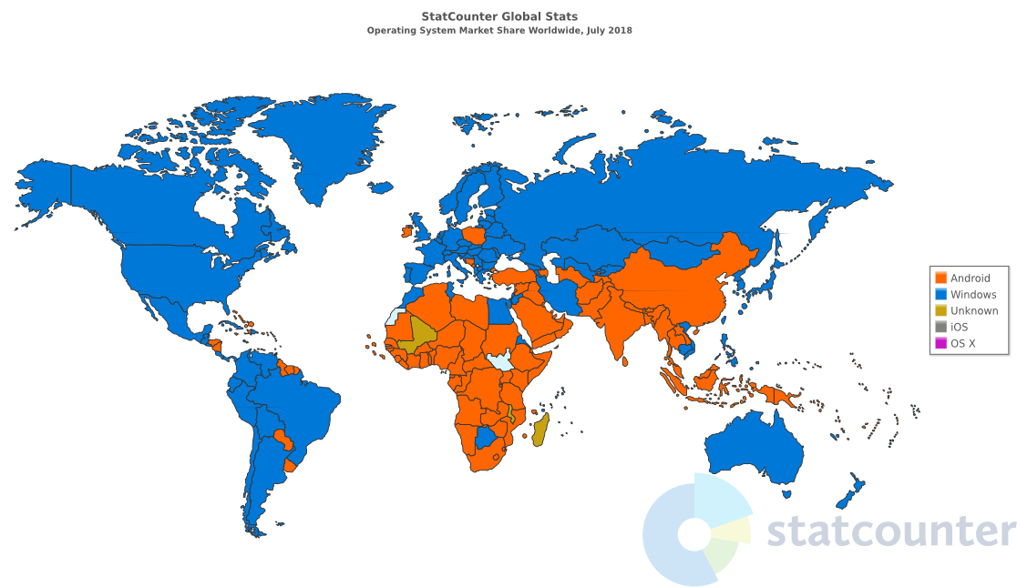
Android as an OS!

Slide 11
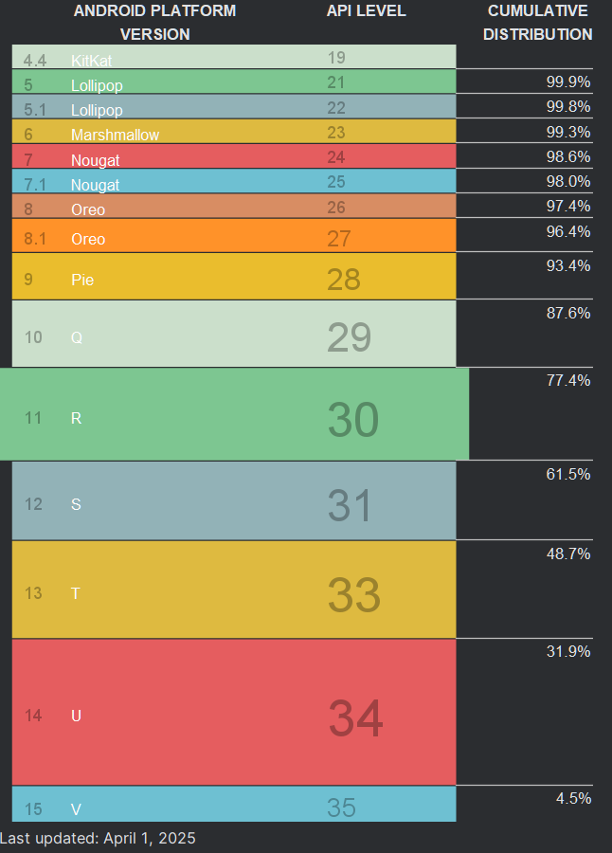
Android Releases
Android 16 Baklava June 10, 2025
Android 15 Vanilla Ice Cream Sept 3, 2024
Android 14 Upside Down Cake Q3 2023
Android 13 Tiramisu released Aug. 15, 2022
Android 12 Snow cone released Oct. 4, 2021
Android 11 Red Velvet cake released Sept 8, 2020
Android 10 Quince Tart released Sept. 3, 2019
Initial release Sept 2008

Slide 12
What you Need
Android Studio Narwhal https://developer.android.com/studio
Detailed installation document posted on FOL Week 1 content

Slide 13
Android Studio
Android Studio Narwhal
https://developer.android.com/studio

Slide 14
Adding debugging capability using a real phone
Using the Android SDK and AVD manager
In general, you will need the usb driver for the specific phone you will be using. If you do not have an android phone install the emulator for a Google Pixel 7.
https://developer.android.com/studio/debug/dev-options

Slide 15
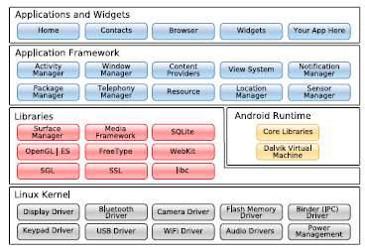
Android System Architecture

Slide 16
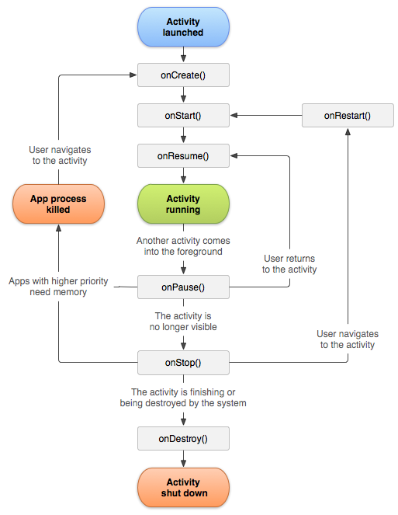
Android Lifecycle

