Slide 1
Google Cloud Credits
INFO 5126: Mobile Development Advanced

Slide 2
All students are allowed a $50 Google Cloud credit
To redeem, follow the instructions posted on the announcements page.
Go to
https://console.cloud.google.com/education
If you already have an account, at the top you can select an old project or create a new one.
Put your coupon code in
It will bring you to your home console page

Slide 3
You need to verify your email
You will then be asked to verify your email. Follow the instructions provided by Google

Slide 4
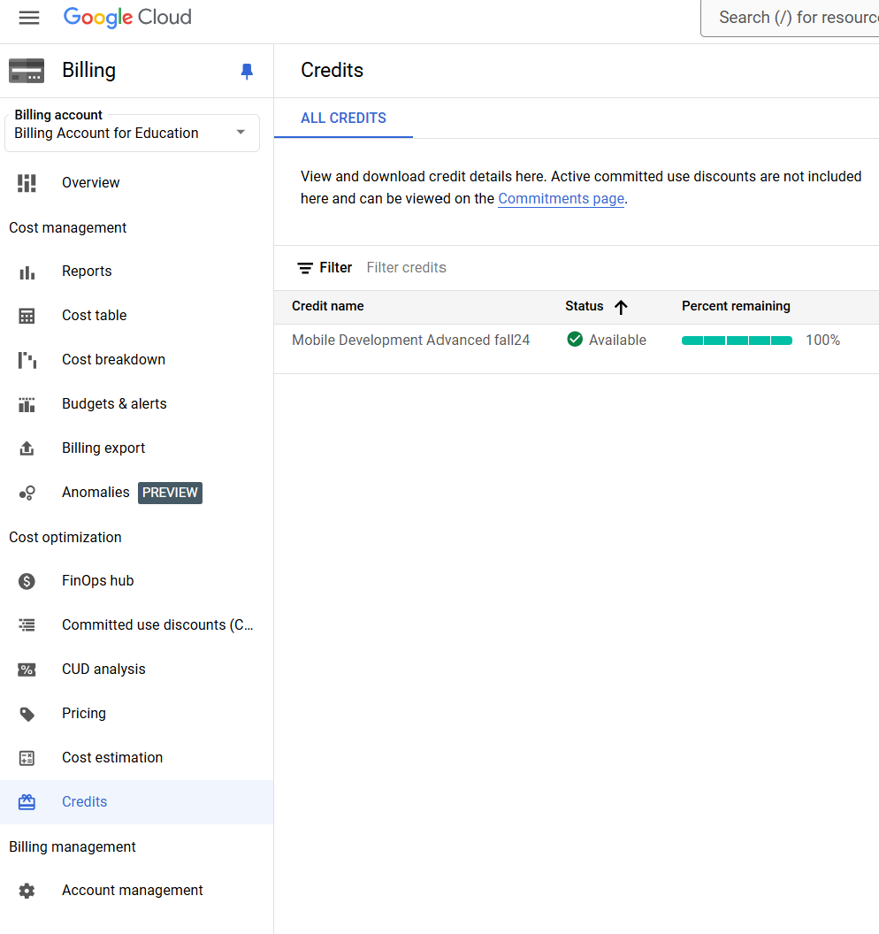
Verify your credit

