Slide 1
Google Maps
INFO 5126: Mobile Development Advanced

Slide 2
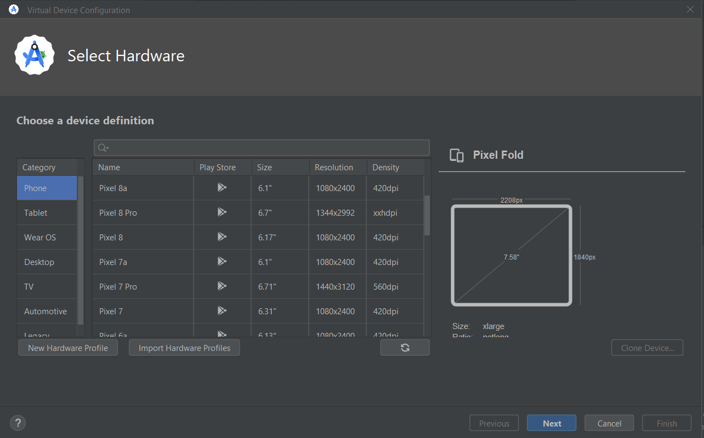
Your Emulators need PlayStore, we installed one that did

Slide 3
Google Maps Key
Create a new “Empty Views Activity” project, and name it GoogleMapsDemo
Add the Google Maps fragment using the File-New-Fragment-MapsFragment
In the layout, go to the Google tab and insert the fragmentContainerView into your activity.
Select OK to add the Google Maps dependency
The android manifest file has instructions to obtain the API key to use google maps in your application. You will need to request keys for all apps that use google maps. This key is tied to your domain and package name. So you will need to register for one for each app you create. Click on the get-api-key
Choose the Billing Account for education

Slide 4
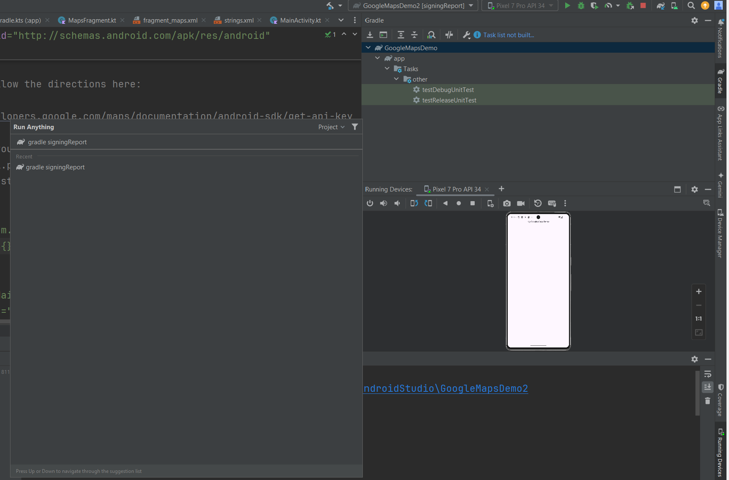
Getting your SHA1 key, tied to hardware
Gradle
Execute Gradle task
signingReport
Your SHA1 key
Will be in your
Run window

Slide 5
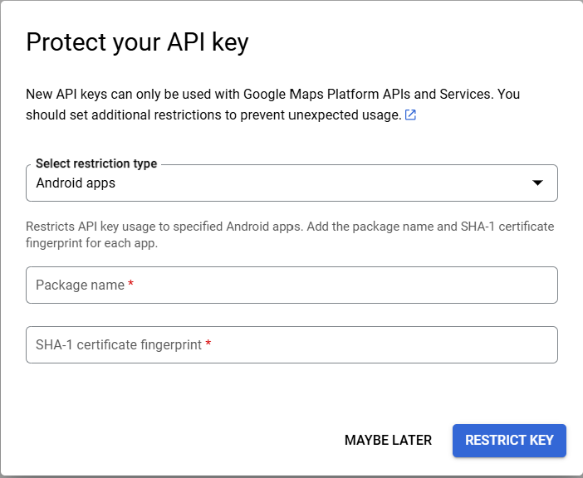
Click on the link in the android manifest file, Add your package name and SHA1

Slide 6
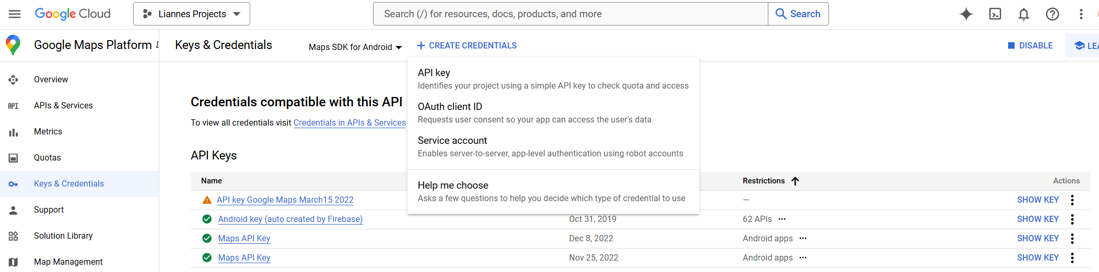
Generate an API key
Keys and Credentials
Create Credentials
API Key

Slide 7
Reference on how to set up your maps api key
https://developers.google.com/maps/documentation/android-sdk/start#get-key

Slide 8

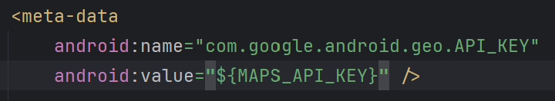
Copy the API key created
Copy the API key created and paste into your android manifest file as stated (NOTE: Do not use my key, it is tied to my laptop and won’t work for you)
Gradle scripts – local.properties
Android manifest file

Slide 9
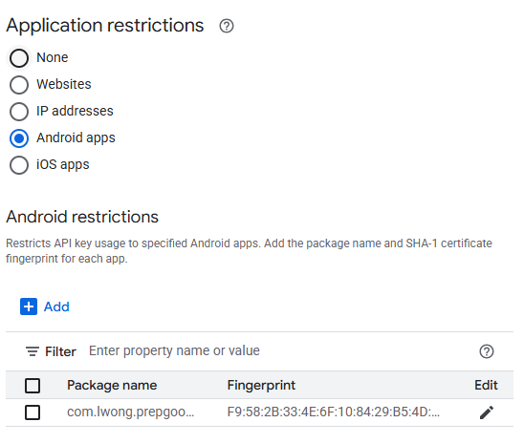
Google Maps API Key
It is good to restrict your access in case others gets hold of your API Key
If you write another app, you should add that package name to the Android Restrictions

Slide 10
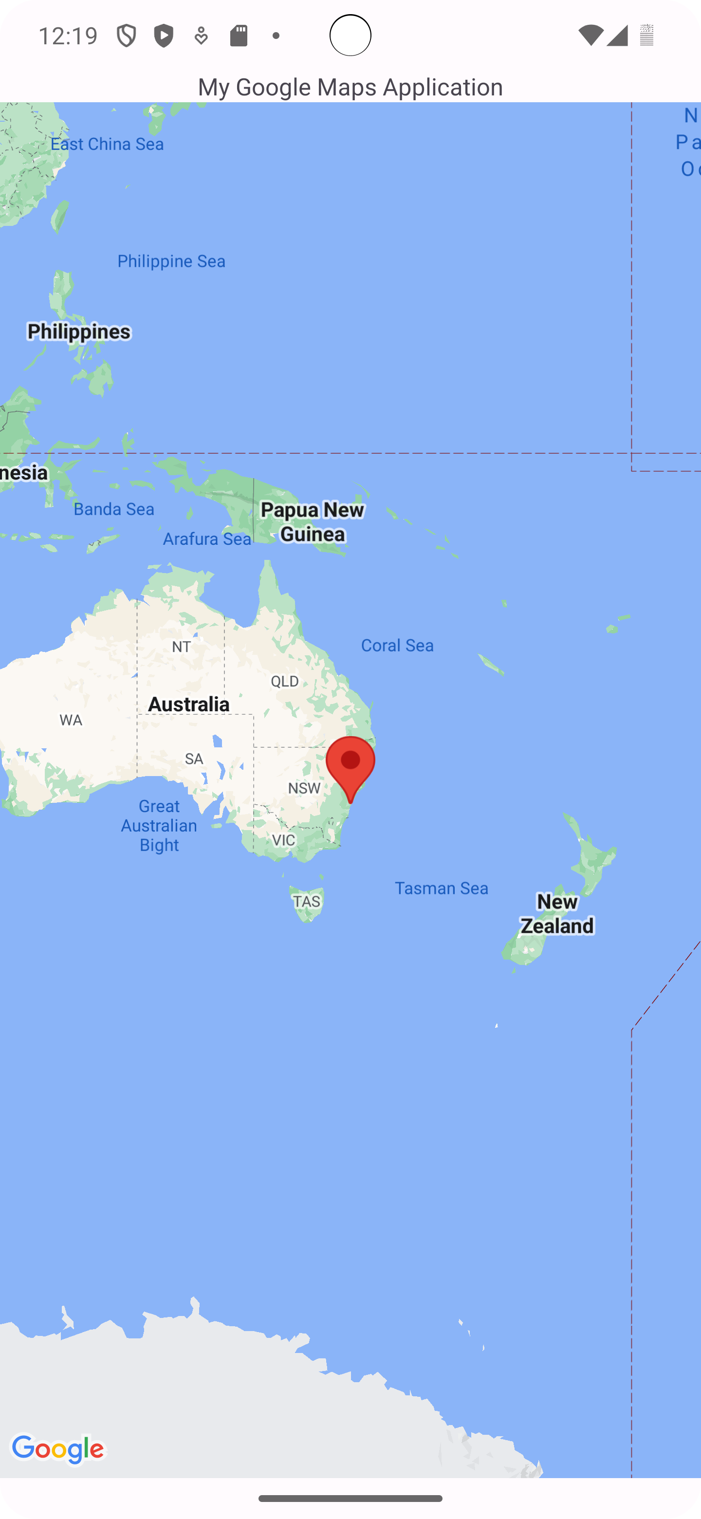
Run the program now, it opens a google maps activity and puts a marker that defaults to Australia.

Slide 11
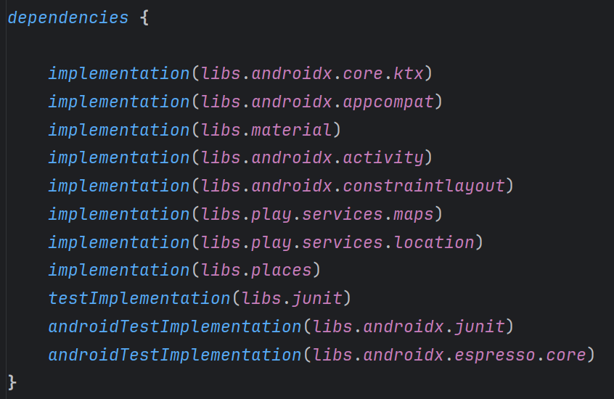
Location and Google Play Services
Notice the build.gradle compiles the play-services-maps in your project

